Slide 1

Company Overview September 22, 2000
EnFORM Technology LLC
Three Greenway Plaza, Suite 810
Houston, Texas 77046
(713) 350-1000
www.enform.com

Slide 2
Contents
Introduction
Who we are
What we do
Strengths & Differentiators
Selected clients
including Representative Engagements

Slide 3
Who We Are
One of the fastest growing Full Service Providers of strategic, end-to-end digital solutions for Global 1000 and emerging companies.

Slide 4
Who We Are
An energetic group of top-notch minds
60% ex “Big 5”
100% employee owned
Rapidly growing
Founded in January, 1998
200+ consultants today
Offices in Houston, Dallas & Austin

Slide 5
Who We Are
Full service internet consulting firm
Strategy
People
Process
Technology
Focused on maintaining a great work environment
Unique people-centric culture
Unprecedented life balance company
Turnover – Unheard of in the industry (~10%)

Slide 6
Who We Are
Focused on partnering
Collaborative teams
Share risk – creative pricing/deal structures
“Go through walls” mentality

Slide 7
Who We Are
How are we able to attract and retain the very best people?
Balance of life - EnFORM offers consultants the opportunity to work for a world-class company without being expected to constantly travel, put your family last, and work overtime.
Community - EnFORM is a place where having fun, strong social relationships, and a “piece of the pie” are all norms.
Freedom to be yourself, to grab responsibility, to influence job assignments, and to channel creative energy and ideas.
Emerging technology - EnFORM is dedicated to “sweet spot” technologies in high demand by both employees and clients.

Slide 8

What We Do
EnFORM Technology
EnFORM Ventures
EnFORM Interactive
EnFORM Solutions
EnFORM Hosting
E-Strategy
Business Plan Review
Capital Raising
Organization Infrastructure Planning
Marketing
Branding
Image development
Graphic Design
Technology Planning
Business System Design
Custom Development
MS/COM+
Java/Corba
Hosting/Co-location
Hardware Architecture
Monitoring
Security

Slide 9
What We Do
EnFORM Ventures
Strategic Planning
Wireless and Internet Strategy
Business Planning and Start-up Services
Technology Assessment/Due Diligence
Executive Coaching
Reengineering and Change Management

Slide 10
What We Do
EnFORM Interactive
Information Architecture
Usability/User Interface Design
Website Development
Content Development and Creative Management
Strategic Branding and Marketing

Slide 11
What We Do
EnFORM Solutions
Technology Planning
Wireless and Internet Architecture
Business System Design
Rapid, Custom Application Development and Systems Integration
Project Management

Slide 12
What We Do
EnFORM Hosting
Complete System Architecture and Design
Hardware Procurement and Leasing
24/7 Systems Monitoring
Custom Security Solutions
Flexible Bandwidth Packages
Performance Tuning
Fully Redundant Environments
Service Level Agreements

Slide 13
What We Do
Java Service Line
The focus of the Java Service Line is on providing industrial strength solutions to the marketplace through the open standards inherent in the appropriate vendor implementations of the Java Platform. The multitude of vendors in this space provides both an excellent variety of implementations, and a quagmire of “here today, gone tomorrow” vendors. EnFORM’s approach to this service line is to remain compliant with the open standards of market leading vendors, avoiding the proprietary implementations of certain vendors, and the immature presence of others. Our development skills in this service line include expertise in a variety of tools, within and outside of the Java platform, some of which include: Java, J2EE (EJB, JSP, applets/Servlets), CORBA, App Servers, XML, HTML.

Slide 14
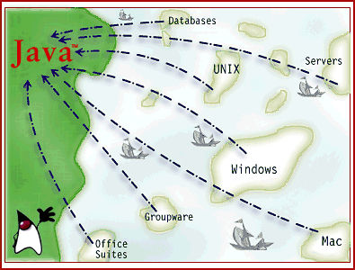
What We Do
Java Integration
Platform Independence
Open Standards
Scalable
Component Based
True Object Oriented Language
Sun e-Integrator

Slide 15
What We Do
Java Integration - Roles
In order to maintain the proper delivery capabilities, the Java Service Line includes consultants that fall into four major roles. Each project will be staffed with a mix of these resources depending on the technical focus of the engagement. Following is the list of these roles along with general responsibilities.
Java Architect
Java Developer
OO Architect
Solaris Systems Engineer

Slide 16
What We Do
Microsoft Service Line
The focus of the Microsoft Service Line is on providing rapid development of stable solutions to the marketplace through a full suite of enterprise capable Microsoft tools and platforms. The strength and market-share of the Microsoft solution provides scalable implementations, and an avoidance of “here today, gone tomorrow” vendors. EnFORM’s approach to this service line is to leverage the proven design and implementation techniques surrounding the Microsoft platform. Our development skills in this service line include expertise in a variety of tools, within and outside of the Microsoft platform, some of which include: Visual Basic, COM/COM+, XML, HTML, ASP, and SOAP.

Slide 17
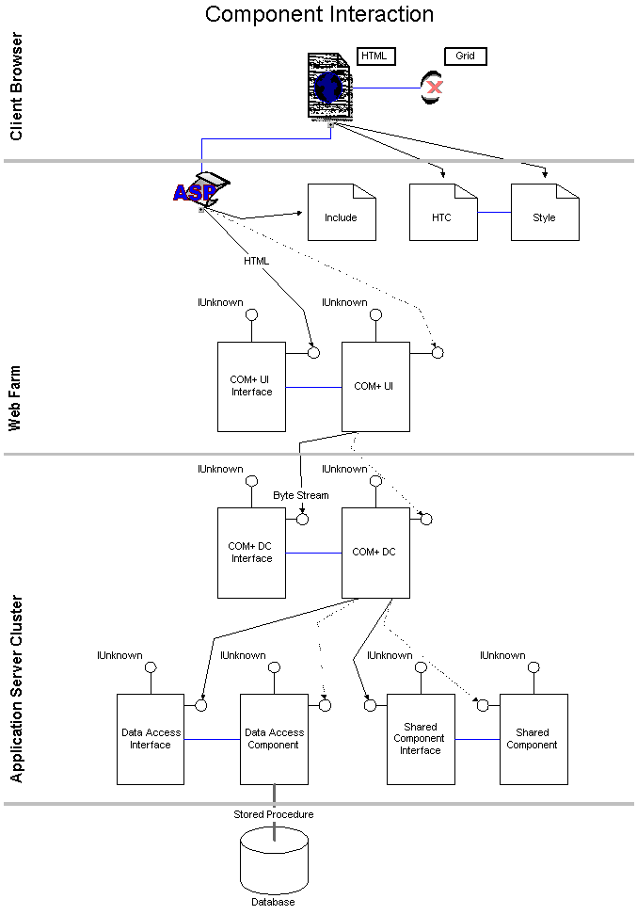
What We Do
Microsoft Integration
Rapid Delivery
Seamless Integration
Scalable
Component Based
Strong Vendor Support
Microsoft Solutions Provider Partner

Slide 18
What We Do
Microsoft Integration – Roles
In order to maintain the proper delivery capabilities, the Microsoft Service Line includes consultants that fall into four major roles. Each project will be staffed with a mix of these resources depending on the technical focus of the engagement. Following is the list of these roles.
Microsoft Architect
Microsoft Developer
OO Architect
Microsoft Certified Systems Engineer

Slide 19
Strengths & Differentiators
Full Service Provider
Strategy, creative, technology consulting and hosting services
Enterprise Capabilities
Client base is primarily Global 1000 companies
Deep skills in architecting and integrating large, complex systems
Rapid Application Development (RAD), Object Oriented-based methodology (including reusable components)
Top-level partners with Sun and Microsoft
Remote Development Centers for leverage, speed, and scale
Quality Reputation
Focus on custom development in the latest technologies
Big 5-quality infrastructure, methodology, and experience
Proven ability to attract, hire, and retain top talent (turnover ~ 10%)
Vertical and geographic concentration
Top-of-mind solution provider in Energy; significant Telecom experience
Well-positioned to leverage Manufacturing, Airline, Emerging markets
Committed to staying ahead of the innovation “curve”
Current R&D and marketing activity focused on development of architectures and prototypes to lower barriers to use of wireless apps

Slide 20


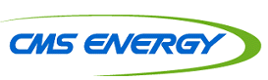

















Selected Clients
The above logos are trademarks of the respective companies.

Slide 21
Sample Engagements
Trinity Industries
TrueQuote.com
Engage Energy
Compaq Computer
Dynegy
TEPPCO
Duke Energy Trading & Marketing
Equiva Trading
Koch Energy Trading
CMS Energy
Woodfuel.com

Slide 22
Sample Engagements (cont.)
Trinity Industries – IronOx Project
Built an e-Commerce B2B auction site for used mobile industrial equipment and stationary manufacturing equipment
4 month development period on an NT/SQL Server 7.0 platform, with JAVA server pages, Java script, and HTML for the front end user interface
The auction transactions are completed utilizing Moai Technologies

Slide 23
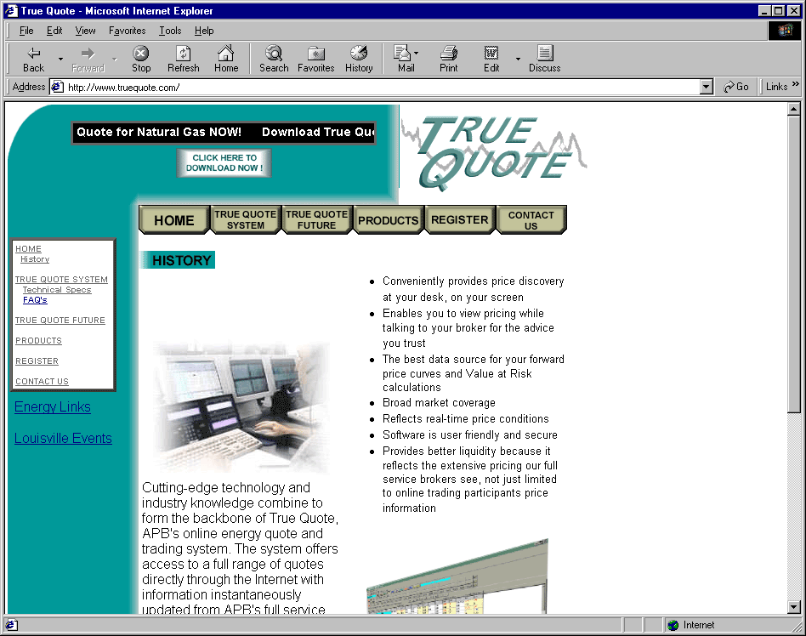
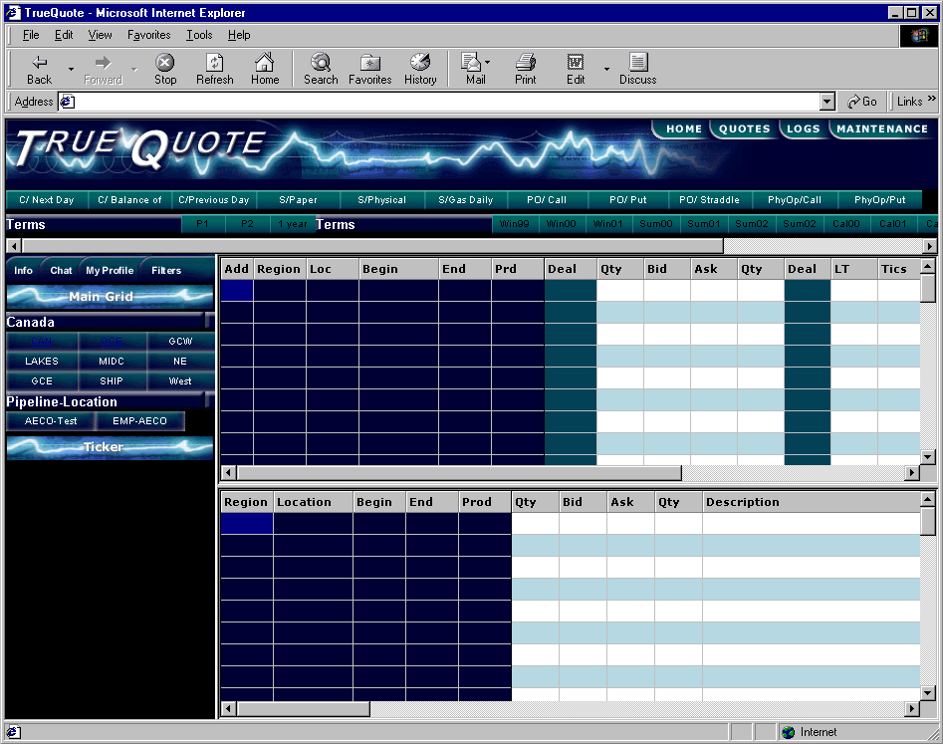
Sample Engagements (cont.)
TrueQuote.com
Multi-commodity eCommerce Trading Platform
Co-located Distributed Forms
Server farms for application load balancing
Architected Microsoft / ASP / XML – technical environment
Vertically Integrated (Energy Portal) Platform

Slide 24
Sample Engagements (cont.)
Engage Energy - Gas Business
$2 billion joint venture between Coastal Gas Marketing and West Coast Gas (Canada)
Inaugural EnFORM project
Designed and implemented fully integrated gas trading/management business application
Full front, mid, and back office capability
Real time information availability
25-person team, 18 months, $8,500,000
Fully-architected technical environment
Implemented September 1999

Slide 25
Sample Engagements (cont.)
Engage Energy - Power Business
Designed and implemented fully integrated electricity trading/management business application
Full front, mid, and back office capability
Real time information availability
Six-person team, six months, $750,000
Recognized as the “crown jewel” trading system at PowerMart 98
Fully-architected technical environment
Implemented August, 1998

Slide 26
Sample Engagements (cont.)
Compaq Computer Corporation
Helped design, test, and integrate product Life Cycle Management processes and systems
Assisted with the design, testing, and integration of Global Procurement Network (e-commerce/ extranet)
Helped design, test, and implement Product Cost Integration processes and intranet applications

Slide 27
Sample Engagements (cont.)
Dynegy Energy Marketing
Second-largest marketer of energy in the U.S.
Performing a package evaluation of products for bidding, scheduling, and settlements with the CA PX and ISO.
Designed back-office operational accounting application for commercial trading of power, gas and coal.
Microsoft COM-based, distributed environment
Design completed July, 1999
Implementation scheduled for Q3, 2000

Slide 28
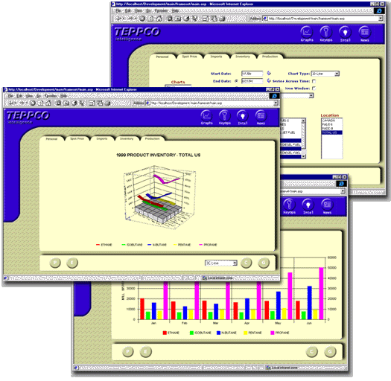
Sample Engagements (cont.)
TEPPCO
Intranet Executive Information System
Three disparate data sources (Oracle, Lotus Notes, Essbase)
Three servers (DEC, NT, Domino)
Architected Microsoft COM technical environment

Slide 29
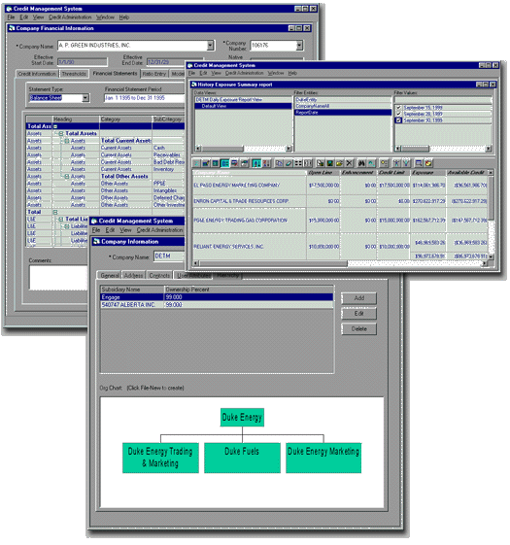
Sample Engagements (cont.)
Duke Energy Trading and Marketing
n-tiered component-based credit management
Tracks enterprise-wide credit exposure
Microsoft COM based technical environment

Slide 30
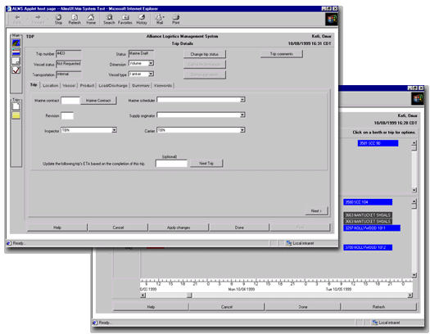
Sample Engagements (cont.)
Equiva Trading Company
Intranet logistical management business application
Tracks world-wide movement of ETCo’s tankers and barges
Real time information availability world wide
Architected Java/CORBA technical environment
Fixed timeframe, fixed budget project
Most successful IT project to date at ETCo

Slide 31
Sample Engagements (cont.)
Koch Energy Trading
Designed and implemented fully integrated commodity trading business application
Full front, and back office capability
Trade any commodity, any trade type
Currently engaged to market the application to commodity traders in multiple industries
Microsoft COM based technical environment

Slide 32
Sample Engagements (cont.)
CMS Energy (Fortune 500 Gas Pipeline Company)
Assisting in the delivery of a GISB compliant extranet application to support its pipeline transportation customers
Supports nominations and volumetric inquiry related functions
Java/CORBA development environment

Slide 33
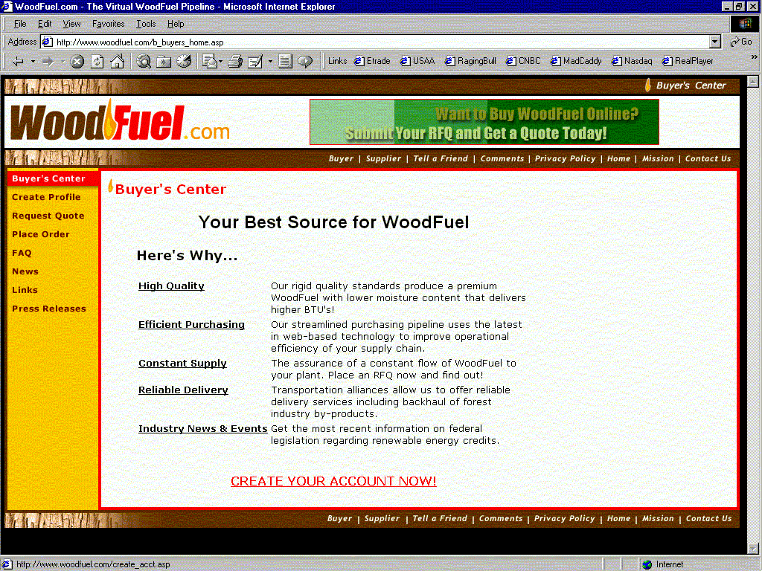
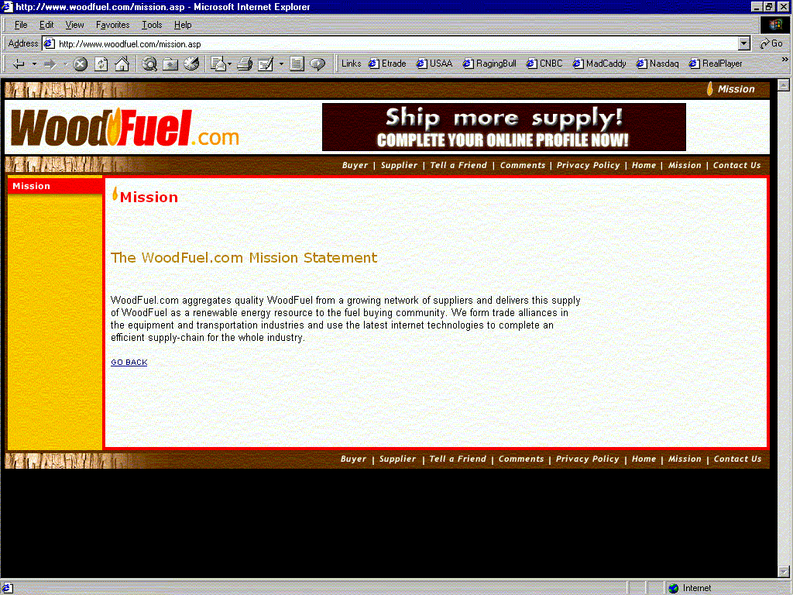
Sample Engagements (cont.)
Woodfuel.com
Vertically Integrated B2B Platform linking buyers and suppliers of alternative energy sources
Architected Technical Environment:
Microsoft / ASP / JavaScript / SQL Server / Flash
Virtual Woodfuel Pipeline

