Slide 1
POWER SECTOR RESTRUCTURING IN EUROPE: 2000
European Union
  EU directive requires phased-in competition between 2/99 and 2003; most have regulated TPA ; some negotiated TPA *
  Countries moving at different paces
  Some non-EU countries following directive
Netherlands
  1999 Amsterdam power exchange
  Unbundled G-T-D-S
  Most generation sold (to discos/foreign)
  33% of market with choice; RTPA
Denmark
  90% of market open; RTPA
  Promoting competitive green power (mostly wind)
  Western Denmark in NordPool; east imminent
Norway
  “Full” competition since 1992; RTPA
  1999, much switching
  Electricity futures market
Sweden
  Full competitive market since 1996; RTPA
  Distribution consolidation, M&A, underway
UK
  1998: complete retail competition: 25% switching rate
  All RECs privatized; some re-sold
  Unbundled G-T-D-S
  2000: mandatory pool being dismantled, replaced with new trading mechanism
  RTPA
Finland
  100% customer choice since ‘97; RTPA
  Linkage of power exchange with NordPool
  Some sales of G-D
Germany
  100% competition since Fall ‘99; NTPA
  Leipzig power exchange launched ‘00
  Single buyer until 2005
  8 supra-regional EUs own 80% of capacity
France
  State monopoly (EdF)
  Considerable foot-dragging on retail access; law passed one year late
  30% opening in ‘00 (minimum); RTPA
Czech Republic
  Some generation privatization
  8 regional disco’s
  9/00 Energy Law: Planned EU membership would force further liberalization
Portugal
  49% of EdP privatized; 20% more late ‘00
  G-T-D separated within EdP holding
  26.5% of market open
  1998 pool est. -- 2% of demand; RTPA
Austria
  Market opening in phases; >20 GWh after 2/00
  RTPA
  Verbund 51% SOU; no changes planned
Spain
  Unbundled G-T-D-S
  Privatization of Endesa (done) and REE (grid-partial)
  Full competition in generation and supply; full retail 2003
  Mandatory pool, 1998; RTPA
Switzerland
  Plans to mirror EC open-access: 2001-07; NTPA
  No IPPs
Italy
  ENEL required to dispose of 15GW by 2001 (has 80% of market)
  Market open: 35%
  Planned G-T-D separation
Greece
  Allowed 2-year competition delay; NTPA
  Current state monopoly (PPC); preparing IPO for 2001
  Few IPPs
Hungary
  Further G-D privatization halted
  Independent regulator
  Nascent wholesale competition
* RTPA = regulated third party access; NTPA = negotiated third party access
Source: McGraw-Hill; FT Energy online; various trade journals; McKinsey analysis
Notes:
<number>
<footer>
<header>

Slide 2
POWER SECTOR RESTRUCTURING IN THE ASIA-PACIFIC REGION
Asia
Most countries outlining restructuring plans, but implementation could be 2-10 years off
China
  State Power Corporation, created in 1998, oversees generation and transmission
  Plan to create five regional generation groups, an entity to oversee tariff rates, & construct a unified transmission network
  Pools trials in 6 provinces underway; one national power pool planned for 2020
  Unbundling & privatization planned
Korea
  IPPs underway
  KEPCO to be unbundled, pool, and retail choice to be introduced
  Fully opened market planned 2009
Japan
  10 private utilities; small IPP program
  March 2000 large users (30% of market) can choose supplier
Taiwan
  TaiPower virtual monopoly
  Draft electricity law sees privatization followed by deregulation; pool by 2008
Philippines
  Omnibus Electricity Bill being reconciled in Congress
  NPC split up and privatized
  Eventual pool and ISO
Pakistan
  IPPs under attack: 8 projects cancelled, allegations of corruption
  Introduction of competitive bidding process for IPP tariffs
  Eventual privatization of all entities except grid
Malaysia
  Unbundling and privatization of assets underway
  Movement toward independent transco; pool planned, but no details yet
India
  Draft Electricity 2000 Bill - state electricity boards to set up regulators at state level and split G-T-D
  Some states started restructuring: Orissa, Haryana, Andhra Pradesh, Uttar Pradesh, Rajasthan
Australia
Unbundling & privatization completed in Vic, underway / planned in other states
National electricity market (6 states) began 12/98
Retail competition phasing in; industrial choice now in 6 of 8 states; full choice in 6 states by 2003
Thailand
  Corporatization, followed by privatization, 2002- 2004
  Pool and independent transco planned, 2003, UK model
Indonesia
  Hard hit by financial crisis – many projects delayed or cancelled
  PLN created 2 generating subsidiaries; further restructuring planned
New Zealand
  Unbundling of G-T-D; G&T will remain state-owned, D privatized
  Same companies cannot own wires and generation or retailing
  Retail customer choice: 100%
Source: FT Energy Online; McGraw-Hill; various trade journals; McKinsey analysis

Slide 3
POWER SECTOR RESTRUCTURING IN LATIN AMERICA: 2000
Latin America
  Restructuring well underway or begun in most of region
  Generally dependent on IPPs for demand expansion
  Historic droughts created generation problems because of large hydro dependence in region
  Several governments offering concessions to build transmission lines
  Markets with long-standing pools often have price erosion, discouraging needed new generation
El Salvador
  1996 unbundling, restructuring
  Some competition in market
  Some generation, distribution privatization
Venezuela
  1999 law passed liberalizing sector
  Privatization begun
  State retains control of tariffs, T&D
  Some wholesale competition
Mexico
  IPPs introduced -- great need for new private power
  Sweeping ‘99 restructuring law hotly contested -- new government insists on market opening, not privatization
Brazil
  New”pulverization” privatization model will disperse ownership
  Large industrial retail competition; full proposed for 2006
  Strong need for private sector in generation, transmission concessions
Colombia
  Disaggregation of G-T-D and power brokering
  1995 spot market and power exchange
  Customer choice >0.1 MW
  Left-wing protests delaying further privatization
Bolivia
  1994 law disaggregating utilities
  Capitalization nearly done
  Investments needed, especially distribution
Peru
  Integrated utilities broken into separate G-D companies
  Privatization program begun mid-1994;
  4 regional discos to be sold
  Unbundling of G-T-D
  Choice for large industrials only
Uruguay
  No current plans to privatize assets
  Legislation proposed for IPPs and unbundling of G-T-D
Argentina
  Privatization of assets since 1990, virtually all SOE sold
  Huge need for new HV transmission
  Competitive generation, central pool for power
  Choice available above 100 kW demand
Chile
  1982 Electricity Law; 2000 proposed regulations to open distribution sector
  Privatized utilities; vertical separation
  IPPs encouraged
  Third party access for transmission
Source: Morgan Stanley; McGraw-Hill; FT Energy online; various trade journals; McKinsey analysis

Slide 4
POWER SECTOR RESTRUCTURING IN AFRICA AND THE MIDDLE EAST: 2000
Middle East and Africa
  Most allowing IPPs to fill power needs
  Unbundling preceding privatization in Mid East
  Several regional power grids underway to enable sharing surplus power
Morocco
  Large BOT IPPs underway
  Transfer of large plant to private sector; more may follow
  Concessions for city power/water distribution systems awarded and pending
Egypt
  Electric Authority turned into holding company, 2000
  Allowing IPPs via B-O-O-T
  Disco sales postponed but planned
  Hub of 6-country transmission link
Israel
1st IPP ‘98; goal is 10% of power from IPPs
Restructuring of IEC long discussed
Ghana, Kenya
  Allowing IPPs
  Possible privatization of Ghanaian distribution, Kenyan generation
Jordan
  G-T-D unbundled, corporatized (‘98) prior to eventual disco privatization
  1st (450 MW) IPP awarded, 2000
Côte d’Ivoire
  IPPS allowed
  Concession to run CIE since 1990
United Arab Emirates
Abu Dhabi privatizing water and power (40%)
IPPs built on BOO and BOOT basis
Discussing Gulf States regional power grid
Nigeria
IPPs, including emergency barge-mounted
IMF loans to encourage power reform
Likely G-T-D disaggregation, followed by privatization
Oman
  seeking private sector help for private power and unified national grid
  no privatization timetable, but mooted
South Africa
  ESKOM, state utility, 36.5 GW
  1st IPP license to be offered in 2001
  White paper now discussing restructuring, possible privatization
  Lynchpin in southern Africa regional grids
Saudi Arabia
SEC created as joint stock company, 2000
IPPs progress stalled; need framework
Source: Energy Information Administration; Financial Times; McGraw-Hill; various trade journals; McKinsey analysis

Slide 5
EUROPE
1997-1998
1999-2000
2001-2002
2003-2005
2005-2007

Slide 6
ASIA
1997-1998
1999-2000
2001-2002
2003-2005
2005-2007

Slide 7
AMERICAS
1997-1998
1999-2000
2001-2002
2003-2005
2005-2007
OTHER COUNTRIES

Slide 8
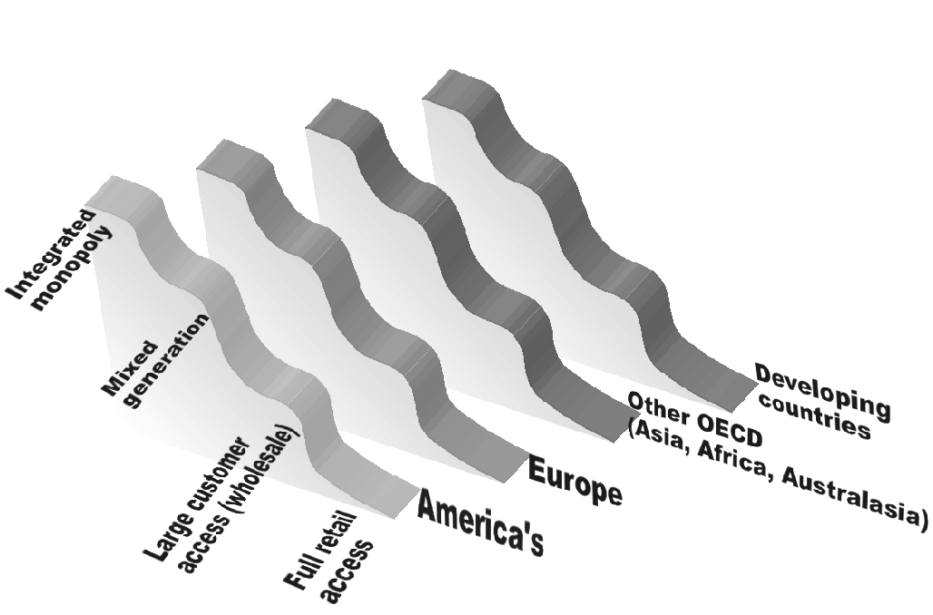
THE SLIPPERY SLOPE TO FULL COMPETITION – 2000
South Africa
India (3/4)
China
Russia
Singapore
Taiwan
Hong Kong
South Korea
Paraguay
Canada (2/3)
Greece
Indonesia
Japan
Malaysia
Thailand
Philippines
France
Mexico
Venezuela
Italy
Poland
India (1/4)
Australia (3/5)
US (2/3)
Spain
New Zealand
Brazil
Argentina
Chile
Germany
Nordic
UK
Canada (1/3)
US (1/3)
Notes:
The pace to full competition varies from region to region.

