Slide 1
Weather Risk Management

Slide 2

Evolution of the Weather Market
Aug 1997
1st weather-indexed commodity transaction (Utility/Enron)
Sep 1997
1st financial transaction (Enron/Koch)
Sep 1998
1st international transaction (Scottish Hydro and Enron)
Oct 1999
1st weather bonds marketed and placed
Jan 2000
1st weather contract traded on Enron-On-Line (“EOL”)
Oct 2000
1st natural gas-based precipitation collar
Present
4,800 deals completed with a notional value of $7.5 Billion
Price Waterhouse Coopers study presented in Bermuda on 6/3/01
Broad End-User Participation
Greater On-Line Influence
Increased cross-commodity transactions
FUTURE
Notes:
<number>
<footer>
<header>
<date/time>

Slide 3

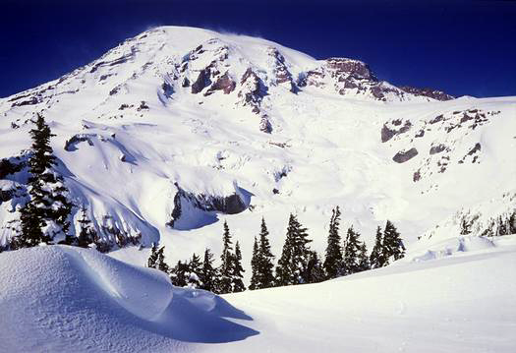
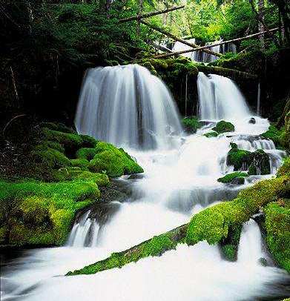
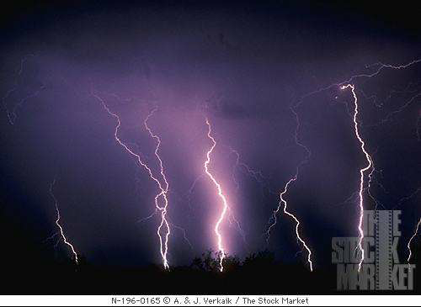


What Are Weather Risk Management Products?
Options and swaps having a pay-out based on a weather index
Heating Degree Days, Cooling Degree Days
Temperature (Maximum, Minimum, Average)
Rainfall (inches)
Snowfall (inches)
Perceived Temperature (Wind Chill, Heat Index)
Other combinations (Custom Index, Quantos, Demand Swaps)

Slide 4
Weather Product Characteristics
Types of Contracts
Swaps & options
Term
Traditionally seasonal
Single and Multi-year transactions
Monthly market active within a season
Weekly market developing for Temp and Load
Size
Up to $650,000 per weather unit (e.g. CDD)
Up to $12 million/bad weather day
Limits
Transactions are capped to reduce aggregate exposure (to date, as large as $250 mm/year)
Locations
All reliable, independent weather stations (NWS in the U.S.)
Baskets (Multiple cities)

Slide 5
Degree Days (examples)
Heating Degree Days
Cooling Degree Days
The average temperatures for the March business week in Atlanta are listed below. The heating degree days for the five days would be computed as:
The average temperatures for the May business week in Atlanta are listed below. The cooling degree days for the five days would be computed as:
HDD = Σmax[0, (65ºF – Avg(Tmax,Tmin)]
CDD = Σmax[0, (Avg(Tmax,Tmin) - 65ºF]

Slide 6
How To Think About Weather Products
(Volumetric vs. Price Hedging)
Date Trade Volume Price Notional
6/15/00 Buy 10,000 shares $4.00 $40,000
6/16/00 Sell 10,000 shares $4.30 $43,000
Profit = $3,000
Date Trade Volume Price Notional
6/15/00 Buy 2000 HDDs $5,000/HDD $10,000,000
6/16/00 Sell 2010 HDDs $5,000/HDD $10,050,000
Profit = $50,000
In the weather market, the $$ don’t move, the degree days (HDDs/CDDs) do.
Notes:
<number>
<footer>
<header>
<date/time>

Slide 7
WEATHER IMPACTS VOLUMES
Warmer Weather
Normal Weather
Colder Weather
Lower Volumes
Price/Volume Risk
Anticipated Base Load Volumes
Price Risk
Higher Volumes
Price/Volume Risk
Potential Risk Management Strategies
Inside FERC/Gas Daily Options
Storage/Storage Options
Weather Swaps and Options
Weather-Linked Gas Options
Inside FERC/Gas Daily Options
Storage/Storage Options
Weather Swaps and Options
Weather-Linked Gas Options
Fixed-Volume Price Swaps and Options

Slide 8
Unique Characteristics of the Weather Market
Predominantly a provider of volume hedges – most other markets are exclusively used for price hedging
Hybrid market with elements of traditional traded commodity markets and traditional insurance markets
Risk capacity/appetite is largely relationship based (insurance influence)
Pricing begins with actuarial view (insurance influence)
Most liquid instruments are swaps traded between market makers to delta hedge exposures (trading influence)
Pricing is greatly influenced by supply/demand balance shifts and forward forecasts (trading influence)
Increased liquidity = more aggressive pricing (trading influence)
Most deals have limits/maximum payouts (insurance influence)

Slide 9

Weather Market Composition
Energy Companies
Insurance/Reinsurance Companies
Financial Institutions
DEALERS
CAPITAL
MARKETS
FINANCIAL
WEATHER MARKET
END USERS
Energy Utilities/Local Distribution
Companies/Pipelines
Agriculture Companies
Ski & Other Vacation Resorts
Construction Companies
Entertainment
Transportation
Retail
Food and Beverage
INSURANCE
BROKERS
Inter-Dealer Transactions

Slide 10
Quantifiable Risks Actively Managed Today
RISK | TOOLS
Price Risk | Futures, swaps, options, etc.
F/X and I/R Risk | Futures, swaps, options, etc.
Credit/Counterparty Risk | Proactive monitoring/credit derivatives
Volumetric Risk | Weather swaps and options, etc., and dual trigger unit outage protection
Regulatory Risk | Lobby for/against critical legislation
Sovereign/Country Risk | Diversification
Operational Risk | Develop policies and procedures/controls
Notes:
<number>
<footer>
<header>
<date/time>

Slide 11
Some Significant Weather Transactions
5 year $55 million Midwest US HDD floor (protection against warm winter)
3 year no limit Western US natural gas linked precipitation collar (protection against drought AND high gas prices)
5 year no limit Western US power linked precipitation collar (protection against drought AND high power prices)
5 year $200 million Northeast US HDD floor (protection against warm winter)
$25 million Southern US HDD floor option (protection against warm winter)
$40 million Western US CDD call option (protection against hot summer)
$200+ million equivalent European freeze call option (protection against more than normal freezing days)
$60+ million equivalent East Asian CDD floor option (protection against mild summer) – not yet complete
Book is made up of geographic, directional and temporal diversification
Notes:
<number>
<footer>
<header>
<date/time>

Slide 12
Weather Derivatives Offered
Not sure how much you want to explain to them. They will know the basics but I do think it is important to show the correlation with weather.

Slide 13
Buying an HDD Swap
PAYOUT $
Slope of the line is the “tick size” of $5,000 per HDD
$ 5 MM
Agreed upon limit ($5mm)
$ 2.5 MM
1,000
2,000
3,000
($ 2.5 MM)
HDD’s
Market Determined strike (2,000 HDDs)
($ 5 MM)
warmer
colder
As the number of HDD or CDD’s vary, the buyer and the seller of the swap have opposite payouts. The fixed HDD payer benefits when the actual number of HDD’s is lower than the agreed upon amount in the contract and the floating HDD payer benefits when the actual number of HDD’s is higher than the agreed upon amount in the contract.

Slide 14
Buying a Weather Call Option
Example: Buying a Weather Call Option
PAYOUT $
Slope of the line is the “tick size” of $5,000 per HDD
$ 5 MM
Agreed upon limit of $5mm
$ 2.5 MM
1,000
2,000
3,000
($ 2.5 MM)
HDD’s
Premium paid by the option buyer to the option seller
Market determined strike of 2,000 HDD’s
($ 5 MM)
warmer
colder
The buyer of the call option pays premium to the seller – usually at the beginning of the risk period (or anytime before the risk period), although this premium may be financed as well. The buyer benefits when the actual number of HDD’s is higher than the strike.

Slide 15
Buying a Weather Put Option
PAYOUT $
Agreed upon limit of $5mm
$ 5 MM
Slope of the line is the “tick size” of $5,000 per HDD
$ 2.5 MM
($ 2.5 MM)
1,000
2,000
3,000
HDD’s
Agreed upon strike of 2,000 HDD’s
Premium paid by the option buyer to the option seller
($ 5 MM)
warmer
colder
The buyer of the put or floor option pays premium to the seller – usually at the beginning of the risk period (or anytime before the risk period), although this premium may be financed as well. The buyer benefits when the actual number of HDD’s is less than the strike.

Slide 16
Buying a Costless Collar Option
PAYOUT $
Deadband between the floor
strike of 1,750 and the call strike of 2,250
$5 million limit on the call
option purchased.
$ 5 MM
$5 million limit on the put
option sold.
$ 2.5 MM
1,000
2,000
3,000
HDD’s
($ 2.5 MM)
Slope of line is tick size of $5,000/HDD.
In this case the tick is the same for
the call and the put, but it doesn’t have to be the same.
($ 5 MM)
warmer
colder
A collar structure is a combination of a put and a call option where one option is bought and the other is sold. Whether you are “buying” or “selling” the collar is usually determined by what you are doing with the call option. For example, if you are buying a collar, you are buying the call and selling the floor. A costless collar is one in which the premium paid for the purchased option is exactly equal to the premium received for the sold option. Collars need not be costless. Costless collars are sometimes described as “swaps with a deadband in the middle.”

Slide 17
Buying a Strangle
Limit of $5 million is the same in this case for the call and the put, but doesn’t have to be.
PAYOUT $
$ 5 MM
Buy a floor and a cap at different strikes of 1,500 and 2,500 HDD’s.
$ 2.5 MM
($ 2.5 MM)
1,000
2,000
3,000
HDD’s
Slope of line is tick size of $5,000/HDD.
In this case the tick is the same for
the call and the put, but it doesn’t have to be the same.
($ 5 MM)
warmer
colder
A strangle is the combination of a put and a call purchased at different strikes. The sum of the two premiums creates an area between the two strikes where the strangle purchaser will lose all of their premium. Outside of the two strikes, the strangle purchaser will begin to recover their premium and then profit. A strangle purchaser believes, generally, that volatility will rise, but isn’t clear on which direction “prices” will go.

Slide 18
Buying a Straddle
Slope of line is tick size of $5,000/HDD.
In this case the tick is the same for
the call and the put, but it doesn’t have to be the same.
PAYOUT $
Limit of $7.5 million is the same in this case for the call and the put, but doesn’t have to be.
$ 5 MM
$ 2.5 MM
1,000
2,000
3,000
HDD’s
($ 2.5 MM)
Buy a floor and a cap at the same strike of 2,000 HDDs
($ 5 MM)
warmer
colder
A straddle is the combination of a put and a call purchased at the same strike. The sum of the two premiums creates a maximum loss only at the strike. Should the ultimate # of HDDs be above or below the strike, the straddle buyer will recover at least some premium. The “breakeven” points for a straddle will be further away from the strike than they were for either the put or the call option (twice as far given put/call parity if the strike is “at the money”). A strangle purchaser believes, generally, that volatility will rise, but isn’t clear on which direction “prices” will go. The “band” within which the straddle purchaser will not profit is narrower than that for the strangle buyer, but the maximum loss (premium paid) is greater.

Slide 19
Weather Exposure in the Energy Industry

Slide 20
Energy
“Consolidated Edison Inc. reported a 17% drop in net income, blaming slack sales caused by mild weather….”
— The Wall Street Journal, Consolidated Edison Inc. October 20, 2000
Weather Influences both Supply and Demand
Generation Fuels
Power Generation
Utility
Power Demand
MWh
Natural Gas
Hydro
Coal
Hedging Supply
Natural Gas/Coal Buy Mild Weather (CDD Cap/HDD Cap)
Hydro Generation Buy Drought (Precipitation Floor)
Focus
Core Budgeting Competency
Hedging Demand
Buy Hot/Cold Weather (CDD Floor/HDD Floor)
Notes:
<number>
<footer>
<header>
<date/time>

Slide 21
Weather Affects Energy Demand – Power
An exponential relationship exists between PJM peak load (weekly average of the hourly on-peak system load) for all and respective prices.

Slide 22
WINTER HDD CASE STUDY
Issue:
Atmos Energy Corporation experiences depressed winter earnings for the winter of 1999 due to a warmer than normal winter
Problem:
Warmer than normal winter weather in their service territory decreases demand for gas supply
Margin analysis indicates that for each HDD below normal, Atmos loses approximately $10,000 in earnings
Objective:
Atmos wishes to take advantage of a cool winter and protect itself against a warmer than normal winter

Slide 23
ALTERNATIVES
Floor: Atmos could purchase an HDD floor that will protect earnings during a warmer than “normal” winter by receiving payments of $10,000 per HDD below the floor strike. Additionally, the floor will allow them to retain the maximum upside associated with cooler than “normal” winter weather.
Collar: Atmos could purchase an HDD floor to provide downside protection against a warmer than normal winter and, to offset the cost of the floor, simultaneously sell an HDD cap that limits its upside in the event of favorable weather. In this case, if cold weather prevails, Atmos will pay ENA $10,000 per HDD above the cap strike, which should be offset by a weather-related increase in earnings .

Slide 24
WINTER FLOOR STRUCTURE
Counterparty: Atmos Energy Corporation
Term: Nov 1, 2000 - March 31, 2001
Index: Cumulative HDDs as measured at Dallas (WBAN #03927)
Strike: 2,010 (1/2 std. Dev. below 10-yr avg)
Payment: $10,000/HDD
Limit: $2,000,000
Premium: $575,000 (indicative)

Slide 25
WINTER FLOOR STRUCTURE
For the Nov 1 - March 31 floor, as HDDs fall below the strike, Atmos is compensated $10,000 per HDD by the floor up to a limit of $2,000,000. If temperatures are cool, Atmos will retain the financial benefits of its business, paying only a floor premium.
The floor is “active” where the line is sloped and “inactive” where it is flat representing ENA payments to Atmos to compensate for a warmer than expected winter.

Slide 26
WINTER “$0 COST” COLLAR STRUCTURE
Counterparty: Atmos Energy Corporation
Term: Nov 1, 2000 - Mar 31, 2001
Index: Cumulative HDDs as measured at Dallas (WBAN #03927)
Upper Strike: 2,165 HDDs
Lower Strike: 2,010 HDDs
Payment: $10,000/HDD
Limit: $2,000,000
Premium: None

Slide 27
WINTER COLLAR STRUCTURE
Atmos is only exposed to the weather when the collar is “inactive” (flat), between the strikes of 2,010 and 2,165, and beyond the $2MM limits at 1,810 HDDs and 2,365 HDDs
Payments from ENA to Atmos to offset lost sales due to warm weather, stabilizing earnings until the $2MM limit is reached at 1,810
Payments made by Atmos to ENA which should be offset by increased earnings from favorable winter weather

Slide 28
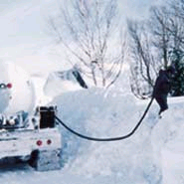
Example of Energy Company Quantifying and Managing its Weather Exposure
Dave—we need to come up with a west coast example for the power desk to relate.– just a thought!!
PD Inc., a retail propane distributor, mainly services residential customers. PD’s sales, concentrated in the Great Lakes region, is heavily affected by winter temperatures. The number of gallons sold is highly correlated to Heating Degree Days.

Slide 29
Energy Example (Cont’d)
PD’s sales are roughly distributed in the following area:
Dubuque, IA (20%); Madison, WI (25%); Grand Rapids, MI (15%); Buffalo, NY (30%); Erie, PA (10%)
Internal studies determined that marginal impact of one gallon sold on PD’s bottom line is $0.50.
Regression analysis has determined that, on average, one extra HDD increases propane sales in the region by 10,000 gal in the period Nov-Mar.

Slide 30
Example Of HDD Floor
Counterparty PD, Inc.
Structure Heating Degree Day (HDD) floor
Index Cumulative HDD’s
Term November 01, 2000 - March 31, 2001
Station Proportionally weighted basket of cities as per breakdown in previous slide
Floor Strike PD receives below 5,080 HDD’s (10-yr. average less 50% st. dev., or 5,257-177)
Payout $5,000/HDD below strike ($0.50 * 10,000)
Limit $2,500,000
Premium ____________

Slide 31
Example of HDD Floor Payout Structure
$
Warmer
Colder

