Slide 1
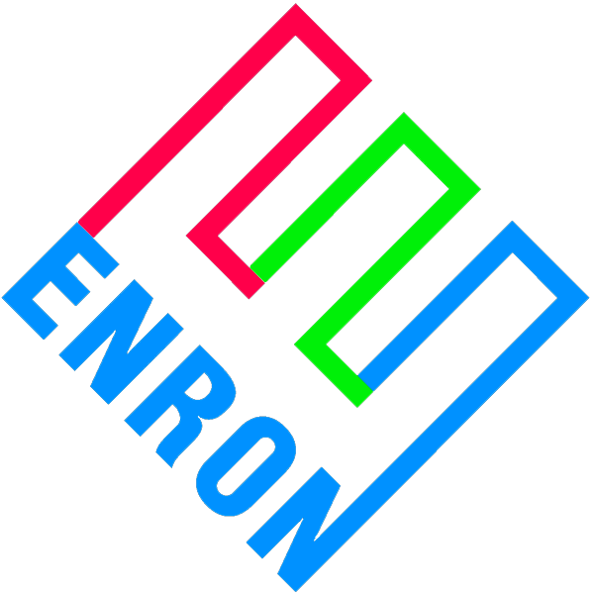
Insurance Company Partner Discussion Enron Price Uncertainty Products (“PUPs”)
December 21, 1999

Slide 2
Overview
Merchant generators face significant financial hurdles
Low credit ratings
High coverage requirements
Low leverage ratios
This is particularly true for mid-merit and peaking units
The financial community seems fixated on intrinsic value
Profits from energy sales
Minimal consideration for extrinsic value (optionality)
Possible reasons for this include:
No familiarity with underlying commodity markets
Lack of conviction around modeled future price lines
Uncertainty with what to do with collateral

Slide 3
Enron’s Perspective
Unlike other lenders, Enron can:
Manage the commodity price risk position
Take possession of and operate the collateral to our best commercial advantage
Be more creative with debtor restructuring
Creditors can offer Enron commodity and geographic alternatives
Objective is to protect Enron’s MTM earnings
This represents an obvious commercial opportunity for Enron to earn fees helping merchant generators
Absorb some merchant price line risk
Concept is only valuable to merchant generators if we can accomplish an investment grade rating, or at a minimum higher leverage at project level

Slide 4
Basic Business Deal
Enron will enter into commodity price risk management contracts designed to provide a minimum amount of commodity revenues sufficient to meet at least 1.0x debt service
On a par amount of bonds we will specify in advance
Our obligations must not be considered a guarantee of debt or hit Enron’s credit or balance sheet on any basis other than commodity price risk management contract
Payments owed to Enron under any contract will be secured by a second mortgage
Subordinate only to senior bonds
Exercisable after fairly short cure period
Enron’s ultimate hammer over equity is the mortgage

Slide 5
Contract Features
The two contracts require performance regardless of the operable status of the power plant
The two contracts are not linked to each other as to performance
Payments required under the two contracts will exactly offset each other
Each of the two contracts can be terminated due to non-performance
The two contracts are non-invasive on plant operations
Financial only, no physical elements
No effect on dispatch of plant, no consumption of environmental permit capacity, or influence on the marketing of capacity, energy and ancillary services

Slide 6
Contract Diagram
Revenues:
EPMI fin. Buy
Energy, capacity, ancillaries
Insurance proceeds, LD pmts. And all other
EPMI
Financial - Buy Contract
$ Fixed
Project LLC
$ Formula floating
Expenses:
1. Debt service & EPMI Fin Buy
2. EPMI Fin Sell
3. $ Owed EPMI
4. O&M
5. Reserve replenishment
6. Equity distributions
EPMI
Financial - Sell Contract
$ Formula floating
$ Fixed
Financial contracts:
Payer: Fixed D/S
Receiver: Formula
floating: The positive difference, if any, between a market based index and a strike price = Fuel Price * heat rate + VOM.
Termination Requirements:
1. Financial-Buy contract cannot terminate due to
bankruptcy.
2. Both contracts can be terminated for non-performance
3. Under any termination, a MTM payment is owed
4. Anytime Financial-Buy terminates, Financial-Sell must also terminate.
MTM effects. offset each other

Slide 7
Project Diagram
Revenues: e, cap., ancillaries, insurance
proceeds, LD payments, other
Trustee: Revenues
1. D/S & Fin buy
2. Fin Sell
3. $ Owed EPMI
4. O&M
5. Reserve Replenishment
6. Equity distributions
$ Debt
service
Project LLC
Bondholders:
All revenues into
A lock box
O&M, Equity dist.
Financial-Sell
$ Fixed
Financial-Buy
$ Formula
$ Fixed
$ Formula
Equity Distributions
EPMI
Payments owed EPMI
are non-recourse
to Trustee
Recourse is to LLC
Guarantee &
Reimbursement Agreement
Fixed (Fin-Buy) = Fixed (Fin-Sell) = Debt Service

Slide 8
Risk Allocation
Enron takes merchant price risk. This is mostly due to the susceptibility of the financial-sell contract to lower prices
Lower than expected revenues will likely bring pressure on projects ability to make payments to Enron
Risks not covered by Enron
Risk Mitigant
Construction completion EPC contractor
Unit operation Operator and equity
Explosion, fire, etc Business interruption insurance
Unit availability Market based LD insurance
Most of the risks not covered by Enron are typically covered in the normal course of business for merchant generators

Slide 9
Enron Risk Management Strategy
Enron needs to manage its risk position as if we were senior lender
Enron needs to have the option of assuming the senior creditor position if we have to
Enron must have the right to purchase the outstanding senior bonds when project is in distress so that we may assume the senior creditor position
Third party creditors (i.e. market based LDs) must be subordinate to Enron
Hedging strategy from Enron’s perspective:
Collateral value + market based hedge values >= par amount of senior creditors + other amounts owed Enron

Slide 10
Example: Simple Cycle Peaker
Project development cost: $500/kw
Par amount of bonds covered by Enron: $375/kw
75% leverage
Typical leverage under merchant scenario: $250/kw
50% leverage or less
Financing details Rating Term I-Rate
PUPs BBB 20-yrs. T + 175-200
Merchant B-BB 10-15 yrs. T + 350-500
Equity returns differential of PUPS vs. merchant is in the range of 5% - 10% against pro-forma future commodity prices

