Slide 1

ISO Data Release
June 7, 1999
Paul Mead, Director
Enron Capital & Trade

Slide 2
Proposal
CAISO should extend the amount of publicly available market data.
Enron advocates the immediate release of ALL market data, i.e.
- All Grid system data.
- All models used in market clearing functions. (e.g. CONG)
- All participant Bids and Offers.
Enron supports an amendment to the ISO tariff that would allow the release of additional data.
Notes:
Some sources of info for this:
Experience from UK Pool - understand this is a different market, but many of the same issues have occurred and so this provides a valid reference point.
2nd Report on Market Issues in the California Power Exchange Energy markets (PX Market Monitoring Committee) March 9, 1999. - appreciate that this is the PX rather than the ISO, but again, many of the market dynamics are directly applicable to the ISO.
ABARE (Aust. Bureau of Agricultural & Resource Economics) report prepared for the Australian Competition and Consumer Commission Jan 1998, on “Strategic behaviour in the national electricity market”.

Slide 3
Rationale
The CA ISO holds a monopoly on electricity transmission.
Market participants should be able to understand all factors that affect the allocation of grid resources.
The CA electricity market exhibits many of the characteristics of other electricity Pool markets.
Experience from other markets shows that, due to the nature of electricity as a commodity, full information disclosure is beneficial to promoting effective market functions.

Slide 4
California Market
Enron is an advocate of open markets with little Regulatory intervention.
However, we believe the CA market currently has characteristics which require Regulatory intervention in the form of information disclosure.
California market characteristics:
  Monopoly provider of transmission
  One dominant energy market
  Indications of market power
  Dominance of RMR reliance

Slide 5
System Data
All information that effects the allocation of monopoly grid resources should be immediately available to market participants to allow them to act and react to ensure optimal market efficiency. i.e;
- Scheduling and use of Grid
- Market clearing mechanisms (e.g. CONG)
- All factors that affect the operation of the grid, including details of which units are scheduled, run, constrained on/off.
Understanding = Confidence = Liquidity

Slide 6
Electricity as a commodity
‘Awkward’ demand side participation (in-elastic)
‘Lumpy’ supply side
  Large units - difficult increments
  Market concentration - e.g. peak periods.
  Entire market residual demand often available to one player.
  Operational constraints/limitations
System Security - Public interest requirements.
Volatile prices

Slide 7
Participant Data
The nature of electricity as a commodity causes difficulties in creating effective market functions.
When electricity markets are established they have been characterized by;
- Pricing anomalies
- Market power / competition issues
Enron believes many of these issues are present in the CA market.
The on-going development of the CA market would benefit from individual participant data release.

Slide 8
Market Concentration
UK - The UK regulator, OFFER has acted three times in the past to address the issue of market power.
Market power has been identified as a key problem with the UK market, which has not allowed the Pool to function effectively.
“The need for frequent intervention by the UK Regulator to address non-competitive behavior and high prices, has led OFFER to support a higher degree of transparency to allow the market to self-monitor” (ABARE)
CA - Enron believes that potential for collusion already exists in the California market. “...there is evidence that some generators were successfully exercising their market power during high-demand hours to raise prices substantially above the level that would have resulted from a fully competitive market” (PX Market Report, p67).
Similar dynamics are indicated in the ISO markets (e.g. $10,000 replacement reserve).
Notes:
Examine market concentration and highlight how release of participant data would help alleviate such issues

Slide 9
Participant Data Release - UK
Example - UK price setting units

Slide 10
UK Data collected
Generator variables - 300 gensets. 1/2 hourly data including:
availability declarations, redeclarations, offer files, plant dynamics, scheduling data, actual metered generation, disappearance ratios, etc etc....
Demand variables - 10 different definitions of demand:
forecast demand for day ahead, week-ahead month-ahead, year-ahead, actual demand, system reserve, weather-corrected demand, standard errors of the forecast, etc etc.......
Price variables - 3 price variables (SMP, PPP and PSP)
provisional and final numbers for each 1/2 hour of the day
Notes:
Slide offered to place the UK example in context and contrast the types of information available.

Slide 11
The table below shows the most recent 7 days available information ending 11 May 1999
        Most Recent 7 Days
Time Day 0 Day -1 Day -2 Day -3 Day -4 Day -5 Day -6
--:-- Tue Mon Sun Sat Fri Thu Wed
0:30 DRAX_02Z FREX_02Z DRAX_02Z DRAX_06Z RATS_02Z FREX_03Z FREX_03Z
1:00 DRAX_02Z FREX_02Z MEDP_01Z DRAX_06Z RATS_02Z FREX_03Z COTT_01Z
1:30 DRAX_02Z FREX_02Z MEDP_01Z DRAX_06Z FREX_03Z FREX_03Z COTT_01Z
2:00 DRAX_02Z FREX_02Z COTT_03Z FREX_03Z FREX_03Z FREX_03Z FREX_03Z
2:30 FREX_03Z FREX_02Z COTT_03Z FREX_03Z FREX_03Z FREX_03Z FREX_03Z
3:00 FREX_03Z FREX_02Z DIDCB05Z FREX_03Z FREX_03Z FREX_03Z FREX_03Z
3:30 FREX_03Z DIDCB05Z MEDP_01Z FREX_03Z FREX_03Z FREX_03Z FREX_03Z
4:00 FREX_03Z DIDCB05Z FREX_02Z FREX_03Z FREX_03Z FREX_03Z FREX_03Z
4:30 FREX_03Z FREX_01Z FREX_02Z FREX_03Z FREX_03Z FREX_03Z FREX_03Z
5:00 FREX_03Z FREX_01Z FREX_02Z FREX_03Z FREX_03Z FREX_03Z FREX_03Z
5:30 FERRC01Z FREX_03Z FREX_02Z DRAX_06Z DRAX_05Z FREX_03Z FREX_03Z
6:00 FERRC01Z COTT_03Z FREX_01Z FREX_02Z FREX_03Z FREX_03Z FREX_03Z
6:30 FREX_03Z FREX_03Z FREX_01Z DIDCB06Z FREX_03Z FREX_03Z COTT_01Z
7:00 AESB_01Z AESB_01Z FREX_02Z DRAX_06Z FREX_03Z AESB_01Z RATS_02Z
7:30 AESB_01Z TILBB08Z FREX_02Z DRAX_05Z KINO_03Z COTT_04Z EGGB_03Z
8:00 RATS_04Z WEBU_04Z FREX_02Z FREX_04Z COTT_01Z COTT_01Z COTT_04Z
8:30 RATS_04Z WEBU_04Z DRAX_06Z FIDF_02Z COTT_01Z COTT_01Z EGGB_04Z
9:00 RATS_04Z WEBU_04Z DRAX_06Z EGGB_03Z COTT_01Z COTT_01Z EGGB_01Z
Notes:
Enron database.
Price setting Units - on the margin

Slide 12
    Price Setting Details For 11 May 1999
Time Slot SMP Genset Code Genset Name Station Name Owner Name
0:30 WD1 10.68 DRAX_02Z Drax2 Drax GT NATIONAL POWER PLC
1:00 WD1 10.68 DRAX_02Z Drax2 Drax GT NATIONAL POWER PLC
1:30 WD1 10.68 DRAX_02Z Drax2 Drax GT NATIONAL POWER PLC
2:00 WD1 10.68 DRAX_02Z Drax2 Drax GT NATIONAL POWER PLC
2:30 WD1 11.00 FREX_03Z France France ELECTRICITE DE FRANCE
3:00 WD1 11.00 FREX_03Z France France ELECTRICITE DE FRANCE
3:30 WD2 11.00 FREX_03Z France France ELECTRICITE DE FRANCE
4:00 WD2 11.00 FREX_03Z France France ELECTRICITE DE FRANCE
4:30 WD2 11.00 FREX_03Z France France ELECTRICITE DE FRANCE
5:00 WD2 11.00 FREX_03Z France France ELECTRICITE DE FRANCE
5:30 WD2 10.65 FERRC01Z FerryC1 Ferrybridge POWERGEN plc
6:00 WD2 10.65 FERRC01Z FerryC1 Ferrybridge POWERGEN plc
6:30 WD2 11.00 FREX_03Z France France ELECTRICITE DE FRANCE
7:00 WD2 12.49 AESB_01Z Barry1 Barry AES
7:30 WD3 12.49 AESB_01Z Barry1 Barry AES
8:00 WD3 16.97 RATS_04Z Rat4 Ratcliffe POWERGEN plc
8:30 WD3 16.97 RATS_04Z Rat4 Ratcliffe POWERGEN plc
9:00 WD3 16.97 RATS_04Z Rat4 Ratcliffe POWERGEN plc
9:30 WD3 16.97 RATS_04Z Rat4 Ratcliffe POWERGEN plc
10:00 WD3 16.97 RATS_04Z Rat4 Ratcliffe POWERGEN plc
10:30 WD3 20.59 COTT_04Z Cottam4 Cottam POWERGEN plc
11:00 WD3 20.59 COTT_04Z Cottam4 Cottam POWERGEN plc
11:30 WD4 20.59 COTT_04Z Cottam4 Cottam POWERGEN plc
Notes:
Who owns these units?
Who is setting price - portfolio bidding.

Slide 13
plc
12:00 WD4 20.59 COTT_04Z Cottam4 Cottam POWERGEN plc
12:30 WD4 22.16 KINO_02Z Kingsn2 Kingsnorth POWERGEN plc
13:00 WD4 22.16 KINO_02Z Kingsn2 Kingsnorth POWERGEN plc
13:30 WD4 22.16 KINO_02Z Kingsn2 Kingsnorth POWERGEN plc
14:00 WD4 20.59 COTT_04Z Cottam4 Cottam POWERGEN plc
14:30 WD4 20.59 COTT_04Z Cottam4 Cottam POWERGEN plc
15:00 WD4 20.59 COTT_04Z Cottam4 Cottam POWERGEN plc
15:30 WD5 20.59 COTT_04Z Cottam4 Cottam POWERGEN plc
16:00 WD5 20.59 COTT_04Z Cottam4 Cottam POWERGEN plc
16:30 WD5 20.59 COTT_04Z Cottam4 Cottam POWERGEN plc
17:00 WD5 20.59 COTT_04Z Cottam4 Cottam POWERGEN plc
17:30 WD5 20.59 COTT_04Z Cottam4 Cottam POWERGEN plc
18:00 WD5 20.59 COTT_04Z Cottam4 Cottam POWERGEN plc
18:30 WD5 16.97 RATS_04Z Rat4 Ratcliffe POWERGEN plc
19:00 WD5 16.45 WEBU_04Z West4 West Burton EASTERN MERCHANT GENERATION
19:30 WD6 16.45 WEBU_04Z West4 West Burton EASTERN MERCHANT GENERATION
20:00 WD6 10.90 FIDF_04Z Fiddler4 Fiddlers Ferry POWERGEN plc
20:30 WD6 10.66 DRAX_05Z Drax5 Drax GT NATIONAL POWER PLC
21:00 WD6 10.85 RATS_02Z Rat2 Ratcliffe POWERGEN plc
21:30 WD6 33.20 WEBU_01G WestG1 West Burton EASTERN MERCHANT GENERATION
22:00 WD6 33.20 WEBU_01G WestG1 West Burton EASTERN MERCHANT GENERATION
22:30 WD6 22.16 KINO_02Z Kingsn2 Kingsnorth POWERGEN plc
23:00 WD6 17.00 FREX_05Z France France ELECTRICITE DE FRANCE
23:30 WD1 12.49 AESB_01Z Barry1 Barry AES
24:00 WD1 10.68 DRAX_02Z Drax2 Drax GT NATIONAL POWER PLC
Last Updated 17 May 1999 16:33:44
Notes:
Market concentration in specific market segments
PG sets price in peaks.
* Frequent occurrence

Slide 14
    Price Setting Gensets - 1 Month Rolling
The table below shows a 1 Month summary detailing the number of occurrences a particular genset was responsible for the setting of SMP. The average, maximum and minimum values are based on SMP in the settlement periods the genset was price setting only. Latest full day of data within report is 11 May 1999
Genset Code Genset Name Qty Set Avg. SMP Max SMP Min SMP
FREX_03Z France 88 11.00 11.00 11.00
EGGB_04Z Egg4 75 17.73 24.98 10.90
EGGB_01Z Egg1 66 19.44 25.14 11.00
FREX_04Z France 62 14.00 14.00 14.00
KINO_03Z Kingsn3 62 17.00 25.23 10.95
DRAX_02Z Drax2 49 12.03 17.87 10.50
FERRC03Z FerryC3 49 20.47 23.90 10.97
FIDF_04Z Fiddler4 48 13.94 16.55 10.69
COTT_01Z Cottam1 43 16.03 20.86 10.48
TILBB08Z TilbB8 39 16.46 22.72 10.80
FREX_05Z France 38 17.00 17.00 17.00
ABTHB08Z Abth8 35 17.12 18.34 11.50
EGGB_03Z Egg3 35 17.19 25.90 10.70
COTT_04Z Cottam4 30 17.11 20.59 10.70
RATS_01Z Rat1 28 12.34 13.41 10.47
TILBB09Z TilbB9 28 17.61 38.19 12.28
RATS_04Z Rat4 25 16.80 31.35 11.40
DRAX_05Z Drax5 24 10.90 12.65 10.62
DRAX_03Z Drax3 22 13.28 16.23 10.60
KINO_02Z Kingsn2 22 17.58 22.16 10.90
AESB_01Z Barry1 20 12.39 12.49 11.49
DINO_01Z Din1 20 34.35 41.20 17.18
WEBU_04Z West4 20 17.64 17.77 16.45
FIDF_01Z Fiddler1 19 16.82 20.54 11.45
DIDC_04Z Didcot4 17 19.15 22.12 12.50
FERRC02Z FerryC2 16 27.09 29.93 19.93
FIDF_02Z Fiddler2 16 20.30 27.91 11.90
FREX_02Z France 16 8.50 8.50 8.50
RATS_02Z Rat2 16 15.15 19.20 10.85
KINO_01Z Kingsn1 15 27.12 29.13 21.96
Last Updated 17 May 1999 16:33:48
Notes:
Examine price range to understand the extent of bid movement.

Slide 15
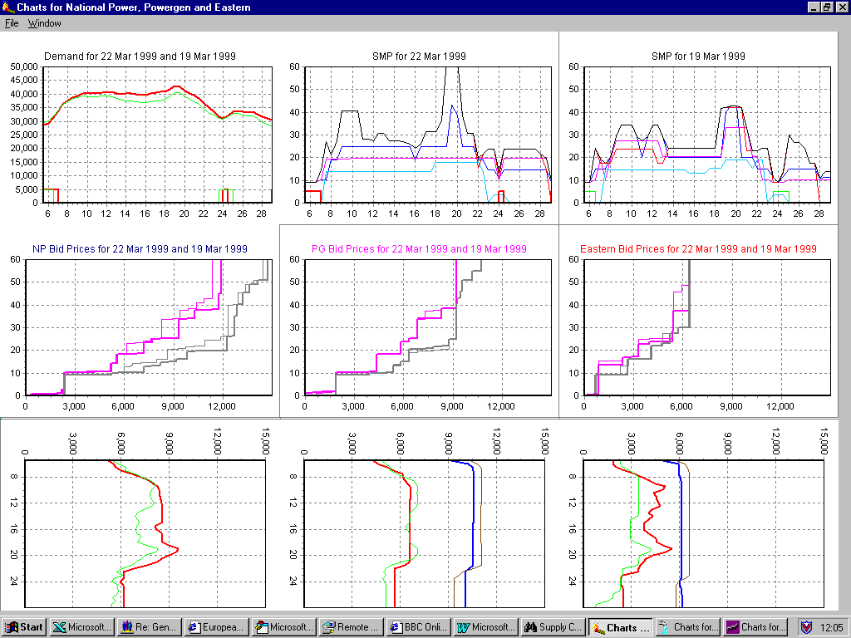
Notes:
Analysis of the bidding strategies - who is changing price
Example = this info could identify opportunities to eliminate the effects of participants price/quantity changes - e.g. understanding that the high price of power is due to competitor pricing strategies would allow cheaper power (e.g. imports) to be supplied which would cause the pricing anomaly to go away.
This info needs to be available immediately to allow short-run price effects to be identified and acted on.

Slide 16
Data Release - Benefits
Assists with the detection and policing of collusive behavior i.e. a positive disincentive to collusion.
Enhances confidence in the market.
Provides more robust investment signals.
Removes information asymmetries between small and large market players.
Promotes optimal allocation of resources.
Enhances liquidity.
Notes:
Detection and policing of collusive behavior i.e. The MSC and the public are able to scrutinize market behavior, analyze the drivers of spot market prices, and are not restricted in the publication of their findings. The threat of detection of non-competitive behaviour is therefore greater.
PX Report - “the optimal data is not always available to anyone and we have had to use a number of approximations”(p41)
PX Report - “we have written this report to provide a detailed analysis of market behaviour and market power issues, subject only to the restriction that we respect the confidentiality constraints of the PX policy.”
Enhances confidence in the market - that the market is operating rationally I.e. Prices reflect true Supply & Demand economics rather than participant bidding strategies.
Provides more robust investment signals to new entrants. E.g. Enron 3000MW of peakers. East v West because we do not believe $10,000/MWh for Replacement Reserve is a robust price signal. (UK new generation due to LT contracts - wrong signal = too much B/L)
Removes information asymmetries. A large market participant, currently receives more market information simply due to the data they receive on their own plant or load. How else can this imbalance be corrected?
Promotes more optimal allocation of resources - generation scheduling - market solutions to operational problems. (e.g. arbitrage with imports)
Enhances Liquidity - Allows better understanding of spot market price drivers facilitating the participation of risk inviting players to offer risk management tools to risk averse participants.

Slide 17
Data Release - Problems?
(1) Individual information is Proprietary:
Enron does NOT advocate any requirement for the disclosure of cost information. Market participants should retain the incentive to lower their costs.

Slide 18
Data Release - Problems?
(2) Full data disclosure introduces opportunities for tacit collusion.
Does more information make the situation better or worse?
- Must examine potential for collusion under existing market conditions.
- Significant influencing factor = Market concentration.
Enron believes that potential for collusion already exists in the California market.
Information by osmosis - market participants can ‘learn’ how to influence the market without explicit data release.
Notes:
(2) Full data disclosure introduces opportunities for tacit collusion.
- The appropriateness or otherwise of releasing market information depends on the likelihood of non-competitive behavior in the absence of further information disclosure. The extent of market concentration will also influence the ability to collude.
- Enron believes that potential for collusion already exists in the California market. The 2nd PX Market Issues Report states “...there is evidence that some generators were successfully exercising their market power during high-demand hours to raise prices substantially above the level that would have resulted from a fully competitive market (p67)”. Similar dynamics are possible in the ISO markets (e.g. $10,000 Replacement reserve).
- Information by osmosis. Experience from both the UK and Australian market indicates that market participants can ‘learn’ how to influence the market without explicit data release.
UK market evidence suggests that initially bids and spot prices were close to marginal cost, but after the first year of operation, bidding behavior changed and became more non-competitive (not due to any additional data release). This has been described as a ‘gradual build-up of collusive behavior’.(ABARE 3.2).
The 2nd PX Market Issues Report also concludes that participant behavior evolved in the direction of strongly profit-maximizing behavior.

Slide 19
Generator objections to additional data release
Participants are obliged to act in a competitive manner
At times of high prices, generator behaviour comes under increased scrutiny.
High prices can be the result of a properly functioning market (electricity is a volatile commodity), rather than non-competitive behaviour.
If this is the case, release of market data would validate generator behaviour and provide further information with which to evaluate the need for market intervention - e.g. price caps.
Why has the release of individual information be resisted mostly by supply-side participants?

Slide 20
Summary
Release ALL market data to ALL participants.
Release data immediately to eliminate short-run pricing anomalies and allow rapid market responses.
Ensure MSC remains strong.
Extend additional disclosure requirements to the PX.
Notes:
Not the exhaustive list………….

Slide 21
Suggested Data Release Items

