Slide 1
R. Martin Chavez
CEO
Kiodex, Inc.
Presentation to:
ISDA 16th Annual General Meeting

Slide 2
Contents
Topic | Section
Introducing Kiodex Kiodex Risk Workbench Functionality and Screenshots Hedging Case Studies Pacific Gas & Electric Delta Airlines Southwest Airlines | I III II

Slide 3

I. Introducing Kiodex

Slide 4

Current Market Challenges
  Extremely high price volatility in commodity markets and the passage of Financial Accounting Standards Board Rule # 133 creates a pressing need for accurate and sophisticated risk management analytics
  Spreadsheets, currently the most widely used form of “risk management,” will no longer suffice in this environment
  Building the appropriate tools in-house to manage these risks is difficult for the following reasons:
    Complexity of products traded (for example, average price swaps and average price options are standard in commodity markets)
    Modeling and analytical complexity of these markets (mean reversion, convenience yield, storage, seasonality, etc.)
  Buying a system off-the-shelf can be cost-prohibitive and lack the necessary analytics.
  Relying on counterparts for risk management creates a conflict of interest.

Slide 5
Kiodex Mission
The Kiodex mission is to make sophisticated, cost-effective risk management tools available to all producers, consumers and traders of commodities, thereby allowing our clients to accurately understand, measure and manage their risk.
The name Kiodex is derived from kiodynos, meaning “risk” in Greek, and the suffix –ex, for “exchange”

Slide 6

The Kiodex Offering
The Flagship Product
The Kiodex Risk WorkbenchSM: Accessed via the Internet, the Risk WorkbenchSM is an easy-to-use risk management system that assists corporations in measuring and managing their exposures to volatile commodity prices and complying with Financial Accounting Standards Board (FASB) Statement 133.
Enabling Technology
The Kiodex Trade EngineTM: An Internet-based, order matching system that powers major electronic exchanges, such as enymexSM. All deals executed on the Trade EngineTM flow directly to the Kiodex Risk WorkbenchSM, enabling ease of deal capture and integration with clients’ back office systems.
Complementary Services
Kiodex Client Services: In addition to comprehensive technical and functional help desk resources, our client services professionals leverage their market expertise to assist with understanding the operational and financial implications of all Kiodex risk reports, optimizing their use of the analytics and reports provided by the Risk Workbench, and applying these tools to implement more sophisticated, customized hedging strategies

Slide 7
Overview of the Risk Workbench
Accessed via the Internet, the Kiodex Risk Workbench^{sm} is an easy-to-use risk management system that assists corporations in measuring and managing their exposures to volatile commodity prices and complying with Financial Accounting Standards Board (FASB) Statement 133
Corporate risk managers, chief financial officers, and treasurers no longer need to install software, incur large upfront costs or commit to costly ongoing maintenance contracts to manage their risk
The Kiodex Risk Workbench^{sm} provides immediate and affordable access to pricing tools and risk management reports, allowing companies to focus on their core business objectives
Kiodex provides immediate, affordable and maintenance-free access to powerful risk management tools.

Slide 8

Value of the Risk Workbench
Sophisticated Tools: Commodity markets are becoming more volatile and FAS 133 is forcing companies to comply with rigorous new reporting guidelines. Most currently available systems, particularly spreadsheets, do not suffice. Companies require sophisticated risk management tools and valuation models to operate and control their businesses. The Risk Workbench^{sm} is the answer.
Cost-Effective: Unlike traditional software companies, Kiodex uses the Internet to distribute the Risk Workbench^{sm}. There are no up-front software purchase costs, no installation fees and no ongoing maintenance costs. Licensing is monthly and fees are based on useage. Kiodex passes its distribution costs savings directly to its clients, offering compelling value. The result is that Kiodex clients have superior risk management technology, previously available only to the top dealers and Wall Street houses, at a fraction of the usual cost.
Easy Access: Our clients do not install software. They access the Risk Workbench^{sm} using any web browser. It’s quick and easy.
Maintenance Free: Clients need expend neither human nor capital resources to maintain, upgrade or install new releases. Kiodex has created a robust technology infrastructure with fully redundant backup facilities. Further, Kiodex maintains a fully staffed Technology Infrastructure Support Team to ensure fast, reliable, scalable and responsive service. The web delivery of the Risk Workbench^{sm} allows Kiodex to provide immediate and simultaneous access to all release upgrades.

Slide 9
Value of the Risk Workbench
Straight-Through Processing: The Risk Workbench^{sm} is integrated with the world’s leading transaction platforms such as enymexSM. Our clients get more than risk management. The Risk Workbench^{sm} allows our clients to price a trade, execute it online, and monitor the resulting aggregate risk. Transactions done on enymexSM feed directly to our clients’ own deal archives on the Risk Workbench^{sm} for immediate portfolio risk analysis.
Trading Controls: Through the multi-level permission hierarchy built into the Risk Workbench^{sm}, our clients establish strict access rules for trading, valuation and reporting. Those rules mitigate fraudulent reporting and valuation activity.
Core Competency: By outsourcing development and maintenance of risk management tools to Kiodex, companies can focus on their own core competencies, whether it is operating a fleet of commercial jet airliners, operating an oil exploration & production company, or managing an electric power grid.

Slide 10
Value of the Risk Workbench
Predictability: Software projects are notorious for their delayed delivery dates and cost overruns. Kiodex is different. We deliver specific and measurable results within the stated timeframe. With the Risk Workbench^{sm}, you always know your monthly costs, and you know exactly when additional functionality will be released.
Security and Audit Trails: All data is transmitted using Secure Socket Layer (SSL) 128–bit encryption. Our system also automatically generates audit trails for all user activity.
Client Service: The Kiodex hallmark is client service. Clients do not pay for Kiodex help-desk and client-care services. Those services are free. We take pride in our ability to build relationships with our clients. Kiodex is your risk management coach, and we place the resources of our entire team at your fingertips.
Future releases with feature enhancements will be immediately accessible and do not require users to transfer or manipulate old data. In advance of upgrade dates, users will be advised of new functionality and features.

Slide 11
Risk Workbench^{sm} Functionality and Screen Shots

Slide 12
Risk Workbench Functionality
Pricing Calculators
The Risk Workbench^{sm} pricing tools allow users to value all instruments before trade execution. Users can easily load and edit market data, including forward curves, volatility curves and model parameters, via the Pricing Screen.
Quantitative Library
The Kiodex Modeling and Analytics team has assembled a library of sophisticated valuation models tailored to the commodity markets. These models accurately represent characteristics specific to commodity markets, such as seasonality and mean reversion, in addition to short-term and long-term commodity market dynamics. Our option valuation tools support volatility smiles and skews.
Risk Report Generator
The Risk Workbench^{sm} offers its users the opportunity to generate a complete set of risk reports. These reports include portfolio sensitivities (delta, gamma, vega, theta), profit and loss explanations, portfolio mark-to-market, settlement, position and trade reports.

Slide 13
Risk Workbench Functionality
Report Customization
Kiodex reports allow clients to aggregate books and portfolios, filter trades by specific criteria within books and portfolios, and filter data content for maximum user flexibility and customization. Within reports, clients can drill-down to groups of trades and individual trades.
Data Flexibility
Kiodex risk reporting functionality allows ultimate data flexibility. Clients can run all reports on archived market data, Kiodex-supported daily market feeds (from a combination of sources), or their own data sets. The Risk Workbench^{sm} further allows all data points to be shifted in any direction, offering full flexibility for stress testing and scenario analysis.
FAS 133
The Risk Workbench^{sm} reporting functionality enables efficient compliance with Financial Accounting Standards Board Statement 133. The Risk Workbench^{sm} generates reports that support grouping, matching and real-time tracking of obligations and hedges.

Slide 14
Risk Workbench Functionality
Delivery Location Analysis
The Risk Workbench^{sm} allows clients to analyze their commodity risk exposure by specific delivery locations. Basis swaps between multiple delivery locations can be entered to support the analysis of delivery location spread risk.
Tailored Design
The client’s system administrator chooses from a wide array of options in setting up preferences, types of traded products, users, books and portfolios. Each client can tailor the Workbench’s capability to meet the organization’s unique requirements.
Products and Markets
The first release of the Risk Workbench^{sm} allows users to manage their risk to physicals, futures, forwards, swaps, listed options, European options, and Asian options on crude oil, refined petroleum products and natural gas.

Slide 15
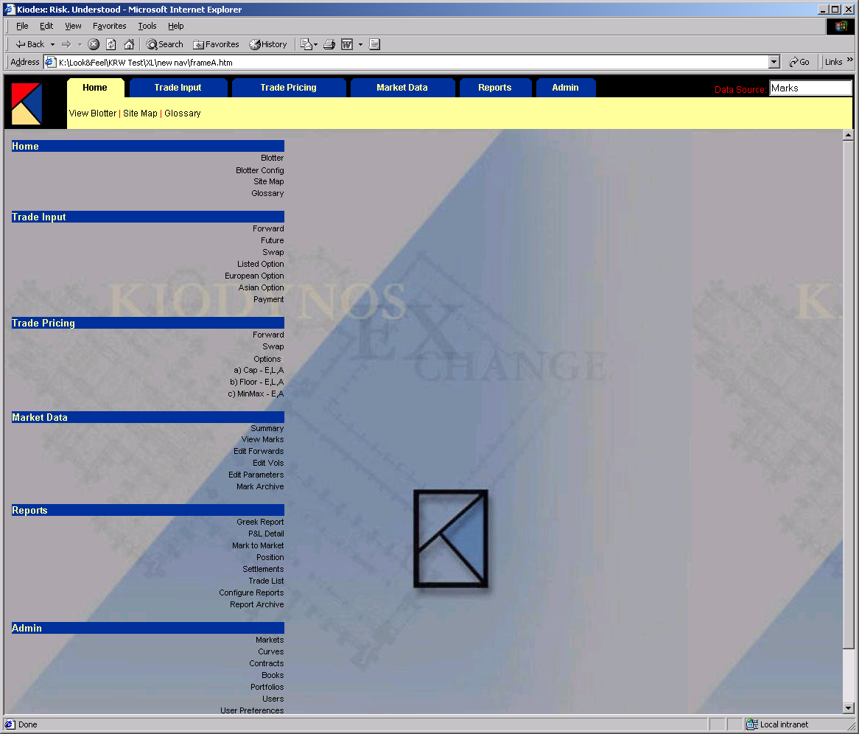
Home Page – Ease of Navigation
On this screen, a user can:
View trade blotters
Configure trade blotters
View a site map
Access a glossary of terms and a full knowledge base including quantitative models.

Slide 16
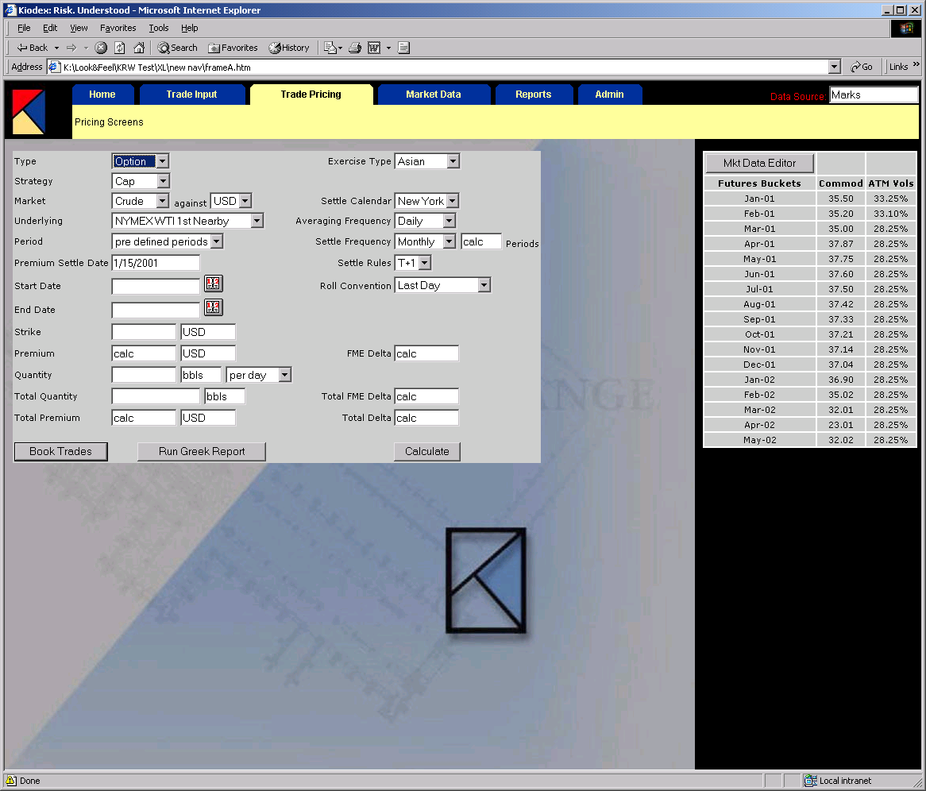
Pricing Screen Example – Asian Option
Users can book a trade into the system directly from the pricing screen, and run a greek report on the proposed trade.

Slide 17
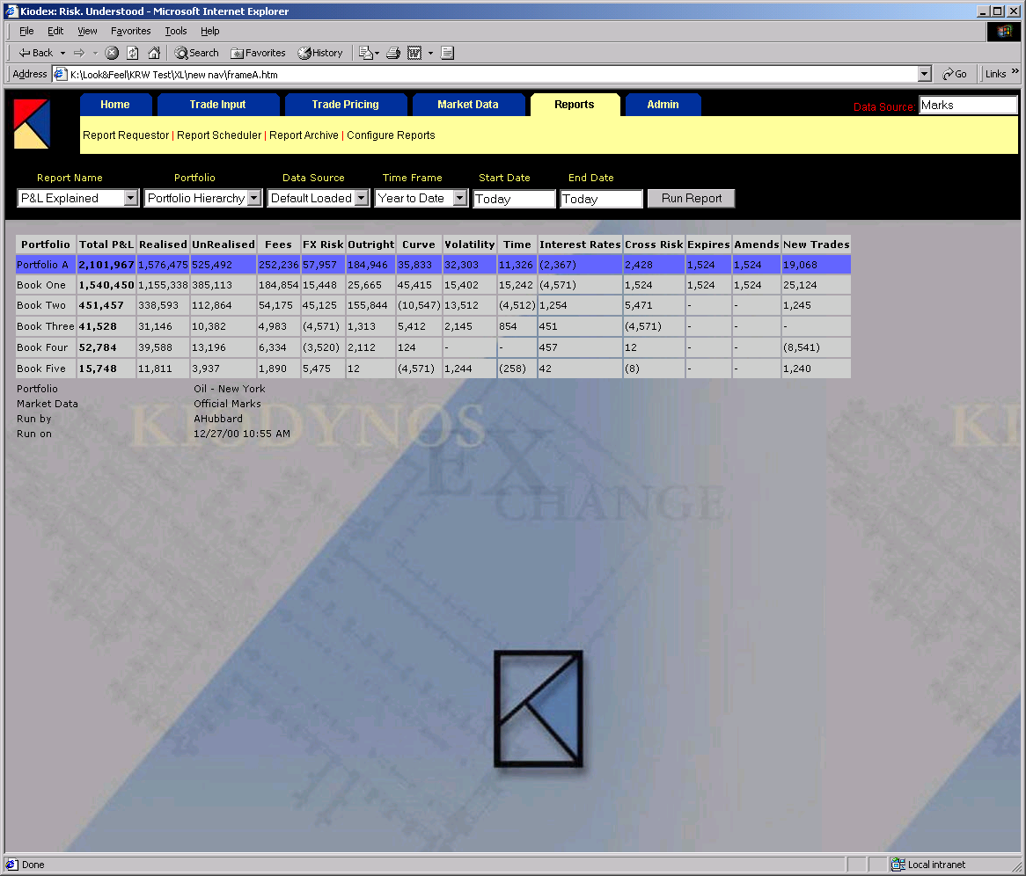
Profit & Loss Example – P&L Explained
Components of the change in P&L for any given period can be analyzed, including changes due to foreign exchange, volatility, forward curves, etc.

Slide 18
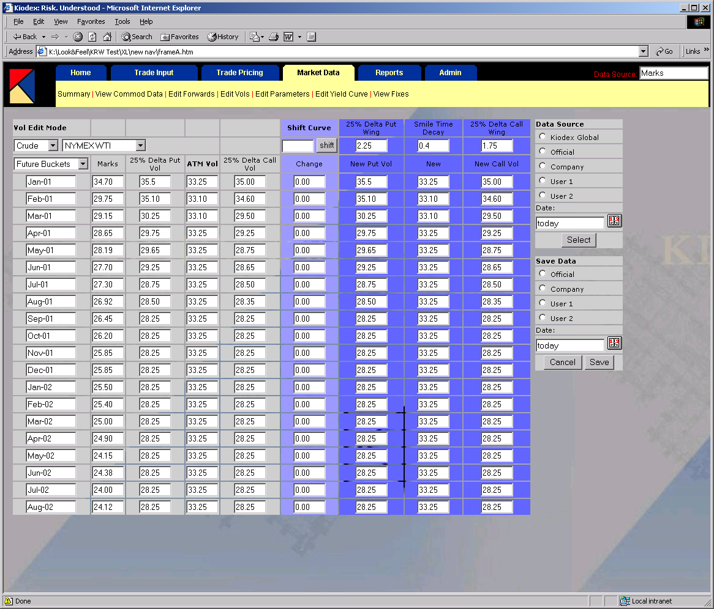
Viewing, Manipulating and Saving Data
The Market Data Editor allows users to load, edit and save forward curves, volatility curves and model parameters for pricing and report generation.

Slide 19
III. Hedging Case Studies

Slide 20

PG&E: What Went Wrong
Wholesale electricity price caps far exceeded retail price caps that PG&E was allowed to charge its customers.
California’s demand for electricity has skyrocketed, but there is no new power generation capacity.
Source: Bloomberg

Slide 21
PG&E: The Impacts of the Crisis
By year-end 2000, PG&E had spent $7 billion more for power than it received from its customers.
PG&E stock hit a new 52-week low of $8.375 on January 18, down from a high of $31.8125.
PG&E credit ratings were downgraded beyond “junk” status by the major ratings agencies.
Gas suppliers are refusing to sell any more natural gas to PG&E.
The State of California faces continuing power shortages and rolling blackouts.
The company has announced over 1,000 lay-offs and must cut back its customer service.

Slide 22
PG&E: The Effects of a Hedging Program
Had PG&E entered into a basic hedge program for at least a portion of their power requirements, substantial savings would have been realized. This is demonstrated by the graph below, which illustrates a hedge program that bought electricity for a one-month period, two months forward on a rolling basis. The effect of the price spikes is greatly nullified, and PG&E could have saved billions of dollars in wholesale electricity costs.
Source: Bloomberg

Slide 23

PG&E: Using the Risk Workbench
Ability to compare hedging programs to determine optimal hedging strategy
Determine bankruptcy price-tolerance thresholds
Test the impact of a major price spike (such as when prices hit $3,000/MWh on 12/8/00)
Access to market data, historical market info (such as the seasonality of electricity prices) and portfolio sensitivity reports through the Risk Workbench
Accurately determine the valuation of proposed hedging transactions
Simple FAS 133-compliant reporting and analysis

Slide 24
Delta Airlines
According to The New York Times Article: “Five Questions for Michelle Burns; How an Airline Burns Less Money,” October 22, 2000:
  Delta Airlines purchases a total of 3 billion gallons of jet fuel annually (250 million gallons/month).
  Fuel costs are Delta’s second highest expense behind salaries, but by far their most volatile.
  Delta’s goal is to protect against price increases but still benefit from declines. They buy options, or financial insurance.
  In the five quarters up to and including Q3 2000, although Delta spent $100 million in option premium expenses, they netted $600 million from their hedging activity.
  By hedging, Delta saved $160 million in one quarter alone (Q3 2000), more than any other airline.
“We hedge because we think it’s the right thing to do from the perspective of managing a very volatile and large expense.” – Delta CFO Michelle Burns

Slide 25
Southwest Airlines
According to The Wall Street Journal Article: “Southwest Airlines’ Big Fuel Hedging Call is Paying Off,” January 16, 2001:
  Southwest Airlines purchases 1 billion gallons of jet fuel annually, also their second largest expense behind salaries.
  Southwest hedged 100% of their jet-fuel needs for the last two quarters of 2000.
  By hedging, Southwest saved $43.1 million during Q3 2000, and between $60 – 65 million during Q4 2000.
  Airlines are increasingly using hedging as a tool to manage earnings in an ultra-competitive environment.
  By isolating the assumed cost of jet fuel well in advance, airlines can build budgets around that cost and better determine projected earnings.
“I think airlines have more refined (hedging) strategies today than they did years ago. This current environment begs for some different approach than what we were using in the past.” – Southwest Airlines CFO Gary Kelly

