Slide 1


Collaborative Negotiation Solutions
Empowering enterprises to negotiate sustainable ebusiness agreements

Slide 2

What Beachfire is All About
Streamlining the negotiation process for complex agreements
Cutting negotiation process costs by up to 50%
Enabling your enterprise to negotiate better deals.

Slide 3
Beachfire Resources
Team Venture Capital Advisors
30 people and growing
Bessemer
John Chambers, Cisco
Over 300 years of combined software experience
Chase Capital
Bob Crowley, Bowstreet
Seasoned management team from Oracle, Lotus, Sun, PwC, PTC, Harvard Negotiation Project, McKinsey
Fleet Equity
Mary Murphy, Cereva
Comdisco
Ted Grossman, Babson College

Slide 4
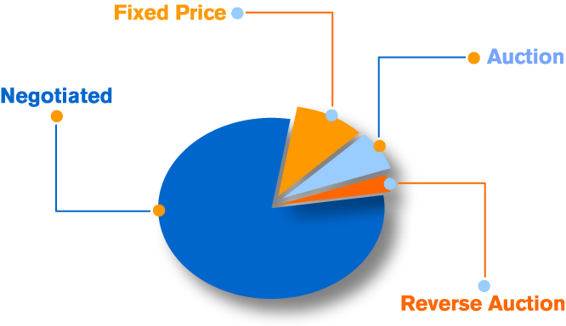
Highest-Value Transactions Are Negotiated
“An estimated 80-90% of all business goods and services are actually traded through extended-term contracts … which are hard to bring on to the Internet.”
- The Economist, October 19, 2000

Slide 5

The Problem
Complex deals take too long to close
Enterprises and partners are widely distributed and hard to bring together
Monitoring deal status during negotiations is hard
Keeping legal costs and response time down is hard
Expensive people’s time isn’t efficiently leveraged
Negotiating offline or in email burns time, money, and opportunity
“The average Fortune 1000 company has between 20,000 and 40,000 total contracts.”
- Goldman Sachs Global Equity Research, February 2, 2001

Slide 6

The Solution is Beachfire
Hosted Software + Professional Services
An integrated, XML-based, collaborative negotiation solution that empowers cross-enterprise, distributed teams to craft well-formed agreements quickly

Slide 7
Bring the Entire Transaction Process Online
Seller:
Find leads, manage customers
Delivery and configuration
Customer & relationship support
Negotiate terms
Negotiate terms
Conference calls, meetings, voicemail, email, fax…
Online
Tools:
Catalogs, Decision Support, SFA, Contact managers
Beachfire Negotiation Solution
Finance & Logistics databases
CRM
Buyer:
Select product and vendor
Online synchronous or asynch negotiation
Document + discussion in central repository
Distributed teams
Cross-enterprise user management
XML-based design
Manage solution acceptance, payables
Monitor performance
Break in online process flow

Slide 8
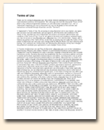
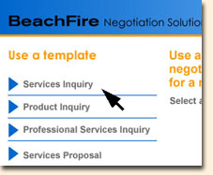
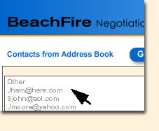
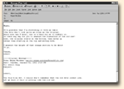
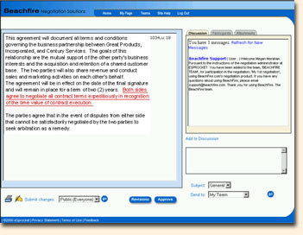
Using Beachfire
Participants enter here
Email invitations
Select a template
Create a team
Use any negotiable document (RFP, listing, statement of work, contract)
Negotiate, edit, discuss terms, monitor status, approve, and store for reuse
Document + Discussion
Financial databases
eLogistics databases
Print
Document store
Accounting databases

Slide 9
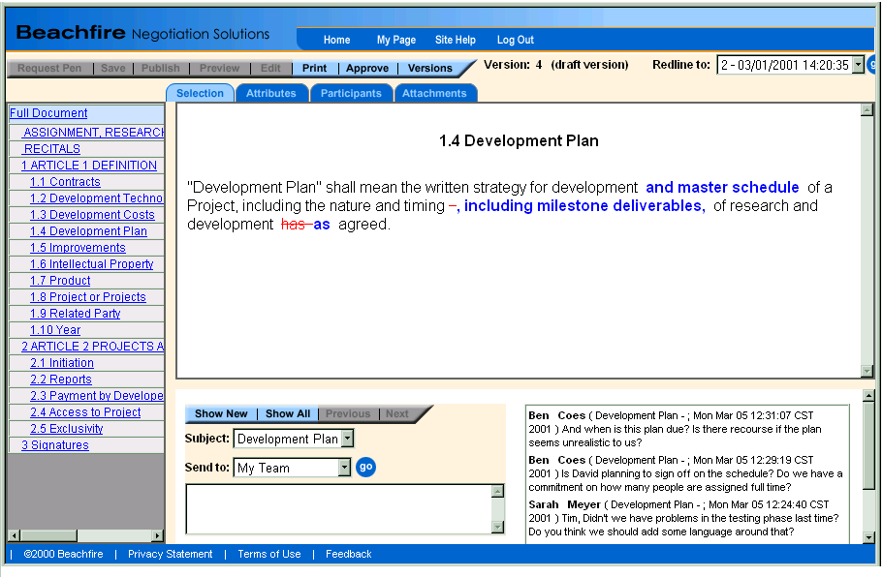
Negotiating an Agreement

Slide 10
Features and Benefits
Cross-enterprise user management: Invitations, access control, negotiation status transparency
Control access
Define each member’s role and rights
Provides accountability and tracking
One-click access to the negotiation site
Common documents: Authorized editing, redlining, version control, secure documents, customizable templates, archiving with discussion stream
Private and non-repudiable negotiation text
Directs attention to changes
Single-pen model prevents version conflicts
Allows later entrants to get up to speed fast

Slide 11
Features and Benefits
Discussion: Asynchronous, permissioned entry, instantaneous, archived with document, indexed, private, semi-private, public to the invited group
No need to assemble all parties for discussion to progress
Expedites negotiations
Allows confidential discussion
Captures issues for review when members enter late and when renegotiating
Integration: Launch negotiation on any incoming document, synchronized with existing user directories, digital signatures, standard ecommerce business document output
Fits into existing processes and systems
Accepts starting documents from multiple sources
Produces output for multiple uses
Reduces disruption & risk of processing errors
Retains and passes valuable data throughout the entire transaction and fulfillment process

Slide 12
Features and Benefits
Central, accessible, secure home for all negotiation elements
Supports distributed teams & anytime activity
Instant access to agreement & discussion
Lets you pinpoint deal roadblocks
Centrally archives your agreements so you can retrieve & manage closed agreements
Hosted service: Scalable, transparently upgraded, neutral environment, infrastructure managed by the host, financial integration, hosted admin
Frees customers from infrastructure support
Seamless upgrades
Equal access for all parties establishes trust between buyer and seller
Available anytime and anywhere
Customization: Enterprise templates, user interface, document content, business rules
Reuse standard contracts & deal language
Increase uniformity of agreements
Embed in existing web sites and pages
Automatic participation rules, access control and routing

Slide 13
Value Proposition for Negotiators
Save time, money, opportunity.
Streamline negotiation process
Get agreements signed off faster
Lower negotiation process costs by 15-30% for you and your customers
Produce better agreements
Monitor deals in progress
Access digital archive of all deals

Slide 14
Beachfire Professional Services
Strategic Negotiation Services
Implementation Services
Negotiation Diagnostic
Current negotiation costs
Current negotiation processes
Negotiation process improvements
Negotiation Strategy & Business Process Design
Business process / rules analysis
Change management
Materials development
Negotiation Workshops
Customization
Document templates
User interface
Automated business rules and work flow enhancements
Integration
Integration with enterprise workflow
Data exchange with legacy databases
Integration with enterprise directories, portals, intranets, extranets

Slide 15

Basic Architecture
Enterprise LDAP Server
Browser
HTML
LDAP
Beachfire Web Page
Server
XML
Beachfire Negotiation
Server
Databases
Notes:
Database does not include document store (although in reality documents are stored in Oracle) because it’s probably not ideal to press the document storage issue at this point.
LDAP may include one of 6 possible LDAP solutions in 3 scenarios:
We store the users on an LDAP server locally.
We use the user’s credentials to validate against a customers LDAP server. Credentials will be Username and Password for version one. Happy to do more advanced…
We have an administrative account on customer’s LDAP server and go validate the user.

Slide 16
Deployment Alternatives
Your
Teams
Beachfire hosting
Responding
Teams
Beachfire 24/7
Data Center
Mixed hosting
Your
Data Center
Your
Teams
Beachfire
7x24 Data Center
Responding
Teams

Slide 17
Integration with Other Systems
Database forms
Document formats
Spreadsheet formats
Contact Managers
Accounts payable/ receivable systems
Beachfire templates and document segmenting
Beachfire cross-enterprise discussion tool
Email Address Books
Beachfire cross-enterprise user admin
CRM systems
Standards for X-enterprise document editing and management
SFA systems
Workflow applications
Existing standards
Existing standards
Workflow applications
Elogistics databases
Email
Standards in
Standards out

Slide 18
Beachfire Lighthouse Program
Lighthouse is an opportunity to pilot the solution and influence our direction
Phase 1:
Phase 2:
Phase 3:
The diagnostic
Assessment of opportunities to improve your negotiation processes
Template creation
Beachfire creates enterprise-specific document templates
Customer use and feedback
You pilot the software and work with Beachfire to improve our solution

Slide 19
Next Steps
Addressing your questions and concerns
Exploring a long-term relationship
Developing an agreement for a software and services trial

