Slide 1
Overhaul of Combustion Turbines
Under NSR Regulations
Presented to:
New Source Review (NSR) Inter-Agency Task Force
Presented by:
Member Companies of the
Interstate Natural Gas Association of America (INGAA)
Washington D.C.
August 2, 2001
<number>

Slide 2
Issue Summary
Routine maintenance of light industrial and aero-derivative combustion turbines utilizing exchange of components with a centralized overhaul facility should not result in NSR re-permitting.
    Some EPA Regions and State Agencies treat such overhauls as routine maintenance, an exempt physical change under NSR rules.
    Recently other Regions and States have begun to regard overhauled exchange components as creating a new turbine unit, requiring NSR review.
The clarification of NSR rules will impact utilization of existing capacity and maintain the reliability of existing gas transmission facilities. The operation of these facilities are critical to natural gas transmission system.
<number>

Slide 3
Key Points
1. Routine maintenance for most light industrial and aero-derivative turbines requires overhaul at about 30,000 hours, 3 to 4 years, to ensure safe and reliable operation.
2. In contrast to larger industrial turbines that are field maintained, light industrial and aero-derivative turbines are designed to utilize central facilities operated or licensed by the turbine manufacturer for overhaul of components.
3. Facility downtime is minimized by installation of overhauled modules from the central inventory.
4. After component overhaul the turbine continues to operate under the same rated capacity and permitted emission limits.
5. Clarification that current overhaul practices are consistent with the routine maintenance exemption can be a direct and immediate improvement in the administration of the NSR program. This will impact the reliability and utilization of existing gas transmission facilities.
<number>

Slide 4
Turbines in Gas Transmission Service
Natural gas-fired combustion turbines are used at compressor stations to transport natural gas through pipelines from source areas to industrial, commercial, and residential consumers.
  Industry relies on turbine operation to provide continuous and uninterrupted
  service of the pipeline system, as required by the Federal Energy Regulatory Commission (FERC)
Compressor stations are located approximately every 70 miles along pipelines.
The are more than 1,400 natural gas-fired turbines in gas transmission.
Most units are simple-cycle, aero-derivative or light industrial turbines.
Average size is approximately 6,300 horsepower (4.7 MW),
Median size is approximately 4,400 horsepower (3.3 MW).
Principal manufacturers:
  General Electric, Rolls Royce, Solar Turbines, Allison
<number>

Slide 5
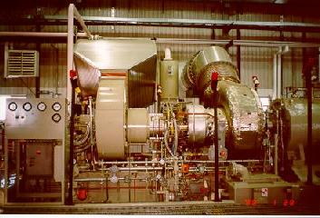
Typical Transmission Combustion Turbine:
Solar Taurus
<number>

Slide 6
Major Components of a
Natural Gas-Fired Turbine
Air inlet system
Accessory drive system
Gas producer*
Fuel delivery system
Cooling system
Lube system
Power turbine**
Power shaft
Control system
Starting system
Exhaust system
*Central facility overhauled/exchanged
**Also central facility overhauled/exchanged for Solar Turbine units
<number>

Slide 7
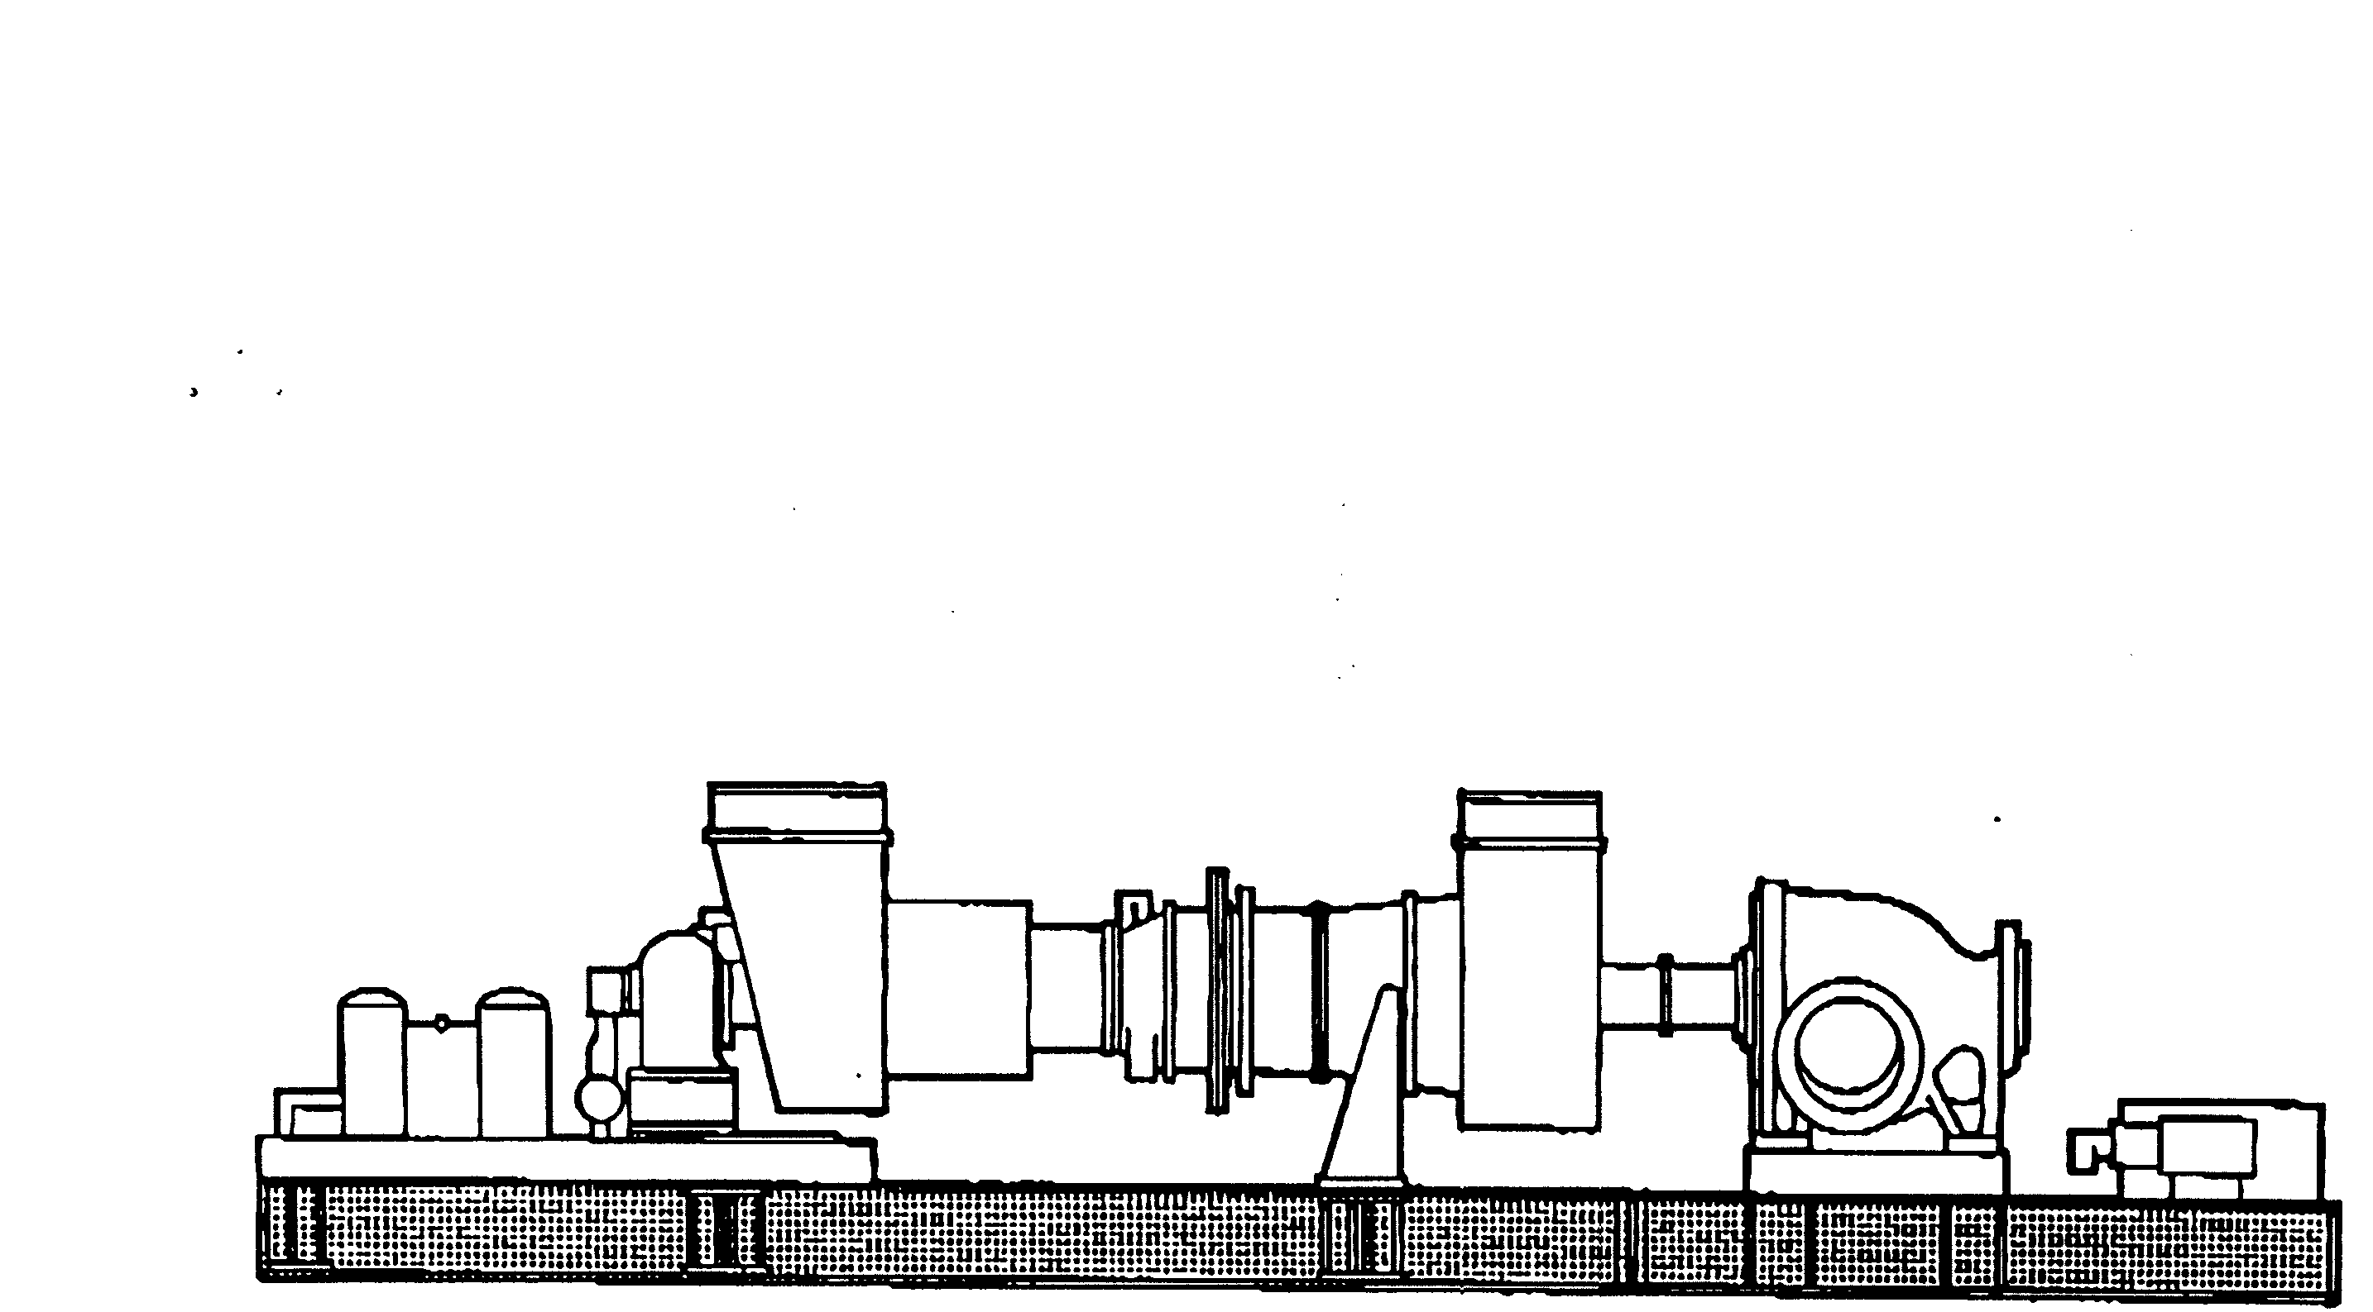
Gas Producer Component
Axial Compressor
Air Inlet
Exhaust Duct
Combustor
Power Shaft
Accessories & Accessory Drive
Power Turbine Component
Driven Unit
(Gas Compressor)
<number>

Slide 8
Overhaul and Exchange of Components
Manufacturers of light industrial and aero-derivative turbines designed-in the use of central facility overhaul and exchange of components.
Use of central overhaul and exchange of components has been the maintenance practice for light industrial and aero-derivative turbines for the past 30 years.
There are important benefits to central overhaul and exchange of components:
  Better QA, components are overhauled with sophisticated equipment and trained personnel
  Lower costs, facility downtime and overhaul costs are reduced
<number>

Slide 9
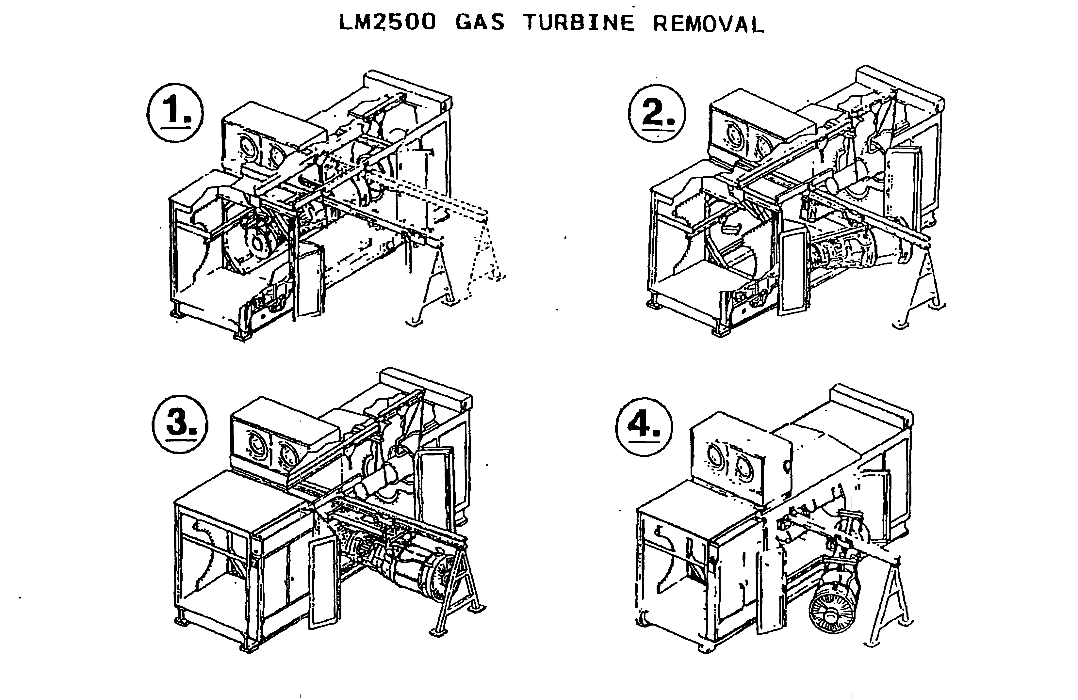
Example: Removal of G.E.
Gas Producer Component
<number>

Slide 10
Component Overhaul
Is Not “Reconstruction”
50% Threshold defined under NSPS regulations
40 CFR 60.15(b): “Reconstruction means the replacement of components of an existing facility to such an extent that: (1) the fixed capital cost of the new components exceeds 50 percent of the fixed capital cost that would be required to construct a comparable entirely new facility...”
Turbine NSPS support document states:
Although substantial portions of turbines are replaced during normal overhauls, “such routine maintenance should be exempted from the regulatory consequences of becoming a reconstructed turbine, subject to the ‘50 percent rule’ discussed in 5.1.2. “ (Vol. I, Page 5-6)
Overhaul costs typically range from 6 to 17% of the total cost of a new natural gas-fired turbine
  Example: Solar Saturn (1,690 hp) (7.6%)
    Avg. purchase price of a new turbine $1,324,720
    Avg. overhaul price $ 100,00
  Solar Mars (15,000 hp) (15.7%)
    Avg. purchase price of a new turbine $6,060,450
    Avg. overhaul price $ 950,000
<number>

Slide 11
Component Overhauls are
Part of Routine Maintenance
Overhaul may be initiated based on:
  Hours of operation and/or number of startups, according to manufacturers’ or 3rd-party schedules for overhaul intervals
  Results of inspection that indicate overhaul is needed include: high equipment vibration levels; abnormal oil temperatures; and, visible damage or wear
Specific intervals vary depending on operating conditions
Manufacturers’ recommendations:
  Solar, General Electric, & Rolls Royce recommend scheduled overhauls at approximately 30,000 hours of service, depending on the turbine model
Based on above, components are typically overhauled every 3 to 4 years of operation.
<number>

Slide 12
Routine Maintenance for Turbines is Addressed in NSPS Record
NSR and NSPS rules have similar exemptions for routine maintenance.
NSPS regulations 60.14(e)(1) state that Administrator shall determine which activities are “routine” for a particular source category
    At the time EPA issued the NSPS for turbines, EPA declined to include a more specific finding about turbine maintenance and argued in the NSPS Support Document that the general NSPS definition was sufficient (Vol. II, pages 2-9 through 2-11)
NSPS Support Document recognizes that, “substantial portions of a turbine may be replaced as a matter of routine maintenance during the normal overhauls” (Vol. I, Page 5-6)
<number>

Slide 13
Current Practice is Consistent with
Turbine NSPS Record
The NSPS Support Document indicates that replacements that occur an overhaul will not be considered a modification:
“The following physical or operational changes will not be considered as modifications to existing gas turbines:
a. Changes determined to be routine maintenance, repair, or replacement in kind. This will include repair or replacement of stator blades, turbine nozzles, turbine buckets, fuel nozzles, combustion chambers, seals, and shaft packings. (Vol. I, page 5-6)
The NSPS Support Document notes that, because of these exemptions, the “impact of the modification provision on existing gas turbines should be very slight.” (Vol. I, page 5-6)
<number>

Slide 14
Recommendation
Determine that “routine maintenance” for light industrial and aero-derivative turbines includes use of central overhaul facilities and component exchanges.
<number>

Slide 15
This Clarification Avoids…
Postponement and/or delay of recommended maintenance schedule.
Increased downtime for on-site or non-central facility work.
Delays due to NSR Review triggered by routine maintenance
Increased downtime can impact deliverability of natural gas.
<number>

