Slide 1

Market Risk Management In Petroleum Industry
Zimin Lu and Alex Huang
Presentation to 2000 International Chinese Petroleum & Petrochemical Technology Conference, Houston, Dec. 1-4, 2000
Enron Research Group

Slide 2
A Business Model
An oil company is vibrant and financially healthy only if
Profit = Revenue - Cost > 0
Cost = Fixed Cost + Variable Cost
Excellent job in engineering and technology leads to
low cost in production
Revenue = Sale Price * Sale Volume
Price swings and demand shocks can make corporate earning volatile

Slide 3
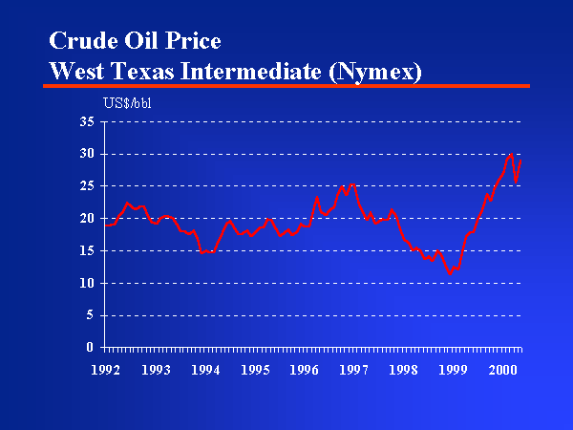
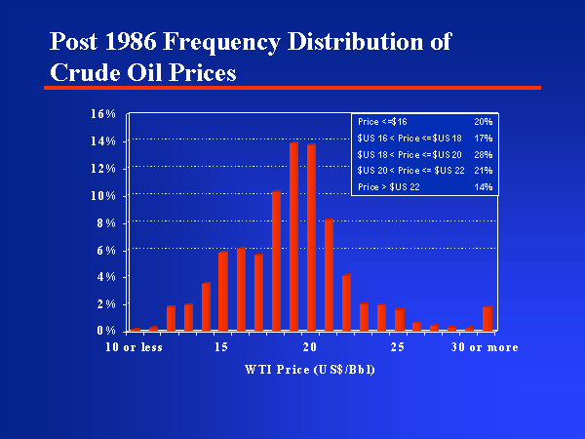
Crude Oil Prices

Slide 4
What is Risk Management ?
Risk management is defined as organized treatment of loss exposures.
Risk management process is defined as the process for making and carrying out decisions that will minimize the adverse effects of potential loss.
With various degree of formality, the risk management function is performed by virtually every individual, family, business, or organization.

Slide 5
Risk Management Examples
1) Car insurance: the holder of the policy has a put option when an accident occurs resulting a loss of the car value. The strike price is the amount of deductible.
2) Fixed rate mortgage with prepayment option: the borrower entered a floating to fixed swap with the lender. The borrower also hold a put option, to put back the loan to the lender with the strike price being the refinancing cost.
3) Oil swap: forward sale at a fixed price. An oil company hedges part of their production when the market price is favorable.
Put option payoff
Lender’s Payoff
25 $/bbl
Car Value
Interest Rate
Spot Price

Slide 6
Risk Management Procedures
1) Identifying and analyzing loss exposures or risk factors
2) Examining the feasibility of alternative risk management techniques
3) Selecting the best risk management technique(s)
4) Implementing the techniques
5) Monitoring the program

Slide 7
Risk Factors
It is impossible to manage risks that have not been recognized.
Upstream: Production and Exploration Downstream: Refinery and Marketing
Business risks are the risks that a corporation is willing to take: Geological risk, environmental risk, technology risk; Strategic risks: political risk, regulatory risk
Financial risks are the risk that a corporation is trying to avoid: market risk, legal risk, credit risk, liquidity risk, operational risk;
Market price risk : Crude oil price, crack spread Volumetric risk : mild winter would decrease the demand for heating oil Foreign exchange risk: global company

Slide 8
Feasibility of Alternative RM Tools
Risk avoidance: MTBE is found in drinking water in CA which would render potential law suit.
Risk Sharing/Pooling: Joint venture, Co-develop an oil concession,vertical integration
Insurance for pure risks: insurable exposures
Market Risk Management Tools
Futures, forwards and swaps
Exchange traded options and OTC exotic options
Financial engineering

Slide 9
Futures, Forward and Swaps
A forward contract is an bilateral agreement between buyer and seller for delivery physical commodity on a future date at a price agreed today.
E.g. you can transact with Enron on EnronOnLine
A futures contract is an exchange traded forward
E.g. NYMEX light, sweat crude oil futures; Contract size: 1,000 bbl; Price quote: $/Bbl, Grade: WTI
Swap is a portfolio of forwards
Fixed-floating swap: pay floating and receive fixed - forward sale

Slide 10
Example: Hedging Production
Using Futures Contract
Company XYZ crude oil production in March,2001 is projected at 600 Bbl/day Monthly volume=30*600=18,000 Bbl
NYMEX March WTI futures is traded at $32/Bbl. XYZ company is bearish. In order to lock in today’s (nice) price, XYZ needs to enter a short position of 18 contract.
Suppose March crude oil ends up at $28/Bbl
Gain from futures position = 32-28=$4/Bbl
Gain from spot sale = $27.5 /Bbl
Total gain = 4+27.5 = $31.5 /Bbl with hedging error = -0.5 $/Bbl

Slide 11
Options Pricing
Call option: gives the holder a right but not obligation to buy the underlying commodity at a fixed price.
Put option: give the holder a right but no obligation to sell the underlying commodity at a fixed price.
Black-Scholes Formula (73)
Options are securitized risk
$\begin{aligned}c=e^{−\text{rT}}E(\text{max}(S_{T}−K,0)) \\ {\text{Se}}^{−\text{qT}}N(d_{1})−{\text{Ke}}^{−\text{rT}}N(d_{2})\end{aligned}$

Slide 12
Financial Engineering
Short covered call + long underlying
Short collar + long underlying
Crude Oil
$38
Crack Spread

Slide 13
Risk Monitoring: VAR
Value at Risk is a statistical measure of risk exposure. VaR is the amount one expects to lose over a time horizon at a given confidence level. For example, if one day VaR is $1.7m at 95% confidence level, it means that the company will have less than 5% chance to lose more than $1.7m in one day.
$\text{VaR}=\left\{x:\int_{−∞}^{x}{P(s,\text{dt})\text{ds}}=5\text{\%}\right\}$

Slide 14
Enron Research Group
An internal quantitative consulting group advises Enron on
Derivatives pricing and assets valuation
Market and credit risk assessment and control
Energy and broadband trading and marketing support
Retail business support
Global markets support: weather derivatives, insurance, agriculture commodities
Interest rate and FX risk

Slide 15
Summary
Risk management is essential to enhance an oil company’s bottom line
Appropriate risk management policy enables an oil company to take business risks at its core competence while mitigating the market risks it does not want to bear
Risk assessment and control rely heavily on quantitative financial modeling

Slide 16
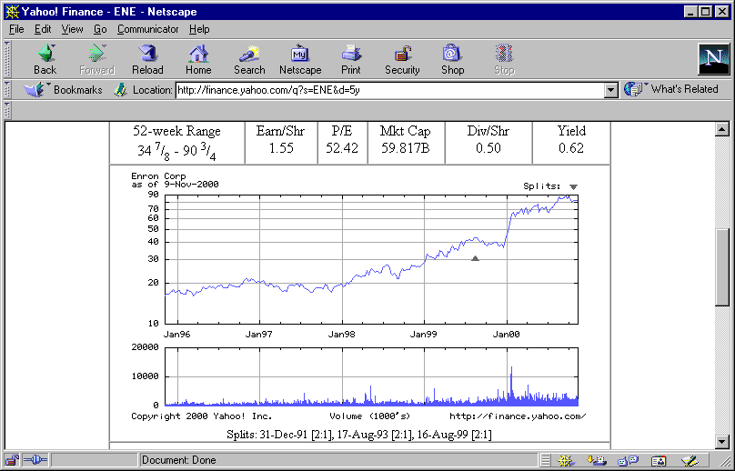
ENRON
Natural Gas,Power,Broadband,and Endless Probabilities

