Slide 1
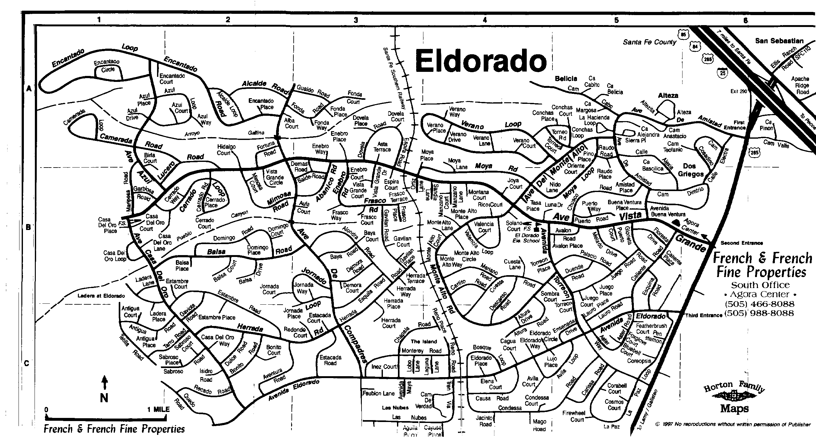
How to get to the NM Keans
Turn west on to Avenida Eldorado. Follow Avenida Eldorado to Condessa Avenue – turn left/south. (If you get to the railroad tracks,
You went just a bit too far.) Follow Condessa as it curves back toward the east. The FIRST right turn is on to Jacinto Road. Our house
Is the second/last house on Jacinto Road before the gate. 3 Jacinto Road.

