Slide 1
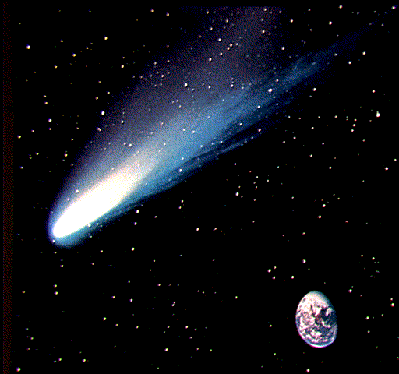


Help us celebrate surpassing the 400 registered users mark!
<date/time>
<footer>

Slide 2

Join us for a Clickpaper Happy Hour!
When: Wednesday, March 21
Where: El Tiempo, 502 Main Street
*On the corner of Main and Prairie
Time: 5pm-7pm
What: Food, drinks, and good company
Be there or be square!
……
Nothing is here

