Slide 1
Do you want Jack Welch’s job?

Slide 2
Spot the pattern . . .
1. Doug Ivester
2. Bob Ayling
3. Dale Morrison
4. Durk Jager

Slide 3
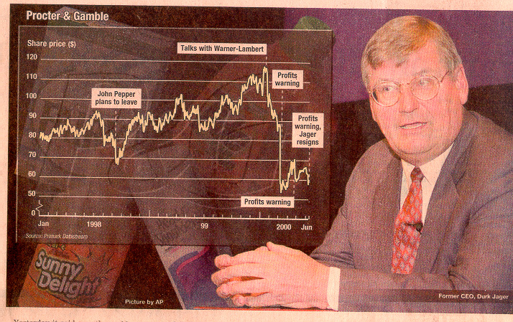
Don’t let this happen to you
STRATEGOS
Strategos Proprietary and Confidential

Slide 4
Defying gravity . . .
1. The law of large numbers

Slide 5
Market cap giants:

Slide 6
Market value superstars:
Market value ($ billions)

Slide 7
The P/E escalator: Average P/E for the S&P 500
Source: Compustat
Notes:
Christopher Orndorff, principal at Payden & Rygel, an LA investment firm, predicts where the stock market be in 10 years time, c. 2009. If average return on stocks continues for next 10 years as it has for last ten years, 18% per year including dividends, and if corporate earnings continue to grow at 6% per year, and inflation stays low at 2%, then the S&P may be trading for 48 times earnings by 2009.
On the other hand, if the PE reverts to normal levels for a low-inflation economy, about 18%, then stocks will return only 1.9% each year.
Morgenson, Cretchen, “Checking the Market’s Arithmetic,” NYT, Feb 14, 1999, Section 3, p. 1
TREES DON”T GROW TO THE SKY.
Liquidity, Internet, Deal-making, one time cost cutting--all of this is fueling the boom in stock prices . . . which of these are really sustainable?
You have to invent new wealth creating strategies--you can’t just ride the escalator . . . cause it’s going to stop . . . and you’re going to have to start climbing under your own steam!!!

Slide 8
Market value superstars:
Projected market value ($ billions)

Slide 9
Do trees grow to the sky?
Projected market value ($ trillions)
Combined value of shares listed on NYSE.

Slide 10
Defying gravity . . .
1. The law of large numbers
2. The law of diminishing returns

Slide 11
Diminishing Returns?
GE’s Revenue/Employee

Slide 12
Diminishing Returns?
GE’s Revenue/Employee

Slide 13
Flat-lining? GE’s net margins

Slide 14
How long?
Income
Growth (%)
1994-1999
Revenue
Growth (%)
1994-1999
Ratio of
Inc/Rev
1994-1999
Unisys 383.2 2.0 195.7
Amerada Hess 493.7 6.6 74.6
Adobe Systems 3668.4 69.9 52.5
Eastman Kodak 151.3 3.9 38.5
Northrop Grumman 1280.0 34.0 37.6
Marriott International 100.0 3.9 26.0
AMR 187.7 9.9 19.0
Allstate 462.2 25.6 18.1
Hershey Foods 149.9 10.1 14.8
Sara Lee 409.0 28.8 14.2
Xerox 79.3 7.8 10.3
New York Times 115.8 7.8 14.9
Cigna 40.7 2.8 14.6
Marriott Intl. 19.7 1.4 14.0
Source: S&P Compustat; Strategos calculations
Notes:
Created 5/10/99 by Michael Hickcox, using pg. 8 spreadsheet.
Only did the 5-year version for this one, as requested. Used net income before extraordinary items.
To make the data more robust, I dropped all of the CAGR’s below 1%. This (and the fact that there’s missing data, negative numbers, etc.) means that you can’t really say that these are the top companies’ ratios. Rather, this is a selection. Also therefore, no companies whose revenue decline is faster than their income decline got onto the list.
The Median % increase in revenues over the 5 year period was 9.3% per year. The Median % increase in net income before extraordinary items over the 5 year period was 9.2%.

Slide 15
Ratio of:
CAGR Net Income
CAGR Revenue
1993-1996
1996-1999
Median for the
S&P 500:
Median for firms
where initial ratio
was > 5.0:
1.1
1.0
10.5
0.8

Slide 16
Merger mania (Worldwide merger activity, $ billion)*
Source: Securities Data Corp
Notes:
Source: Securities Data Company
“The Trustbusters’New Tools,” The Economist, May 2nd 1998, p.62.
Also see:
“Europe Appears on Verge of a Merger Boom,” by Jeffrey L. Hiday, WSJ, November 24, 1998, p. A14

Slide 17
Merger mania:
Source: Salomon Smith Barney and Thomson Financial Securities Data
Notes:
Source: “Mergers Snapshot,” The Wall Street Journal,” February 9, 2000, p. C22.

Slide 18
Average operating margin for the S&P 500:

Slide 19
Trends in IT:
Standard platforms
Outsourcing
IT Consulting
Web Hosting
Exchanges
ASPs

Slide 20
Defying gravity . . .
1. The law of large numbers
2. The law of diminishing returns
3. The law of averages

Slide 21
How long will this last?
GE’s P/E Ratio (as of 18.8.00)

Slide 22
The challenge of sustaining high shareholder returns: (1990-1999)
Compaq
Home Depot
Intel
Oracle
Number of companies
Number of years in which total shareholder returns
exceeded the 75th percentile for the S&P 500
Source: S&P Compustat; Strategos calculations
Notes:
Updated 5/10/99 by Michael Hickcox, using pg. 6 spreadsheet.
This page is pretty labor-intensive and technique is important.
A much easier (and potentially more accurate) method of calculation would be to take the 12/31/98 S&P500 and compute how many years those particular 500 stocks have exceeded the 3rd quartile.
An argument against the current method utilized, is that a really stellar company could have exceed the 3rd quartile 9 years running, but if it’s only been in the S&P500 3 years than it only gets counted as a three. So, to maintain that this “chart shows the number of years that stocks in the S&P 500 have exceed the 3rd quartile,” is a misnomer.
You may want to change the purplish line--it bore more relevance to the old number distribution.

Slide 23
Defying gravity . . .
Divide and divide again

Slide 24
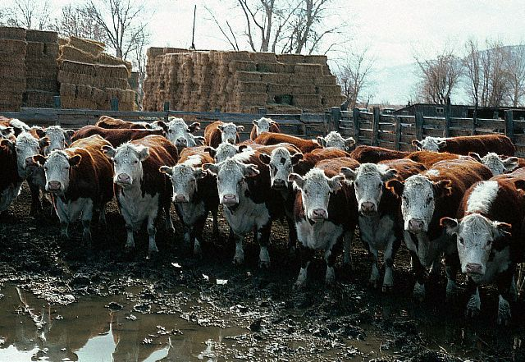
Is this how you see your company?

Slide 25

Or is this how you view your company?

Slide 26
How do you see your company?
My company = a business model
My company = an industry leader
My company = an earnings factory
My company = an opportunity generating machine

Slide 27
Defying gravity . . .
Divide and divide again
Find new wealth-creating strategies

Slide 28
Alchemy:
Billions
Millions
Market
Value
Annual
Revenue
Akami 7.2 4.0
Ariba 40.0 45.4
ARM 11.8 62.1
Brocade Comm. 24.9 68.7
Commerce One 11.2 33.6
Inktomi 15.0 71.2
Phone.com 7.9 13.4
Redback Networks 22.5 64.3
Rambus 7.5 43.4
Sycamore Networks 3.3 11.3
VeriSign 35.3 84.8

Slide 29
Innovation pathways:
Difficulty
Core
Renewal
Schwab
White Space
Businesses
Enron
Spin
Ins
Cisco
Under-utilized
strategies for GE
Spin
Outs
Virgin
Portfolio
Shuffles
C&W
Potential for Leverage
Notes:
These may not be discrete innovation styles, but innovation routines and approaches?

Slide 30
Defying gravity . . .
Divide and divide again
Find new wealth-creating strategies
Become less “average”

Slide 31
Sails and anchors at GE Profits ($ millions)

