Slide 1
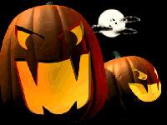
BOO!
We’re having a
Halloween Happy Hour
(sponsored by the Analyst Advisory Board)
All Analysts and Associates,
Come to the Continental Club (3700 Main Street)
on Thursday, October 26
between 6:00 and 9:00.
Bring your dancing shoes, the El Orbits will be playing!

