Slide 1
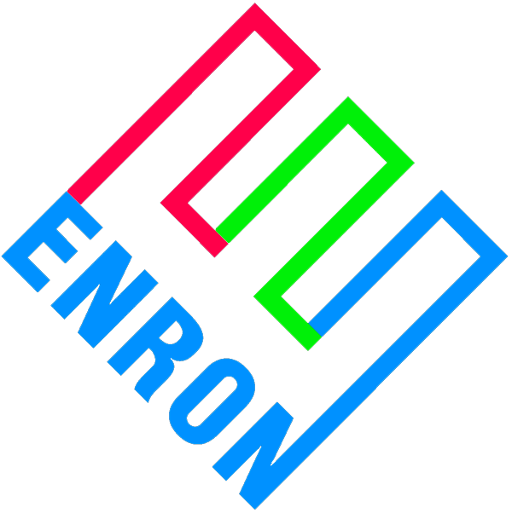
Merchant Plant Finance
Price Risk Management Products
Goldman Sachs
May 3, 2000

Slide 2
Basic Concept
Debt capital markets are over-pricing merchant market risk
This represents an opportunity for ENA to step inside the capital markets and capture commodity positions and basis points
  Merchant price line risk at ENA curves
Enron’s risk basis is as a secured lender
In essence, ENA sold to equity the right to put the plant to ENA at debt levels
  Put strike price equal to outstanding debt
  Exercise of put means equity will write-off their entire investment
To accomplish objectives, ENA will enter into commodity price risk management contracts to eliminate merchant price line risk to debt

Slide 3
Basic Price Risk Management Contracts
EPMI
Financial - Buy Contract
20-years
$ Fixed = D/S
Initial
Project
315 MW
7 x LM6000, SS
$550/kW to build
$375/kW leverage
$ Formula e-
EPMI
Financial - Sell Contract
20-years
$ Formula e-
$ Fixed = D/S
$ Formula e- The positive difference, if any, between a market based index and a strike price = fuel price * heat rate + VOM.

Slide 4
Contract Features
The two contracts require performance regardless of the operable status of the power plant
The two contracts are not linked to each other as to performance
Payments required under the two contracts will exactly offset each other
Each of the two contracts can be terminated due to non-performance
The two contracts are non-invasive on plant operations
  Financial only, no physical elements
  No effect on dispatch of plant, no consumption of environmental permit capacity, or influence on the marketing of capacity, energy and ancillary services

Slide 5
Risk Allocation of Project
Enron takes merchant price risk. Lower than expected markets will likely bring pressure on Project’s ability to repay monies owed to Enron
Risks not covered by Enron
Risk Mitigant
  Construction completion EPC contractor
  Unit operation Operator and equity
  Explosion, fire, etc Business interruption insurance
  Unit availability Market based LD insurance
Most of the risks not covered by Enron are typically covered by other parties for merchant generators in the normal course of business

Slide 6
Flow Diagram
EPMI’s structure assures that
revenues > O&M and debt service
  This puts Enron’s credit on merchant price line assumptions
Equity’s option to repay shortfalls are the same both pre & post Enron
  Before, equity had to decide whether or not to default on debt. Now equity must decide whether or not to default on Enron
Enron assumes a credit position comparable to senior secured, but on more favorable terms to equity
  Higher leverage
  Longer term
  No market windows
  Net bp savings
$ Revenues
e-
ICAP
Other
Project
L.L.C.
Option, but not
obligation to
make up short-
fall in $
$ if necessary
EPMI
1. O&M
$ repayment
2. Debt Service
3. Equity

Slide 7
Basic Credit Structure
Revenues
Bulk Power Mkts.
e-
ICAP
Ancillaries
$ Fixed = D/S
O & M
EPMI
Fin - Buy
$ formula e-
D/S
Bondholders
EPMI
Fin - Sell
$ Fixed = D/S
Fin - Sell
$ formula e-
Equity
Credit Contribution is from inserting contracts on either
side of D/S in the flow of funds

Slide 8
Basic Deal Structure
144 (a) Offering
$ Proceeds
Bondholders
144 (a)
Trustee
e-
LLC
$ D/S
Reimbursement
Agreement
$ Fixed
e-
e-
$ Fixed
EPMI
Fin. Buy
EPMI
Fin Sell
ENRON
Baa2/BBB+
Guarantee
Guarantee
EPMI Financial Buy directly with trustee to make bankrupt remote
EPMI Financial Sell with LLC
Reimbursement Agreement covers monies owed to Enron under either agreement

Slide 9
Potential Insurance Company Roles
Basic deal structure: sell to Enron an insurance policy that puts cap on Enron’s loss exposure
Expanded deal structure: in addition, extend credit swap to the Enron SPV that guarantees project loan debt service

Slide 10
Loss Exposure Cap
Relative Risk Positions of the Parties
Insurance Payout
Debt + ENA (FB, FS) - Proceeds
of Sale - ENA Deductable
Equity Risk
ENA Risk
Insurance Risk

Slide 11
Loss Exposure Cap
Viewpoint of the Parties
Probability
P 5
P 95
Equity
ENA
Insurance
Co. Risk
Basis
Enron Risk
Basis
Equity
Projections
PV Result

Slide 12
Basic Deal Structure
Event map leading to insurance payout
$ Proceeds
$ Proceeds
Senior
Bondholders
144 (a)
Trustee
e-
LLC
$ D/S
Reimbursement
Agreement
EPMI buys
bonds
$ Fixed
e-
e-
$ Fixed
EPMI
Fin. Buy
EPMI
Fin Sell
ENRON
Baa2/BBB+
Guarantee
Guarantee
Third
Party Buyer
1. LLC defaults under EPMI Financial-sell
2. EPMI terminates Financial-sell
  Causes MTM to be owed to EPMI
  Creates 2nd secured obligation under reimbursement agreement
3. Project LLC goes into bankruptcy
4. EPMI buys Sr. bonds to control process
5. EPMI takes control of asset through bankruptcy
6. Enron sells asset to a third party
7. Enron collects an insurance policy
  Puts net of deductable
Insurance
Company

Slide 13
Expanded Deal Structure with
Enron as Project Lender
$ Proj.-Loan
20-year
$ Funding
Loan
20-year
LLC/
Trustee
Enron
SPV
Capital/Bank
Markets
BBB+/Baa2
Ins. Co. rating
$ D/S
$ D/S
Fin Buy
e-
Fin Sell
$ Fixed
$ Fixed
x-year
wrap
e-
Insurance
Co.
Policy
EPMI
Insurance
Co.
- Limits
exposure
$ Premium
Potential for credit duration mismatch between 20-year term of either loan and a x-year insurance company wrap
The insurance wrap will likely evergreen every x-years
Funding loan must accommodate springing credit change

Slide 14
Alternative Funding Strategy
FAS 125 deal: Enron sells loan to bank
Insurance
Co.
Credit Wrap
Bank
Fixed CF’s
Sale of
Loan
L+200
$ Premium
$ Negotiated
Loan
ENE
Project LLC
Sell N/R to Bank - diff
between interest rates,
which is gain for ENE
FB & FS creates credit
FAS 125 Issue - Securitization
Financial Assets
Insurance Co. understands nature
of credit and write policy
  Total return swap?
P & I
L+400
FB
FS
Insurance
Co.
Policy
EPMI
- Limits
exposure
$ Premium

Slide 15
Concept Economics
$450/kW Power Plant
Capital Markets
Rating: B- to BB+
IR (T=6%): T+350 to T+500
Leverage: <50%
Capital Structure:
Debt: $225/kW
Equity: $225/kW
Total: $450/kW
Debt Service: $28/kW-yr $31/kW-yr
PV10: $212/kW $235/kW
$ Benefits: Base Case ($23/kW)
Enron PRM
BBB- & Higher
T+150 to T+250
60% 75%
$270/kW $337/kW
$180/kW $113/kW
$450/kW $450/kW
$26/kW-yr $35/kW-yr
$221/kW $297/kW
+$36/kW +$27/kW

Slide 16
Predicting the psychology of equity
Enron has sold equity a put on the underlying project putting Enron into essentially a creditor position
Enron’s security features, restrictive covenants and mortgage motivates equity to refinance ASAP
As soon as equity can achieve higher leverage/term than outstanding Enron loan, equity will refinance
Highly unlikely that equity
will exercise put early
in its life…equity has too
much invested.
At very least, equity will refinance
when residual value is in excess of
par amount of bonds outstanding

Slide 17
Enron’s Commercial Objectives
Structure puts Enron’s credit on the merchant price line
  Achieve investment grade rating for project
Enron’s participation characterized as a PRM contract, not a guarantee of debt
Incent, but not obligate equity to make additional payments when required or lose plant
  Short cure periods
  Mortgage on asset
Incent, but not obligate equity to refinance, taking Enron out of credit support role

