Slide 1
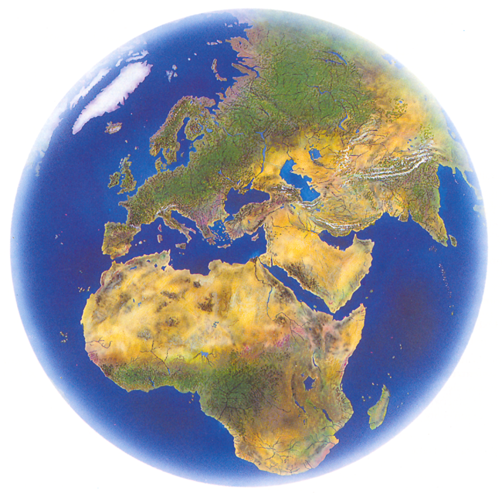
Enron Global Markets
October 2000

Slide 2
Enron Global Markets
New business unit that will focus on global markets and commodities outside Enron’s traditional gas and power markets
Global Crude and Products
Coal, Emissions and Transportation
LNG and Middle East
Currency, Equities, Interest Rate and Agricultural Trading
Insurance
Weather
EGM provides a true network for market making opportunities for commodities that are enormous in market size
Will capture value of Enron’s existing trading network and international asset positions
Operations will coordinate with our North American and European businesses

Slide 3
EGM’s Wholesale Business
Natural Gas
Power
Financial
Trading
Transportation
Coal
Crude &
Products
Emissions
Weather
Insurance
LNG
Pulp &
Paper
Merchant
Investments
Metals

Slide 4
Crude &
Products
Coal
LNG
Emissions
Weather
EGM
Transportation
Insurance
Agribusiness
FX/Rates

Slide 5
Enron Global Markets
Offices
Coal Activities
Crude and Product Activities
Weather
LNG
Houston
London
Oslo
Singapore
Helsinki
Seoul
Tokyo
Sidney
Panama
Europe
China
Australia
USA
Korea
USA
UK (Europe)
Singapore
Australia
Panama
USA Europe
Japan
Australia
-

Slide 6
Enron Coal
Largest coal trader in the world
Expanding into Asia markets
Lead and grow business via electronic trading on EnronOnline
Conduit into transportation trading
Group working on clean energy solutions
Trading emissions(SO₂ ), coal and freight online

Slide 7
Enron LNG
Creating an Enron Network of LNG supplies, transportation, terminals and markets with maximum optionality
Gaining access to a broader network of terminals
Optimize the use of Huegh Galleon and Texmar vessels
Developing online trading network from Asia hub

Slide 8
Crude and Products
Business includes crude and products, (gasoline distillate, MTBE, residue, heating oil, jet), petrochemicals, LPGs and plastics
Actively trading products on EnronOnline
Significant growth expected due to focus on online trading, financial markets and geographic product expansion, and product origination and market activity

Slide 9
Enron Weather
A leading market maker in weather products
Current products cover 25 U.S. states and 7 countries
Extensive growth expected by expanding the product lines and into Asian markets
EnronOnline’s success has been and will continue to be the platform for growth (currently the fourth most traded commodity on EOL)

