Slide 1
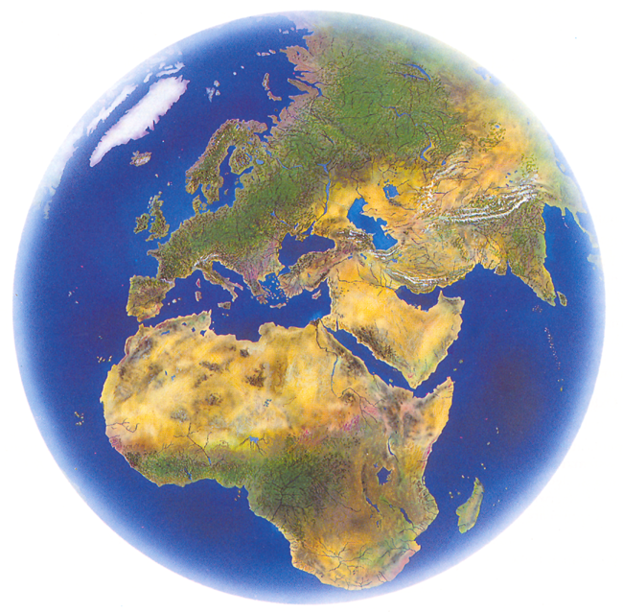
Enron Global Markets
Working
Draft
October 2000

Slide 2
Enron Global Markets
New business unit that will focus on global markets and commodities outside Enron’s traditional gas and power markets
  Global Crude and Products
  Coal and Emissions
  Transportation
  LNG and Middle East
  Currency, Equities and Interest Rate Trading
  Agricultural Trading
  Insurance
  Weather
EGM provides a true network for market making opportunities for commodities that are enormous in market size
Will leverage value of Enron’s existing trading network and international asset positions
Operations will coordinate with our North American and European businesses

Slide 3
EGM’s Wholesale Business
Natural Gas
Power
Financial
Trading
Transportation
Agriculture
Global Crude &
Products
Coal &
Emissions
Weather
Insurance
LNG
Pulp &
Paper
Merchant
Investments
Metals

Slide 4
EGM’s Wholesale Business
Crude &
Products
Coal
LNG
Emissions
Weather
EGM
Transportation
Insurance
Agribusiness
FX/Rates/
Equities

Slide 5
Enron Global Markets
Creating New Networks in Global Commodities
Offices
Coal Activities
Crude and Product Activities
Weather
LNG
LNG Ships
Houston
London
Oslo
Singapore
Seoul
Puerto Rico
Tokyo
Sidney
Panama
Dubai
Europe
China
Australia
USA
Korea
South Africa
Japan
India
USA
UK (Europe)
Singapore
Australia
Panama
Korea
Japan
Argentina
USA
Europe
Japan
Australia
India
Puerto Rico
Venezuela
Georgia
Louisiana
LNG Under
Development

Slide 6
Developing High Growth Wholesale Business
Coal $60B
Crude & Products $____B
Largest domestic coal trader
Largest UK coal trader
Expanding into Asia
Emissions trading and freight online
Leader in risk management products
Crude and products (gasoline, heating oil, jet, gasoil, residue) MTBE, petrochemicals, plastics and LPGs
Actively trading online
Geographic product expansion
Largest petrochemical trader on the world
Enron
Global
Markets
Weather $Trillion+
LNG $18B
Leading market maker
Products offered in every state and 10 countries on 4 continents
Successful trading on EnronOnline
Product offering covers entire developed world
Flexible Global Network
Developed online trading network
Shipping business growing
Leverage EnronOnline, North American, and European Networks

Slide 7
Enron Coal
Key Active
Areas
Coal Offices
Largest domestic coal trader
Leader in risk management products and services, producer finance, eCommerce and OTC markets
Combines producer finance, marketing, trading, transportation, emissions technology & trading to provide services to its customers
Lead and grow business via electronic trading on EnronOnline. Currently trading emissions, coal and freight online
Conduit into transportation trading
Expanding into Asia markets

Slide 8
Enron LNG
Key Active
Areas &
Contracts
Under
Development
Creating an Enron Network of LNG supplies, transportation, terminals and markets with maximum optionality
Gaining access to a broader network of terminals
Optimize the use of Dabhol Hoegh Galleon and Exmar vessels
Developing online trading network from Asia hub

Slide 9
Crude and Products
Key Trading
Areas
Business includes crude and products (gasoline, heating oil, jet, gasoil, residue) MTBE, petrochemicals, plastics and LPGs
Actively trading products on EnronOnline - Currently only platform with global coverage
Largest petrochemical trader in the world
Continued growth expected due to focus on online trading, financial markets, geographic product expansion, and product origination and marketing activity

Slide 10
Enron Weather
Key Weather
Transactions
Largest weather trader in the world
Transacted in all lower 48 states and 10 countries on 4 continents
Product offerings cover entire developed world
Extensive growth expected by new product and new market development
EnronOnline’s success has been and will continue to be an important platform for growth
Via our retail organization, Enron is the largest aggregator of positions naturally exposed to cold winters

