Slide 1
October 2000
Confidential & Proprietary
Management Presentation
Gleason Overview

Slide 2
Overview
Gleason Overview
Plant Description: 546 MW (nominal) natural gas-fired, simple-cycle facility
Location: 60-acre tract in Gleason, Tennessee, in TVA subregion of SERC
Power Interconnect: TVA 500 kV line
Gas Interconnect: ANR Pipeline ML2-Weakley Interconnect
Start of Construction: September 1999
Commercial Operation Date: June 21, 2000
Approx. Max. Annual MWh: 532,992 @ 59ºF
Approx. Run Hours: 915
NOx (per unit): <25 ppm
CO (per unit): <30 ppm

Slide 3
Facility Strengths
Gleason Overview
“First-mover advantage” inside TVA
TVA and surrounding areas have historically experienced extreme power price volatility
Ideally suited to capitalize on gas/power arbitrage opportunities
Expansion/conversion potential
Site has room for additional gas turbines
Turbine technology and layout allow for easy conversion to combined cycle
Request for interconnect expansion submitted to TVA August 2000
Access to water with onsite wells
30-minute normal unit ramp-up from cold to full load

Slide 4
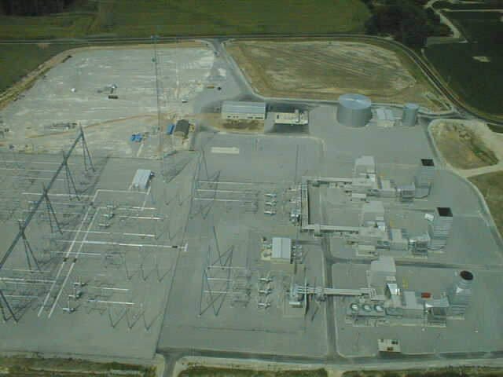
Plant Picture
Gleason Overview

Slide 5
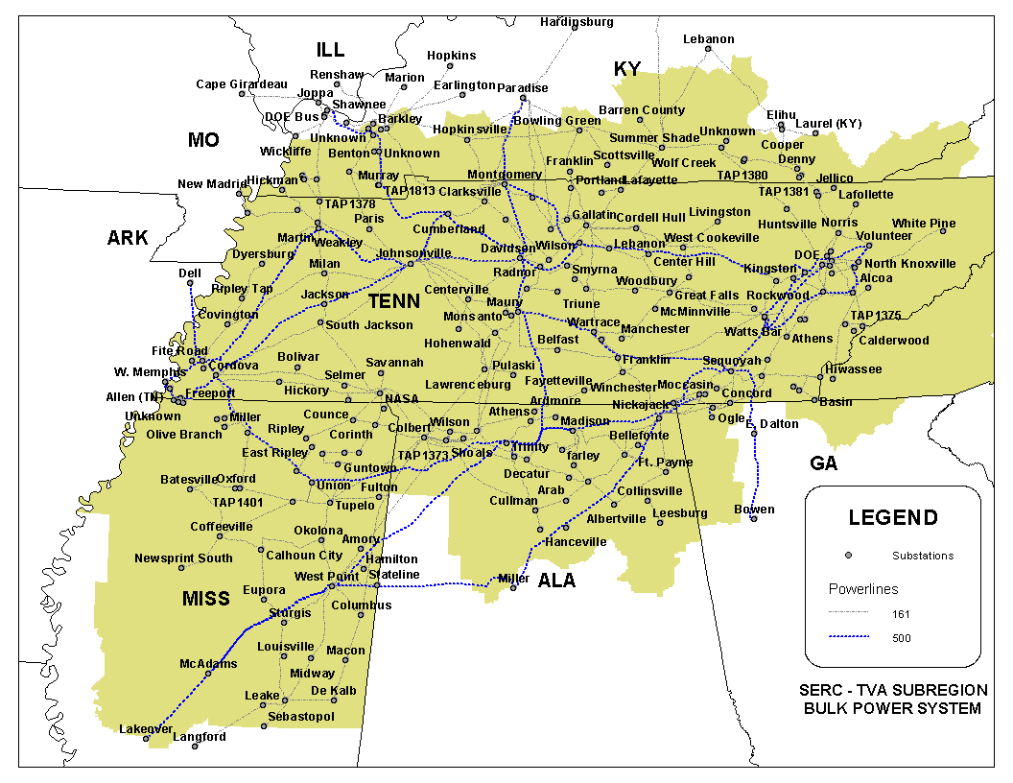
Regional Overview
Gleason Overview
Gleason Plant

Slide 6
Power Market Opportunities
Gleason Overview
Gleason Power I, L.L.C. is qualified as an Exempt Wholesale Generator and has authority to sell energy and capacity at market-based rates
TVA’s extensive 500 kV system provides system users excellent transmission reliability and reach
Gleason’s location in TVA and access to eastern U.S. electricity market provide sales opportunities into the wholesale power markets
Gleason provides access to TVA system with direct connections to 12 surrounding control area markets
Gleason is two utility wheels away from over 70 control area markets

Slide 7
Equipment Overview
Gleason Overview
Turbines: 1 Westinghouse 501 FC turbine and 2 Westinghouse 501 FD turbines with evap. cooling
Turbine Warranty Expiration: June 1, 2001
Switchyard Equipment: ABB, high-voltage interconnect breakers
Switchyard Configuration: single ring bus
Transformers: (3) ABB 160 MVA, 3 winding, single-phase, 18.0 kV/500 kV (2 FD) and (1) ABB 240 MVA, 2 winding, 3 phase, 13.8kV/500kV (1 FC)
Control System: WDPF
Generator Circuit Breakers: (3) ABB (11,500A)
Generator Voltages: 13.8 kV (FC (hydrogen cooled)) and 18 kV (FD (air cooled))
Plant Distribution Voltages: 4160V and 480V
GLEASON
ENGL
500 kV
TVA
Johnsonville
B
B
Switchyard
G1
B
B
1B,1C
B
G2
GSU1A
B
B
G3
TVA
GSU2
Weakley
B
B
Substation
Summer
Nominal
Winter
Unit MW Rating:
182
182
182 FD
175
182
182 FC
B = Breaker
GSU = Generator Step-up Unit

Slide 8
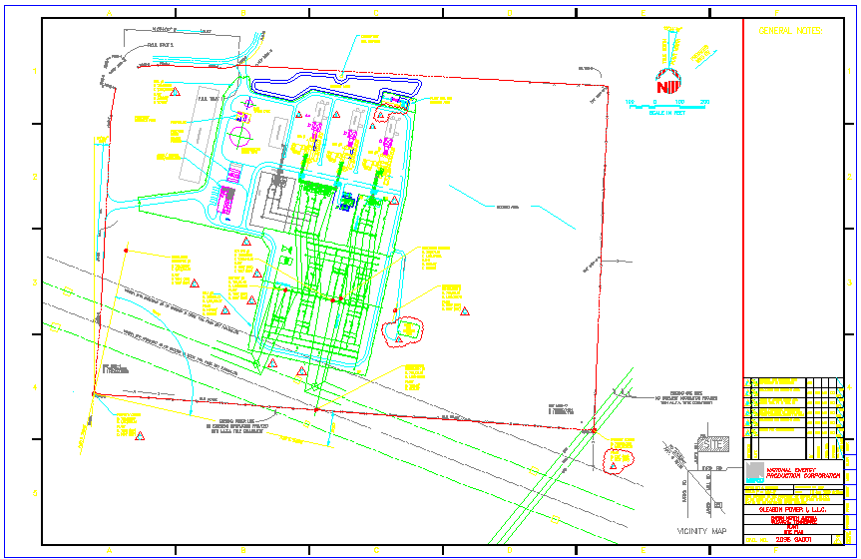
Plant Layout
Gleason Overview

Slide 9
Performance Results
Gleason Overview

Slide 10
Power Interconnection
Gleason Overview
Interconnected to 500 kV TVA line (Johnsville-Weakley) that traverses the site
As part of Gleason interconnection agreement, TVA required an upgrade of the Shelby substation:
Gleason reimburses estimates of upgrade costs incurred by TVA on a quarterly basis
Gleason receives credits dollar-for-dollar, in the amount of any Upgrade Costs paid which may be used to pay TVA for network, firm point-to-point, or non-firm point-to-point transmission charges
On December 31, 2009, TVA will pay to Gleason an amount equal to the difference between total Upgrade Costs paid by Gleason and sum of transmission credits used to date
Through September 2000, Gleason has paid to TVA $2.6 million of Upgrade Costs and transmission credits in the amount of $772,000 have been used
Estimated remaining construction costs are $24.9 million, to be paid from October 2000 through September 2002
Gleason’s purchaser will assume obligation to pay future upgrade costs and will be entitled to receive all existing and future credits and December 31, 2009 payment

Slide 11
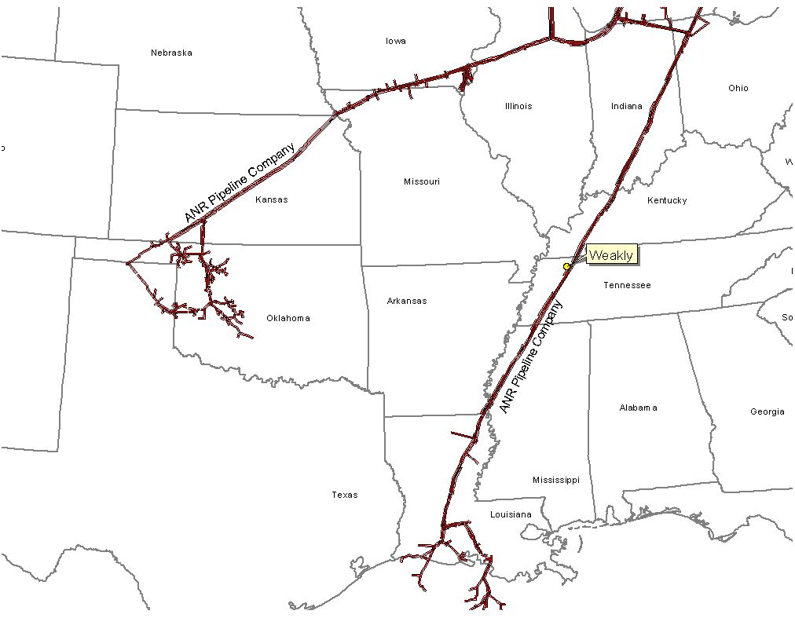
Gas Transportation
Gleason Overview
Pipeline: ANR Pipeline (“ANR”)
Delivery Point: ANR ML2 - Weakley County Interconnect
Base Contract:
Service: ITS-3/IPLS
Term: 10 years (Apr-Oct) beginning March 1, 2000
Volume: 93,000 MMBtu/d
Rate: $0.11 plus fuel and ACA from Chicago or SE LA
Fuel: 0.0% on backhaul; 2.69% on forward haul
Receipt Points: SE LA Header and Joliet, Ill.
Balancing: $0.02 per MMBtu/d balancing up to 93,000 MMBtu
Backup Contract: Capacity release or seasonal firm can be used. Additionally, Gleason is party to a Precedent Agreement with ANR providing Gleason ability to purchase 80,000 MMBtu of firm capacity from Chicago to Gleason plant-gate
Balancing: IPLS service subject to economic dispatching and pipeline operational conditions; balancing-in-kind; allows for uneven hourly flow at plant delivery point with even 24-hour supply flow
Other: ANR will maintain lateral and meter for $6,000 per year; ANR constructed interconnect and owns hot tap and Electronic Measurement System; reasonable effort to provide 560 psi; if pressure is below 560 psi on day Gleason nominates gas using ITS-3 agreement, ANR will waive IPLS for volumes parked

Slide 12
Plant Location
Gleason Overview

Slide 13
Control Area Status
Gleason Overview
Gleason control area, ENGL, has been designated a control area in accordance with NERC policy
Control area designation is valuable for point to point power sales and scheduling of power
Control area options for Gleason purchaser include:
control area services provided by TVA
control area re-established by purchaser in accordance with NERC procedures
control area and scheduling services provided by Enron affiliate under separate contract

Slide 14
Expansion/Conversion Opportunity
Gleason Overview
Gleason designed to facilitate future plant expansion and/or conversion to combined cycle
Request for interconnect expansion submitted to TVA in August 2000
Net heat rate could go from 10,900 Btu/kWh (HHV) currently to 7,000 (HHV), depending on equipment
Net output could go from 546 MW (nominal) currently to 850 MW (nominal), depending on equipment
Gleason conversion should take approximately 18 to 24 months
Installation of an SCR should facilitate getting a PSD permit for combined cycle operation

Slide 15
Environmental Specifications
Gleason Overview
Discharge Permit: Not Required
Air Permit: Non-PSD
NOx Control Method: Water injection
Compliance Method: CEMS
Limits: 249 T NOx per year
249 T CO per year
Actual Commission NOx: <25 ppm
Estimated Run Hours: 915

Slide 16
Operating Costs
Gleason Overview

Slide 17
Organizational Chart
Gleason Overview
Gleason is currently operated by Operational Energy Corp (“OEC”), an Enron Corp. subsidiary
It is anticipated that at closing, O&M contract with OEC will be terminated
Gleason personnel are currently employees of OEC

Slide 18
Legal Structure
Gleason Overview
Gleason Power I, L.L.C. (“Gleason Power”) leases the facility (including real property) from the Industrial Development Board of Weakley County for a term of 15 years beginning on September 16, 1999
Gleason Power has the right to buy the facility at any time during the term of the lease or within 90 days after the expiration thereof for $500.00
Gleason Power is a Delaware limited liability company and is 100% owned by Enron North America Corp.
Purchaser will acquire 100% of member interests in Gleason Power

