Slide 1

®
Energy Commodity Pricing and Price Risk Management In Volatile Markets
Gil F. Muhl
Vice President
AGA Conference
September 19, 2000
Washington DC

Slide 2
Primary Factors Influencing Commodity Prices
A Booming Economy - Strong Demand for Power Generation and Manufacturing
Declining Natural Gas Production
“Masking of Warmer Than Normal” Winters the Past Three (3) Years
U.S. Gas Storage Levels Lowest in Past Six (6) Years
Other Heating Fuels Showing Significantly Higher Prices & Lower Stock Levels
Notes:
<number>
<footer>
<header>
<date/time>
So how does the interstate gas market measure up to these policy objectives 10 years after restructuring began?
The market has matured, and has become more dynamic than ever before
Competition is intense, and regulated prices have become irrelevant in most markets. We experience discounting pressures on all of our systems except during peak periods. During periods of peak demand, pipelines continue to be limited by an annual average rates, while re-sellers in the bundled secondary market can charge market clearing prices for the delivered commodity.
The secondary market is vibrant. 20% of all firm capacity is contracted via capacity release programs.
As customers are increasingly able to access supply from different supply basins, the spread between traditional production area and market area prices have narrowed. Transportation rates have become a function of differentials between supply regions -- also an indication that maximum rates are irrelevant.
There are numerous pipeline projects proposed and in construction, including projects to import Canadian supplies, and projects to carry gas from mid-continent to eastern markets -- again the economics of these projects are driven by price spreads across the regions.
In search of higher netbacks and increased flexibility, natural gas producers are moving downstream into transmission through equity investments and capacity commitments.
And, during this period gas markets have grown -- fulfilling the Order 636 predictions that competitive markets could simultaneously serve the customer and promote the use of natural gas.

Slide 3
Other Factors Influencing Commodity Prices
Interdependence of Commodities/Convergence of Markets
Supply/Demand Imbalance - Make Up of Fuel Stack, Retirement of Old Plants, Maintenance, Availability of Fuels, Transmission Constraints, Environmental Concerns, Weather Seasonality, Demographics, Load Profiles
Information Received by Traders
Inflation Rates and Interest Rates
Notes:
<number>
<footer>
<header>
<date/time>
So how does the interstate gas market measure up to these policy objectives 10 years after restructuring began?
The market has matured, and has become more dynamic than ever before
Competition is intense, and regulated prices have become irrelevant in most markets. We experience discounting pressures on all of our systems except during peak periods. During periods of peak demand, pipelines continue to be limited by an annual average rates, while re-sellers in the bundled secondary market can charge market clearing prices for the delivered commodity.
The secondary market is vibrant. 20% of all firm capacity is contracted via capacity release programs.
As customers are increasingly able to access supply from different supply basins, the spread between traditional production area and market area prices have narrowed. Transportation rates have become a function of differentials between supply regions -- also an indication that maximum rates are irrelevant.
There are numerous pipeline projects proposed and in construction, including projects to import Canadian supplies, and projects to carry gas from mid-continent to eastern markets -- again the economics of these projects are driven by price spreads across the regions.
In search of higher netbacks and increased flexibility, natural gas producers are moving downstream into transmission through equity investments and capacity commitments.
And, during this period gas markets have grown -- fulfilling the Order 636 predictions that competitive markets could simultaneously serve the customer and promote the use of natural gas.

Slide 4
U.S. Natural Gas Spot Price Outlook
(in $/MMBtu Henry Hub, LA.)
2001
5.14
$5.24
2000
5.01
4.30
4.25
2001
4.20
4.05
3.47
2.99
2.66
2.75
2000
$2.37
1999
1999
projected
historical
Source: NYMEX (9-11-00 close)

Slide 5
U.S. Residential Natural Gas Prices Since 1984
(1999$/MMBtu)
2000/2001
Winter Estimate
1984
1986
1988
1990
1992
1994
1996
1998
2000
1985
1987
1989
1991
1993
1995
1997
1999
Residentials will purchase gas this winter
at real prices last paid in 1986/87
Source: U.S. DOE (EIA)

Slide 6
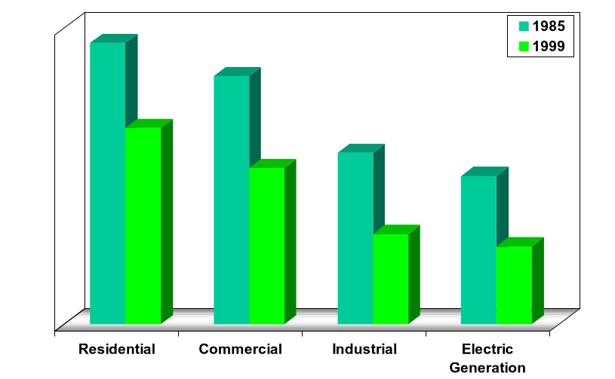
U.S. Average Gas Prices by Sector 1985 vs. 1999 (Restated in 1999$/MMBtu)
-30%
$9.48
-37%
$8.36
$6.62
-48%
$5.79
-48%
$5.27
$5.00
$3.04
$2.62

Slide 7
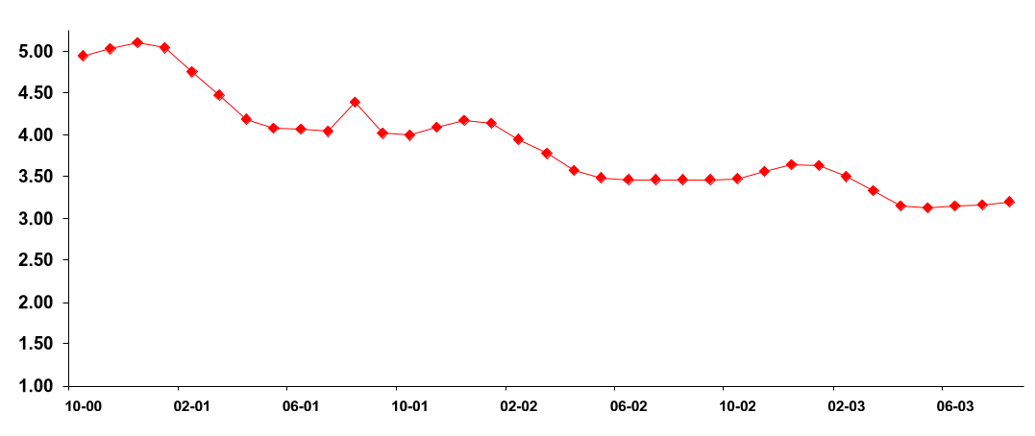
Backwardation Price Curve for Wellhead Gas
($/MMBtu)
$5.15
This Winter
$4.25
Next Winter
$3.75
Winter 02/03
Source: NYMEX (September 11, 2000)

Slide 8
Estimated Storage Inventory
2000 Est.
10% Lower
Than 5 Year
Average
2000 Est.
12% Lower
Than 1999

Slide 9
Historical Winter Weather

Slide 10
Taking No Action is Accepting the Risk of Market Volatility
Spot Price Electricity ERCOT
NYMEX Natural Gas
NYMEX Sweet Crude
30-year Treasury Bond Yield
Power
Oil
Gas
Bonds
Notes:
<number>
<footer>
<header>
<date/time>

Slide 11
Increased Price Volatility has Become Common in the Gas Industry
January 1980 - January 2000
1999 Dollars
1996 Winter
Peak
Nominal Dollars

Slide 12
What Are The Main Drivers Of Short-term Price Volatility?
Affects Supply Affects Demand
Weather
Economic/business conditions
Stock levels
Pipeline capacity
Operational difficulties
Lack of timely,
reliable information

Slide 13
Commodity / Risk Management
Notes:
Welcome,
I'm a bit new to EES, but not to Enron - so while I have industry knowledge I am learning to applyit to the N.A. retail environment. What I am going to attempt to do is explain as simply as possible how our commodity solution will work for Square D and to explain some of your options and the fundamentals of the future energy markets.

Slide 14
Summary of Products Traded
Natural Gas
- Physically and Financially
- All Pipes and Locations in
North America
- Internationally
Electricity
- Physically and Financially
- All locations in U.S.
- Internationally
Crude Oil
- WTI
- WTS
- Brent
- Dubai
- Bow River
- Light Louisiana Sweet
- Heavy Louisiana Sweet
- Various California Crudes
Petrochemicals
- Benzene
- Tolulene
- Xylene
* Mixed Xylene
* Paraxylene
* Orthoxylene
- Styrene
- Methanol
- Mono-Ethylene Glycol (MEG)
- Cyclo Hexane
- Pure Theraphtalic Acid (PTA)
- Propylene
- MTBE
Plastics
- Ethylene
- Propylene
- Polypropylene-various grades
- Polyethylene-various grades
© 2000 SW-2060214-<number>

Slide 15
Summary of Products Traded (cont)
Fuel Oil
- NYH/GC 1%
- NYH/GC 3%
- Europe 1%
Natural Gas Liquids
- Ethane
- Propane
- Normal Butane
- Iso-Butane
- Natural Gasoline
Coal
- Domestic and International
- All Grades All Locations
Emissions Credits
- SO2
- NO2
Distillates and Others
- Jet Fuel-#54, #55, DERD
- Low Sulphur #2
- Gasoline-All Grades
- Alkylate
- Naptha
- Condensate
- Crack Spreads
Weather Derivatives
- Swaps, Caps, Collars, Floors
Pulp and Paper Products
- LWC No. 5, 34lb- 240lb
- Newsprint
- Linerboard
- OCC, ONP Recycled Materials

Slide 16
Keys to a Successful Risk Management Program
Risk management is used to decrease uncertainty - not to beat the market
Belief that future outcomes can be changed
Doing nothing is the same as speculating
Risk management is a dynamic, iterative process
Have a view on the market and be prepared to change course

Slide 17
Hedging Minimizes Price Risk Speculating Means Unknown Outcomes
Hedging
Speculating
Specific objective driven
Offset by cash position
Reduces volatility exposure
Reduced likelihood of large losses
Stable production costs
Profit driven
No offsetting cash position
Volatility driven
Reduced Increased likelihood of large losses or gains
Full spectrum from home run to bankruptcy
Notes:
<number>
<footer>
<header>
<date/time>

Slide 18
Price Risk Continuum
Many pricing options exist between fixed and index
Fixed Price
Volatility
Index Price
Less
More
Notes:
<number>
<footer>
<header>
<date/time>
We already know that Square D prefers to be toward the index side of this continuum. We want to stress the options however along the spectrum.

Slide 19
Commodity Products Values and Limitations

Slide 20
Alternatives to Hedging Still Leave You Exposed to Price Risk
Some companies simply buy spot
- No supply commitment, no price protection
Buying “on index” (i.e. Monthly Price)
- Supply commitment, but no price protection
- Benefit is always being “at the market”
- Exposed to risk of price spikes
- Can be used with financial price protection
Doing nothing is a decision - you are choosing to speculate on the direction of energy prices

Slide 21
Why Hedge? Market-Based Pricing Is Speculation
Commodity Market
Exposure
Consumer Product
Company
End Product Markets -
Pricing Pressure
Price
Price
Time
Time
Problems
Fluctuating earnings and margins
Focus resources on commodity price forecasting rather than controllable costs

Slide 22
Commodity Price Stability Risk Management Objectives
Hedge Commodity
Exposure
Consumer Product
Company
End Product Markets -
Pricing Pressure
Price
Price
Time
Time
Benefits
Reduces price risk exposure
Insures against adverse price movement
Reduces earnings variability
Facilitates planning/budgeting
Enhances credit worthiness

Slide 23
Commodity Deal Structures

Slide 24
2000/01 Winter Price Hedging ($/MMBtu)
8/31/00 Lock-in Price for Dec. ‘00/Jan ‘01 - $4.80/MMBtu
Historic 2000 prices through August
Jan/Feb 2000 Hedge for Dec. ‘00/Jan ‘01 - $2.79/MMBtu
Jan
Feb
Mar
Apr
May
Jun
Jul
Aug
2000

Slide 25
Products For Energy Buyers In A Rising Market
Fixed Price
Index Swap
Price Ceiling (Call Option)
Index Plus (with Cap)
Costless Price Cap
Index Minus (with Floor)
Extendable Options
Double-Up Sale
Reset Price Options
Price Collars
Participating Collars
Bull Call Spread
Weather Options
Straddles (Volatility)

Slide 26
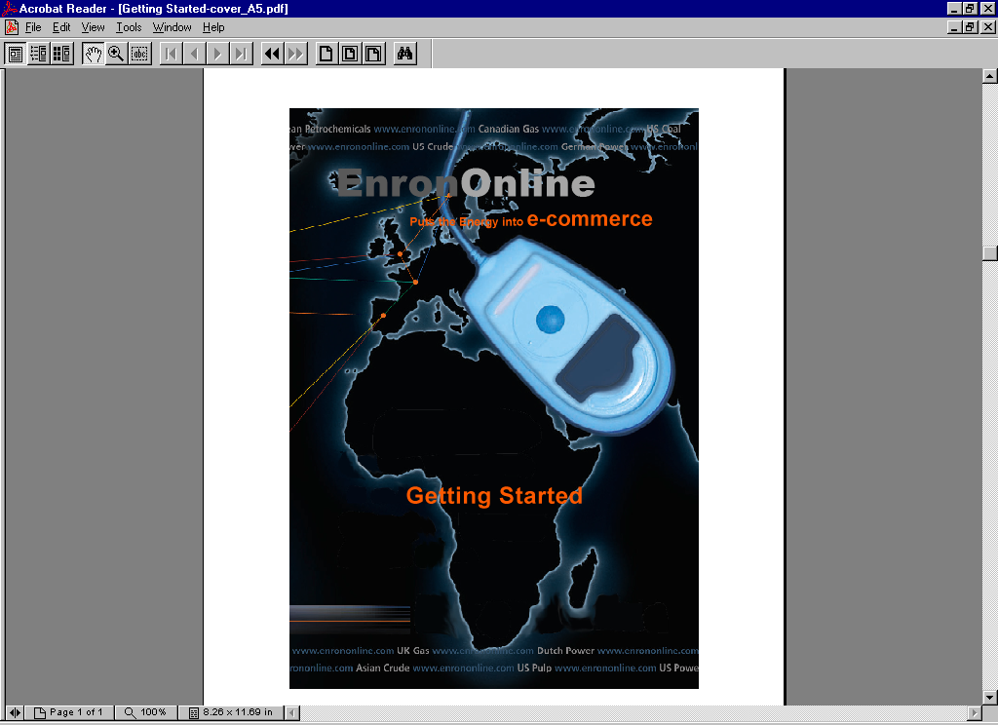
The Future: Electronic Commerce Comes of Age

Slide 27
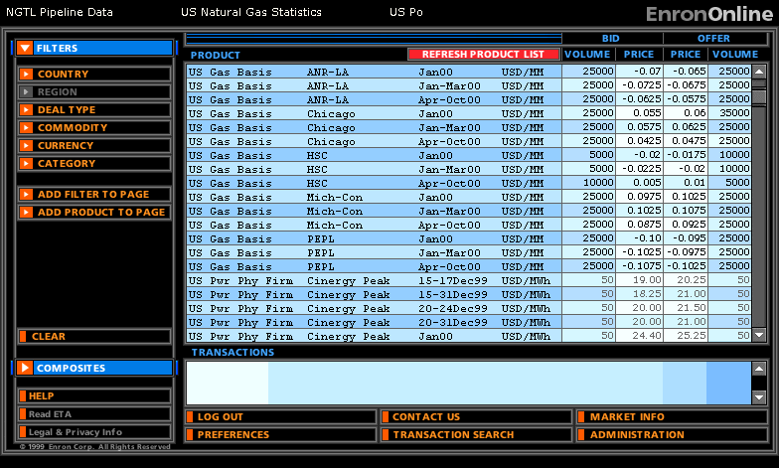
Crude and Products are also available
© 2000 SW-2060214-<number>

Slide 28
A Real Energy Crisis - 1970’s Headlines
INDUSTRIAL OUTPUT DOWN 1% IN JANUARY-
SHORTAGES BLAMED
CARTER WARNS OF “IMPENDING CRISIS”
FORD, GOVERNORS DISCUSS GAS SHORTAGES
GAS DIVERSION CURBED
ENERGY GAS BILL SIGNED
LAW WAIVED TO EASE GAS TRANSPORT
BLIZZARD STRIKES GAS-SHORT STATES
FACTORIES CLOSED IN 15 STATES
FPC HIKES ‘NEW’ NATURAL GAS RATE; COURT ORDERS REFUND
DATA LACKING
SCHOOLS CLOSED FOR LACK OF HEAT
COMPANY BUYS OWN GAS FIELD
GAS WITHHOLDING CHARGES DENIED
FPC REPRISALS CHARGED
FPC ACTS TO EASE FUEL SHORTAGES
WITHHOLDING OF GAS NOT FOUND
RESERVES FALL IN ‘75
INDUSTRY ACCUSED
UTILITIES BLAMED
OVERCHARGE SUIT SETTLED

Slide 29
®

