Slide 1
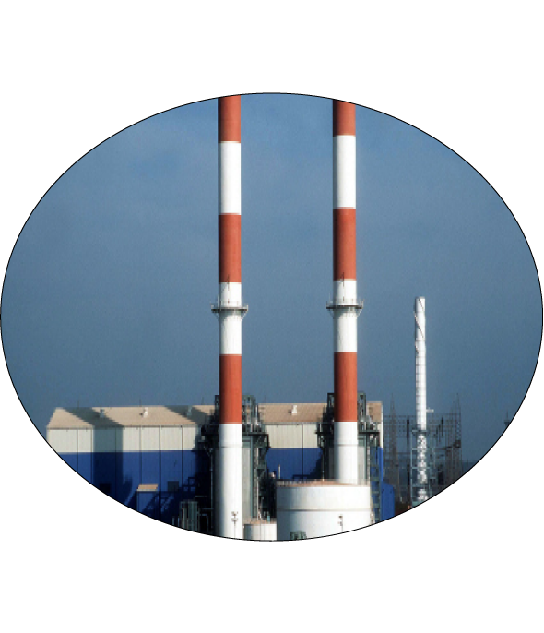
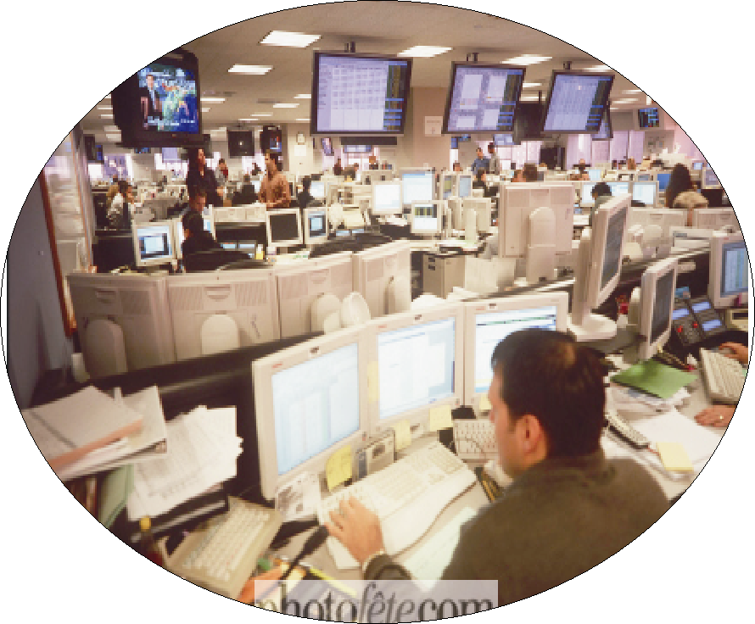


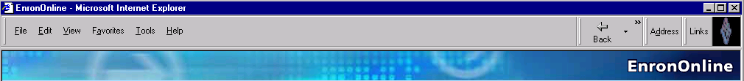
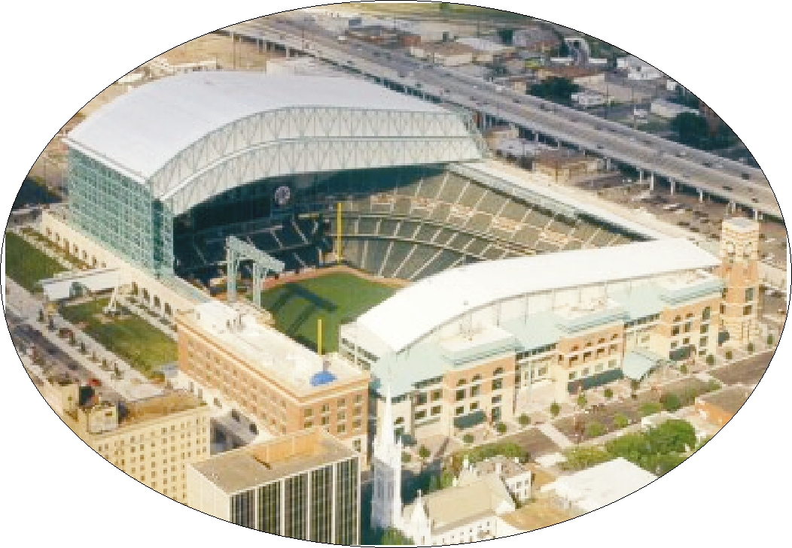
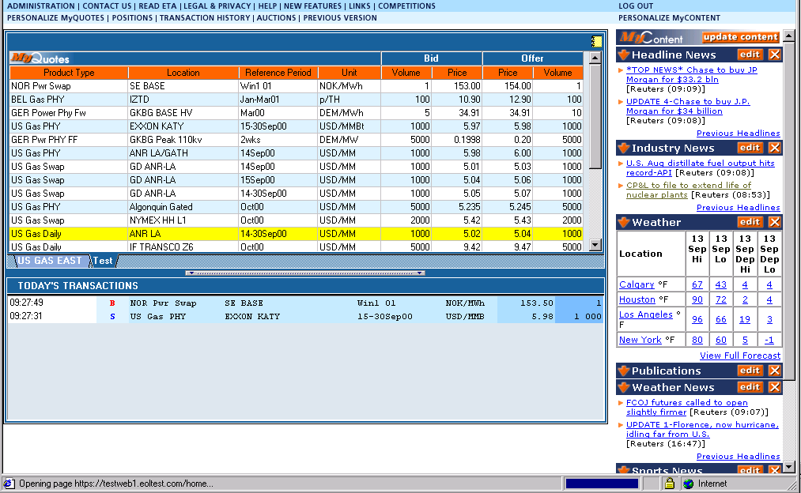
Enron Evolution

Slide 2
First Revolution (circa 1985- )
Wholesale Open Access with Interstate
Natural Gas Transportation
Transwestern Northern Natural Florida Gas Northern Border
Pipeline
Bundled
Pipeline Sales
Commodity
Sales
Enron Gas Marketing
From One to Two Profit Centers

Slide 3
Second Revolution (circa 1990- )
Adding Financial Market Making to Physical Delivery
Physical
Financial
Matching supply to demand
Geographical network
Logistics
Structured term products
  Swaps/options
Market making/liquidity
Credit

Slide 4
Third Revolution (circa 1995- )
Expanding the Market-making Model
Freight
Credit
Metals
Commodity
Product
Financial
Bandwidth
Australian Power & Gas
Pulp & Paper
Coal
Weather
Scandinavian Power & Gas
Plastics
Emissions
Financials (interest rate, equity)
UK Power & Gas
Electricity
Currencies
Natural
Gas
1985
1986
1987
1988
1989
1990
1991
1992
1993
1994
1995
1996
1997
1998
1999
2000
2001
* Lighter shading indicates a developing market
Darker shading indicates a mature market

Slide 5
Fourth Revolution (circa 1997- )
Retail Services
Customer
Receives
Enron Competencies
Improved Core Business Focus
Redeployment of Capital
Reduced Operating Costs
Risk Transference
Access to World-Class Capabilities
Energy Management
Asset Management
Financial / Capital
Risk Management
Leverage Enron’s core competencies to complement Customer’s business

Slide 6
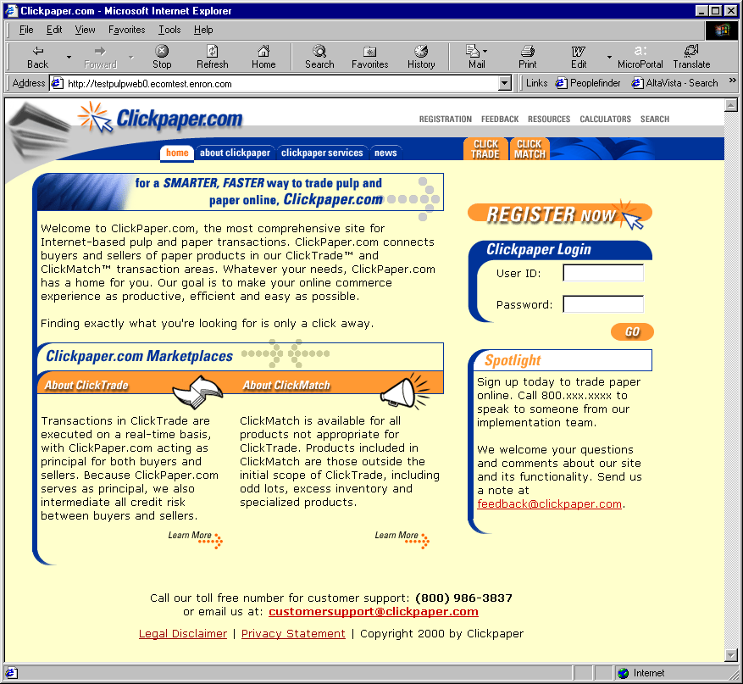
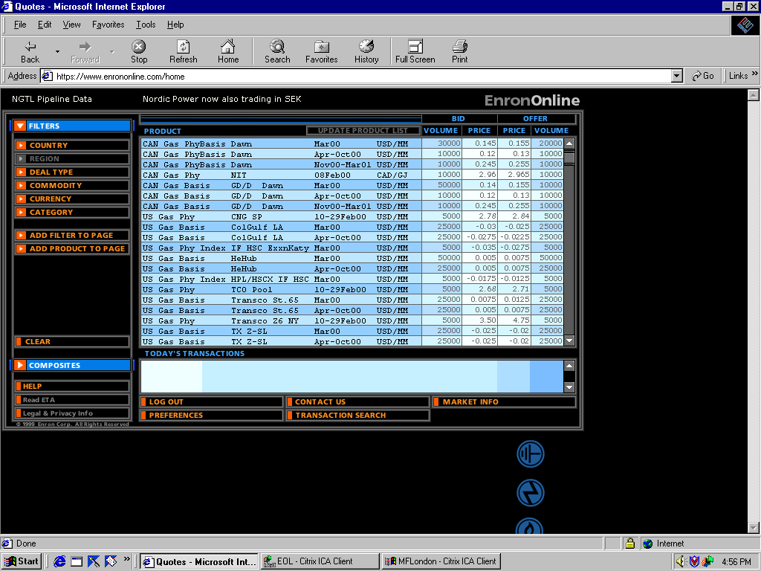
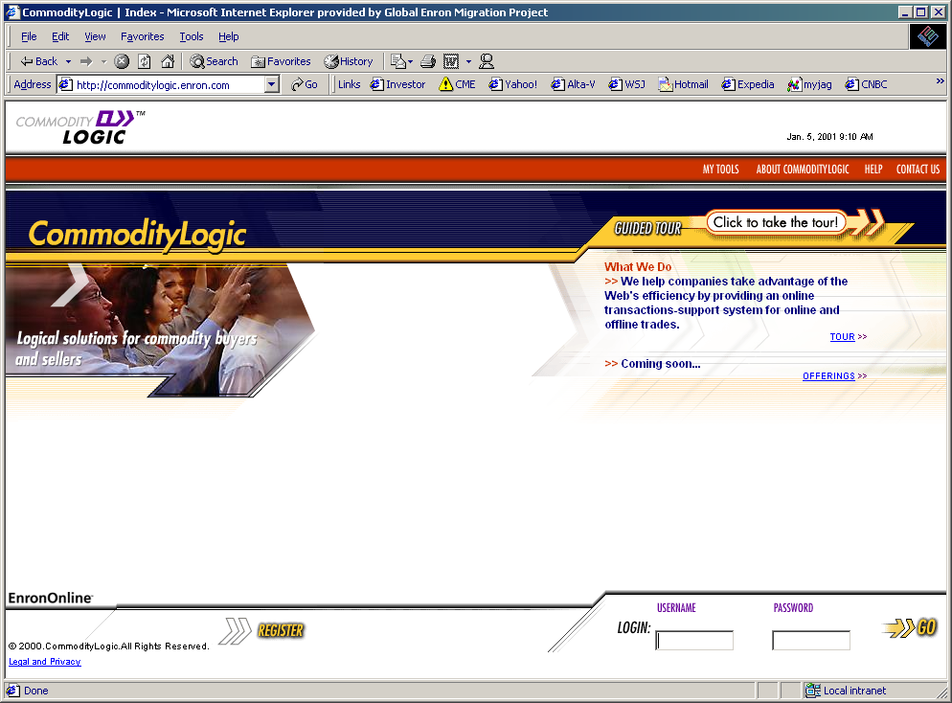
Fifth Revolution (circa 1999- )
EnronOnline
V2.0
Leveraging Information Technology
Clickpaper.com
EnronOnline
CommodityLogic
November 1999
Enron Credit
Using information technology to help markets mature, improve client interaction, open new markets, and create network efficiencies
2001

Slide 7
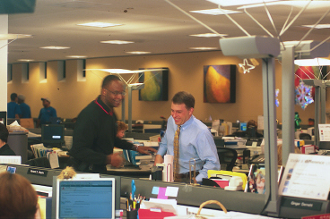
The Underground Revolution - Corporate Culture
Before
After

Slide 8
Enron Today

Slide 9

®
Global
Services
Wholesale
Services
Retail
Services
Broadband
Services
Portland
General
Global
Assets
Transmission
Services
North America
Power
Gas
Europe
Power
Gas
Metals
Other
Industrial
Markets
Global
Markets

Slide 10
Enron Total Revenues
(In Millions)
100,789
100,189
40,112
31,260
20,293
8,984
9,189
13,289
5,460
6,415
7,986
4,970
4,373
4,526
4,631
5,698
1986
1987
1988
1989
1990
1991
1992
1993
1995
1999
2000
2001*
1994
1996
1997
1998
Source: Statistical Supplement
* Through June 30, 2001

Slide 11
Industry Maturation Curve
Mature Industry
Enron Global Services
Growth Industry
Enron Wholesale Services
Enron Retail Services
Emerging Industry
Enron Global Markets
Enron Industrial Markets
Enron Broadband Services

Slide 12
Enron’s Wholesale Businesses
Natural Gas
Power
Coal &
Emissions
Global Crude &
Products
Shipping
Weather
Financial
Trading
LNG
Insurance
Freight
Pulp &
Paper
Merchant
Investments
Metals

Slide 13
Promoting Efficient Logistical Networks
MAPP
MAIN
NPCC
ECAR
COB Hub
ComEd
Hub
PJM Hub
Cinergy Hub
MACC
WSCC
SPP
SERC
Paulo Verde Hub
TVA
Hub
ERCOT
Henry Hub
Entergy Hub
FRCC
Offices
Energy Exchanges
Energy Partnerships
Third-Party Capacity
Leased Gas Storage
Power Plants
In Operation
Sale Pending
Under Development
Marketing Activity
Gas Coal
Power Metals

Slide 14
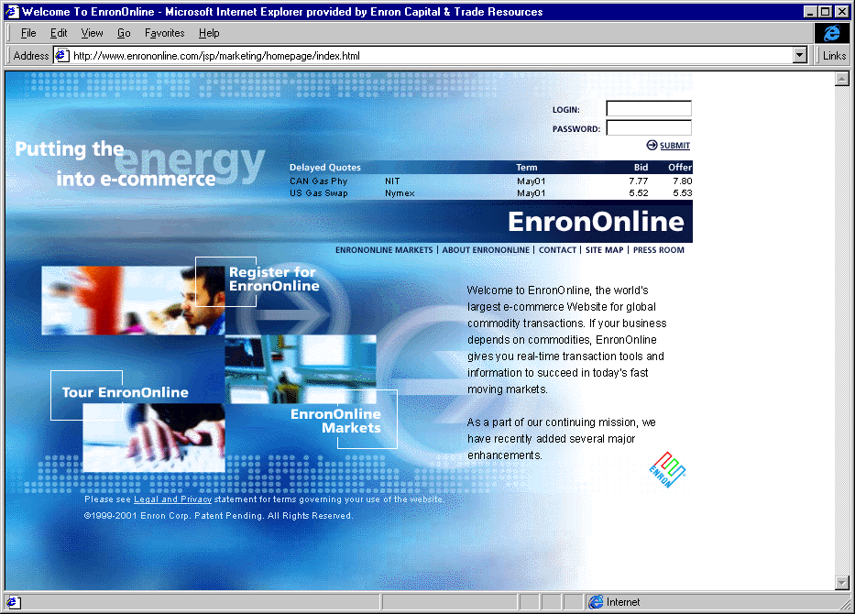
Converging Virtual and Physical Networks
Third- Party
Systems
MAPP
MAIN
ECAR
NPCC
COB Hub
ComEd
Hub
MACC
PJM Hub
WSCC
SPP
Cinergy Hub
Paulo Verde Hub
SERC
Henry Hub
Entergy Hub
TVA
Hub
ERCOT
Arcos
1,200 MW
FRCC

Slide 15
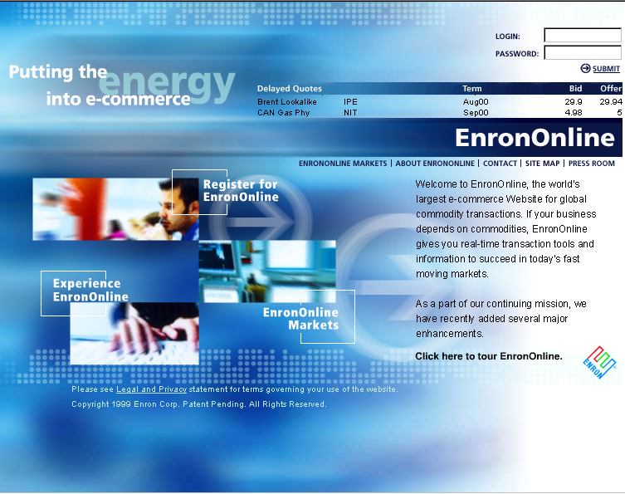
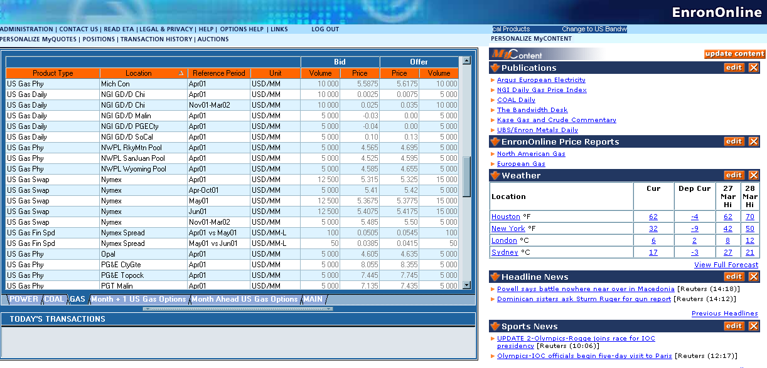
EnronOnline
The Free, Internet-based, Global Transaction System Which Allows Counterparties to View Real Time Prices From Enron’s Traders and Transact Instantly Online

Slide 16
Commodities Available on EnronOnline
Argentine Natural Gas
Asian Crude & Products
Asian Metals
Australian & Japanese
Weather
Australian Power
Austrian Power
Bandwidth
Belgian Natural Gas
Canadian Natural Gas
Canadian Power
Credit Derivatives
Dutch Power
Dutch Aluminium
Emissions
European Coal
European Weather
German Power
International Coal
Japanese Aluminum
LME Metals Contracts
LPG
Nordic Power
Oil & Refined
Products
Petrochemicals
Plastics
Pulp & Paper
Sea Freight
Spanish Power
Swiss Power
UK Metals
UK Metal Spreads
UK Natural Gas
UK Power
US Gas Pipeline Capacity
US Gas Spreads
US Lumber
US Metals
US Natural Gas
US Power
US Steel
US Weather

Slide 17
Enron Retail Services
Energy Outsourcing
The Comprehensive Long-term Management of Energy-related Assets, Information, and Facility Services.
Energy Asset Management
Energy
Information
Management
Commodity Management
Capital
Design & Engineering
Construction
Operations &
Maintenance
Facility Management
Commodity supply and metering in deregulated markets
Tariff management in regulated markets
Utility representation
Tariff arbitrage
Reduced commodity consumption through optimization of capital investment
Reduced demand charges through load management
Lower operation and maintenance costs
Improved worker productivity and/or customer experience through better environment
Increased labor productivity through elimination of craft specialization and application of best practices
Reduced administrative and purchasing costs
Competitive cost of capital
Customized realization
Asset/Contract monetizations
Reduced administrative costs
Consolidated billing for services
Correction of utility over billing
Improved decision making through better use of information

Slide 18


























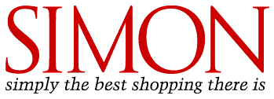


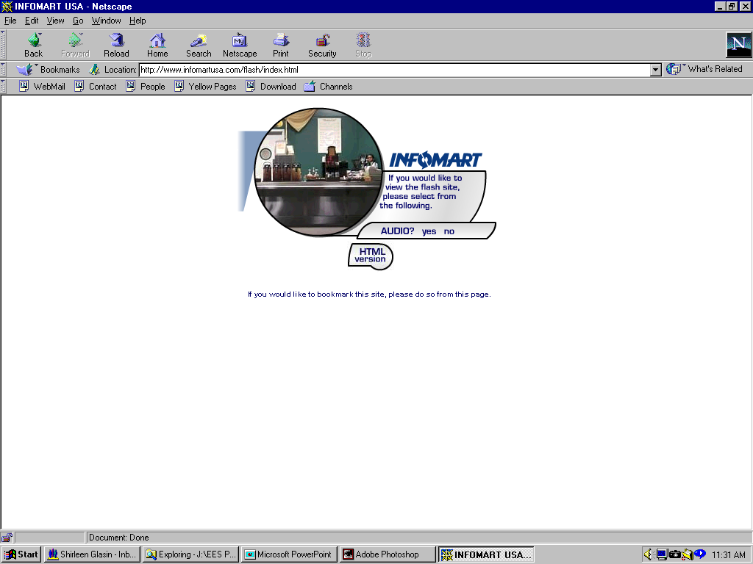












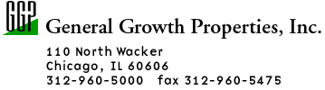
























Partial List of Enron Retail Clients
Industrial / Manufacturing
High Technology
REITs / Retail
Structure
Hotels
Food Processing
Sports Venues
Financial Institutions
Public Sector/Institutions
Notes:
-Upstream / downstream supply chain
-nat.l / 10 yr. deal
-Others not here - confidentiality - competitive advantage
-BICCGeneral - Leading manufacturer of specialty cable products to the telecommunications and high-tech markets through 60 facilities, world-wide
manufacturing - quebecor, rigid, firestone, polaroid, ownes corning, TRW, springs, solo, tyco, O-I, Pilkington, Eli Lilly
high tech - pacific bell, IBM, lucent, applied materials, GTE, infomart, compaq,cypress, sony, cisco, triquint
hotels / reits - hyatt, simon, glacier, excelsior hotel, hilton, starwood, general growth properties
food processing - packaged ice, tricon, ocean spray, rich’s, suiza
sports venues - enron field, giants, browns
financial institutions - chase, bank of america, fidelity, prudential
public sector/institutions - general service admin, los angeles county, veterans affairs

