Slide 1


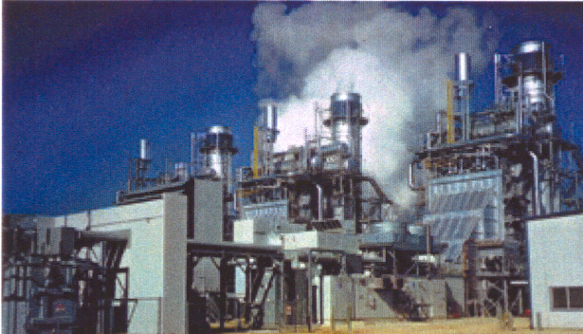


Hedge Strategy Discussion: Load Serving Entities

Slide 2
Northeast Power Origination/Mid-Marketing Team
Northeast Regional M.D. | Dave Duran | (713)853-7364
NY Mid-Marketing | Janelle Scheuer Steven Plauche | (713)853-1639
NY Origination | Michael Brown | (713)853-1930
PJM Mid-Marketing | Pearce Hammond Joe Gordon | (713)853-7379
PJM Origination | Mark Bernstein | (713)853-7516
Nepool Mid-Marketing | George Wood Jason Thompkins | (781)729-1854 (713)853-4766
Nepool Origination | John Llodra | (978)449-9936
Northeast Analyst | Jennifer Stewart | (713)853-9700

Slide 3
Discussion Highlights
Enron at a Glance
Recent Influential Events-- California Crisis
Hedging Volatility
Developing a Risk Management Program
Developing an Execution Strategy

Slide 4

Enron at a Glance

Slide 5

Enron at a Glance
Transportation & Distribution
Retail Energy
Wholesale
Energy
Broadband Services
Net Works
Natural Gas Transportation and Electric Distribution
Energy Outsourcing to Commercial and Industrial Customers
Marketing and Delivery of Energy Products Worldwide
Bandwidth Management and Broadband Delivery Services
Expansion Vehicle for New Commodity Market Penetration

Slide 6
Enron Wholesale Services
Regional Energy Networks
North America
Europe
Offices 11 Employees 2,730
Offices 18 Employees 1,520
Offices
Australia
Marketing Activity
Gas
Power
Japan
Global Markets
Crude & Products, Coal & Emissions, Weather, LNG
Industrial Markets
Pulp, Paper & Lumber, Metals, Steel
Global Assets
Asset Operations Worldwide
Enron Net Works

Slide 7
Enron at a Glance
Enron Corp
Total Assets
(Millions)
Enron Corp
Total Revenues
(Millions)
Enron Corp
Net Income
(Recurring, Millions)
$53,000
$1,300
$101,000
$33,381
$893
$40,112
$453
$11,966
$9,105
$226
$8,984
$4,631
1989
1994
1999
2000
1989
1994
1999
2000
1989
1994
1999
2000

Slide 8
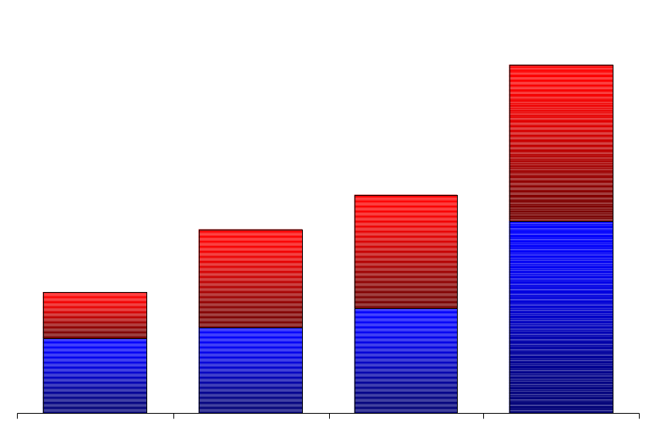
Enron at a Glance
Enron Wholesale Physical Volumes
(BBtue/d)
51,715
Enron Wholesale Financial Settlements
(BBtue/d)
196,148
Power and Other
Gas
32,429
27,308
99,337
17,970
75,266
49,082
1997 1998 1999 2000
1997 1998 1999 2000

Slide 9
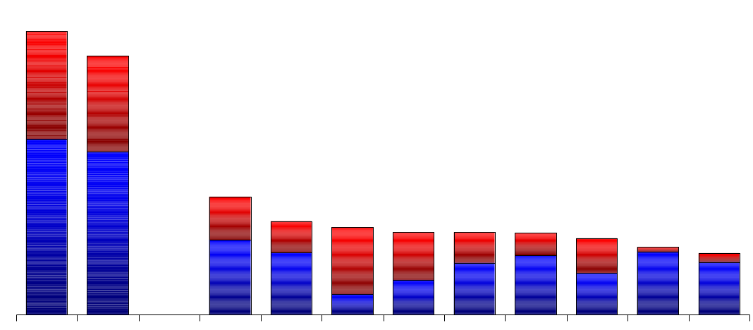
Enron at a Glance
45.6
41.7
Power
Gas
19.2
15.0
14.1
13.3
13.2
13.1
12.3
10.9
9.9
Enron FY00
Enron
Duke
Aquila
AEP
PG&E
Reliant
Dynegy
Southern
Coral
Sempra
3Q YTD
Source: Gas Daily, Power Markets Week, Oil Daily

Slide 10
Enron Wholesale Service Average Daily Transactions
Enron at a Glance
8,000
7,900
6,000
EnronOnline
Traditional
4,000
2,000
650
0
Nov Dec. Jan. Feb. Mar. April May June July Aug. Sept. Oct. Nov. Dec.
1999
2000

Slide 11
Enron at a Glance
Core Capabilities
Physical delivery of energy commodities
Risk management
Finance
Asset development
Multi-commodity
Reliability
Flexibility
Access to information
Inter-regional market opportunities

Slide 12
Recent Influential Events-- California Crisis

Slide 13
This page intentionally left blank.

Slide 14
California Crisis Conditions
1. Expected skew between supply and demand
2. Forward price not supportive of new build
3. No recent power plant development
4. Limited new development expected in short term
5. Long lead time necessary to develop large
generating facilities (3-5 years)
6. Excessively restrictive environmental rules
7. Price caps
8. Utility objective to beat index
9. Illiquid market
10. Threats to take over generators by state authority
11. Majority of load primarily unhedged

Slide 15

NYISO Conditions
1.
2.
3.
4.
5.
6.
7.
8.
9.
10.
11.

Slide 16
Hedging Volatility

Slide 17
Hedging Volatility
Hedging
Specific objective driven
Offset by position
Reduces volatility exposure
Reduces likelihood of large losses/gains
Stable expenses
Speculating
Profit driven
No offsetting position
Volatility driven
Increased likelihood of large losses/gains
Full spectrum-- from home run to bankruptcy

Slide 18
Hedging Volatility
Mwh
Date

Slide 19
Hedging Volatility

Slide 20
Developing a Risk Management Program

Slide 21
Developing a Risk Management Program
Determine Objectives
Lock in margins
Meet budget and earnings expectations
Increase financial flexibility/ lower cost of capital
Develop growth strategy with price certainty
Ensure financial health
Disaster Insurance
Equalize cash flows
Reduce rate payer exposure
Increase stock price
Capture existing imbedded optionality in contract to maximize value
Secure at better than index

Slide 22
Developing a Risk Management Program
Quantify Exposure
Analyze existing portfolio
Load
Generation
IPP contracts
Other supply contracts
Financial hedges
Other hedges (pump storage, TCCs, Fuel Adjustment Clause)
Other risks (Unit outage exposures, sensitivity to weather)
Analyze exposure characteristics
Price exposure passed through
Political risk threshold
Shape of exposed profile
Elasticity: impacts of a price increase
Risk of individual price spikes or average price

Slide 23
Developing a Risk Management Program
Assess Management’s Risk Tolerance and Style
Percentage to hedge
Risks to hold to keep prices low (basis, ICAP, shape)
Threshold levels
Risk appetite/view of selling optionality to reduce prices
Importance of maintaining benefit in a low price environment
Sophistication level
Determine Implied view of market
Up, down, or neutral
Understand Available Instruments– (See product descriptions)
Swaps
Options
Combinations

Slide 24
Developing a Risk Management Program
Understand Available Instruments (cont.)-- SWAP
Hedge Payout Hedge Performance
Market View | Inferior Superior
Very Bullish
Bullish
Neutral
Bearish
Very Bearish
Volatile
Enron pays LSE
LSE pays Enron
Market Swap

Slide 25
Developing a Risk Management Program
Understand Available Instruments (cont.)-- CAP
Hedge Payout Hedge Performance
Market View | Inferior Superior
Very Bullish
Bullish
Neutral
Bearish
Very Bearish
Volatile
Enron pays LSE
LSE pays Market Price
Market Cap

Slide 26
Developing a Risk Management Program
Understand Available Instruments (cont.)-- COLLAR
Hedge Payout Hedge Performance
Market View | Inferior Superior
Very Bullish
Bullish
Neutral
Bearish
Very Bearish
Volatile
Enron pays LSE
LSE pays Market Price
LSE pays Enron
Market Collar

Slide 27
Developing a Risk Management Program
Understand Available Instruments (cont.)– 50% PART SWAP
Hedge Payout Hedge Performance
Market View | Inferior Superior
Very Bullish
Bullish
Neutral
Bearish
Very Bearish
Volatile
LSE pays Enron (effectively shares in 50% of benefit below strike)
Enron pays LSE
Market 50% Participating

Slide 28
Developing a Risk Management Program
Determine Customized Strategy
Swap Program: exclusively use swaps, increasing lock in commodity price as it falls (with upper threshold)
Options Program: exclusively employ options, maintain upside potential, pay upfront fee as in insurance
Portfolio Program: i.e. diversify products in strategy to obtain optimal performance
Active Hedging Program: monitor market and make continuous adjustments to maximize performance

Slide 29
Developing a Risk Management Program
Match objectives to strategy
Hedging Objective | Strategy
Disaster Protection | Buy Calls
Cash flow Smoothing | Buy Collar
Hedge Gain Maximization | Various Combinations of Derivatives
Strategic or Project Hedge | Buy Long Term Swap

Slide 30
This page intentionally left blank.

Slide 31
Developing a Risk Management Program
Match strategy to exposure
Load Profile/Shape Management: Seasonal
Typical Seasonal Summer Load Profile
*Data represents the 1999 average and peak summer loads on weekdays in May- Sept.. from 8 a.m. until 11 p.m.

Slide 32
Solution: Swap

Slide 33
This page intentionally left blank.

Slide 34
Developing a Risk Management Program
Problem: Load profile/Shape management (cont.)
Daily Load Shape & Seasonal Load Shape
$
Pool
LSE
e-
e-
$
Fixed
Rate Payers

Slide 35
Solution: Swap (CFD)
$
Fixed $

Slide 36
This page intentionally left blank.

Slide 37
Developing a Risk Management Program
Match strategy to exposure
Load Profile/Shape Management: Daily
Typical Daily Summer Load Profile
*Data represents the 1999 average and peak hourly loads on weekdays in July and Aug. from 8 a.m. until 11 p.m.
HOUR

Slide 38
Solution: Swap

Slide 39
Developing a Risk Management Program
Match strategy to exposure
1. Blocks of energy Go long or short “fringe” areas. Swap coverage based on fixed quantity throughout coverage period.
2. Load Growth Option: Fix costs for given volumes, LSE can increase coverage at anytime, according to contract terms.
3. Fixed Profile Coverage: Swap coverage based on fixed profiles for on-peak and off-peak days and various temp. categories
4. Flexible Shape Profile: Swap coverage based upon self-shaping, with minimum percentage of peak applied
5. Full Load Following: Swap coverage based on actual usage
Least expensive Most expensive
Highest Risk Lowest Risk

Slide 40
Developing a Risk Management Program
Match strategy to exposure
Manage unhedged “shoulders”
Overhedge in those time frames of concern
Include some fixed profile or load following to minimize potential exposure in time of concern
Super peak swap 5x8
Cap (does not create second exposure if overhedged)

Slide 41
This page intentionally left blank.

Slide 42
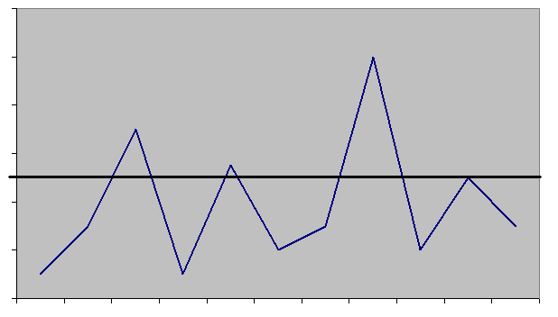
Developing a Risk Management Program
Political Threshold & Price Exposure Pass Through
Disaster insurance, Take full advantage of low prices
PRICE
Disaster/ Political Threshold
Market
TIME

Slide 43
Solution: Out of the money Cap
Cap Strike

Slide 44
Equals ‘Disaster Insurance’
Effective Price

Slide 45
This page intentionally left blank.

Slide 46
Developing a Risk Management Program
Problem: Political Threshold Price; Exposure Pass Through
$
Pool
LSE
e-
e-
$
Rate Payers

Slide 47
Solution: Cap. Enron pays LSE when market exceeds specified strike price so cost is not passed on to customers
Upfront fee
$
*Premium Payment:
-Optionality in other contracts
-Sell floor
-Cash

Slide 48
Developing an Execution Strategy

Slide 49
Developing an Execution Strategy
Identify Market Difficulties
Illiquidity
Cannot execute large size
Cannot deal (even moderately) without moving market
NYISO price revisions
Limited financial products actively traded
Operational Risk
Unit trips not within control

Slide 50
Developing an Execution Strategy
Outline method of Price Discovery
Small group of counterparties (confidentiality)
Enron-on-Line (EOL)
Work with Enron to gain market knowledge
Best time to execute transaction
Market flows
Unit outages
Weather conditions

Slide 51
Developing an Execution Strategy
Determine Execution Strategies Given Market Limitations
Quiet execution
Enron-on-Line
Specify parameters
Work with Enron to adjust parameters given market conditions and product availability
Include alternate hedging products in portfolio
Weather hedges
Heat rate swaps/ Btu swaps (link to gas price)
Unit contingent outage option

Slide 52
Developing an Execution Strategy
Determine Execution Strategies Given Market Limitations (cont.)
Transact when liquidity is highest (i.e. morning)
Hedge in most active zones possible (consider taking on basis risk if designated zone is highly illiquid)
Hedge in active terms: off-peak often illiquid, consider hedging off-peak by transacting in on-peak market
Focus on commodity exposure. (Largest exposure is to commodity risk, which is also the most liquid component)
Very expensive to hedge ICAP and ancillaries (cost to hedge may be significantly above current market due to illiquidity)
Dependent on recovery mechanism-- fuel hedge (i.e. natural gas) may be a consideration

Slide 53
Developing an Execution Strategy
Determine Execution Strategies Given Market Limitations (cont.)
Specify parameters
Lay out buying program– dollar cost averaging. Set up targets to execute and thresholds as stop loss targets
Determine who has authority to transact
Obtain necessary approvals, so as not to miss market opportunities
Ensure documents are complete

Slide 54
®

