Slide 1
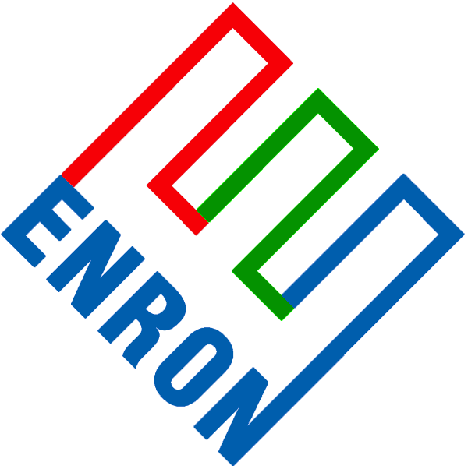
Huber Energy
San Juan Gathering System Discussion

Slide 2
Background
Huber owns gathering assets in the San Juan basin used for its Energy’s equity production
Huber does not consider the gathering system to be a core asset and is interested in monetizing the asset
Within the last year, Huber was in discussions to divest of the asset, but the discussions ended when it became apparent that the proceeds from the sale would flow directly back to J.M. Huber Corp, rather than staying within Huber Energy, the E&P business unit
Huber remains interested in monetizing the gathering system; however, any agreeable transaction structure must allow Huber Energy to benefit from the proceeds of the monetization
ENA’s speculation is that a transaction could be structured whereby Crestone acquires the assets for fair market value and ENA, acting as a clearinghouse, allows Huber to realize the gathering system’s value through a commodity-based transaction

Slide 3
Potential Structure
For discussion and illustrative purposes, the following assumptions have been made:
  The fair market value of Huber’s San Juan gathering assets is $15 MM
  The book value of the gathering assets is $10 MM
  The outright cash payment to Huber for the gathering system cannot be less than the book value (no loss is triggered on the asset sale)
  Huber Energy, which is J.M. Huber Corp’s E&P business unit, can retain the gain on sale if the value is realized through a commodity based contract
  The respective parties can reach agreement such that each is compensated in the following manner:
    Huber – monetizes non-core asset at fair value, allowing capital to be re-deployed in core E&P business
    ENA – extracts value through structuring of commodity contract
    Crestone – acquires gathering asset at fair value
Huber
Gathering Assets
ENA
Gathering Assets
Crestone
$10 MM (Cash)
$15 MM (Cash)
Commodity Swap (see next slide)
($5 MM in-the-money)
Initial Cash Impact:
cash $10 MM
swap present value $ 5 MM
+$15 MM
Earnings Impact:
gain on sale $ 0
derivatives gain $ 5 MM
Note: FASB may require that the gain resulting from the swap liquidation be allocated over the original term of the swap.
Initial Cash Impact:
Pmt to Huber ($10 MM)
Pmt from Crestone $15 MM
+$ 5 MM
Earnings Impact:
gain on sale $5.0 MM
M2M loss ($4.8 MM)
+$0.2 MM
Note: The earnings estimate above assumes the swap can be structured such that ENA can mark a loss of less than $5 MM.
Initial Cash Impact:
Pmt to ENA ($15 MM)
Earnings Impact:
No immediate earnings impact for Crestone. Earnings will be realized on an accrual basis.

Slide 4
Commodity Swap Structure
The commodity swap in this transaction could be structured in a number of different ways. Below is an example of a financial structure based on the Inside FERC San Juan index.
The market price for April 2002 through March 2005 IF EPNG San Juan index swap is $3.03 per MMBtu
The present value of a 50,000 MMBtu per day swap for the above mentioned term that is $0.10 per MMBtu in-the-money is $5 million
ENA
$3.13 per MMBtu
Huber
ENA Swap Contract
Market
(5 Year financial swap on 50,000 per day)
IF EPNG San Juan Index
$5 MM (Cash)

Slide 5
Questions/Comments
What is the book value of the assets?
What is the market value of the assets?
Does Huber Energy get to retain the sale proceeds up to book value?
  If not, is the magnitude of the gain (market value less book value) large enough to motivate Huber Energy to transact?
Is it feasible for Huber to sell the gathering system for less than book value?
  If so, more value could be realized by Huber Energy through the swap
If Huber intends to immediately liquidate the swap, the transparency of the transaction would be significant, as Huber would likely obtain a firm quote from an outside party just prior to closing the deal. This would reduce ENA’s ability to extract a sizeable margin.
This structure assumes simultaneous execution of all contracts between ENA, Huber, and Crestone. ENA would not be exposed to equity risk from the gathering assets.
The transaction, as presented, would effectively provide Enron a low-cost source of off-balance sheet financing.

