Slide 1
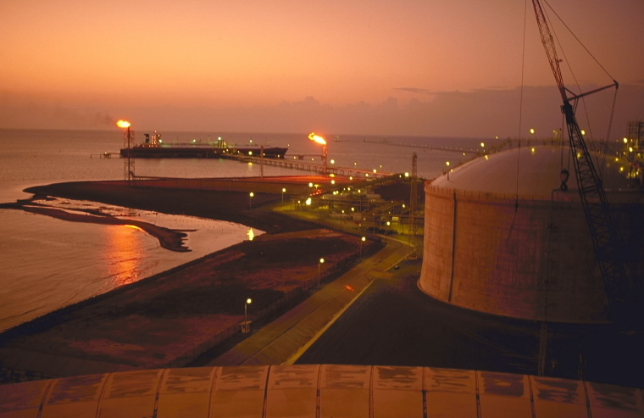
GASTECH 2000
November 14 -17, 2000
Houston, Texas
Natural Gas Utilization –
Will LNG stay competitive?
AMOS AVIDAN
Bechtel Corporation

Slide 2
Competitive Gas Projects
Outline
  Gas export competition heats up
  Keys to successful gas projects:
    Government, customer, and developer commitment
    Lower costs, better technology
    Project planning and execution

Slide 3
Competitive Gas Projects
LNG Markets and Projected Demand (mta)
Major expansions
in Korea
Cove Point
16 terminals
in Japan
Bilbao
Elba Island
X
X
E. Asia:
1999 - 67
2010 - 113
Puerto Rico
Europe/Med:
1999 - 20
2010 - 40
Dabhol
Americas:
1999 - 3
2010 - 15
India:
1999 - 0
2010 - 12
Brazil
Receiving terminals
Existing
Engineering/construction
Planned
Reactivation
Potential new terminals
World LNG trade, mta
1999 - 90
2010 - 180
X

Slide 4
Competitive Gas Projects
LNG Supply
Norway
Alaska
Kenai
Sakhalin
Abu Dhabi
Das Island
Algeria
Skikda
Arzew
Camel
Iran
Trinidad
ALNG 1
ALNG 2&3
Egypt
Oman
Libya
Yemen
Brunei
Qatar
Qatar Gas
Ras Laffan
Malaysia
I &II
Tiga
Venezuela
Nigeria
Angola
Indonesia
Arun
Badak
Tangguh
Australia
Liquefaction Plants
Existing
Engineering/construction
Planned

Slide 5
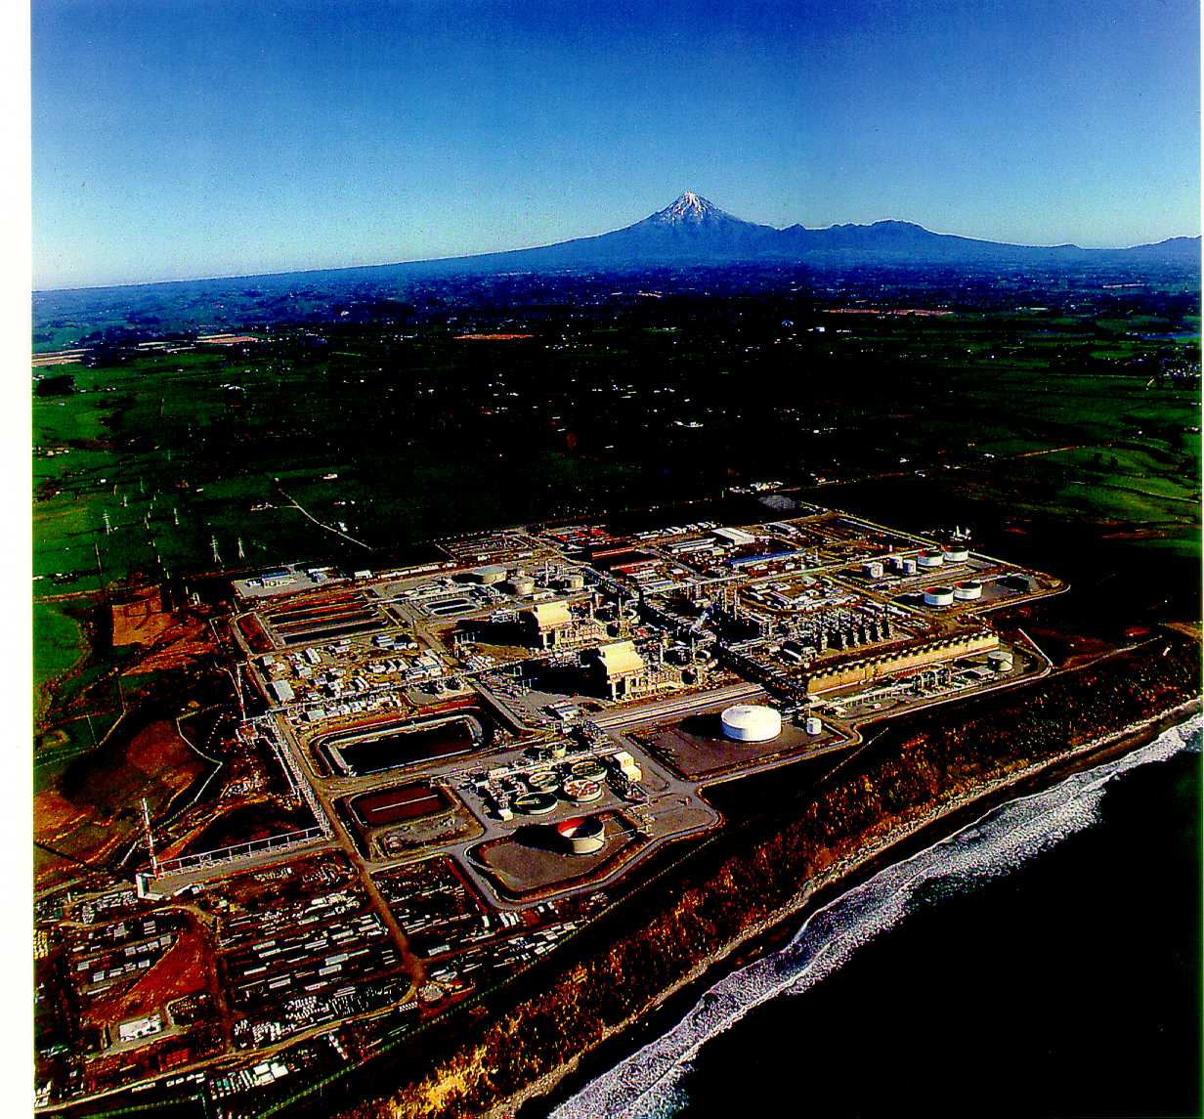
Competitive Gas Projects
GTL Prospects are Improving
  GTL costs are down to about $25,000/bbl (USGC)
  Niche projects – need local incentives, risk mitigation
  GTL is product driven:
  clean fuels, chemicals, and specialty products
The world’s first GTL plant
(New Zealand, 1985 Bechtel)

Slide 6
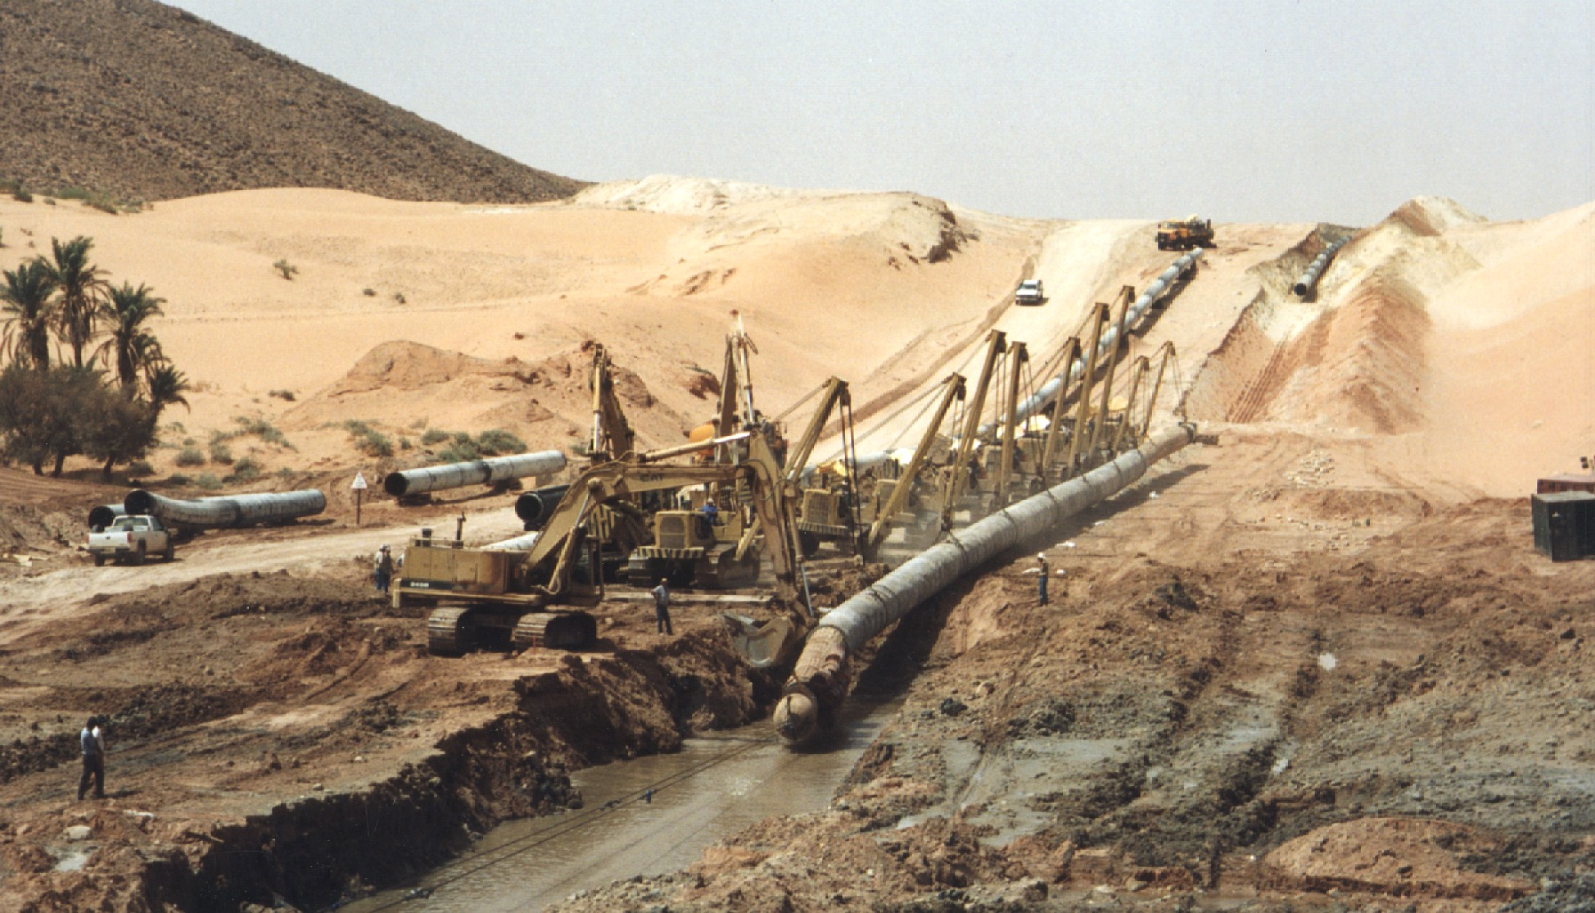
Competitive Gas Projects
LNG vs. Gas Pipelines
Technology has lowered pipeline costs faster than LNG costs
  P/L competitive at up to 6,000 km
  Geopolitical considerations
  Stability of route
  Market Logistics
The Maghreb export pipeline from Algeria to Spain (Bechtel)

Slide 7
Competitive Gas Projects
New gas transport options
Other gas transport options are not likely
to become major competitors to LNG by 2010:
  Gas hydrates
  Compressed natural gas
  Long distance electric lines, etc.

Slide 8
Competitive Gas Projects
LNG Project Development Trends
  Have project development schedules and costs improved much since the 1970s?
  Gold-plating in the 1980s and early 1990s?
  Current trends favor integrated project teams, standardized designs, the use of design competitions, and more value engineering

Slide 9
Competitive Gas Projects
Typical LNG Project Schedule (from LNG2, 1970)
Year 1
Year 2
Year 3
Year 4
Year 5
Year 6
Negotiations
Government/Administrative Approvals
Corporate Structure
Liquefaction Plant
Pre-Engineering
Detailed Engineering
Ordering
Site Preparation
Plant Construction
Port Construction
First Production
Ships
Pre-Order Activity
Orders Placed
Scheduling Delay
Construction Ship 1
Outfit Ship 1
Trials Ship 1
Ready Ship 1
Reception Terminal
Pre-Engineering
Detailed Engineering
Ordering
Site Preparation/Civils
Plant Construction
First Send Out
From “World LNG Trade in the Seventies,” Filstead, LNG-2 (1970)

Slide 10
Competitive Gas Projects
LNG Project Development History
Years

Slide 11
Competitive Gas Projects
Liquefaction Plant Owners Costs
$ / tpa
700
600
500
Mostly economy of scale
(3.5/1)^{0.65}=2.2
400
Single
Train
300
200
100
0
65-70
70-75
75-80
80-85
85-90
90-95
95-99
‘00
Trinidad
Train 1
Trinidad
Trains 2 and 3
Adapted From: bp 7/00 strategy presentation (www.bp.com/alive_assets/downloads)

Slide 12
Competitive Gas Projects
ALNG Has Set New Standards
Improvement over 1998 IPA Best-in-Class Benchmarks
Adapted from: “New gas for Europe - The Atlantic Mediterranean Basin”, S. K. Welch, BP, The European Summer Gas Conference, London 23rd June 2000

Slide 13
Competitive Gas Projects
Project Execution – A. the Traditional Approach
Scoping
FEED
EPC
Contractor A
Contractor B
Bid
Bid
Owner specs
EPC contractor (B) does not add value to
scoping, technology selection, specs, and FEED
Technology selection
Cost basis: 100
Schedule (from start of FEED): 60

Slide 14
Competitive Gas Projects
Project Execution – B. FEED Design Competition
Scoping
FEED
EPC
Contractor A
Contractor B
Bid
Contractor B
Owner specs
Bid selection
Cost basis: 80
Schedule (from start of FEED): 48

Slide 15
Competitive Gas Projects
Project Execution – C. Integrated Project Team
Scoping
FEED
EPC
Contractor B
Contractor B
Contractor B
Negotiate
Negotiate
Choice of specs and technology
Cost basis: 70
Schedule (from start of FEED): 42
Comparison: Cost Schedule
A - Traditional 100 60
B - Design Competition 80 48
C - Integrated team 70 42

Slide 16

Competitive Gas Projects
Atlantic LNG - Project Successes
  Optimized Phillips Cascade liquefaction process
  Concept to first production – 6.5 years
  Train 1 EPC – 34 months
  Owners cost of $225/ton – a record for a single train
  (Trains 1 - 3 average less than $200 - lowest cost new LNG)
  World-class safety record
  Contract variations < 3 percent

Slide 17
Competitive Gas Projects
Summary
  The keys to successful LNG projects:
    Government and developer commitment
    Leading edge, low-cost technologies
    Superior project planning and execution
  The importance of project execution strategy:
    FEED design competitions can lower costs and shorten schedules
    Integrated project teams can improve performance further

