Slide 1

Gas Pipeline Group

Slide 2
Gas Pipeline Group
Key Component of Enron’s Energy Strategy
Strong Returns with Consistent Earnings and Cash Flow
Solid, Competitive Position in All Markets Served
Market-Oriented Business Approach
Key Ties to Other Enron Businesses

Slide 3
Enron’s Gas Pipeline Group
Northern Border
Throughput (BBtu/d)
9,182
8,800
Northern Natural Gas
Transwestern
Florida Gas
1998
1999
Operates 32,000 Miles of Natural Gas Pipelines
Serves Customers in 21 States
Transports 15% of U.S. Natural Gas Demand

Slide 4
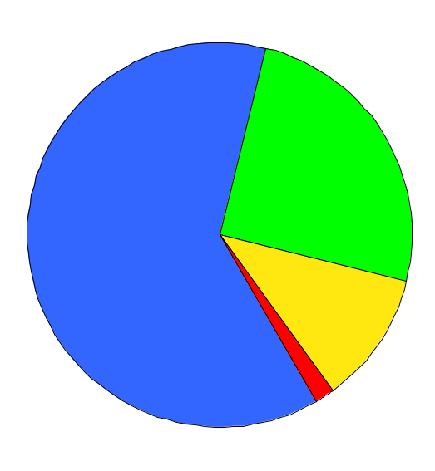
Financial Highlights
Income Before Interest and Taxes
(Millions)
1999 Net Income Contributions*
$380
$351
Transwestern
(100% Owned)
Northern
Natural Gas
(100% Owned)
Florida Gas
(50% Owned)
Northern Border
(8% Owned)
1998
1999
* Estimated

Slide 5
Northern Natural Gas Company
Western
Canadian Basin
Attractive, Growing Markets
Serves Major Utilities, Industrials and Marketers
Flexible Operations and Innovative Services
Extensive Interconnections with Major Pipelines
Cutting Edge Storage and Risk Management Products
Flexible Pricing and Terms
Multiple-Year Contract Extensions
Over 85% of Revenues Comprised of Demand Charges
Montana
Montana
North
Dakota
Minnesota
Michigan
South
Dakota
Wyoming
Wisconsin
Rocky Mountain Basins
Iowa
Nebraska
Illinois
Hugoton
Basin
Kansas
Missouri
Anadarko
Basin
New Mexico
Oklahoma
Permian
Basin
Texas
16,463 Miles
4.3 Bcf/d Peak Capacity
Storage
4,000 MW of Generation Proposed in Market Area

Slide 6
Transwestern Pipeline Company
2,487 Miles
1.6 Bcf/d Peak Capacity
Serves the Growing California Market
Benefiting from Changing U.S. Gas Flows
Bi-Directional Flow Capabilities Provide Optionality
New Flexible Services
Expansion Opportunities
140 MMcf/d to California
Over 90% of Revenues Comprised of Demand Charges
Nevada
Colorado
Utah
San Juan
Basin
Kansas
Anadarko
Basin
California
Oklahoma
Arizona
New Mexico
Permian
Basin
Texas
14,000 MW of Generation Proposed in California

Slide 7
Florida Gas Transmission
Only Major Pipeline Serving Rapidly Growing Peninsular Florida
Extensive Access to Production
Over 90% of Revenues Comprised of Demand Charges
Track Record of Continued Expansion
Alabama
Georgia
Louisiana
Texas
Mississippi
Texas and Louisiana Onshore
Mobile Bay and Deepwater Supply
Florida
Additional Gulf of
Mexico Supply
4,795 Miles
1.5 Bcf/d Peak Capacity
2.4
2.1
1.7
1.4
.9
13,000 MW of Generation Proposed in Florida
.8
Phase I
Phase II
Phase III
Phase IV
Phase V
Phase VI
1987
1991
1995
2001E
2002E
2003E
Capacity (Bcf/d)

Slide 8
Florida Gas Transmission
Continued Expansion Opportunities
Phase IV
Phase V
Phase VI
Capacity
(MMcf/d)
250
400
300
Contract
Term
(Years)
20
20
--
Cost
(Millions)
$270
$420
$400
Expected In-Service
Spring
2001
Spring
2002
Early
2003
Pipe
Compression
Existing
Phase IV
Ft. Myers
Phase V

Slide 9
Northern Border Pipeline Company
Low Cost Link Between Canadian Reserves and Midwest Market
Transports Nearly 25% of Canadian Gas to the U.S.
Fully Contracted Under Long-Term Agreements
Expansion Opportunities
Unique Cost of Service Tariff; 100% Demand Charges
Western
Canadian Basin
Monchy
North Dakota
Williston
Basin
Minnesota
Montana
Wisconsin
South Dakota
1,214 Miles
2.4 Bcf/d Peak Capacity
Chicago
Iowa
North
Hayden
Illinois
Indiana
Existing Pipe
Project 2000 Expansion
4,000 MW of Generation Proposed in Illinois

Slide 10
Summary
Strong Returns with Consistent Earnings and Cash Flow
Solid, Competitive Position in All Markets Served
Market-Oriented Business Approach
Key Ties to Other Enron Businesses

