Slide 1
New Technology:
The Starline 2000 & 200 Gas Main and Service Rehabilitation Process
Presenter: Ted T. Fiala

Slide 2
Starline Applications
Starline 2000 process application for mains
  4-inch through 24-inch diameter
  Multiple 45 degree bends
  Cast Iron or Steel
  Inches W.C. pressure through 60 psig systems
Starline 200 process application for services
  ¾ -inch through 4-inch diameter
  Multiple bends/offsets
  Inches W.C. pressure through 60 psig systems

Slide 3
Benefits of CIP liners for Natural Gas Systems
Significant savings compared to traditional replacement methods.
Bonding/adhesion improved due to sandblasting cleaning process.
Ability to tap existing services using internal robotics reduces restoration costs.
New services connections can be made using traditional tapping equipment due to adhesion improvements.
Service life of Starline CIP liners is tested to be greater than 30 years.

Slide 4
STARLINE 2000 Process Steps

Slide 5
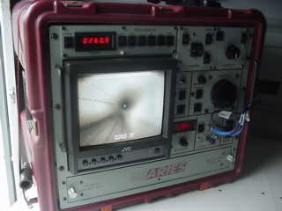
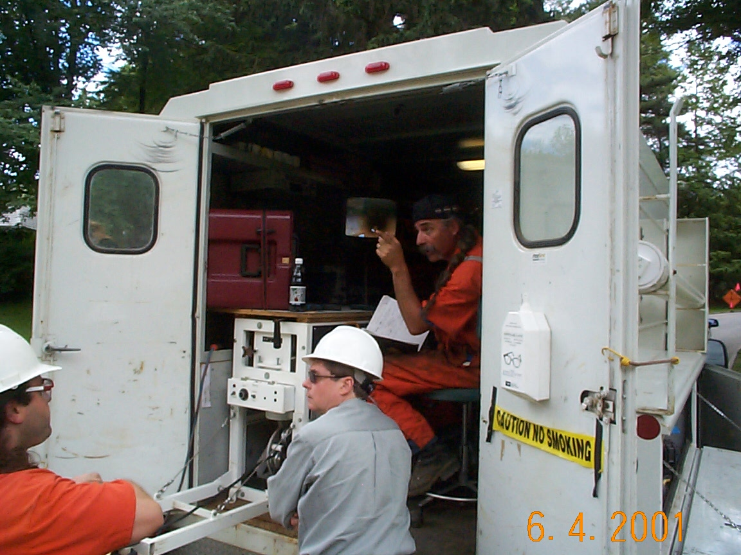
Once decontaminated, the main is visually inspected using a robotic camera

Slide 6
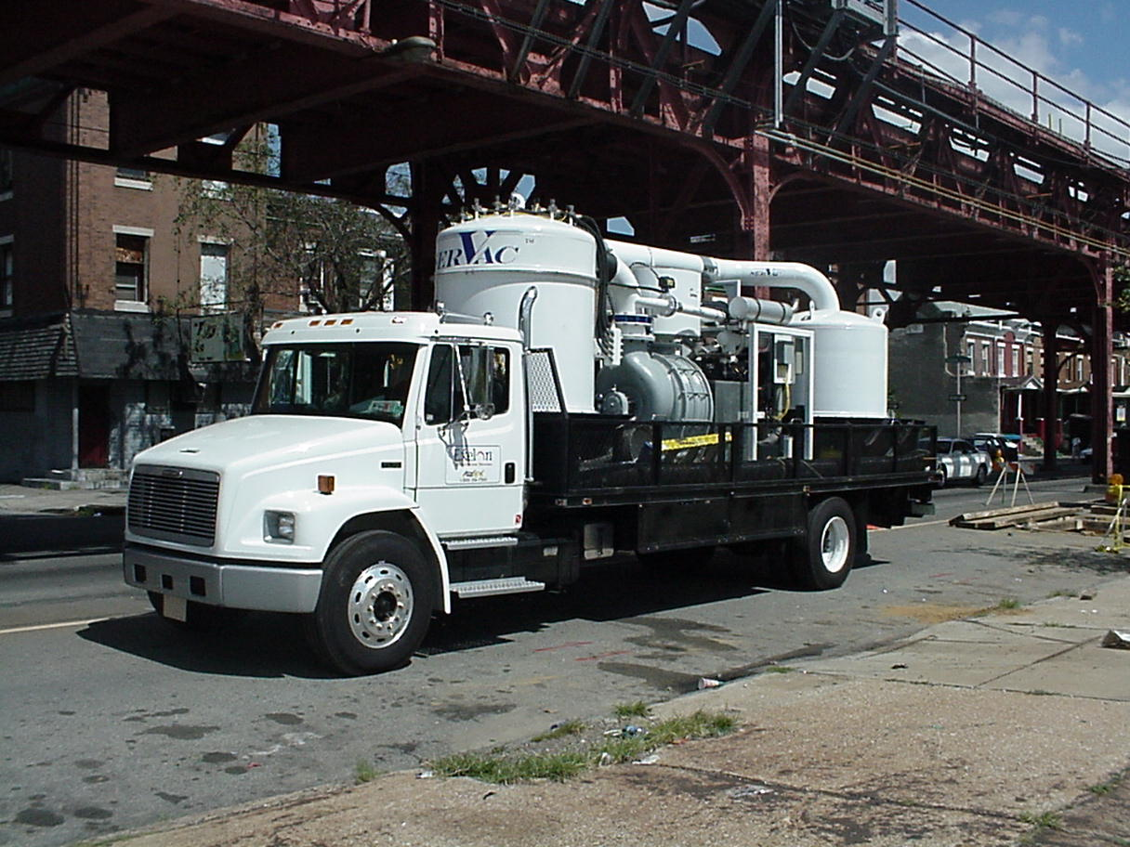
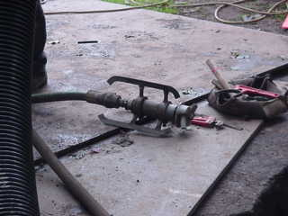
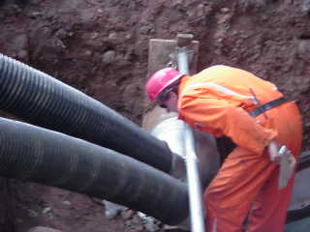
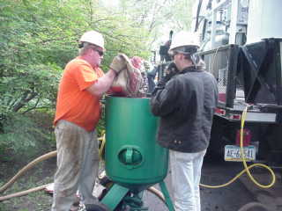
After the initial inspection, the pipe cleaning is performed using a combination of sand blasting and vacuuming

Slide 7
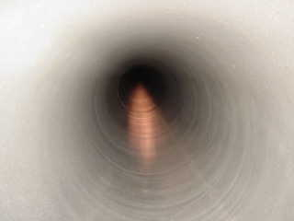
A second camera inspection is then performed to ensure the effectiveness of the cleaning for proper adhesion.

Slide 8
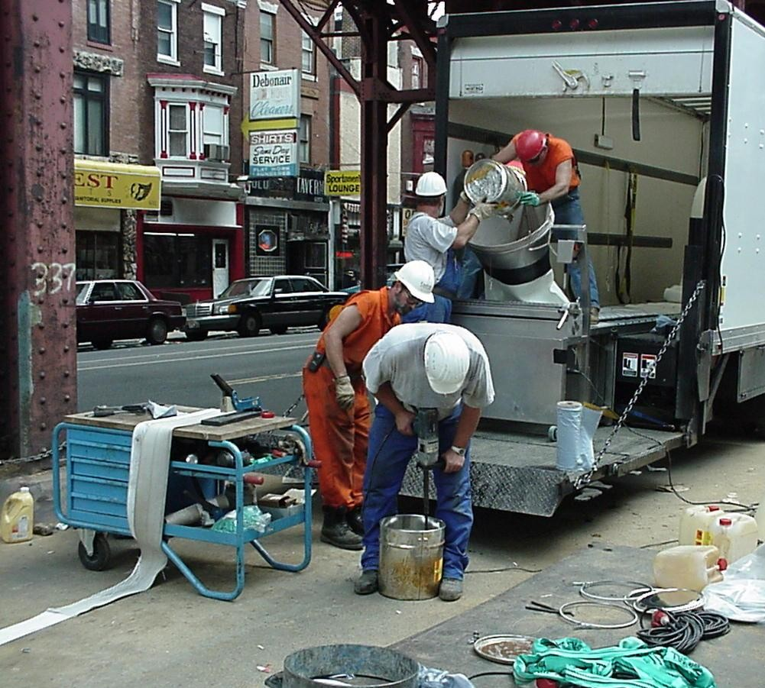
Epoxy is mixed and poured into liner material

Slide 9
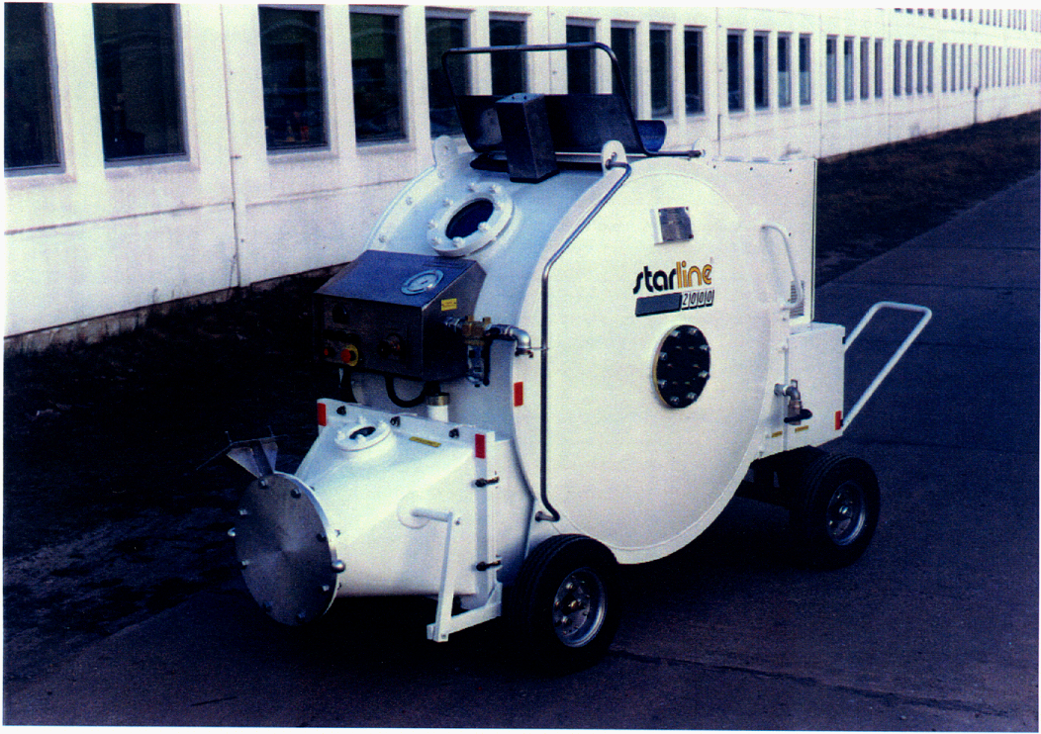
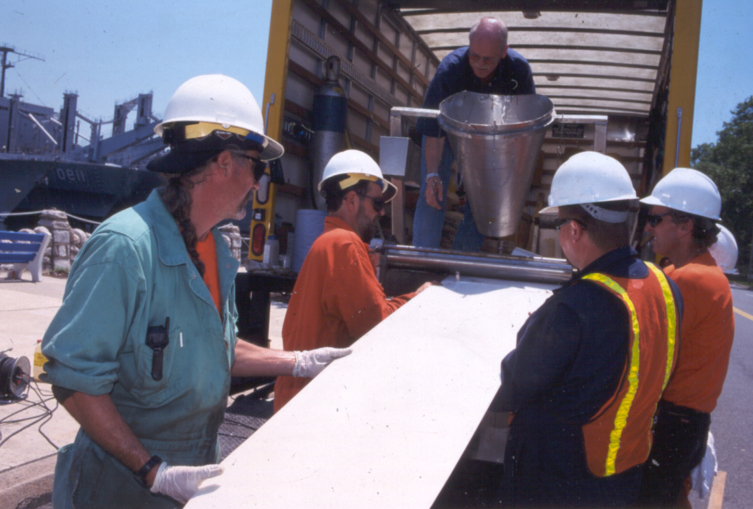
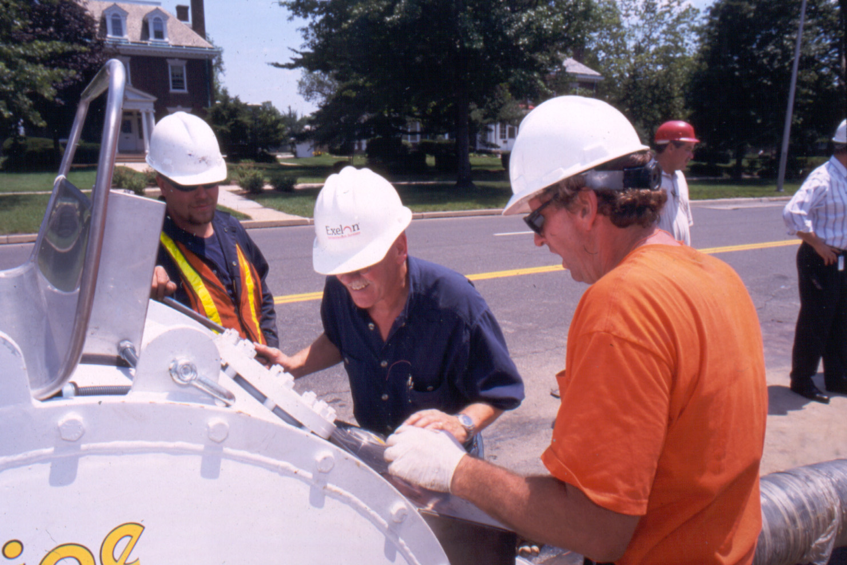
Liner is loaded into pressure drum

Slide 10
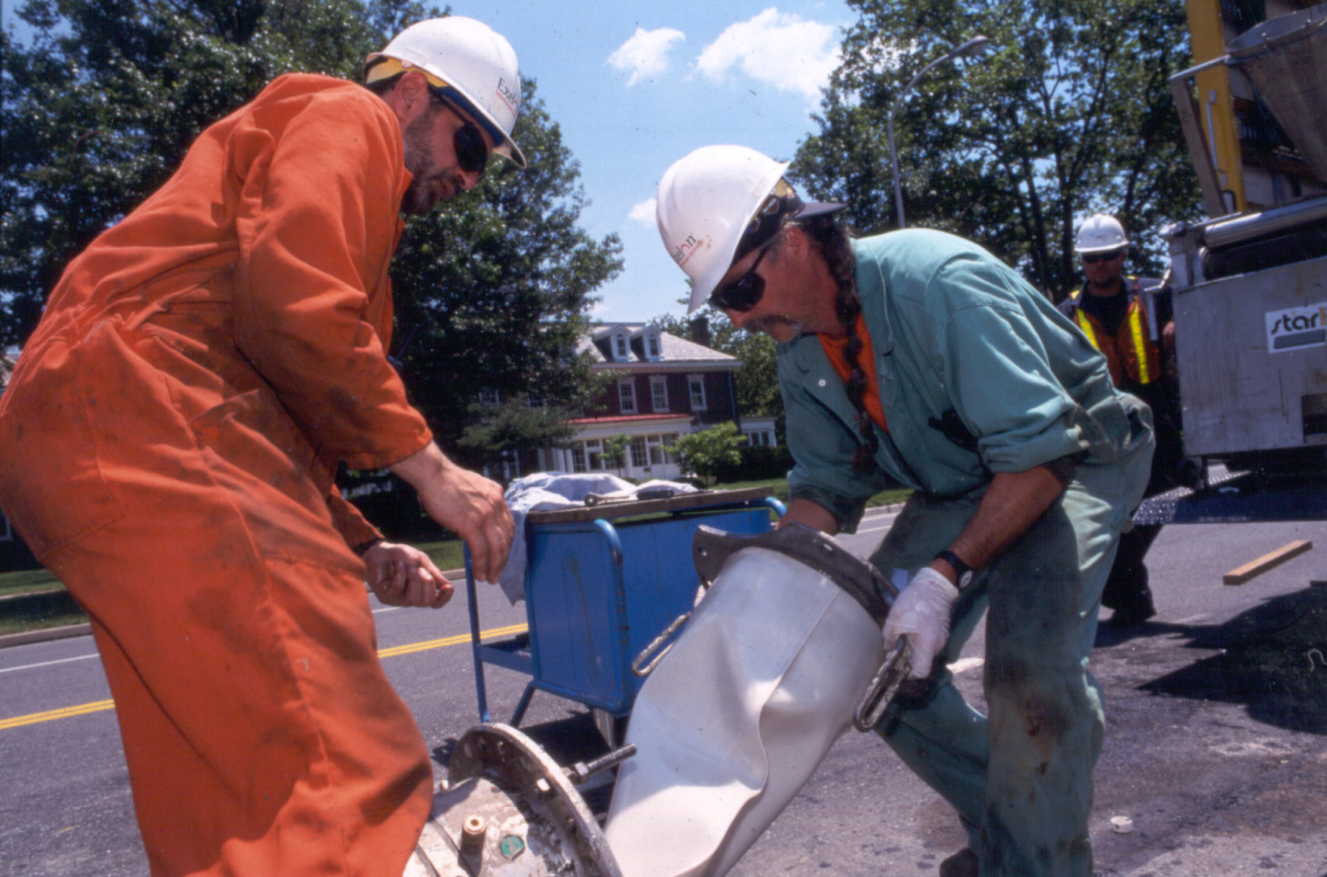
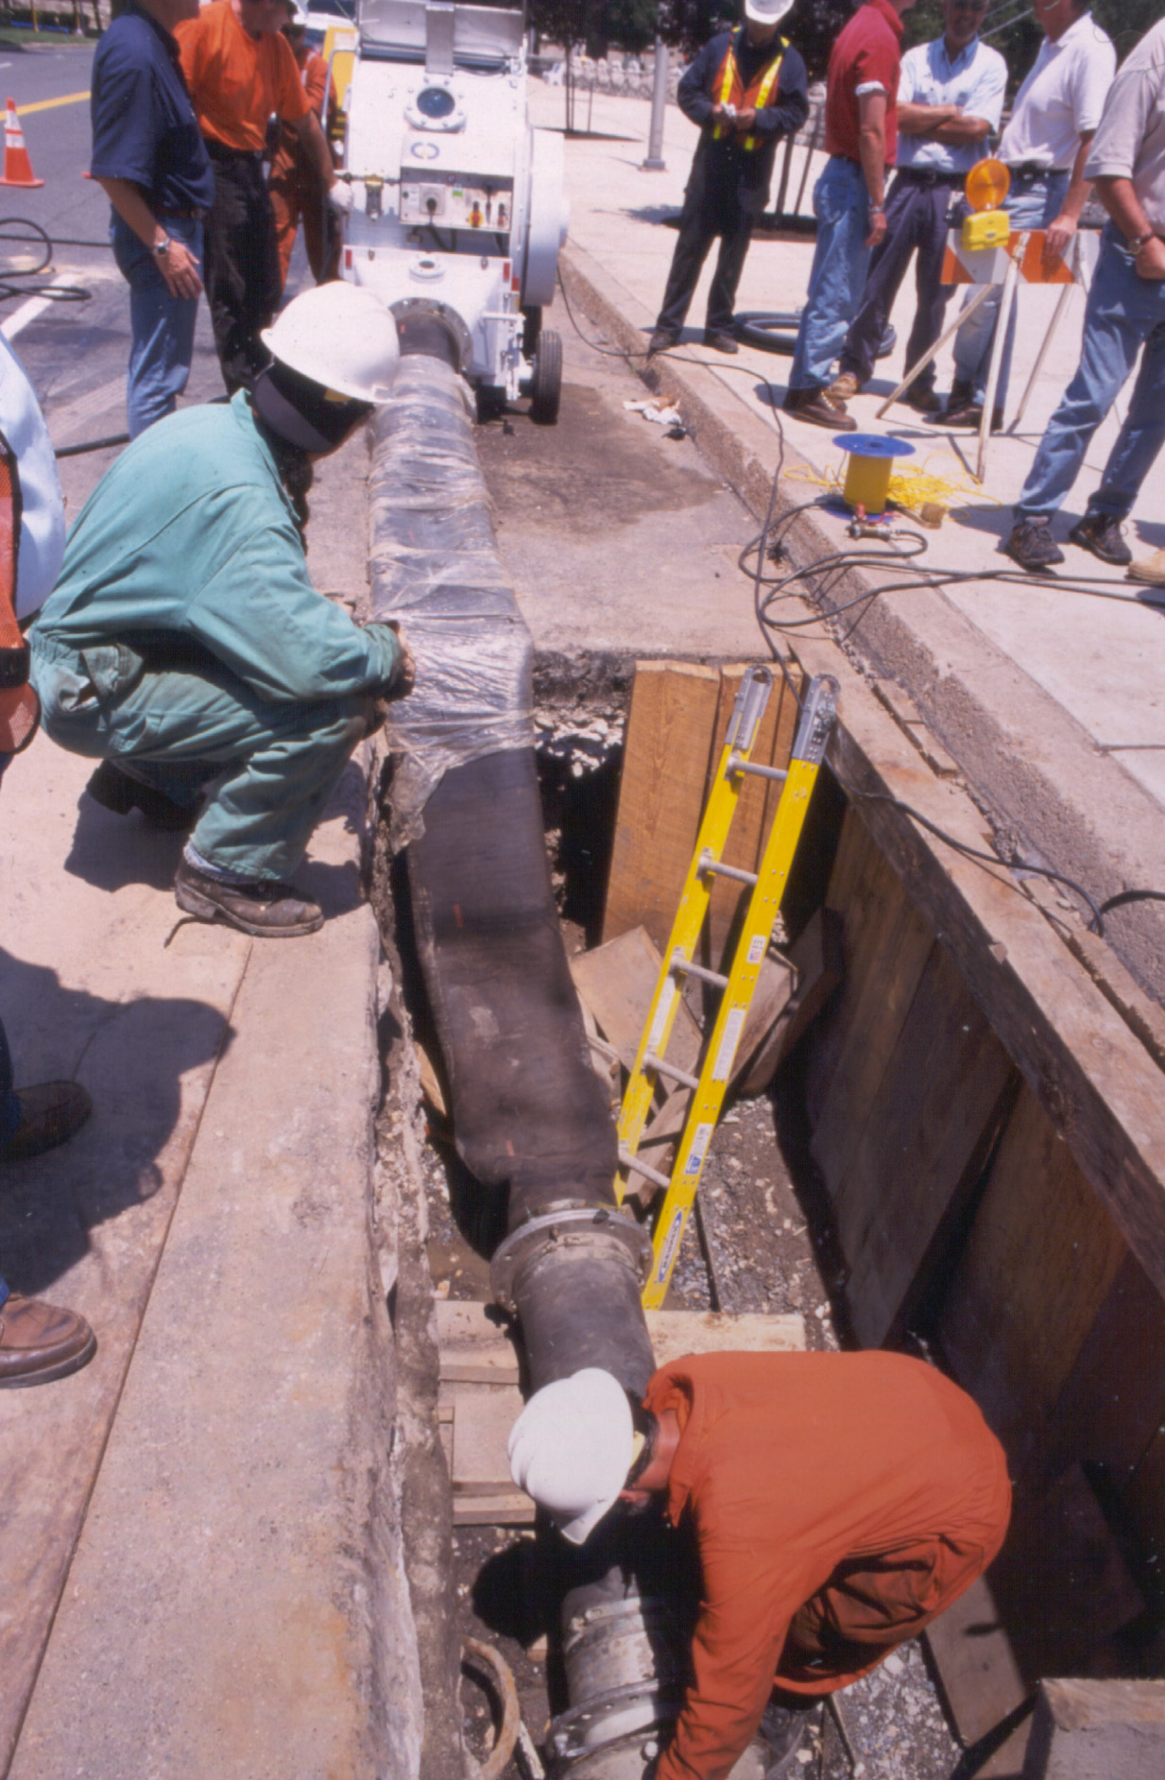
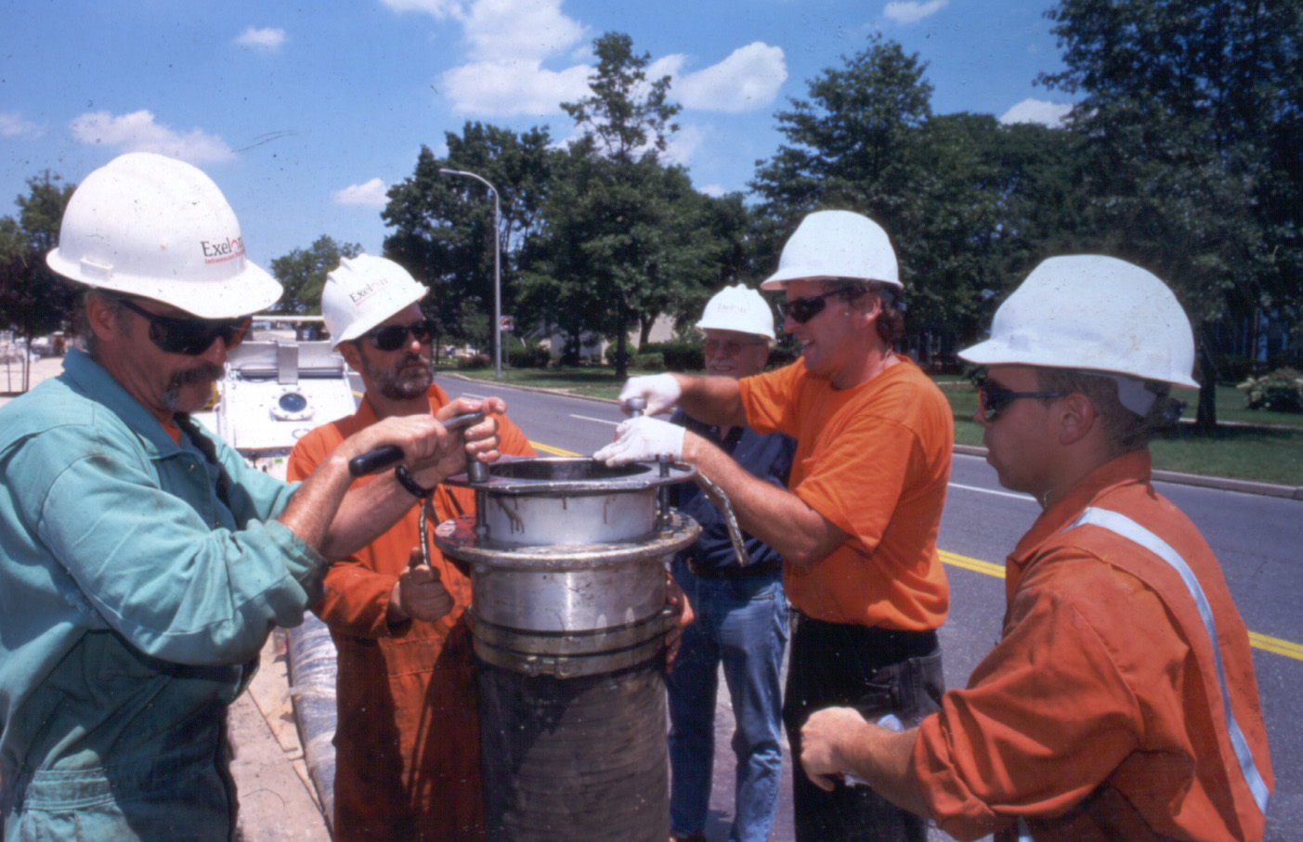
Liner attached to inversion cone which is then mounted to the main section to be lined and the inversion begins.

Slide 11
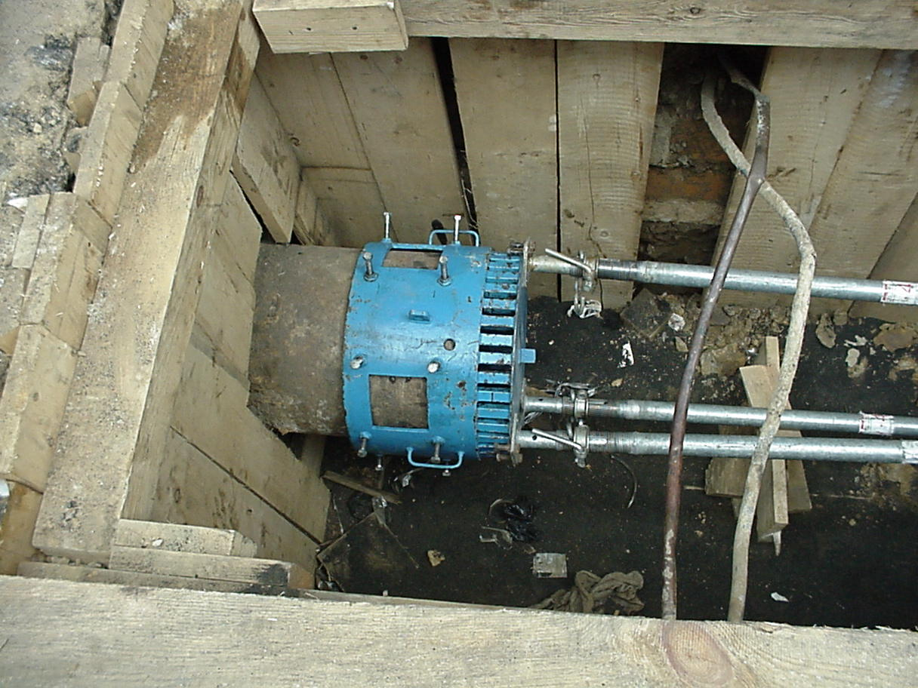
Liner inverted into catch basket

Slide 12
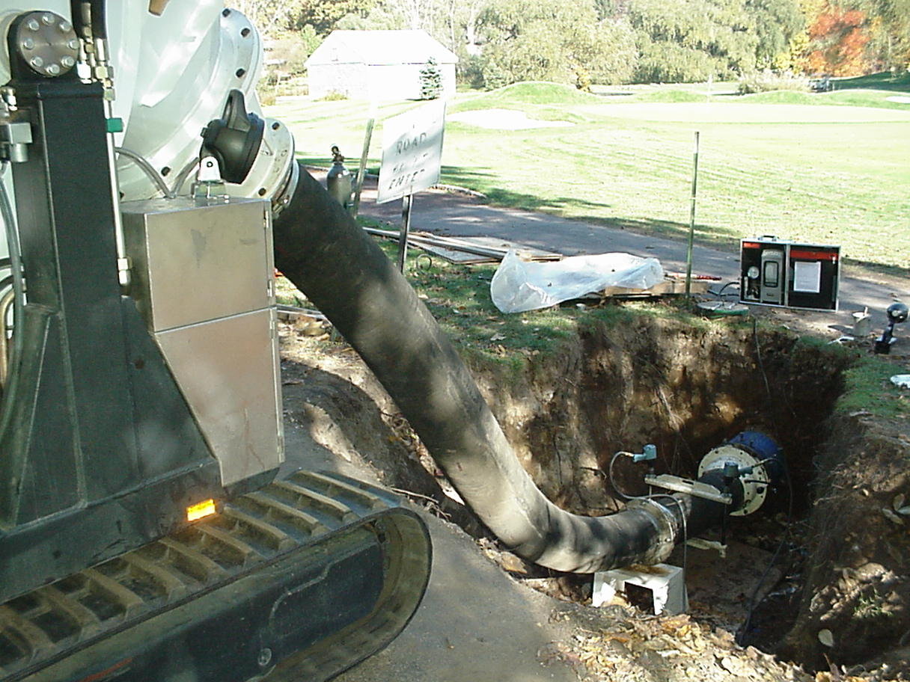
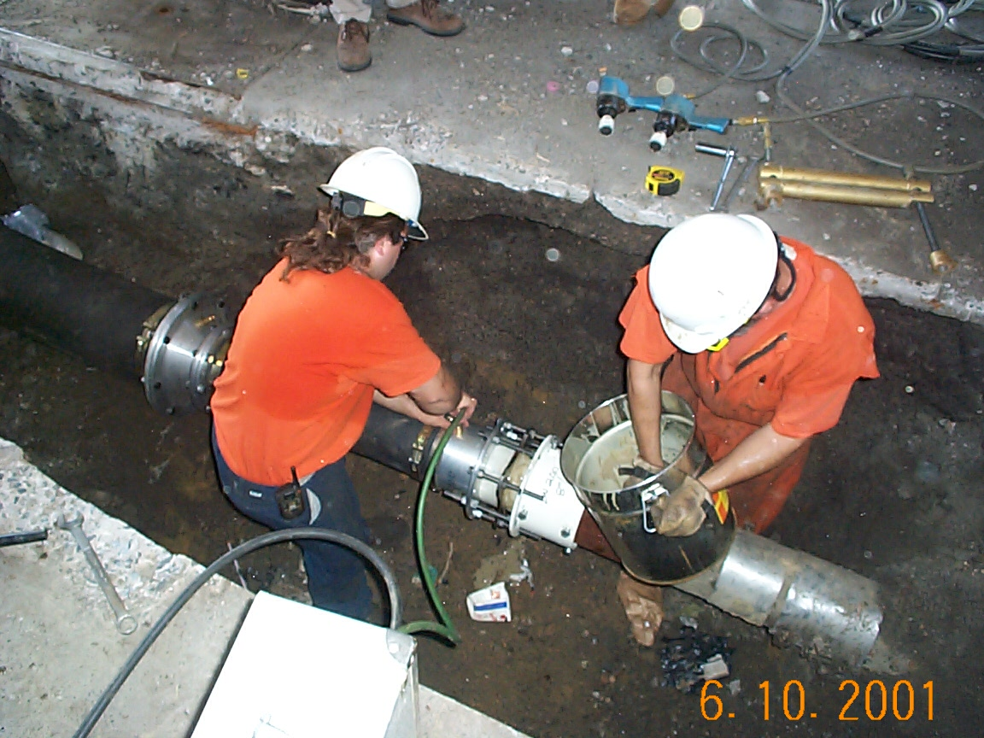
Equipment is disconnected and liner cured at ambient temperatures overnight (12 – 14 Hrs)

Slide 13
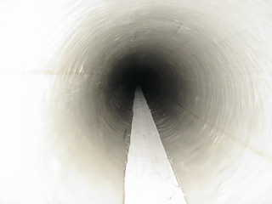
Curing Process is then followed by a final visual inspection of lined segment via the robotic camera.

Slide 14
Steps in the Process (continued)
Inversion process from mixing to beginning of curing process is completed in approximately two hours.
Main section cured using ambient temperature overnight (12-14 hrs)
Main is pressure tested and returned to service completing project.

Slide 15
Questions?
Ted Fiala
Director, New Technologies
Exelon Infrastructure Services
610-690-6762
Ted.fiala@exelonis.com

Slide 16
Mike Beezak
Manager of Prudent Main Replacement
Philadelphia Gas Works
Mike Beezak will present in conjunction with Ted Fiala. He will present a high-level case study on a PGW/EIS starline program.

