Slide 1

Waha HubCo
Overview
October 2001

Slide 2
Objectives
HubCo Objectives:
  Purchase/sell transport and storage positions to access physical supply/offtake at Waha
  Create a physical header system at Waha that provides transportation/storage to third parties
  Increase supply sources for Enron pipelines and revenue sources for assets
  Capture supply/demand/price information to support ENA trading
  Provide for a physical Waha basis that will support the development of a synthetic transport product between Waha and other EOL points in Texas.
NNG/TW Objectives:
  Maximize value earned from pipeline investment by increasing transport revenue, lowering operating costs, or selling assets at a premium.
  Continue to have access to supply at Waha.
  Cross sell other GTS services that bring value to Enron.
Sid Richardson Objectives:
  Increase connectivity of Sid Richardson processing plants to balance flow, increase utilization rates, and reduce costs.
  Increase optionality to market Sid Richardson gas.
  Increase utilization of Sid Richardson’s assets.
Two options have been identified to physically create HubCo with Enron and Sid Richardson assets

Slide 3
HubCo Deal Structure
ENA
Sid Rich.
GTS
Capital and/or Assets
Capital and/or Assets
Capital and/or Assets
% Equity Interest
% Equity Interest
% Equity Interest
Partnership Agmts.
GTS
Sid Rich or GTS
HubCo
Access to production in/around Waha
Access to intrastate and interstate pipelines
Access to storage
EOL trading point
Nomination, scheduling & hub mgmt services
O&M Agmts.
Hub Serv. Agmts.
ENA (EOL)
Storage/Bal Agmts.
Hub Transp. Agmt.
Interconnect Agmt.
Unocal
Shippers
Sid Rich.
Pipelines

Slide 4
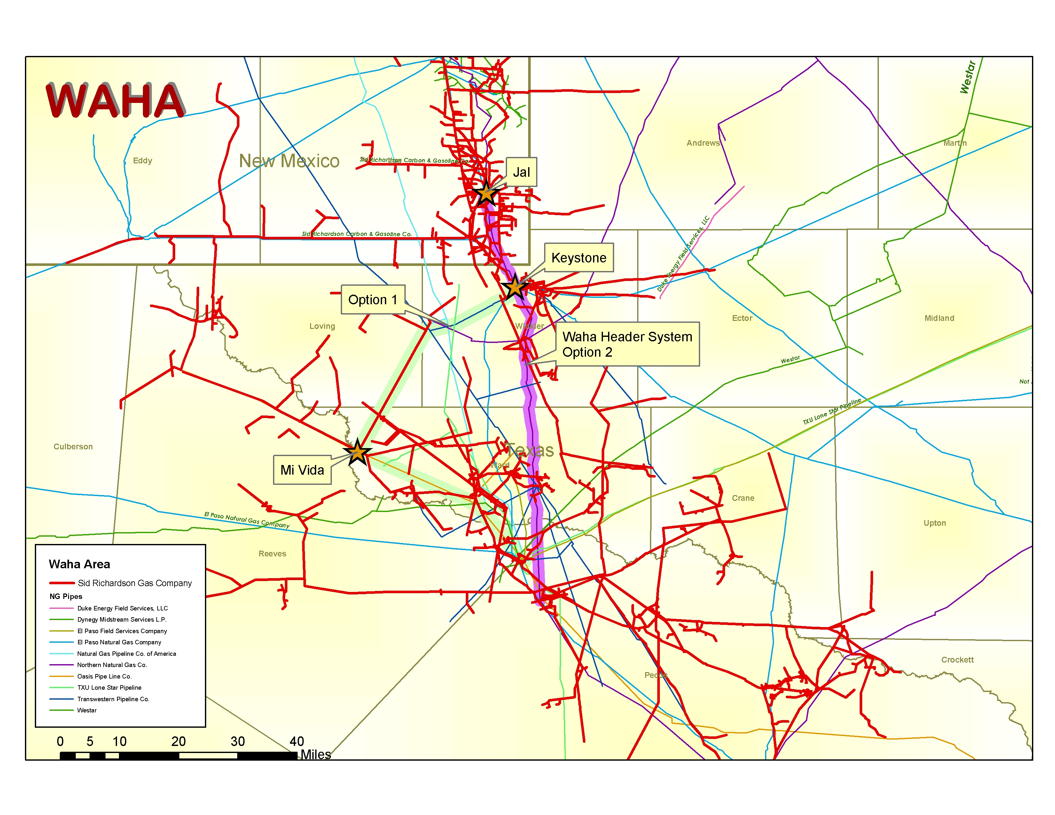

Slide 5
HubCo Interconnects (Option: NG Only)
Intrastate Connects:
Sid Rich – Mi Vida ( ) MMcfd, ( ) psig
Unocal – Keystone ( ) MMcfd, ( ) psig
Interstate Connects:
Northern ( )MMcfd, ( ) psig
EPNG ( )MMcfd, ( ) psig
Transwestern ( ) MMcfd, ( ) psig
Sid Rich Jal
HubCo pipe from NNG
Technical/Capital Investment Factors:
Upgrade NNG HubCo line to run at higher pressure
Set compression at key interconnects and continue to run NNG HubCo line at lower pressure.
Use of existing compression owned by NNG and Sid Richardson
Commercial Factors:
Compensate NNG for use of pipeline
Provide NNG with other sources of supply to justify asset transfer.
Provide supply Sid Richardson with alternate market outlets
Develop a structure to leverage Enron’s systems and services
Keystone
HubCo pipe from NNG
Waha
Interstate Connects:
Transwestern ( ) MMcfd, ( ) psig
Northern ( ) MMcfd, ( ) psig
NGPL ( ) MMcfd, ( ) psig
EPNG ( ) MMcfd, ( ) psig
Intrastate Connects:
Aquilla/Dow - Oasis ( ) MMcfd, ( ) psig
TXU Lone Star ( ) MMcfd, ( ) psig
EPFS/TXU - Valero ( ) MMcfd, ( ) psig
EPFS/DEFS – Guadalupe ( ) MMcfd, ( ) psig
Oneoak – Westar ( ) MMcfd, ( ) psig
Sid Richardson ( ) MMcfd, ( ) psig

Slide 6
HubCo Interconnects (Option: TW Only)
Intrastate Connects:
Sid Rich – Mi Vida ( ) MMcfd, ( ) psig
Unocal – Keystone ( ) MMcfd, ( ) psig
Intrastate Connects:
Sid Rich – Mi Vida ( ) MMcfd, ( ) psig
Oasis ( ) MMcfd, ( ) psig
TXU Lonestar ( ) MMcfd, ( ) psig
EPFS/TXU – Valero ( ) MMcfd, ( ) psig
Keystone
Interstate Connects:
Northern ( )MMcfd, ( ) psig
EPNG ( )MMcfd, ( ) psig
Transwestern ( ) MMcfd, ( ) psig
Sid Rich and TW assets
Interstate Connects:
Transwestern ( ) MMcfd, ( ) psig
Mi Vida & West
Commercial Factors:
Use of Oasis line for HubCo – nomination and scheduling issues
Payment to Sid Richardson and TW for use of their lines.
Develop a structure to leverage Enron’s systems and services
Technical/Capital Investment Factors:
Upgrade TW lines and interconnects to Sid Richardson
Create expanded interconnect to Oasis.
Upgrade Sid Richardson lines and meters to handle additional two way volume
Oasis Transport
Waha
Interstate Connects:
Transwestern ( ) MMcfd, ( ) psig
Northern ( ) MMcfd, ( ) psig
NGPL ( ) MMcfd, ( ) psig
EPNG ( ) MMcfd, ( ) psig
Intrastate Connects:
Aquilla/Dow - Oasis ( ) MMcfd, ( ) psig
TXU Lone Star ( ) MMcfd, ( ) psig
EPFS/TXU - Valero ( ) MMcfd, ( ) psig
EPFS/DEFS – Guadalupe ( ) MMcfd, ( ) psig
Oneoak – Westar ( ) MMcfd, ( ) psig
Sid Richardson ( ) MMcfd, ( ) psig

Slide 7
Implementation
Define the asset base for HubCo and form a new intrastate pipeline (JV or other) to allow physical connectivity between market participants:
    Sid Richardson contributes assets
    Enron (ENA, GTS) contributes capital and/or assets
    All pipeline services provided under outsourcing contracts
Establish the roles/responsibilities of parties and enter into service agreements with GTS, ENA and others for commercial services:
    Nominations/scheduling/confirmations
    Billing/reporting/cash management
    Auditing
Enter into service agreements with Sid Richardson, Unocal, GTS and others for operational services:
    Operations/gas control
    Physical balancing/measurement
Enter into interconnect and transport agreements with 3rd parties:
    Hub services provided for a fee
    Transport agreement terms are standardized

