Slide 1
Introduction to Options: Pricing Presented by Grant Masson Enron Research Group Houston, TX September 13, 2000

Slide 2
Outline
 What is an option premium?
 Basic concepts in option valuation
 Options in practice: Hedging costs and revenues

Slide 3
What is an Option Premium?
 It is money that the seller receives in
payment for option
 It is equal to the money the seller expects
to have to pay to the option buyer in a
probabilistic sense
 (Actually, the premium is more than that
because the seller wants to make a profit)

Slide 4
What is an Option Premium?
(An Alternative Interpretation)
 Option premium should equal (or exceed)
cost of hedging incurred by seller
 Hedging involves periodically buying and
selling a fraction of the underlying
according to the option's “delta” (describe
in section IV)
 N.B. Hedging costs in this context does
not mean transaction costs

Slide 5
Calculating an Option Premium
 To calculate a European option
premium requires two ingredients:
– Option pay-off structure
– Probability distribution of asset
price at expiration date

Slide 6
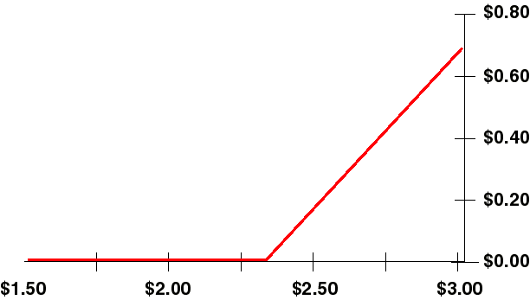
Calculating an Option Premium
(Continued)
Long Call option pay-off structure
Pay-off
(MMBtu)
Gas Price (/MMBtu)
Tells us what the option will pay to the holder at option expiration

Slide 7
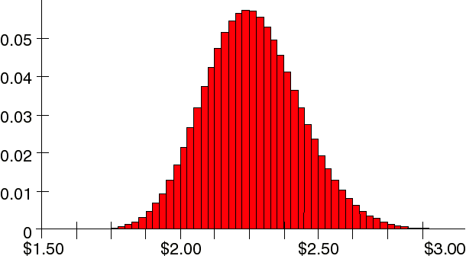
Calculating an Option Premium
(Continued)
Natural gas futures contract price probability distribution
Probability
Gas Price (/MMBtu)
Tells us how likely it is that the asset has a particular price at option expiration

Slide 8
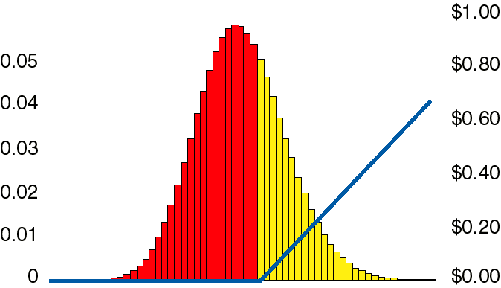
Calculating an Option Premium
(Continued)
Combining the two...
Probability
Pay-Off
Gas Price (/MMBtu)
Option Premium = ∑(Option Pay-off X Probability)

Slide 9
Calculating an Option Premium
(Continued)
 In more formal terms:
- Option premium is expectation of
option pay-off
Option premium = PV { E[ƒ(S,K)] }
Where ƒ(S,K) = Max[S-K,0] for calls
and ƒ(S,K) = Max[K-S,0] for puts

Slide 10
The Problem of Risk Preferences
 Option premium is usually paid up-front, so it
is the present value of the expected pay-off
at expiration
 How is an option (or any other investment)
Present Valued?
– Risk adjusted rate of return is normally used
– What is the risk of holding an option?
– This perplexed all of mankind until 1973,
when Black and Scholes published their
famous paper

Slide 11
Option Valuation
 Five factors influence the price
of a plain vanilla call option on a commodity
Strike price : pay-off
Underlying price
Volatility : prob. dist.
Time to expiration
Interest rates : discounting
}
Notes:
<number>
<footer>
<header>
<date/time>

Slide 12
Option Valuation: An Example A European Call Option on Gas
 Gas Price as of today: $2.30/MMBtu
 Strike: $2.30/MMBtu
 Volatility: 15%
 Time to expiration of
option: 30 days
 Interest Rate: 7%
Premium: $0.039/MMBtu

Slide 13
Strike
For a Call option:
 The higher the strike (the more
out-of-money), the larger the
fraction of the probability distribution excluded, and the
less expensive the option.
 A deep in-the-money option is one where no part of the probability distribution is excluded by the payoff line.

Slide 14
What is Volatility?
 Volatility measures, in some sense,
the range of possible prices at some
point in the future
– How “quickly” prices become
uncertain as time goes forward
– how much a price “zig-zags” over time
 The higher the volatility, the broader
the range of possible future values
– Higher volatility usually makes options
more expensive

Slide 15
Time
 Time, like volatility, increases
the price uncertainty. It broadens
the probability distribution.
 Longer dated options are more expensive than shorter dated options.

Slide 16
Interest Rates
 For vanilla options on futures, interest rate used only for discounting
 For options on stocks, currencies, and other instruments, interest rates
play additional role

Slide 17
Risk Parameter Names
 Names derived from Greek Alphabet
Symbol
Name
Delta
Gamma
Theta
Rho
Vega
Eta
Sensitivity of
Premium
Delta
Premium
Premium
Premium
Premium
To
Underlying Price
Underlying Price
Time to Expiration
Interest Rate
Volatility
Correlation

Slide 18
Options in Practice
Application of options to the Electricity Industry
Hedging Costs
Hedging Revenues

Slide 19
Cost Effective Fuel Supply Hedging the Cost Side
 Plain Vanilla Solutions
Call option
 Exotic Solutions

Slide 20
Hedging Costs
 Goal: To reduce uncertainty in cash
going out the door
 Methods:
– Buy fuels using swaps, etc. to lock
in future prices now
– Buy fuels at spot prices, in order to
enjoy any price drops, but buy insurance
against possible price increases
This price insurance is called an option

Slide 21
Hedging Costs: Plain Vanilla
 A utility wishes to protect
against cost increases in a
single fuel (e.g. gas)
 A simple, understandable,
effective way to achieve this
is to buy a call option
(aka a ceiling or cap ) on the fuel
Notes:
<number>
<footer>
<header>
<date/time>

Slide 22
Financial Call: An Example
 You (a utility) have contracted
with a gas producer to purchase firm gas for November at a
floating price
– Nov. forward gas price is
presently $2.50/MMBtu
– You do not wish to pay more than $2.80/MMBtu
– You purchase from a third party (e.g. ENRON) a financial call
with a strike of $2.80/MMBtu

Slide 23
Financial Call: The Numbers
 November gas contract price: $2.50/MMBtu
 Strike price: $2.80/MMBtu
 Volatility: 15%
 Interest rate: 6%
 Time to expiration of option:
May 3 - Oct. 24 (174 days)

Slide 24
PART III - Electricity Pricing Hedging the Revenue Side
 Comments
 Plain Vanilla Solutions
– Put option
– Collar
 Exotic Solutions

Slide 25
Hedging Revenues
 Goal: To reduce uncertainty in cash coming in the door
 Methods:
– Sell electricity forward using
swaps, etc. to lock in future
prices now
– Sell electricity at market prices, in order to enjoy any price increases but buy insurance against possible price drops.
This price insurance is called an option

Slide 26
Hedging Revenues: Puts
 A utility wishes to protect
against drops in electricity prices
- A simple, understandable, effective way is to buy a put (or
floor) on electrictiy

Slide 27
Financial Put: An Example
 You (the utility) have contracted
with a large industrial customer to
provide 100MW base load power for
the month of November at COB
index price
 Assume COB November price is $30/MWh
 You do not wish to be paid less than $23/MWh
 You purchase from a third party
(e.g. ENRON) a financial put for
100MW base load power with a
strike of $23/MWh

Slide 28
Financial Put: The Numbers
 November Electricity Price: $30/MWh
 Strike: $25/MWh
 Volatility: 40%
 Interest rate: 7.27%
 Time to expiration of option:
May 3 - Oct. 22 (172 days)
Notes:
<number>
<footer>
<header>
<date/time>

Slide 29
Collars
The option discussed above, while very useful, suffers from one serious flaw:
It costs something!
In the never ending search for a Free Lunch, risk managers have come up with the
Costless Collar

Slide 30
Collar: The Idea
 You wish to protect yourself against drops in electricity prices but want to participate in profits if prices go up
– You purchase a put option on electricity
with a strike below present prices

Slide 31
Collars: The Idea
 You would prefer not to pay cash
for the put option and are willing
to give up some of the potential
profits if prices go up.
– You simultaneously sell a
call option on electricity
with a strike above present
prices

Slide 32
The cost of the purchased put option can be made to equal the cost of the sold call option, so you pay nothing.
The combination put-call forms a band or Collar on electricity prices
Call
Put

Slide 33
Collar: An Example
 A utility is selling electricity to a
large industrial customer in July
at COB index price
 Assume July COB peak electricity
is $29/MWh
 The utility establishes a collar
(via a third party such as ENRON)
on electricity where the minimum
price for electricity is $27/MWh
and the maximum is $31.50/MWh
What is the behavior of this structure?
What does this structure cost, if anything?

Slide 34
Collar: The Numbers
 July Electricity: $29/MWh 30% volatility
 Put strike: $27/MWh
 Call strike: $31.50 /MWh
 Interest rate: 7.0%
 Time to option expiration:
May 3 - Jun. 25 (48 days)

