Slide 1
Introduction to Options: Basics
Presented by
Grant Masson Enron Research Group
Houston, TX September 13, 2000

Slide 2
Outline
 Definitions and pay-off diagrams
 Basic option types
 Different underlying assets

Slide 3
Pay-off Structures
Buy (Long) Futures
K: Delivery
Price
K
Profit
Asset Price
Pay-off

Slide 4
Pay-off Structures
Sell (Short) Futures
K: Delivery
Price
K
Profit
Asset Price

Slide 5
Basic Definitions
 Call Option
– Buyer has right but not obligation to
purchase underlying asset from
option seller
• At an agreed upon price: The Strike
• On, or sometimes before specified date -
The Expiration Date
– Buyer expects asset price to increase
– Seller is obligated to sell asset at strike
price should the buyer exercise
his/her option
– Seller expects asset price to fall or not change

Slide 6
Basic Definitions
 Put Option
– Buyer has right but not obligation
to sell the underlying asset to option seller,
• At an agreed upon price: The Strike
• On or sometimes before a specified date:
The Expiration Date
– Buyer expects asset price to fall
– Seller is obligated to purchase underlying
asset at strike price should buyer exercise
option
– Seller expects asset price to increase or not change
 In both calls and puts, buyer pays seller a
Premium for the option

Slide 7
Pay-off Structures
Buy (Long) Call Option
K: Strike
Price
K
Profit
Asset Price
- Pay-Off
-- Net Profit

Slide 8
Pay-off Structures
Sell (Short) Call Option
K: Strike
Price
K
Profit
Asset Price
- Pay-Off
-- Net Profit

Slide 9
Pay-off Structures
Buy (Long) Put Option
K: Strike
Price
K
Profit
Asset Price
- Pay-Off
-- Net Profit

Slide 10
Pay-off Structures
Sell (Short) Put Option
K: Strike
Price
K
Profit
Asset Price
- Pay-Off
-- Net Profit

Slide 11
Pay-Off Structures
(Continued)
 Description of long call pay-off
c = Max [ (S_{T} - K), 0]
 Description of long put pay-off
p = Max [(K - S_{T}), 0]

Slide 12
Trading Strategies
 Strategies involving buying and/or selling
more than one option yield very specific
pay-off structures
 (And also yield a bevy of fanciful names)
 To name a few:
– Straddles
– Strangles
– Butterflies
– Collars (see homework)
– etc, etc.

Slide 13
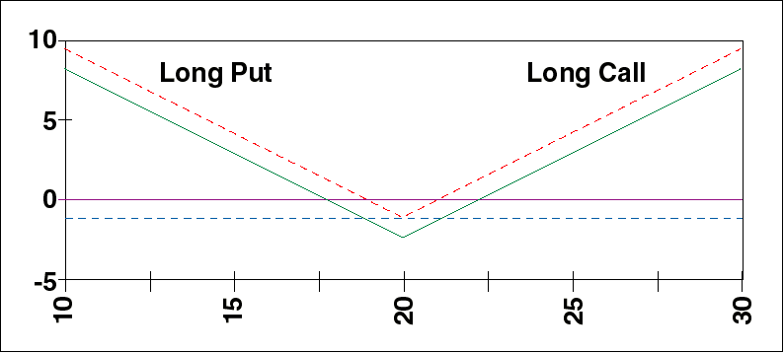
Long Straddle

Slide 14
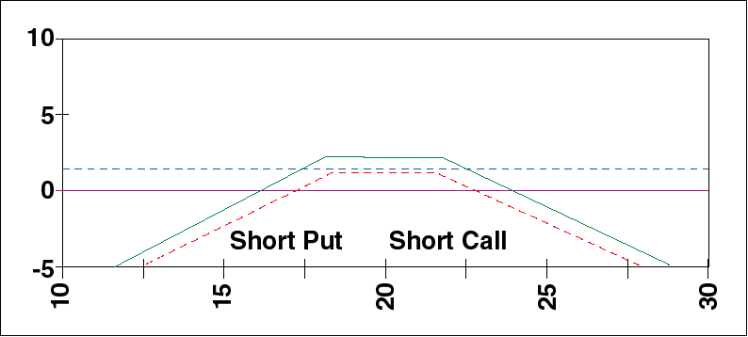
Short Strangle

Slide 15
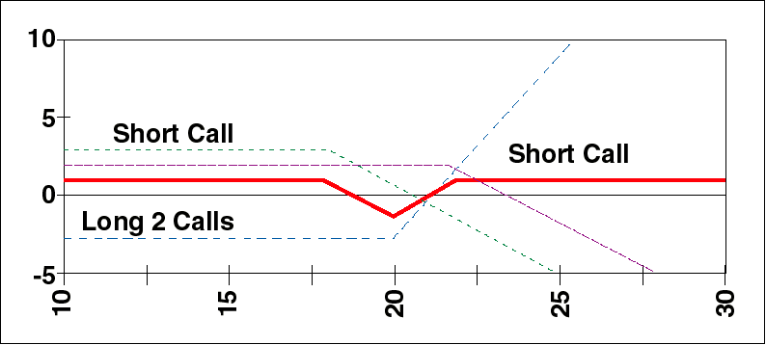
Long Butterfly Spread

Slide 16
Basic (Plain Vanilla) Option Types
 European option
– Can be exercised only at
expiration date
 American option
– Can be exercised at any time
during the life of the option

Slide 17
Exchange vs. OTC Options
 Exchange
– Standardized (contract size, quality, delivery,
exercise price, expiration, etc)
– Clearinghouse (i.e. the exchange) stands
between buyer and seller and guarantees
contract
 OTC
– Highly specialized (e.g. Enron draws up
contract to fit exact needs of customer.
Are often exotic)
– No guarantee against default

Slide 18
Exchange Traded Options
(Comments)
 Most exchange traded options are American in style
 American options are more expensive than European
 We often ignore American aspect of options
– European style is much easier to treat
mathematically
– Enron’s customers are usually not interested
in early exercise of options on gas or oil
forward contracts

Slide 19
OTC Options (comments)
 OTC options that are popular with Enron customers
– Asian options (average price options)
– Swaptions (options on swaps)
– Spreads (options on the difference between two
underlying prices)
– Even more exotic structures

Slide 20
Underlying Assets
 Options exist on a wide variety of instruments
– Stocks
– Stock indices (SP500, CAC40, etc.)
– Futures on all sorts of commodities
• Foreign currencies
• Bonds (i.e. interest rates)
• Pork bellies, Aluminum
• Oil, natural gas, …
– Even two futures simultaneously
• Heating oil crack spreads
• Gasoline crack spreads

Slide 21
Options Pay-Offs in Practice
 Stocks: Buyer can purchase actual shares
 Stock Indices: Settle in cash
 Futures: Buyer is entered into futures
contract and receives cash
 Contract matures shortly after
option expiration

Slide 22
Physical vs. Financial Options
 Physical options
- Options to take delivery of (or to deliver)
a physical commodity: Mcf of gas, MWh
of electricity, etc.
- Strike price is simply the agreed upon
cost of the commodity
 Financial options
- Only cash is exchanged
- Settlement is the difference between
“commodity price” and the Strike price
- Implies that there is an agreed upon
method of determining “commodity price”
e.g. index price, futures settlement price

Slide 23
“Moneyness”
 In-The-Money option
- For a call: S > K
- For a put: S < K
- The option is worth a lot
 At-The-Money option
- For a call or a put: S ~ K
- The option is worth something
 Out-Of-The-Money option
- For a call: S < K
- For a put : S > K
- The option is not worth much

Slide 24
Intrinsic Value and Time Value
 Intrinsic value of an option is defined to be
- For calls: Max[(S - K), 0]
- For puts: Max[(K - S), 0]
at any time during its life
- In-the-Money options have high intrinsic value
- Out-of-the-Money options have zero intrinsic value
 Time value of an option is the value over and
above its intrinsic value
- In some sense, it is the price a seller must
charge for the possibility that the option
expires in-the-money
- At-the Money options have largest time value
compared to in- or out-of the money options

Slide 25
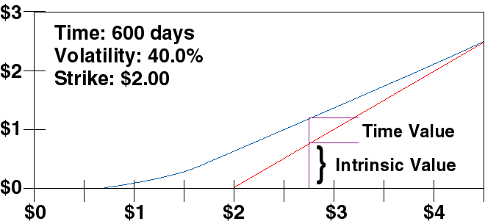
Bounds on European Call
Option on Futures

