Slide 1

Enron Net Works GMOnline Opportunity
April 2001

Slide 2
Today’s discussion focuses on how EnronOnline’s suite of eMarketplace products can benefit GM.
Discussion Topics
Enron and EnronOnline Overview
Market Transformation Process
Overview
Case Study
Legal and Credit Considerations
New Value Opportunities
Product Offering Options

Slide 3
Enron’s eCommerce systems have driven the company’s rapid revenue growth rate during the last two years.
Enron’s Success in eCommerce
Enron’s Quarterly Revenue Growth
EnronOnline
launched
Nov 1999
2000 Operating Income
$1,953 million
2000 Net Income
$979 million
1999 Operating Income
$802 million
1999 Net Income
$893 million

Slide 4
Enron uses its platform to operate a principal-based, private exchange.
Section Heading
Where EnronOnline fits as a Marketplace
Transaction Method | Description | Advantages | Disadvantages
Over the telephone | Person-to-person direct deal making. | Customizable | Less liquidity Time consuming No transparency
Many-to-Many Exchange | Independent or consortia-led matchmaking services. Examples: Transora, HoustonStreet | Large number of potential counterparties | Differing creditworthiness May lack product standardization
Regulated Commodity Exchange | Trading marketplaces for established commodities open to members. Examples: NYMEX, CBOT | Liquid markets Real-time prices | Delayed access Margin required Membership Costs
Private eMarketplace | Principal-based marketplaces, where one company is the buyer or seller in all transactions. Examples: EnronOnline, DynegyDirect | Fast, free access Two-way market Price transparency Real-time prices

Slide 5
Discussion Topics
Today’s discussion focuses on how EnronOnline’s suite of eMarketplace products can benefit GM.
Enron and EnronOnline Overview
Market Transformation Process
Overview
Case Study
Legal and Credit Considerations
New Value Opportunities
Product Offering Options

Slide 6
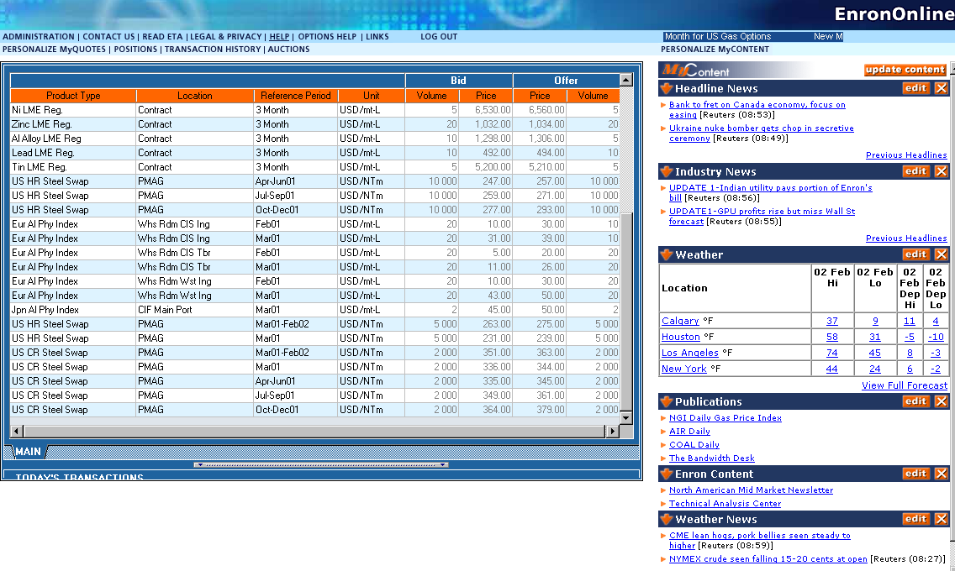
GM can create a private exchange to maximize profit opportunities.
eMarketplace Setup
Commodity
Purchasers
How GM Online would work
GM Commodity Transactions Group
Commodity
Producers
GMOnline
OEMs
Other
Market
Makers
GM
Market
Manager
Software
Prices &
Volumes
Buy/Sell
Physical/Financial
EnronOnline
New
Suppliers
New
counter-
parties

Slide 7
GM can use a market transformation process to extract additional value from buying and selling commodities.
Market Transformation
Market Transformation Process
Establish an
eMarketplace
using the platform
Create
Liquidity
through
market making
Expand Services
with risk
management
products
Process Steps
Transaction Types | Buy and sell physical products in the spot market | Buy and sell forward contracts for physical product | Offer additional financial products Fixed & floating price swaps Call & put options Forward financial contracts
Activities | Create product descriptions Utilize access to physical supplies Define delivery points Create standardized products, terms, and conditions Setup software, hardware, database Integrate with back office systems | Manage counterparties and credit Encourage counterparty transactions | Link products for automatic updates Expand to other commodity markets
Milestones | Online eMarketplace ready to transact | Counterparties transacting actively Forward price curve defined | Market making in additional commodities

Slide 8
How Enron moved metals onto EnronOnline is representative of the success that can be achieved through implementing our product suite.
Case Study
Case Study: Enron Metals
Establish an
eMarketplace
using the platform
Create
Liquidity
through
market making
Expand Services
with risk
management
products
MG plc (Global metals trader) acquired for $446 million (Jul 2000) Rollout of first metals products on EnronOnline (Jul 2000) - Aluminum LME contract Nickel LME contract Zinc LME contract Copper Physical Integrated with AS/400 Back Office Systems Built standard, enforceable contract Created product descriptions | Added London Metals Exchange registered contracts (Oct 2000) Added 24-hour trading (Nov 2000) Transactions increased sharply during the first six months of operation | Continued to increase transactions Notional value to date > $30 billion Transaction count > 50,000 Offered new products online Copper Financial Aluminum Physical Index Offered new services Logistics Swaps

Slide 9
Case Study
Enron moved metals trading online with a speed that rivaled its speed to move its natural gas trading operations online.
Case Study: Metals vs. Natural Gas (the first eight weeks)

Slide 10
Case Study
In the last nine months, both online and over-the-counter metals transactions have more than doubled for Enron.
Average Daily Transaction in Metals
# of Transactions

Slide 11
Enron has a framework for managing counterparty access based on creditworthiness.
Credit Overview
Managing Credit - Overview
EnronOnline allows control and modification of the access levels for every counterparty at the product level
Customer access levels
None - customer has no access to products
Read – customer can view products and pricing but has no transaction rights
Execute – customer can view and transact on products
Customer profiles can be changed based on inputs from GM’s credit management system

Slide 12
There are three key documents that create the legal and contractual environment of the eMarketplace.
Legal Documentation
Legal Contract Overview
Password Application (PA)
Document by which customers agree to be bound by their clicks.
Only document (one-page) which has to be physically signed by the counterparty.
Electronic Trading Agreement (ETA)
Provides a framework for online trading.
Covers use of passwords and establishes the principle of clicking on a product.
Accepted online – only one ETA per company is required.
General Terms and Conditions (GTC)
Provides the general contractual framework for multiple transactions in a given commodity.
Existing Master Agreements supercede the GTC.
Identifies termination rights, provisions for security, operational conventions, force majeure, payment periods, tax treatments, etc.
Accepted online – one GTC per commodity.
In addition to the contracts above, EnronOnline framework includes:
Disclaimer – covers confidentiality, liability, and ownership issues
Product Long Description – legally binding description of a particular product

Slide 13
Discussion Topics
Today’s discussion focuses on how EnronOnline’s suite of eMarketplace products can benefit GM.
Enron and EnronOnline Overview
Market Transformation Process
Overview
Case Study
Legal and Credit Considerations
New Value Opportunities
Product Offering Options

Slide 14
GM can use the Enron Net Works software tools to create additional value…
Value Creation Opportunities
Creating Value with the Enron eMarketplace Platform
Value Opportunity | Examples and Description
Reduced Transaction Processing Costs | Reduce costs with straight-through processing Scale to handle more transactions Eliminate errors
Supply Chain Optimization | Use forward prices to reduce total cost
Improved Buy & Sell Side | Increase contract flexibility Increase price flexibility Reduce friction for buyers and sellers Expand product mix Optimize prices in real-time
Profits from Market Making | Buy and sell commodities on own account, take difference (spread) as profit
Profits from Position Taking | Arbitrage products (time-based, location-based) Use market knowledge to profit from direction of future prices Sell extra inventory acquired at below-market prices
Revenue from New Products | Capture premiums from financial hedging instruments (swaps, options, etc.)
Increased Market Size | Accelerate liquid market development by increasing # of buyers and sellers Identify new suppliers
…resulting in enhanced financial performance and increased enterprise value.

Slide 15
Discussion Topics
Today’s discussion focuses on how EnronOnline’s suite of eMarketplace products can benefit GM.
Enron and EnronOnline Overview
Market Transformation Process
Overview
Case Study
Legal and Credit Considerations
New Value Opportunities
Product Offering Options

Slide 16
Enron Net Works is offering a suite of eCommerce product solutions.
Product Offering Options
Enron Net Works: Product Offerings
Option 1: Posting on EnronOnline | Option 2: Private-Label eMarketplace | Option 3: Combined Offering
1 month to implement | 2-3 months to implement | 2-3 months to implement
Use Market Manager software to post product prices and volumes on EnronOnline | Create a GM-branded eMarketplace using Market Manager tools | Use Market Manager to post to EnronOnline Create a private eMarketplace for GM
Managed hosting by Enron Access to Enron’s counterparties | Managed hosting by Enron Scalable as GM’s products and markets grow | Managed hosting by Enron Access to Enron counterparties Scalable as GM markets grow
Business Process Services (Managed Trading, Risk Management, and eCommerce Services) Product Authoring (Contracts, Documentation, Descriptions) Commodity Marketing and Branding Services Technical and Commercial Help Desk (24x7x365) Technical Programming Services
Timing
Description
Features
Add’l
Services

Slide 17
Discussion Topics

