Slide 1
The War Economy
Gas Fundamental’s Presentation
November 6, 2001

Slide 2
The War Economy
Overview of the Troubled Regions (political/social unrest)
Political/Economic
  GDP Forecasts, Consumer Confidence and Spending
  Monetary/Fiscal Policy-Fed Action,Tax Cuts, and Government Spending
Industrial/Commercial Consumption
  Bailouts and Spending Effects-Military, Tourism, and Airlines
  Industrial Demand
Energy Infrastructure
  Nuclear, Pipeline, and Power Plant Security
  Shipping
Political Diplomacy
  Possible next targets and ramifications
  Coalitions being built in Middle East
OPEC
  Threats to countries and supply, ramifications of breakup
  Russia vs. Saudi Arabia

Slide 3
Overview of Troubled Regions

Slide 4
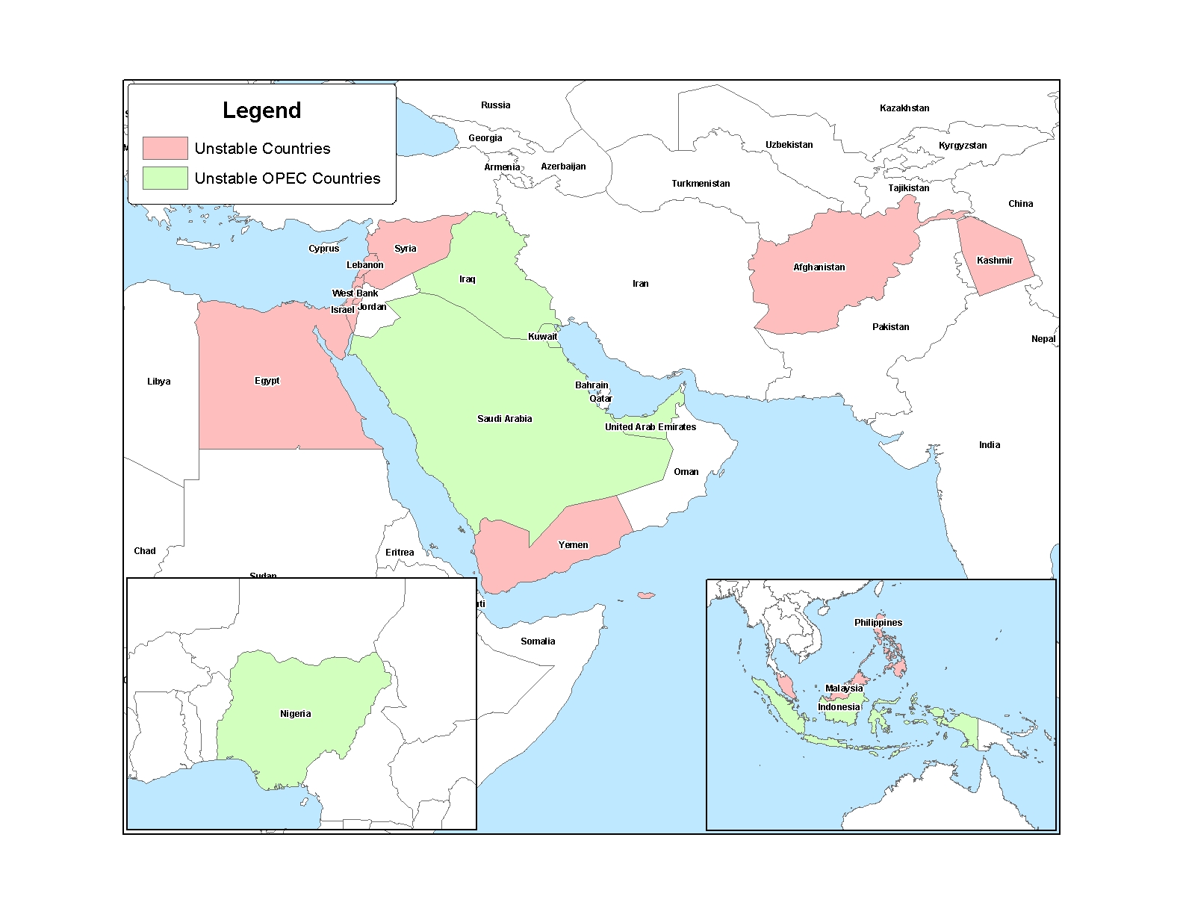
Troubled Regions of the World

Slide 5
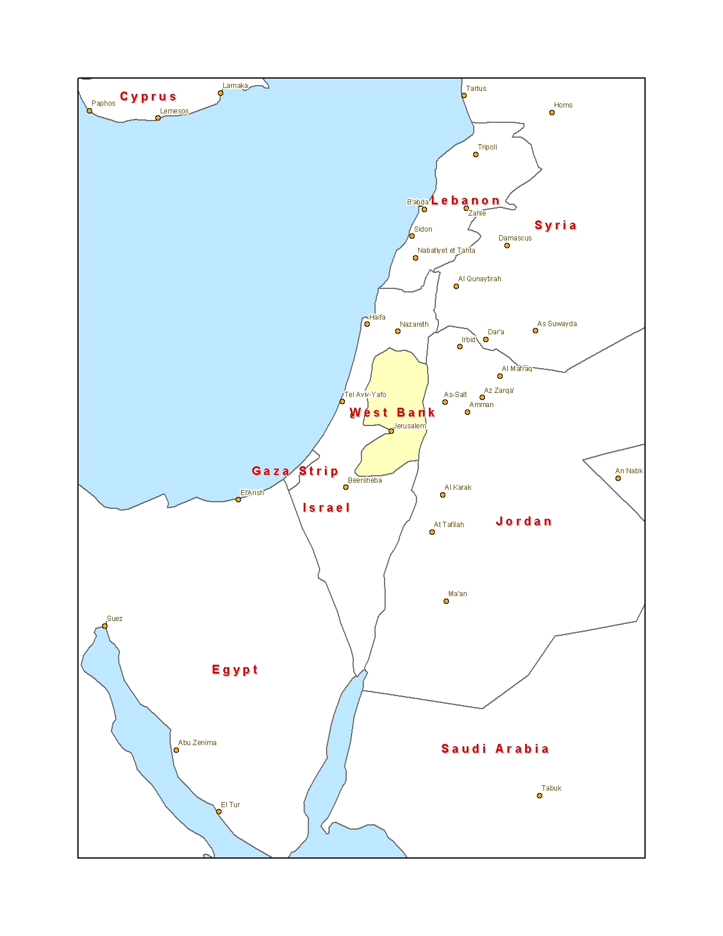
Israeli-Palestinian Conflict

Slide 6
Political/Economic

Slide 7
Federal Bank Actions
First rate cut on January 3rd – 10 cuts this year
  Declined from 6% to 2.5% since Jan’00
  GDP typically lags between 2-3 Quarters

Slide 8
Effect of Interest Rate Cuts
  Inflation rate stayed down
    CPI hovered around 3.5%
    Effect of cuts dampened by weak dollar, layoffs, excess capacity and cheap imports
    Cheap energy prices
  Housing Starts remained strong
    Real estate stronger than the rest of the economy
  Stock Market declined led by tech sector
    Consumer Confidence continues to devalue equities but effect of “tech wreck” dampened
    Shift towards real estate
  Corporate Spending declined
    Effects of stimulus plan might be limited due to tremendous overbuilding during boom. Fed cannot make unprofitable projects profitable.

Slide 9
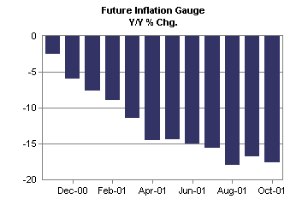
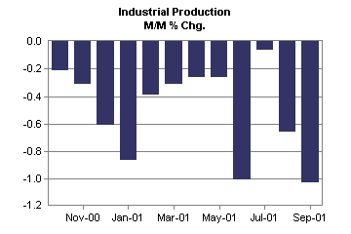
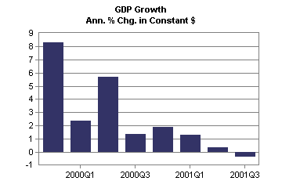
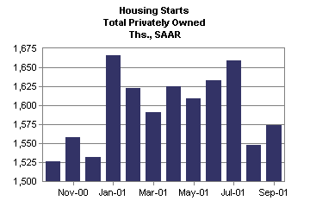
Key Economic Indicators

Slide 10
House Package – Tax Cut
House Package (vote: 216-214)
  Cost: 2002- $100 billion; 10 year- $159 billion
  Individuals
    New rebates between $300-$600 rebates
    Reduction in Marginal tax rate to 25% starting 2002 instead of 2006
    Increased Capital loss deductions from $3,000 to $5,000
  Corporations
    Provide 30% business expensing for purchase of capital assets
    Speed-up depreciation to 15years for remodeling of leased property
    Permanent repeal of corporate alternative minimum tax

Slide 11
Senate’s Package – Spending
“….. strictly show business” Treasury Secretary O’Neill on House proposal
Senate shares the this sentiment and proposes a package with two major changes
  Estimated Cost: $65-$75 billion
  Senate Republicans Favor:
    Tax break for business – revival led by business investment (approx. $75b)
    Cash payment to low-wage workers ( approx. $14b)
  Democrats Favor:
    Unemployment compensation
    Health benefits
    Raising Minimum Wage

Slide 12
Economic Stimulus so far…
“…..stimulus needs to be at least 1% - or $100 billion of the GDP” Fed Chairman Alan Greenspan
Actions taken to date:
  Tax cuts in Spring 2001 - $1.35 trillion
  $15 billion airline bailout
  $40 billion NYC recovery efforts
  Economic Stimulus Plan - $70 to $100 billion
Revival would be led by the consumer…..

Slide 13
Consumer Spending is Key to The US Economy
Consumer spending is 2/3 of Total Spending
Current Factors Affecting Consumer Spending:
  Unemployment
  “Bunker Mentality”: September 11th has kept the consumer at home and shopping less freely
Result: Fallen consumer spending has contributed to the contraction in the economy: GDP in Q3/01 was -0.4%

Slide 14
Consumer Confidence, Unemployment & GDP
There is a strong correlation between consumer confidence and GDP, correlation = 0.9

Slide 15
Employment: Before and After September 11th
Since Sept. 11th, at least one US company has announced layoffs practically every day
Many analysts project national unemployment going as high as 6.0% in early 2002
Notes:
Northeast – airlines, insurance, investment banks etc
Midwest – steel, automobile companies
Unemployment is projected to reach 5.8% nation wide in 2002 according to a survey of investment banks

Slide 16
When Will Consumers Start
Spending Again?
Presently: Home refinancing will help boost the economy
  Lower interest rates could pump $50 billion into the economy in 2001
    Two benefits to refinancing: 1. Monthly mortgage payments are lower and 2. The extra cash from refinancing is usually spent or saved
Late 2001/Early 2002: Economic stimulus package is imminent
  The House has proposed a $100 billion stimulus plan
    Who benefits: Big tax break to corporations
  Senate favors a $70 billion stimulus plan
    Who benefits: Even split between tax breaks for corporations and aid to unemployed
Into 2002: Possible tax rebate
  Most likely this won’t happen any time soon
  Could be added to tax return in April 2002

Slide 17
GDP Forecast: Reuter’s Wall Street Survey
Consumer spending will contract in Q4/01, job cuts will continue, and GDP will decline
Reuters Wall Street survey shows a rebound in the economy as early as Q1/02

Slide 18
Industrial/Commercial Consumption

Slide 19
Industrial Production (IP)
Past performance – longest decline in history
  12 consecutive declines in September 2001
  Capacity and inventory consolidation
Short term – recession and lower demand
  Low capacity utilization
  Low capital investment spending
Long term – turnaround & growth
  Great monetary and fiscal policy
  Recovery in consumer confidence

Slide 20
Industrial Demand for NG
Coal
Elect
NG
GDP Composition
Other
NG Composition
’98 Total = $8,509 billions
Total = 19.8 Bcf/day
Industry’s Energy
Total = 65 TBtu/day
Other includes: NGL, residual fuels, distillate fuels, coke, etc.

Slide 21
Drivers for Industrial Demand
2000-2001 NAPM Index
Industrial & consumer spending
  NAPM
  Cons. spending rebound
Light vehicle sales
  $2,000 worth of chemicals per vehicle
  $1,000 worth of steel & aluminum per vehicle
Housing starts
  Construction spending
  Building materials
  Appliances/durable goods
Exports, Construction, & Fertilizer usage
60
Inde
50
40
30
1-00
3-00
5-00
7-00
9-00
11-00
1-01
3-01
5-01
7-01
9-01

Slide 22
Consumer Spending Declines
Sharp drop post September 11th
  Sharper Image sales down 40%
  GAP and other apparel down 9%
  Discount stores remained defensive
Rebound In October
  Spending remains choppy
  Likely to running below last year
  Sharper Image sales still down 30 – 35 %
  Wal*Mart sales on track with expectation

Slide 23
Wal*Mart Sales on Track

Slide 24
Industrial Production Outlook
  IP (%) = -0.0421t²+1.29t-5.1182
IP(%) -- growth in percent from today
t -- time step in months

Slide 25
What Matters Now?
  Unwanted inventories and excess capacity were eliminated
  Oil and gas prices have fallen
  Great loosening of monetary and fiscal policy
  Very low industry capacity utilization
    September @ 75.5%,
    The lowest level since 1983
  Corporate-financing gap is at the highest level, 2.5% of GDP
  (capital spending - internal cash flow)
  Higher Insurance rates for corp.

Slide 26
Industry Break Down
Refineries - 2.69 Bcf/day
Pulp & Paper - 1.52 Bcf/day
Ammonia - 1.49 Bcf/day
Ethylene/Propylene - 1.47 Bcf/day
Steel - 1.25 Bcf/day
Industrial
Aluminum - 0.35
Consumption
Bcf/day
Methanol -
19.8
Bcf/day
0.26 Bcf/day
Other Industry - 6.25 Bcf/day
Food, transportation, coal, textile, beverage, tobacco, apparel, furniture, printing, etc.
Other Chemicals - 4.52 Bcf/day
Plastics, rubber, resins, industrial gases, etc.

Slide 27

Refineries NG Demand
Winter weather outlook
Heating fuels demand
Low oil prices
Product demand
  Airline industry
  Tracking industry

Slide 28

Pulp & Paper Industry Demand
  September pulp inventories down 11% from August
  Capacity utilization down
  79% vs. 84 last month
  Shipments down 5.4% yoy
  Advertising decline

Slide 29

Ammonia Industry Demand
  Increased demand
  Low NG prices
  Imports shipping cost
  Weather delays
  High inventories

Slide 30
Ethylene Industry Demand
New production capacity
  ExxonMobil
  BASF/Autofina
Low capacity utilization
Low energy cost
Low ethylene demand
  Automotive industry

Slide 31

Steel Industry Demand
Potential US trade restrictions
Low capacity utilization
  72.2% in September
Low demand
Low prices
High imports volumes

Slide 32

Aluminum Industry Demand
Lower energy cost
Low capacity utilization
Low demand
  Automotive industry
  Material substitution
Few remaining producers

Slide 33

Methanol Industry Demand
Lower NG prices
Low capacity utilization
Higher shipping cost
  Imports more expansive
Low demand
New offshore mega plants
  Much lower prod. cost

Slide 34
NG Demand by Other Industry
Lower inventory levels
Low capacity utilization
More efficient technologies
Low demand
  Automobil sales
  Housing starts
  Consumer spending

Slide 35

Total Industrial Consumption
  Gas Fundamentals Forecast

Slide 36
Defense Spending vs. GDP

Slide 37
Defense Contracts: No major impact to demand
Exposure to Defense Contracts
U.S. = 1.2% of GDP
Above average
Average
(based on Jan. 2000 data)
Below average

Slide 38
Travel/Tourism: Significant Effect on Demand
Exposure to Terrorist Effect
Note: Includes tourism,
restaurants, securities,
P&C insurance, and
civilian aerospace.
U.S. = 10% of GDP
Above average
Average
Below average
(based on Jan. 2000 data)

Slide 39

Travel and Tourism
The nations 2nd largest employer.
18 million people generated about $1 billion in national, state and local tax revenue in 2000.
1 in 10 people have a job in this sector.

Slide 40

Effects on Airline Industry
Industry Size - $237 billion.
Projected 2001 Economic Impact of Attack - $15 billion.
Layoffs approximately 137,000 workers.
20 % capacity cut.
Industry forecasts 40% drop in revenues.

Slide 41
Effects on Airline Related Manufacturing
Boeing deliveries down
  500 planes delivered this year as opposed to 538 originally planned.
  Next year’s shipments are projected to fall 20%.
  Loss in sales could exceed $2 billion
General Electric and other part manufacturers orders fall.
  Drops expected to be as much as 25%.
  Layoffs in many commercial airline production plants.

Slide 42
Effects on Tourism Industry
Industry size - $168 billion
Projected 2001 economic impact - $16 billion
Florida, alone, forecasts 20% decline in tourism related revenue, nearly $300 million.
Theme parks projected to lose $680 million.
Lodging industry as whole to lose $10 to $15 billion over next three months.

Slide 43
Effects on Tourism Related Manufacturing
Hotel construction takes a hit.
  Construction industry expected to decline 6.3% in terms of dollar volume.
  Intense price competition results in reduced profit margins forcing production on new hotels to decline.
Decline is expected to last until at least second half of 2002.

Slide 44
Summery of Industrial/Commercial Demand
Industrial Consumption: Bearish to Flat
Commercial Consumption: Bearish
Residential Consumption (based on Employment decline): Bearish

Slide 45
Energy Infrastructure

Slide 46
Nuke Infrastructure
103 Nuclear Plants
  In 2000, Nukes generated 20% of the nations electricity (753 billion kWh)
  Utilization rate of 88%
Nuclear Plant security does not meet minimum requirements.
  47% failure rate in repelling armed attackers
  Bringing plants up to code costs $2,000,000
Uncertainty
  Loss of the NRC report creates uncertainty about nuclear supply
  When nuke goes down, 44% of generation replacement is natural gas
    1100MW reactor loss will increase NG demand by 1.82 Bcf/d

Slide 47
Pipeline Security Measure
Pipelines have adopted “heightened awareness” practices
  Restricted access to previously public facilities
  Instructed security guards on new threats
  Notified land owners about notification procedures with suspicious activity
FERC has promised to allow energy companies to recover the cost of any security upgrades
  DOT expects companies to pay for most security costs
  No new additional expenditures

Slide 48
El Paso Explosion/Market Analysis
Supply Disruption Case Study:
El Paso Pipeline Explosion August 19, 2000
  Took 500 MMcf/d off the market
  Combination of fuel switching by downstream customers, maximum storage withdrawals, an OFO, and other customer cooperation to compensate
  Flows were up on Northern Natural (200-300 MMcf/d) and Transwestern (50-75 MMcf/d)
  Border spreads increased substantially from $1.48 to $2.16
  Gas flows were backed into Waha increasing prices by $0.30
Utilities did not experience supply problems

Slide 49
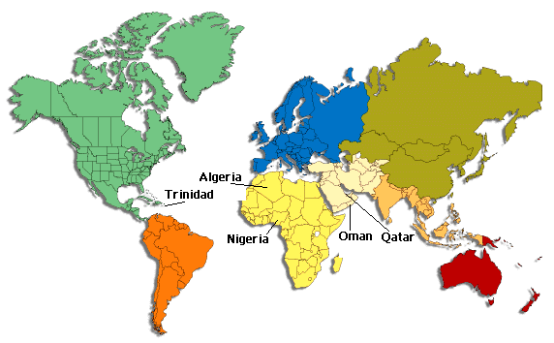
LNG Supplies
We expect an across the board tightening in security at ports.
  Boston’s mayor remains concerned about risks due
  to LNG ships in port

Slide 50
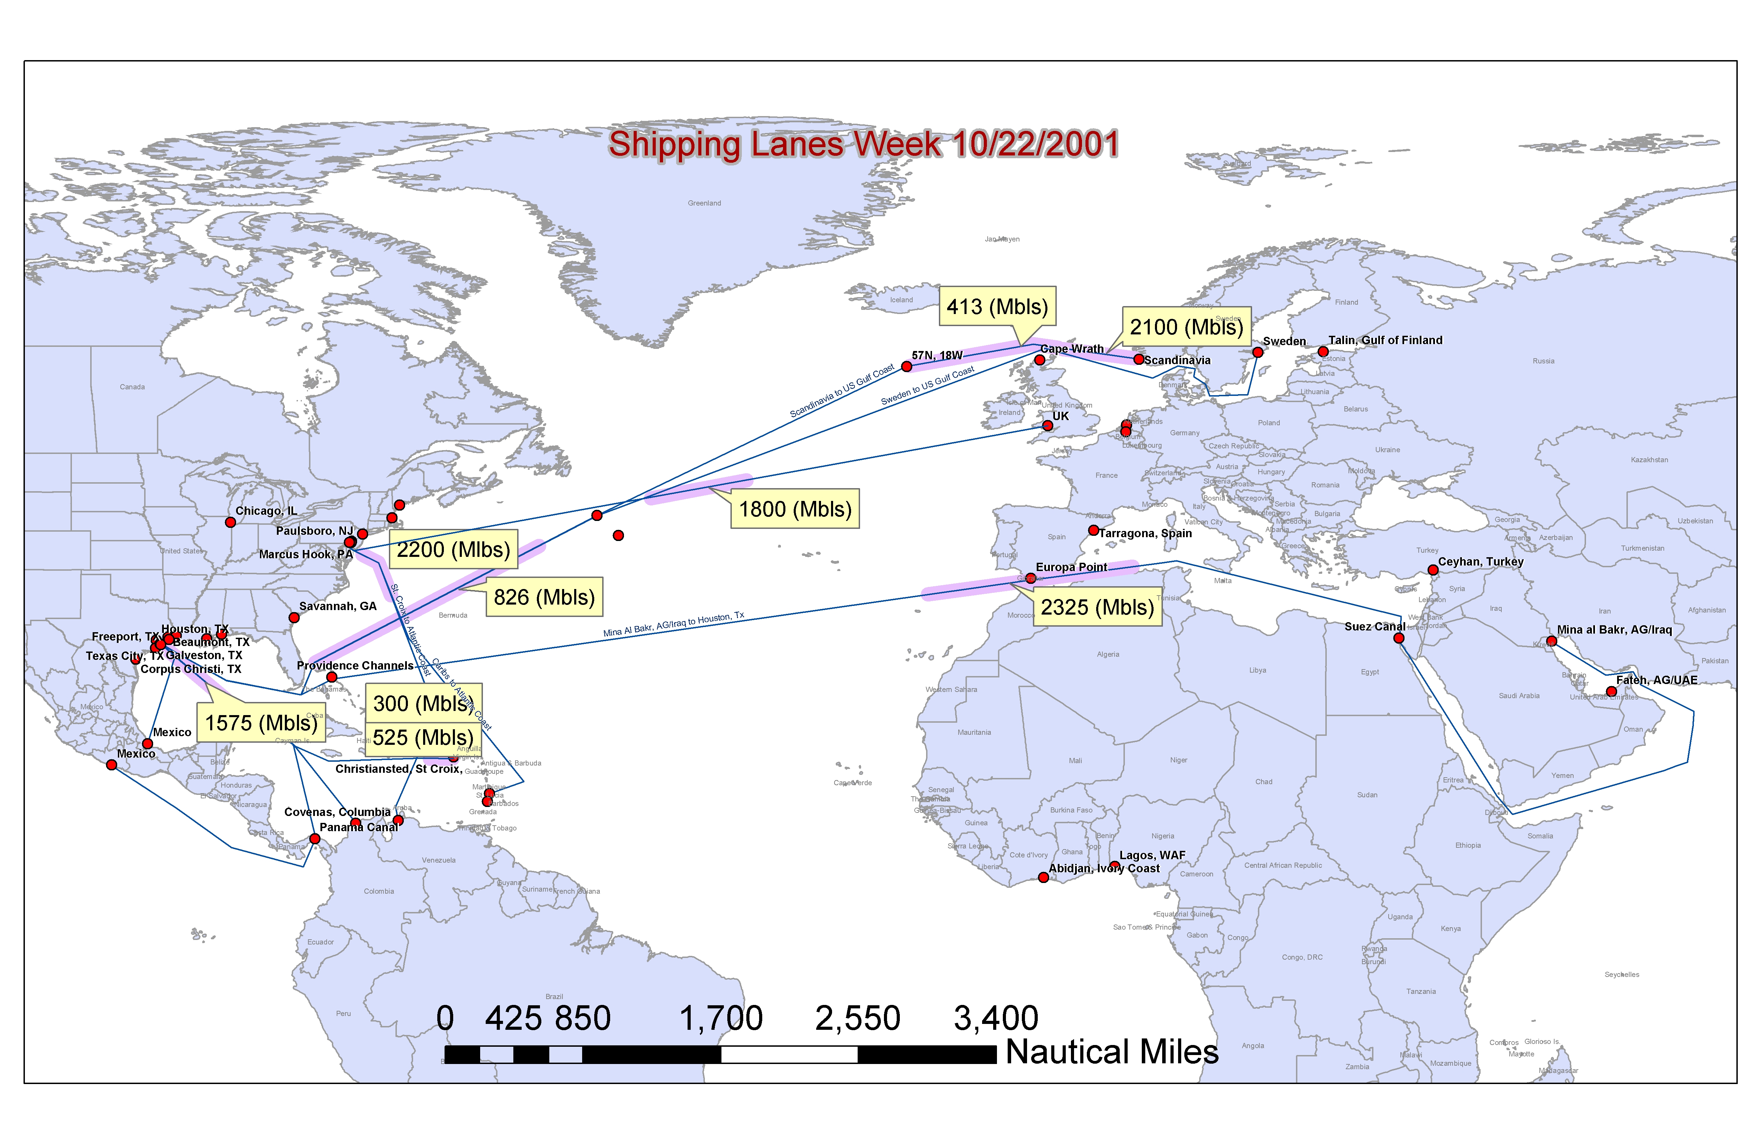
Shipping Lanes

Slide 51
U.S. Security Measures
94 Security Zones have been established
Commercial vessels require 96-hour advance notice
  Must include crew list that details each nationality
  Seafarers from particular countries will not be permitted to leave their ship
    Afghanistan, Algeria, Comoros, Cuba, Egypt, Iran, Iraq, Jordan, Kuwait, Libya, Malaysia, Maldives, North Korea, Pakistan, Palestinian, Qatar, Saudi Arabia, Somalia, Sudan, Syria, Tajikistan, Tunisia, Turkey, Turkmenistan, UAE, Uzbekistan, Yemen, Yugoslavia
Armed Coast Guard boarding of commercial vessels
Escort of cruise ships and certain U.S. naval ships in and out of port
500-yard security zone around U.S. naval vessels.
Authority to control the anchorage and movement of any vessel in U.S. waters
Security Measures in effect from 10/4/01 – 6/15/2002

Slide 52
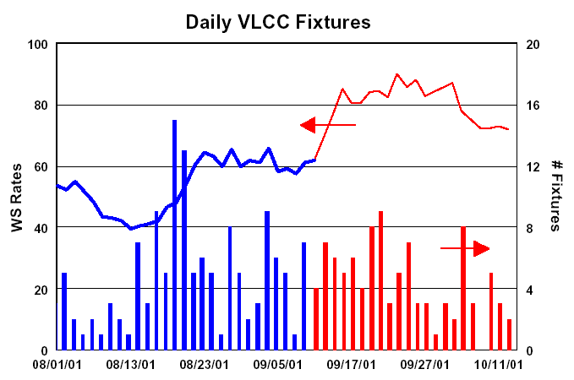
Surcharges Due to War-Risk
Shipping rates for vessels transiting the Gulf are expected to rise an average 10 – 15% from Sept. 27th
Premium for “hull and machinery coverage” to double to .025% for ships transiting the Suez Canal and Red Sea
Ships traveling through the Western Gulf, as well as to Sri Lanka, are expected to have rates increase by .075%
Surcharges of $.50 a barrel to Iranian or Iraqi crude. Other Gulf countries could be pushed up to $.25 a barrel

Slide 53
Shipping Surcharges

Slide 54
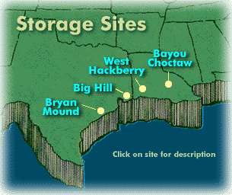
Strategic Petroleum Reserves
Currently at 540 million barrels
Congress Votes to Stockpile
  Increase storage facilities from 700 Million Barrels to 1 billion barrels
    Cost $500 million and 5 years to finish
    Buying 460 million barrels at $19 per barrel would cost roughly $9Billion
Approaches
  Expand reserves to 1 billion barrels
  Expand quickly to 700 Million Barrels
  Slowly increase reserves to 700 Million Barrels
Sources of SPR

Slide 55
Political Diplomacy and OPEC

Slide 56
Possible Targets
Iraq
  616,000 MMBD of crude to US
Syria & Lebanon
  Syria exports 276,000 MMBD, mostly to Europe
  Lebanon will follow suit
Philippines-Abu Sayyef
  Major trading partner of US-electronics products and garments
  Major energy product importer
Indonesia
  World’s largest exporter of LNG
  Major refiner of Saudi Crude
Yemen
  367,000 MMBD
Saudi Arabia
  8 MMBD exported

Slide 57
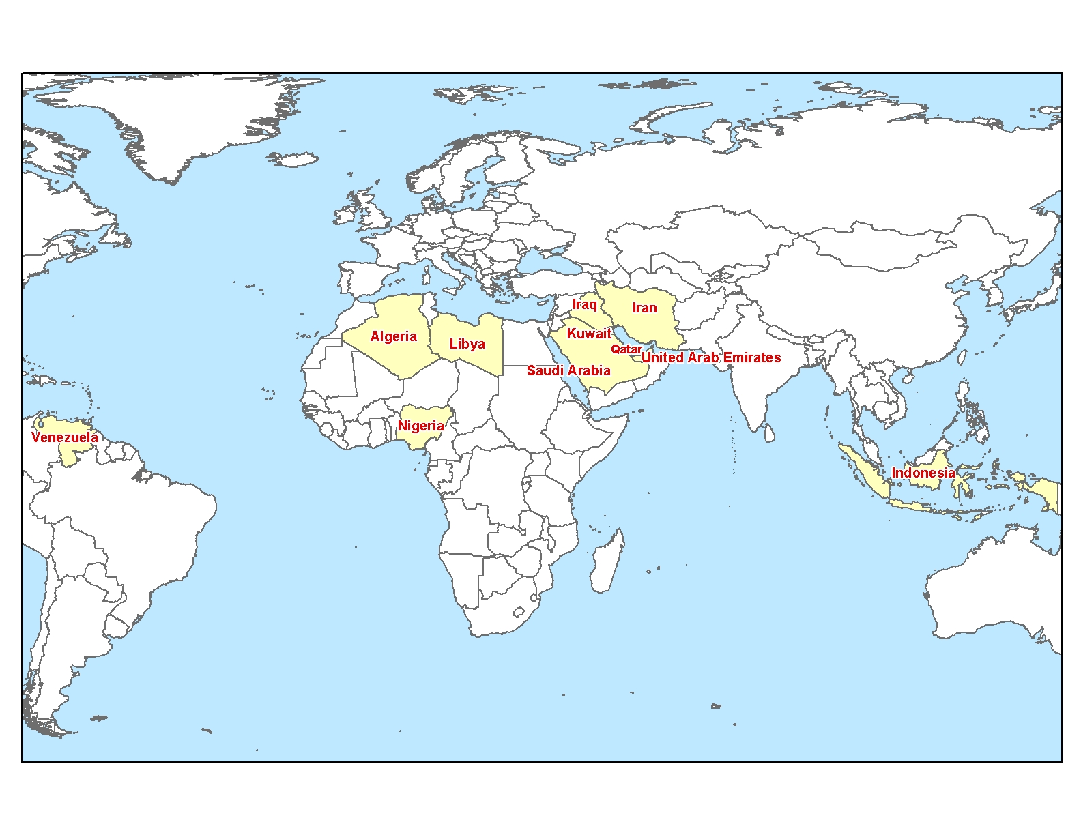
OPEC Countries

Slide 58
Impact of OPEC
OPEC controls 2/3 world exports
Crude prices direct impact on GDP growth→indirectly effects gas demand
High crude prices→High #6 prices→less gas switching
  Study showed that in 1994 70% of establishments that could switch from #6 to gas did sighting fear of shortage as main concern
Doubts of OPEC control on reduction capability keep prices low
Every dollar crude goes down→$5 billion in disposable income pumped back in to economy
Non-OPEC countries gain market/price control, i.e. Russia

Slide 59
Oil Price Effect on GDP

Slide 60
Crude Oil Relationships

Slide 61
Fuel Switching
45,722 MW of Natural Gas to F06 Switchability
  5.855 Bcf/d equivalent

Slide 62
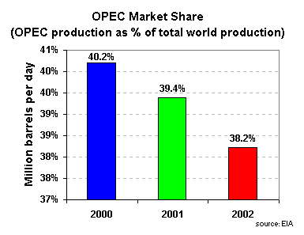
OPEC
World Oil Price’s @ 2 Year Low
World Demand Low-Jet Fuel, ect.
Chavez Tours Middle East
Heavy Lobbying by ALL
Calls for a reduction of 1 MM bpd
Disbelief of OPEC’s power
Iraqi sanctions→Cut of Supply
Working with non-OPEC countries
OPEC meeting on Nov 14

Slide 63
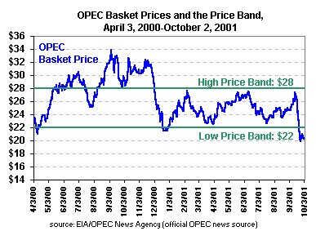
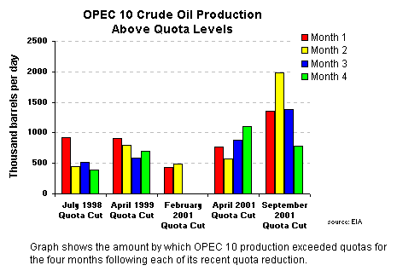
OPEC Production Cuts

Slide 64
What Truly Decides Who Fights:
Net Oil Importers
Top Petroleum Net Importers, 2000
(Million Barrels per Day)
Rank
Country
Consumption
Production
Net Imports
1.
United States
18.7
7.7
11
Leading the War on Terrorism
2.
Japan
5.6
0.1
5.6
Considering sending warships:first since WWII
3.
Germany
2.8
0.1
2.7
Providing 3,900 troops for War
4.
South Korea
2.1
0.1
2.0
Reinstating war games with US in SE Asia
5.
France
2.0
0.1
2.0
Considering/Organizing troop involvement
6.
Italy
2.0
0.1
1.8
Leading charge on money tracking; offered to send troops
7.
Spain
1.5
0.0
1.5
8.
India
1.8
0.7
1.1
9.
China
4.6
3.2
1.4
10.
Taiwan
0.8
0.0
0.8

Slide 65
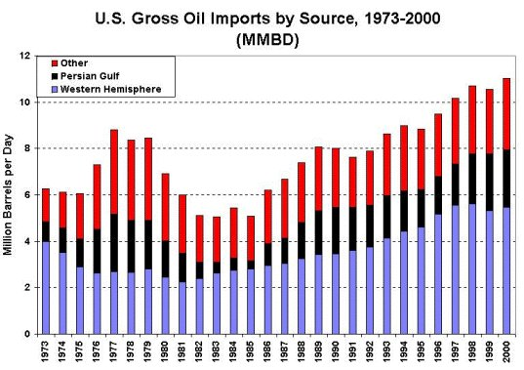
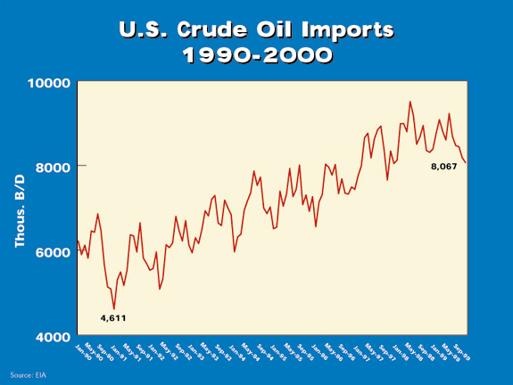
US Oil Exposure
US consumption-18.7 MM bpd
  43% motor gasoline
  25% “other oils”
  19% distillate fuel oil
  9% jet fuel
  4% residual fuel
US Production- 7.7 MM bpd
US Imports-11.09 MM bpd
US Exports-0.08 MM bpd
Oil demand has slumped by 4% (750,000 bpd) since 9/11
1.6% increase in US crude oil inventories, refined products also up

Slide 66
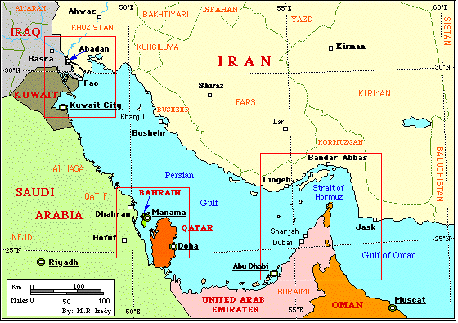
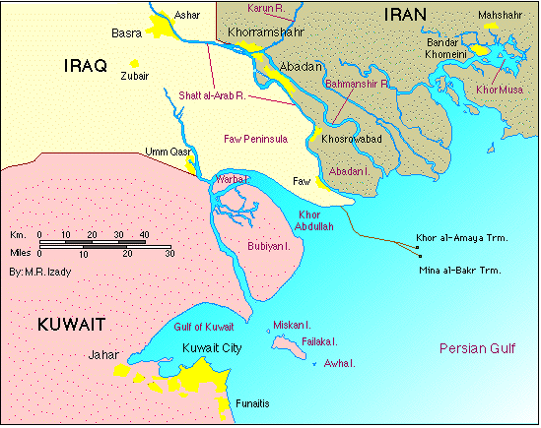
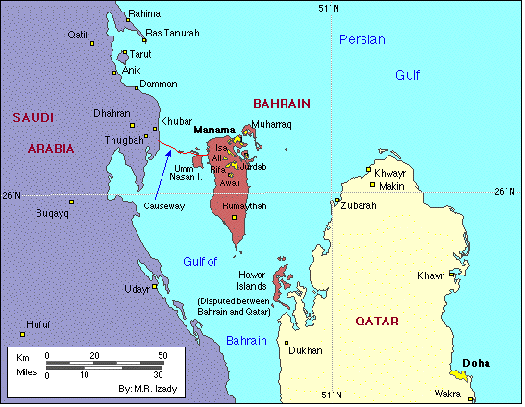
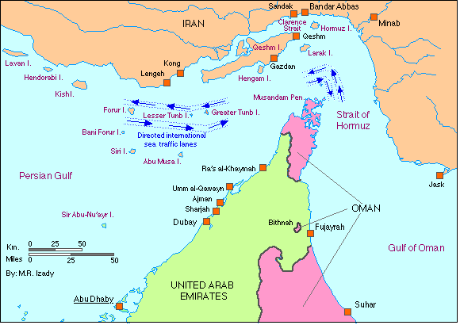
Places to Watch
(The Persian Gulf)

Slide 67
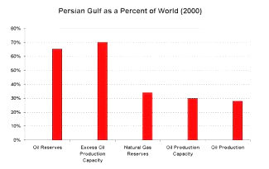
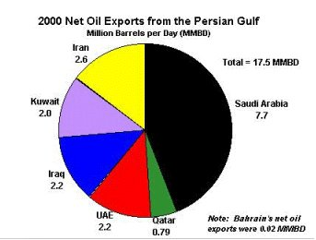
Places to Watch
(The Persian Gulf)

Slide 68
Russia(including “Stans”)vs. Saudi Arabia
2000 production-8.03 MM bpd
Not bound by OPEC
Aug’01 Production-8.04 MM bpd
Estimated Capacity-9.2 MM bpd
Consumption-3.4 MM bpd
Proved Reserves- 65* MM barrels
World’s largest supply of NG (1,700 TCF in proven reserves)
Increased Capital potential
Pipeline Projects
Putin-Bush Relations good
2000 production-9.15 MM bpd
OPEC Quota- 7.5 MM bpd
Aug ’01 Production-8 MM bpd
Estimated Capacity-10.1 MM bpd
Consumption-1.3 MM bpd
Proved Reserves-261.7 MM barrels
Increased Risk Premium
Natural Gas Projects
SA Royalty loosing face

Slide 69
Summery of Oil Impact on Gas
If no threat to supply
  Fuel Switching Increase: Bearish
  Low oil price’s impact on economy: Bullish
  Fuel Switching would be more influential
If Supply Threatened
  Gas demand would increase: Bullish

Slide 70
In Conclusion…
Fiscal Stimulus: Bullish
Consumer Confidence: Bearish
Industrial/Commercial: Bearish to Flat
Security Threats and Costs: Bearish
OPEC: Mostly Bearish

Slide 71

God Bless America

