Slide 1
Routine Overhaul of Combustion Turbine Components
Presented to:
U.S. Environmental Protection Agency (EPA)
Presented by:
Member Companies of the
Interstate Natural Gas Association of America (INGAA)
Durham, North Carolina
November 9, 1999
<number>

Slide 2
Topics
Turbines in Interstate Natural Gas Transmission Service
Overhaul Practices
Overhaul Process
Components Subject to Overhaul
Gas Producer and/or Power Turbine Replacement Components
Overhaul Intervals
Costs for Overhaul
Regulatory Context for Overhaul
Routine maintenance exempt from definition of “modification”
Overhaul costs below 50% threshold in definition of “reconstruction”
Review of four regulatory solutions proposed by Washington Department of Ecology to EPA Region 10
Industry Recommendations to EPA
<number>

Slide 3
Turbines in Interstate Natural Gas Transmission Service (1)
Natural gas-fired turbines used at compressor stations to provide power to move natural gas within the pipeline
Industry relies on turbine operation to provide continuous and uninterrupted service of the pipeline system, as required by the Federal Energy Regulatory Commission (FERC)
Compressor stations located approximately every 70 miles
More than 900 natural gas-fired turbines in service
Most units are simple-cycle, aero-derivative or light industrial turbines
Average size is approximately 6,300 horsepower Median size is approximately 4,400 horsepower
Principal manufacturers:
General Electric, Rolls Royce, Solar Turbines, Allison
<number>

Slide 4
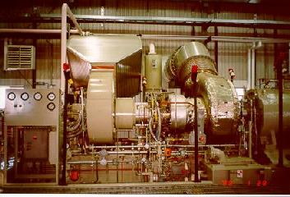
Solar Taurus
<number>

Slide 5
Solar Mars
<number>

Slide 6
ANR sideview (Detroit Diesel)
<number>

Slide 7
General Electric LM1600 & LM2500
Insert photographs provided
by Great Lakes & ANR
<number>

Slide 8
General Electric LM1600 & LM2500
Insert photographs provided
by Great Lakes & ANR
<number>

Slide 9
General Electric LM1600 & LM2500
Insert photographs provided
by Great Lakes & ANR
<number>

Slide 10
General Electric LM1600 & LM2500
Insert photographs provided
by Great Lakes & ANR
<number>

Slide 11
Major Components of a Natural Gas-Fired Turbine
Air inlet system
Accessory drive system
Gas producer
Fuel delivery system
Cooling system
Lube system
Power turbine
Power shaft
Control system
Starting system
Exhaust system
<number>

Slide 12
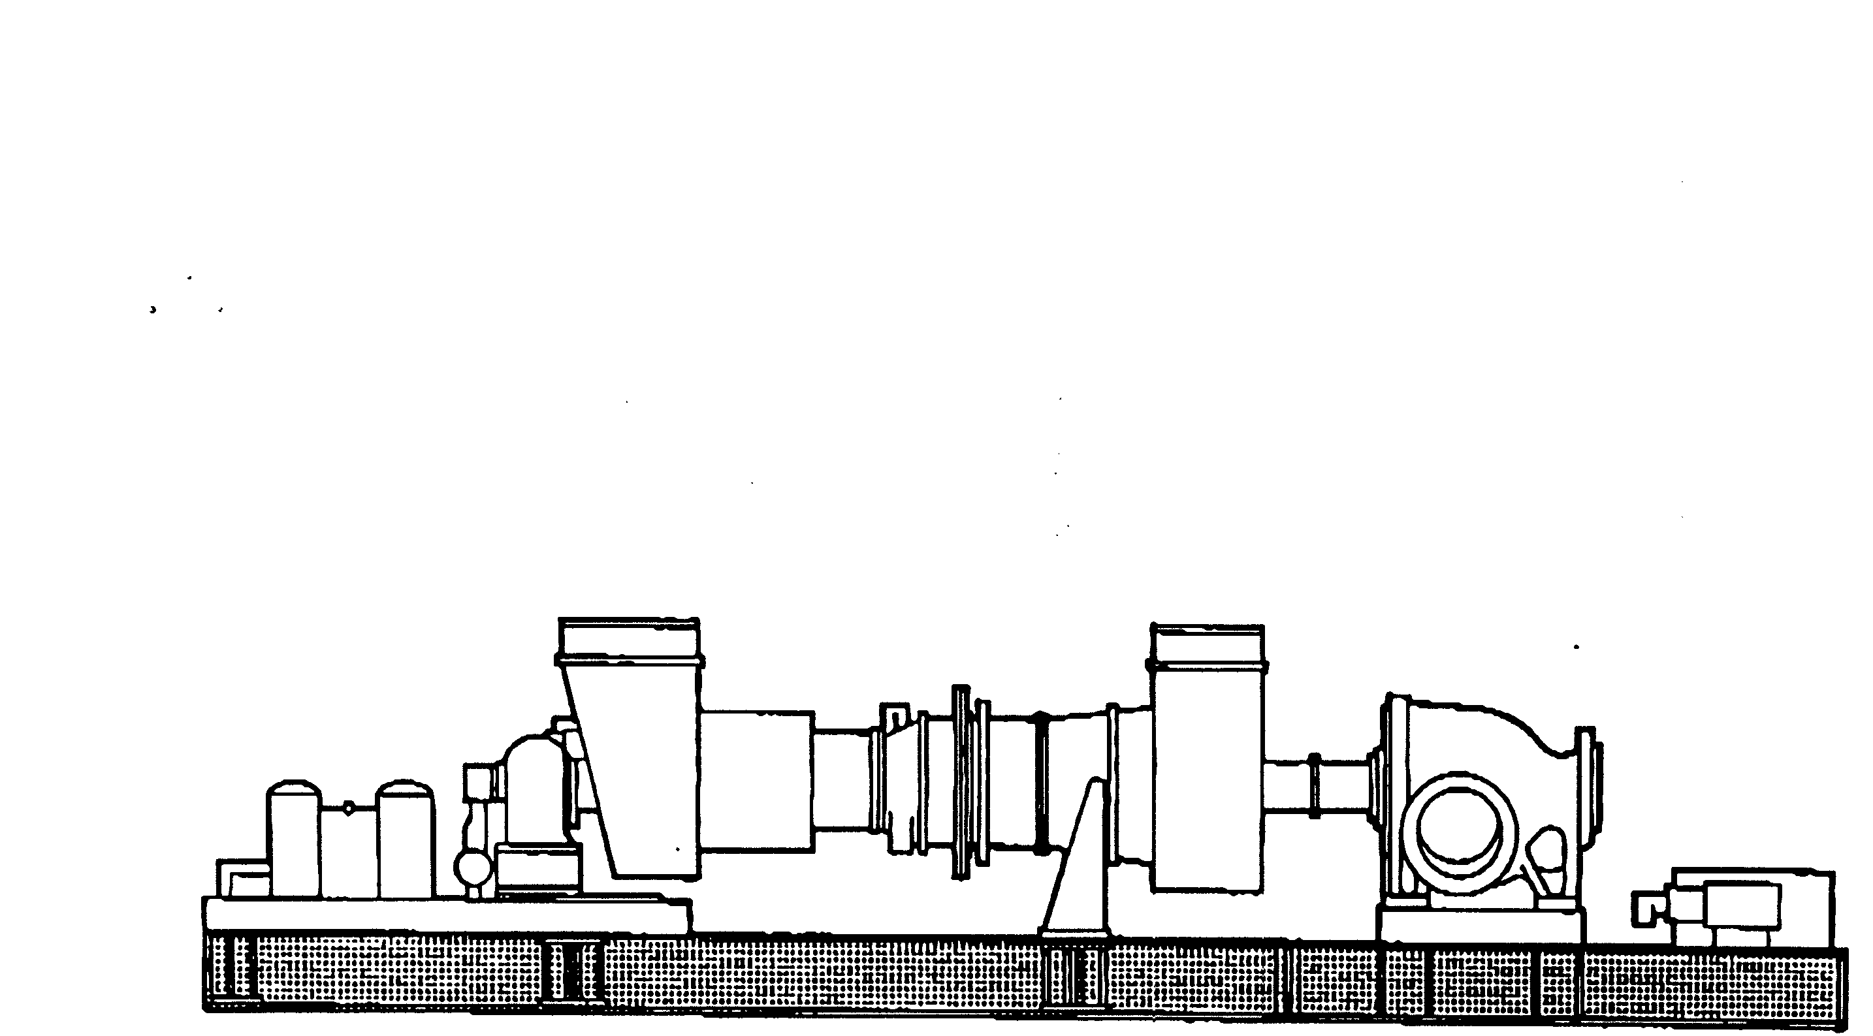
Gas Producer Component
Axial Compressor
Air Inlet
Exhaust Duct
Combustor
Power Shaft
Accessories & Accessory Drive
Power Turbine Component
Driven Unit
(Gas Compressor)
<number>

Slide 13
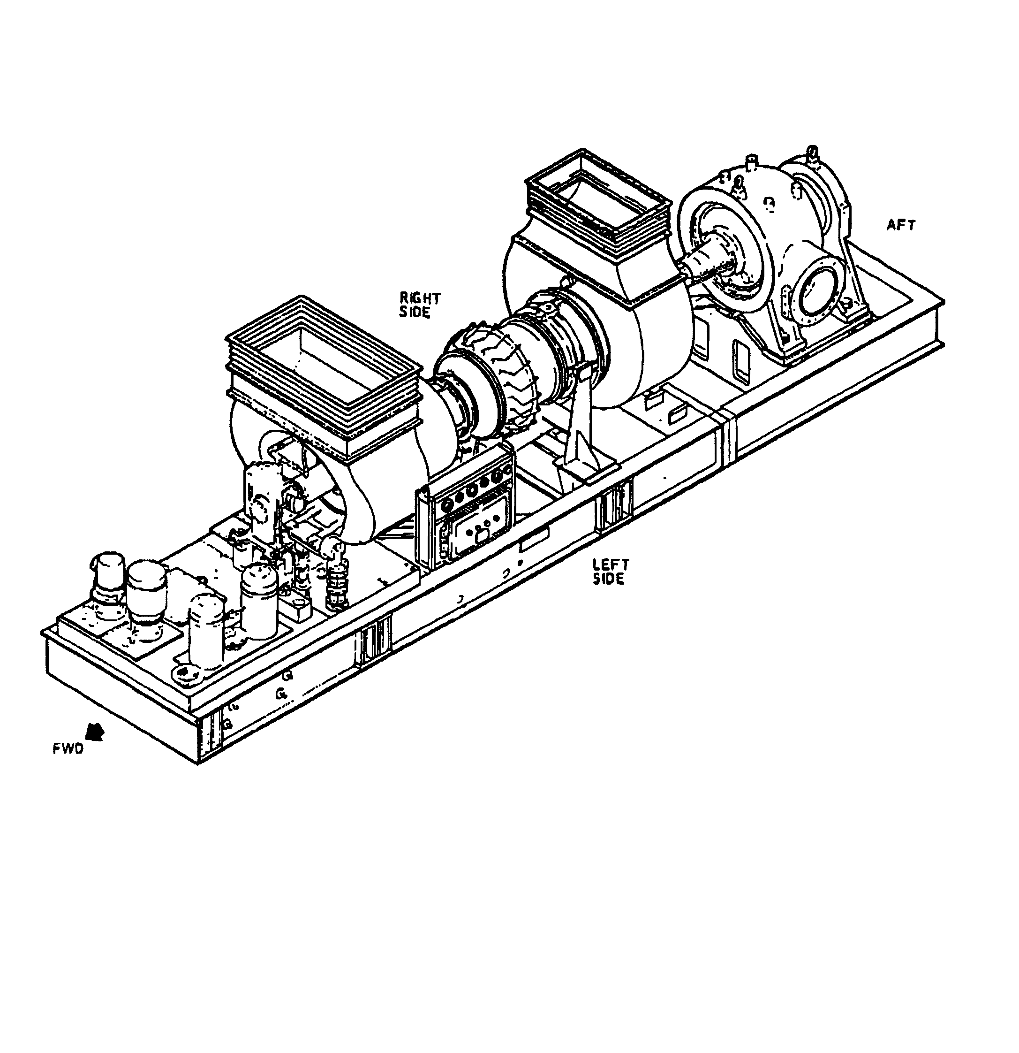
<number>

Slide 14
Solar Taurus
<number>

Slide 15
Solar Saturn Gas Producer & Power Turbine Components
Insert cut-away view for gas compression
with big duct -- black & white
<number>

Slide 16
Solar Saturn Gas Producer & Power Turbine Components
Insert cut-away view for gas compression
with big duct -- color
<number>

Slide 17
Overhaul Practices: Process (1)
To provide safe, reliable service, turbines require a program of planned maintenance, including overhaul of the gas producer and power turbine components
Need for overhaul stems largely from wear of the axial flow compressor & the “hot” section components, as a result of turbine operation:
thermal stresses
mechanical stresses
corrosion & erosion
foreign object damage
Overhaul process includes disassembly, inspection, repair and/or replacement, assembly, & testing of gas producer and power turbine components
Requires a specialized facility & trained personnel
<number>

Slide 18
Overhaul Practices: Process (2)
Particular attention to wearing subcomponents
For example:
Rotor and stator wear and clearances
Inspection and repair/replacement of bearings and seals
Deposits, erosion and corrosion pitting of the inlet guide vanes and/or exit guide vanes
Fretting and/or cracks in combustion liner or cans
Foreign object damage
Degree to which parts or components are replaced depends on the conditions noted during inspection, number of hours in service, and number of starts
Overhaul restores the mechanical performance of components to ensure safe & reliable service
<number>

Slide 19
Overhaul Practices: Process (3)
Routine overhaul does not increase horsepower output, heat input, or brake-specific emissions
Power uprates can, in some cases, be added, but this is a separate process from routine overhaul
Power uprates are not considered routine maintenance
Industry recognizes that power uprates may be considered a modification under PSD, NSR, minor NSR, and/or NSPS
Power uprates that increase mainline pipeline capacity typically require reporting to and approval by the Federal Energy Regulatory Commission (FERC)
<number>

Slide 20
Components Subject to Overhaul
Gas producer and/or power turbine components subject to overhaul
Following subcomponents are inspected and may be repaired or replaced during overhaul:
Front bearing housing – Turbine blades & discs
Inlet guide vanes – Hot section subcomponents
Axial flow compressor case – Internal wheelcase
Stator vanes – Air intake snouts
Bleed valves – External wheelcase
Axial flow compressor wheels & shaft – Nozzle box
Axial flow compressor outlet casing – Rear bearing assembly
Axial flow compressor rotor blades – Flame tubes & air casing
Fuel injectors
For many turbines, gas producer and/or power turbine components designed for modular replacement
<number>

Slide 21
Solar Saturn Gas Producer & Power Turbine Components
Insert cut-away view for gas compression
with big duct -- black & white
<number>

Slide 22
Solar Gas Producer & Power Turbine Components
Taurus Cutaway
<number>

Slide 23
Use of Replacement Gas Producer & Power Turbine Components
Manufacturers designed-in ability to replace gas producer and/or power turbine as modular components
Use of replacement components has been a principal part of maintenance for past 30 years
Key benefits of the use of replacement components
Centralized facility to perform overhaul, with sophisticated equipment and trained personnel
Reduced downtime
Companies created specifically to provide this service
Use of standard exchange gas producer and/or power turbine components does not extend the life of a turbine
<number>

Slide 24
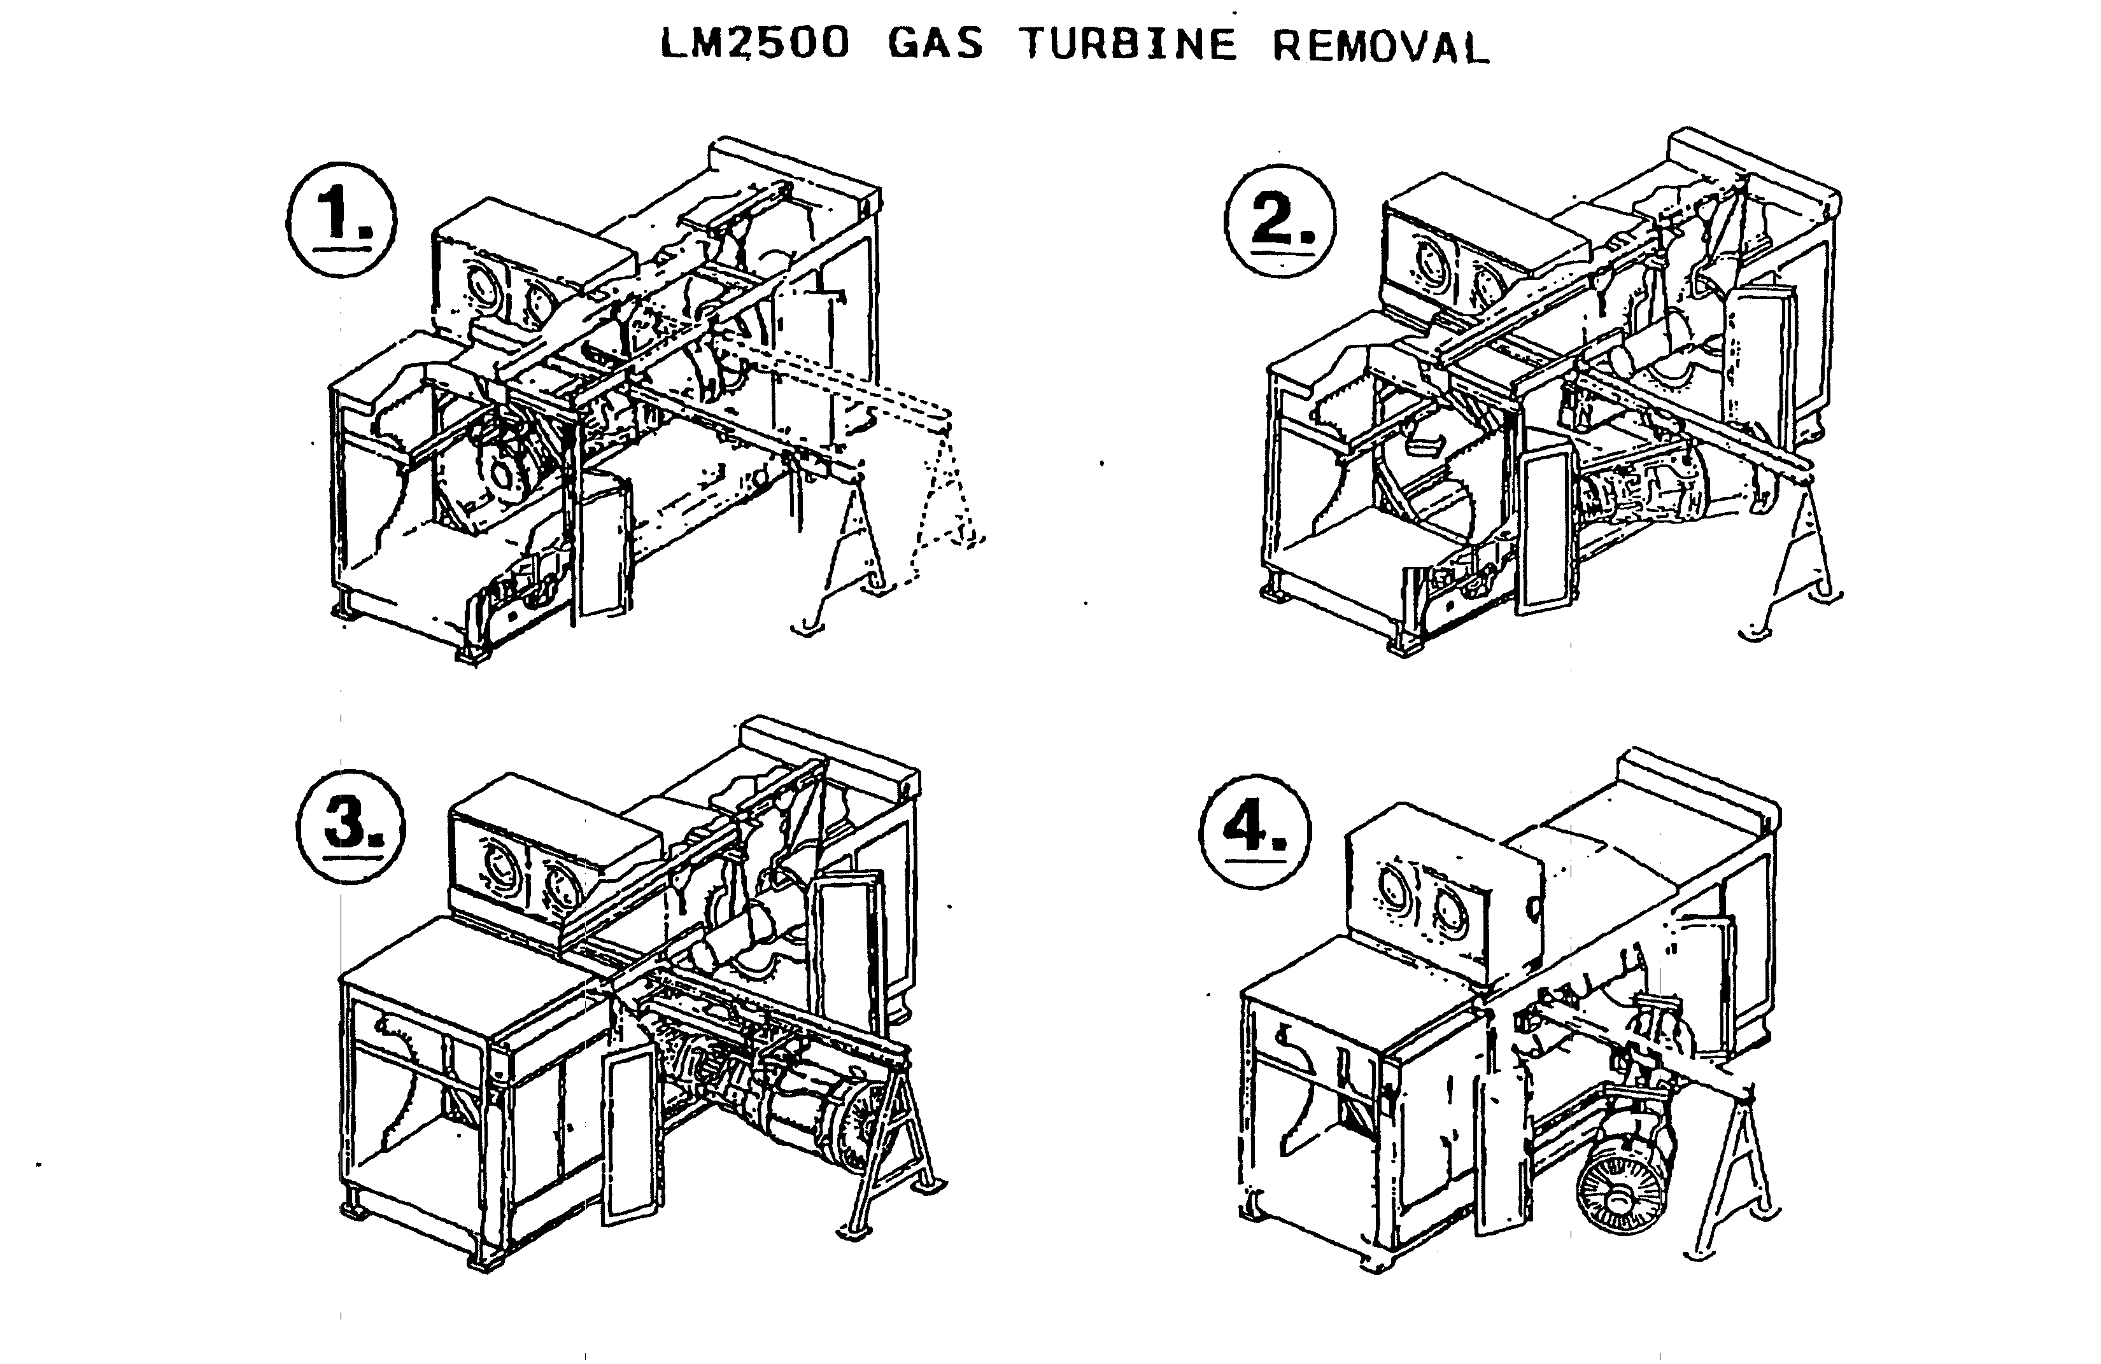
Removal of G.E. Gas Producer Component
<number>

Slide 25
Overhaul Interval
Overhaul may be initiated based on:
Hours of operation and/or number of startups, according to manufacturers’ or 3rd-party schedules for overhaul intervals
Results of inspection that indicate overhaul is needed, including high equipment vibration levels, abnormal oil temperatures, & visible damage or wear
Specific intervals vary depending on operating conditions
Manufacturers’ recommendations:
Solar, General Electric, & Rolls Royce recommend scheduled overhauls at approximately 30,000 hours of service, depending on the turbine model
Based on above, gas producers and/or power turbines overhauled at least every 3 to 4 years of operation
<number>

Slide 26
Costs of Overhaul
Overhaul costs typically range from 6 to 17% of the total cost of a new natural gas-fired turbine
Examples from Solar:
Solar Saturn (1,690 hp)
Avg. purchase price of a new turbine $1,324,720
Avg. overhaul price $ 100,000 (7.6%)
Solar Mars (15,000 hp)
Avg. purchase price of a new turbine $6,060,450
Avg. overhaul price $ 950,000 (15.7%)
<number>

Slide 27
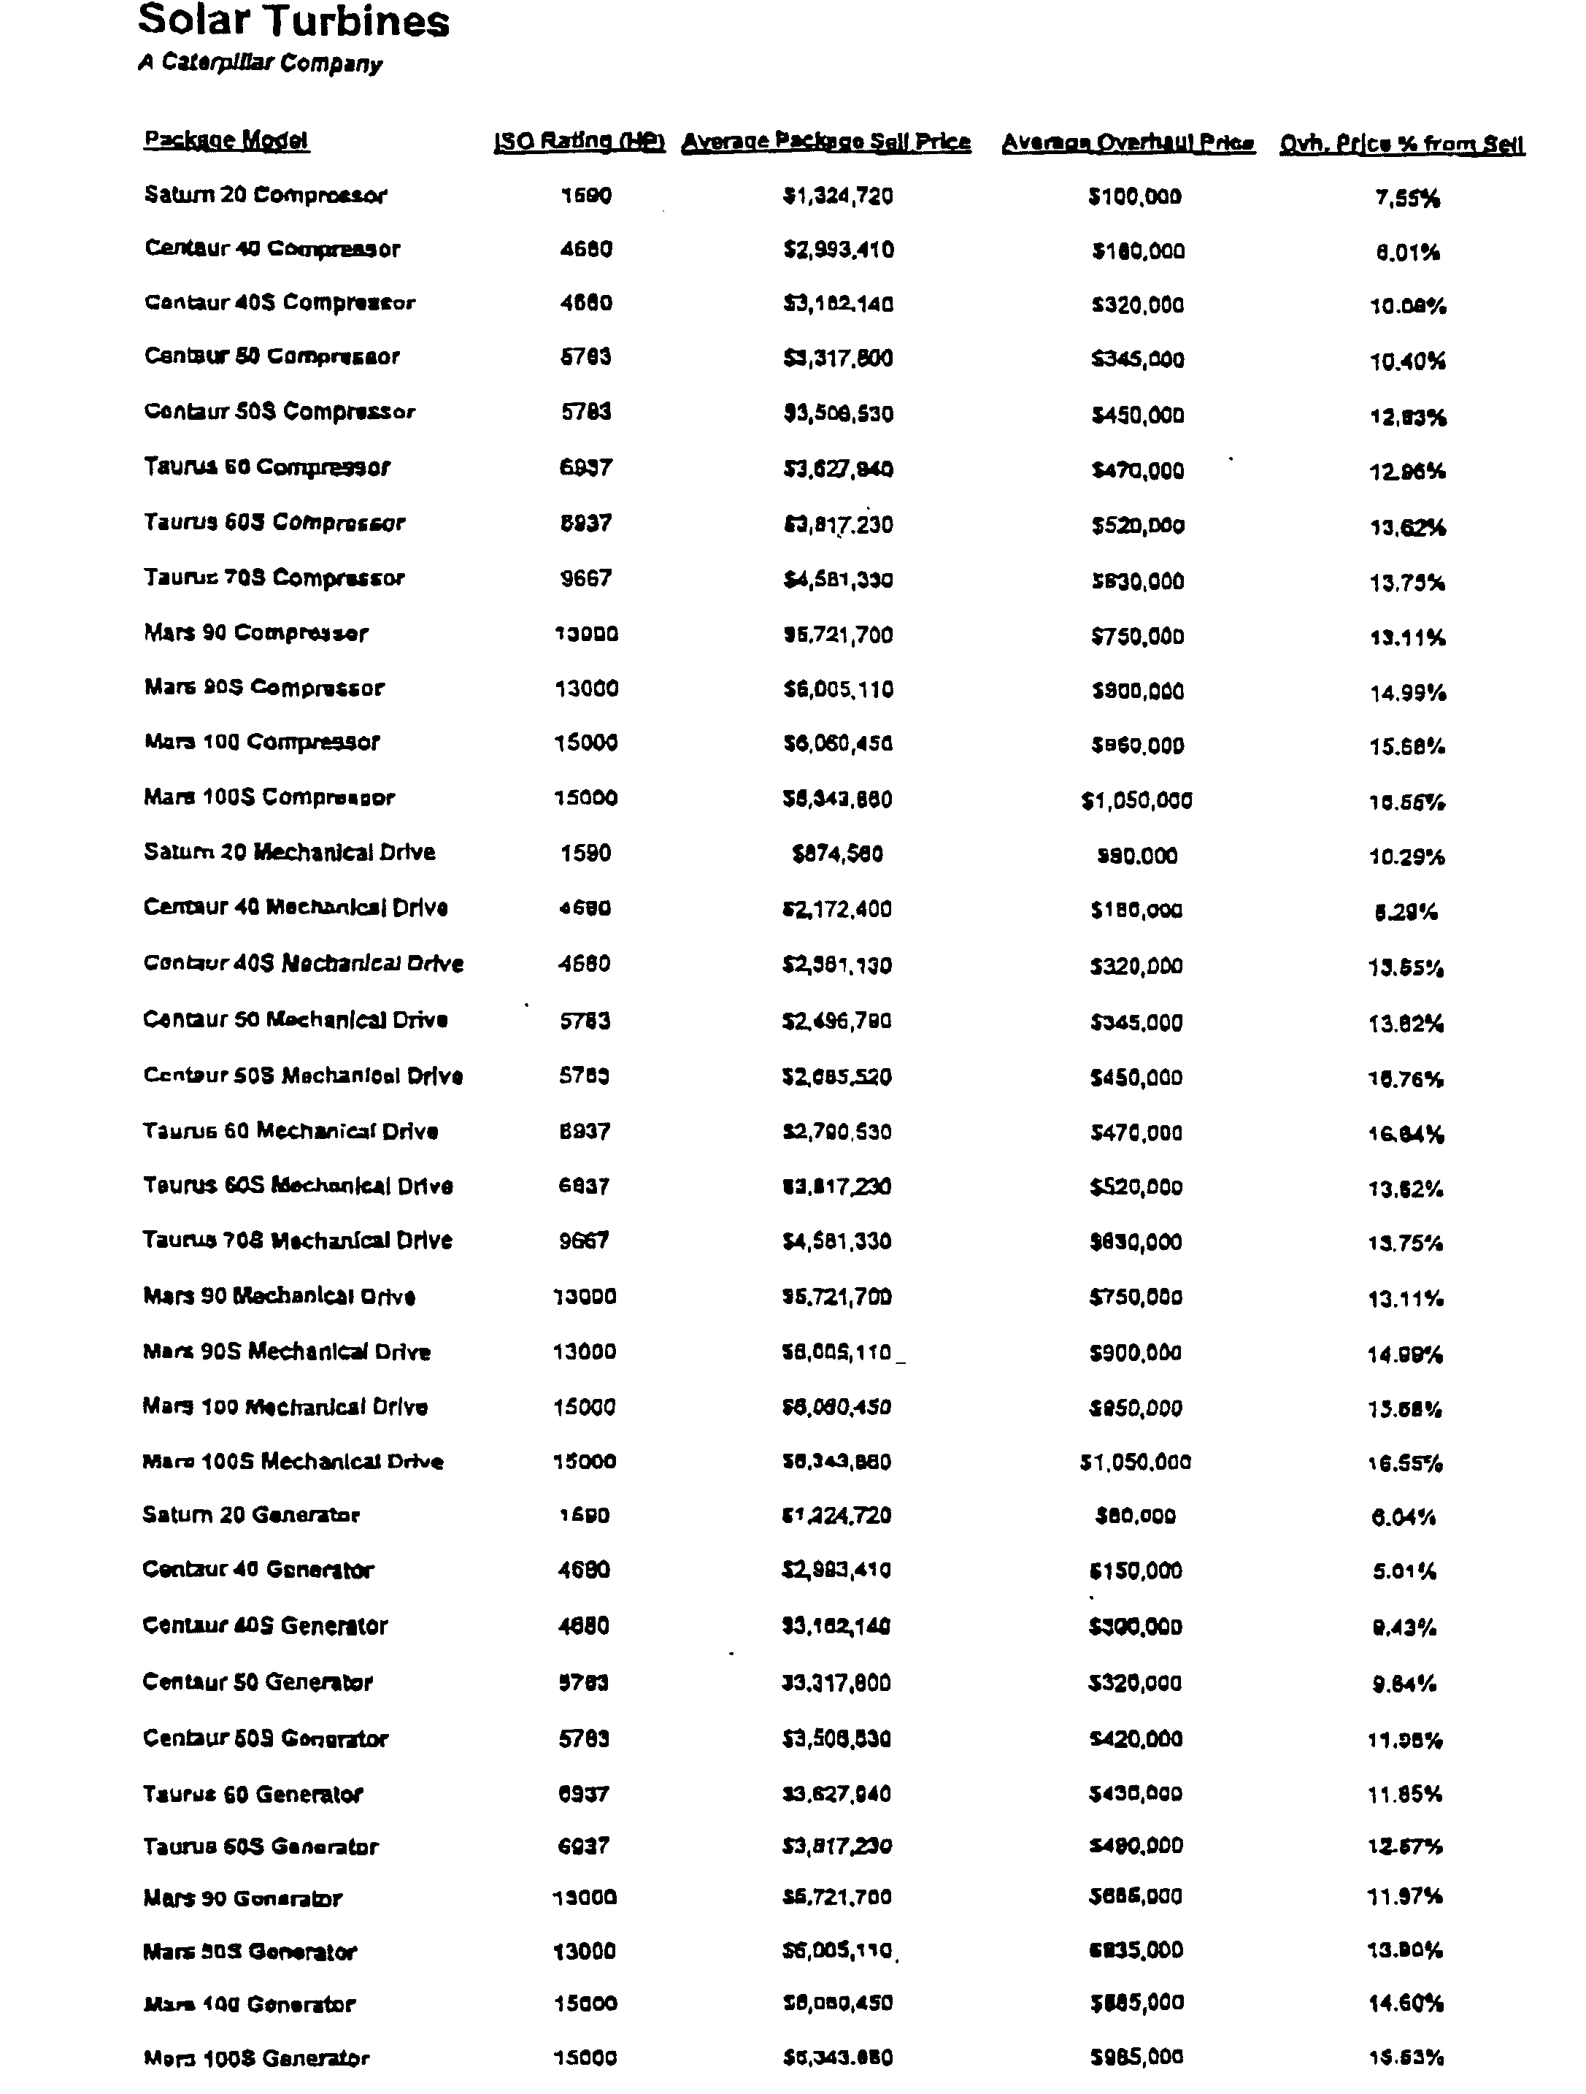
<number>

Slide 28
Regulatory Context for Overhaul: “Modification” (1)
Defined under NSPS and PSD regulations as changes that result in an increase in emissions
40 CFR 60.14(a): ”Except as provided under paragraphs (e) and (f) of this section, any physical or operational change to an existing facility which results in an increase in the emission rate to the atmosphere of any pollutant to which a standard applies shall be considered a modification within the meaning of section 111 of the Act.”
40 CFR 51.166(b)(2)(i): “Major modification means any physical change in or change in the method of operation of a major stationary source that would result in a significant net emissions increase of any pollutant subject to regulation under the Act.”
Routine maintenance exempt from definition of “modification” under NSPS and PSD
40 CFR 60.14(e)(1) and 40 CFR 51.166(b)(2)(iii)(a)
<number>

Slide 29
Regulatory Context for Overhaul: “Modification” (2)
NSPS regulations 60.14(e)(1) state that Administrator shall determine which activities are “routine” for a particular source category
At the time EPA issued the NSPS for turbines, EPA declined to include a more specific finding about turbine maintenance and argued in the NSPS Support Document that the general NSPS definition was sufficient (Vol. II, pages 2-9 through 2-11)
NSPS Support Document recognizes that, “substantial portions of a turbine may be replaced as a matter of routine maintenance during the normal overhauls” (Vol. I, Page 5-6)
<number>

Slide 30
Regulatory Context for Overhaul: “Modification” (3)
NSPS Support Document states that the type of replacements that occur during turbine overhaul will not be considered a modification:
“The following physical or operational changes will not be considered as modifications to existing gas turbines: a. Changes determined to be routine maintenance, repair, or replacement in kind. This will include repair or replacement of stator blades, turbine nozzles, turbine buckets, fuel nozzles, combustion chambers, seals, and shaft packings. (Vol. I, page 5-6)
NSPS Support Document notes that, because of these exemptions, the “impact of the modification provision on existing gas turbines should be very slight” (Vol. I, page 5-6)
<number>

Slide 31
Regulatory Context for Overhaul: “Reconstruction”
50% Threshold as defined under NSPS regulations
40 CFR 60.15(b): “Replacement means the replacement of components of an existing facility to such an extent that: (1) the fixed capital cost of the new components exceeds 50 percent of the fixed capital cost that would be required to construct a comparable entirely new facility, and (2) it is technologically and economically feasible to meet the applicable standards set forth in this part”
NSPS support document notes that this provision is intended to:
“ensure that an owner or operator does not perpetuate an existing facility by replacing all but vestigial components, support structures, frames, housing, etc., rather than totally replacing it in order to avoid subjugation to applicable standards of performance” (Vol. I, page 5-3)
NSPS support document states:
Although substantial portions of turbines are replaced during normal overhauls, “such routine maintenance should be exempted from the regulatory consequences of becoming a reconstructed turbine, subject to the ‘50 percent rule’ discussed in 5.1.2. “ (Vol. I, Page 5-6)
<number>

Slide 32
Regulatory Context for Overhaul: Industry Observations (1)
Overhaul of gas producer and/or power turbine components is considered “maintenance” for the turbine source category
Overhaul necessary to maintain safe and reliable operation of original turbine equipment
Overhaul recommended by all turbine manufacturers as a part of routine maintenance procedures
Overhaul performed on a routine basis, at least every 3 to 4 year years of operation, based on hours of operation or inspection results
<number>

Slide 33
Regulatory Context for Overhaul: Industry Observations (2)
For many turbine models, use of replacement gas producer and/or power turbine components is a part of routine overhaul
Certain turbine models are specifically designed so that overhaul is achieved through the use of replacement gas producer and/or power turbine components
Replacement gas producer and/or power turbine components have been used as a part of the overhaul process for more than 30 years
The use of standard exchange gas producer and/or power turbine components do not extend the life of the turbine
Therefore, overhaul, including the use of replacement components, is exempt from consideration as a “modification” under PSD and NSPS
<number>

Slide 34
Regulatory Context for Overhaul: Industry Observations (3)
Overhaul, including the use of replacement gas producer and/or power turbine components, does not meet the regulatory definition of “reconstruction”
Costs for overhaul, including the use of replacement components, typically range from 6 to 17% of the cost to purchase a new natural gas-fired turbine
Since the costs to overhaul these components of a natural gas-fired turbine do not exceed 50% of the cost to purchase a complete turbine, the overhaul procedure does not meet the regulatory definition of “reconstruction”
<number>

Slide 35
Options Proposed by Washington Department of Ecology
1. Require each facility to undergo major and minor NSR permitting each time a compressor is sent out for routine maintenance/ replacement
2. Require the facility (or pipeline company) to list the serial numbers of all compressor units that are owned and available for its use statewide -- this would require the company to own and keep available a pool of replacement turbine units
3. Permit the equipment based on the manufacturer and model number of the equipment to be installed -- allow routine maintenance -- notification of maintenance by replacement would be required -- if replacement is not “like-kind” (e.g., different model, manufacturer, or anything that would increase emissions or capacity) the project must undergo permitting
4. EPA agrees that routine maintenance operation of removal and replacement by a refurbished unit of the same make and model is not a modification of the source that requires permitting under federal rules
<number>

Slide 36
Options Proposed: Industry Observations (1)
Washington’s letter implies the entire turbine entity covered by Subpart GG is being replaced, when, in fact, only components of the turbine entity are being replaced
Washington has requested EPA concurrence that the use of replacement components is routine maintenance
INGAA member companies believe that under the current NSPS and PSD regulations, EPA does not have discretion to move directly to choosing any one of the four options
Without EPA action to develop a new definition of maintenance, INGAA believes that options 1, 2, or 3 would be inconsistent with the exemption provided for routine maintenance, repair, and replacement included under the current PSD and NSPS regulations
<number>

Slide 37
Options Proposed: Industry Observations (2)
Before EPA can select options 1, 2, or 3, the Agency would have to make one of two determinations:
1. Determine that routine maintenance practices conducted during the past 30 years, including the use of replacement gas producer and/or power turbine components, do not represent the regulatory definition of “maintenance”
2. Determine that routine overhaul constitutes “reconstruction”
Without one of these two determinations, EPA has no federal regulatory basis to require NSR review or notification of overhaul -- In short, a modification or reconstruction has not occurred
If EPA were to adopt options 1, 2, or 3, the Agency would need to address the following issues:
The Agency effectively would be limiting the life of a million-dollar or more combustion turbine to less than four years since the turbine would have to be permitted every four years when overhaul would be required
Costs for routine overhaul would be increased dramatically due to the need for a fleet of spare components
<number>

Slide 38
Options Proposed: Industry Observations (3)
Option 4, that no further NSR or PSD review or notification is needed, is the only acceptable option:
The solution is consistent with the regulatory exemption for routine maintenance, repair, and replacement under PSD and NSPS
The solution is consistent with the documentary record regarding turbine maintenance practices
The solution recognizes that industry practice for over 30 years has included the use of replacement components for the gas producer and/or power modules
The solution does not impose additional capital investment to maintain a pool of spare components to ensure safe and reliable operation of turbomachinery
The solution does not impose unnecessary reporting requirements
<number>

Slide 39
Recommendations to EPA
Overhaul is routine maintenance for natural gas-fired turbines and is exempt from the definition of “modification” under PSD or NSPS
Use of replacement gas producer and/or power turbine components as a part of the overhaul process also is exempt from the definition of “modification” under PSD or NSPS
Overhaul costs, including overhaul using replacement components, do not exceed 50% of the cost to purchase a new natural gas-fired turbine & therefore overhaul is not considered “reconstruction” under NSPS
<number>

