Slide 1

Fiber Optic Public Lands Rights-of-Way
Stephen Burns
Chairman, Telecommunications Right-of-Way Coalition (TelROW)
Director, Federal Government Affairs, Enron

Slide 2
Fiber Optic Public Lands Rights-of-Way
Section 504(g) of 1976 FLPMA:
“The Secretary, with respect to the public lands and, the Secretary of Agriculture, with respect to lands within the National Forest System (except in each case land designated as wilderness), are authorized to grant, issue, or renew rights-of-way over, upon, under or through such lands for…”
“The holder of a right-of-way shall pay annually in advance the fair market value thereof as determined by the Secretary granting, issuing, or renewing such right-of-way…”
[In 1999, there were 60,970 rights-of-way permits on BLM land]

Slide 3
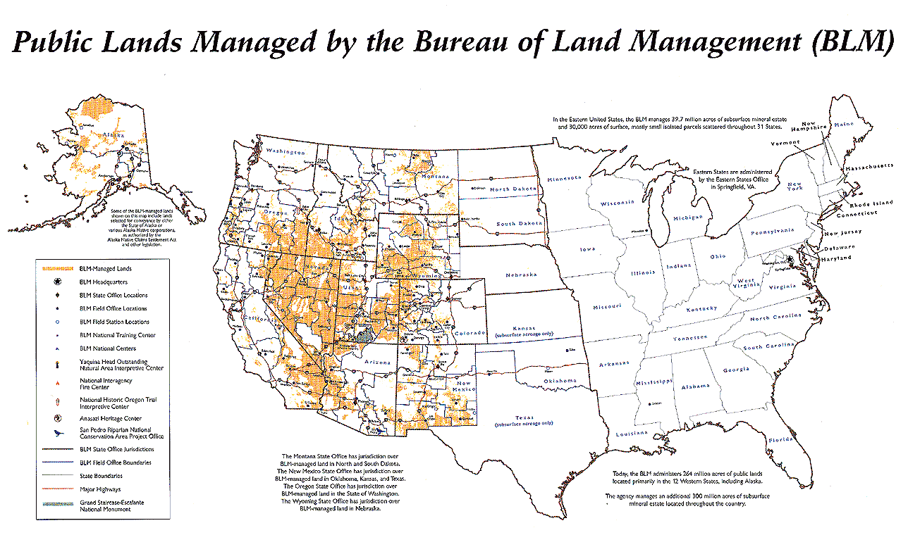
Fiber Optic Public Lands Rights-of-Way

Slide 4
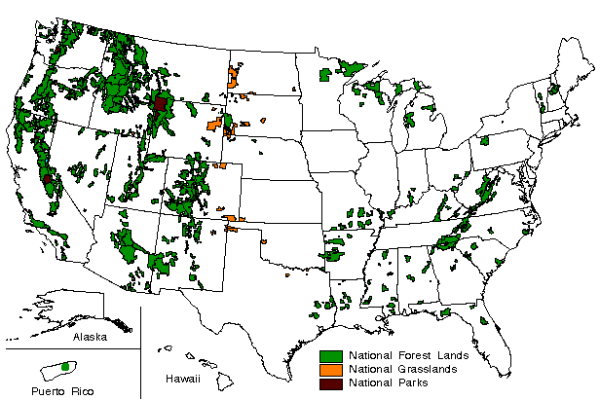
Fiber Optic Public Lands Rights-of-Way

Slide 5
Fiber Optic Public Lands Rights-of-Way Enron Intelligent Network (EIN)
Vancouver
Seattle
Portland
Minneapolis
Boise
TORONTO
Milwaukee
Detroit
Albany
Chicago
Buffalo
Boston
Salt Lake City
Cheyenne
Omaha
Des Moines
New York
Denver
Indianapolis
Philadelphia
San
Sacramento
Kansas City
St. Louis
Cincinnati
Washington DC
Francisco
Louisville
San Jose
Las Vegas
Nashville
Memphis
Chattanooga
Charlotte
Los Angeles
Phoenix
Dallas
Atlanta
San Diego
El Paso
Jackson
Tucson
Austin
Tallahassee
Jacksonville
San Antonio
Houston
New Orleans
Tampa
Orlando
LEGEND
Fort Lauderdale
Fort Lauderdale
Fort Lauderdale
Fort Lauderdale
Fort Lauderdale
Fort Lauderdale
Fort Lauderdale
Fort Lauderdale
FIBER ROUTE
Fort Lauderdale
FUTURE ROUTE
CITY POP

Slide 6
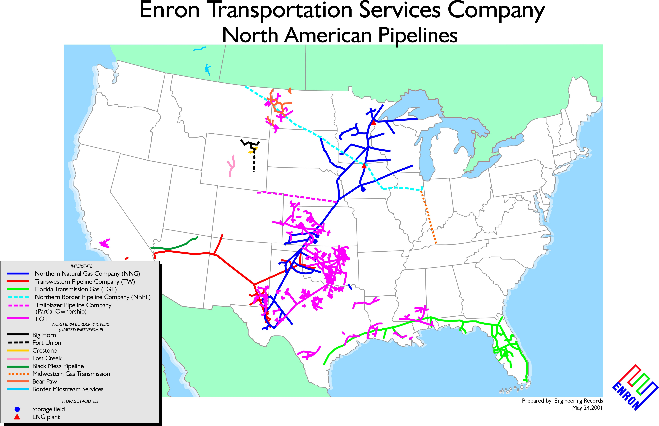
Fiber Optic Public Lands Rights-of-Way

Slide 7
Fiber Optic Public Lands Rights-of-Way
Prior to 1986, fair market value was determined by a variety of means: appraisals, negotiations, a small percentage of the permittee’s investment in the land, or a small percentage of the estimated value of the land
In 1986, BLM and USFS implemented a fee schedule that reflected land values representing the low end of the market (indexed to the Implicit Price Inflator to account for future inflation). In 2000, that schedule was:
Zone Value Oil and Gas Pipelines Electric Trans, telephone, other
per acre rental rate linear rights-of-way (fiber)
$ 50 $ 2.56 $ 2.24
100 5.13 4.49
200 10.26 8.97
300 15.38 13.46
400 20.51 17.95
500 25.64 22.44
600 30.77 26.92
1,000 51.28 44.87

Slide 8
Fiber Optic Public Lands Rights-of-Way
Chronology of Events
April 1996: GAO Report: “U.S. Forest Service: Fee System for Rights-of-Way Program Needs Revision”
Conclusion: The Forest Service needs to update its current fees to fair market value for rights-of-way used by operators of oil and gas pipelines, power lines, and communications lines.
2. 1997 FTV Build (Enron-Williams-Touch America)
- 37 miles in USFS land on Mt. Hood and Ochoco National Forests in Oregon
- difference between published fee schedule and 2000 assessment = over 250 fold increase

Slide 9
Fiber Optic Public Lands Rights-of-Way
Chronology
Sept 1999 – March 2000: Public Service of New Mexico Four Corners Build – power line/fiber (5700 percent fee increase)
BLM “Fiberent” proposal
- no single fiber cable right-of-way; each individual fiber in a cable is required to have its own right-of-way permit
- fibers that are bought, sold or leased would still be covered, but “without additional approval from BLM, providing that rent would still be determined by applying the existing linear schedule to each fiber”
Implication: the Fiberent policy is a fundamental change from measuring the “impact on the land” to “value of the commerce traveling over that land”

Slide 10
Fiber Optic Public Lands Rights-of-Way
Fiberent Proposal
Fiber Cable
Regen Site (1/2 acre)
1. Length x width/43,560 (sq ft in 1 acre)
2. Add other acreage
3. Multiply total by zone rental fee
______________________
12 acres + .5 = 12.5 acres
in zone 2 = $76.80
x 144 fibers per cable
$11,069
Result of New Policy would be an increase from $76 to $11,000
52,800 ft
10 ft
ROW

Slide 11
Fiber Optic Public Lands Rights-of-Way
FTV Build: USFS Charges
Mt Hood National Forest
1998 Construction Permit $2,665
1999 Construction Permit $2,793
2000 Special Use Permit $212,269
2001 Special Use Permit Renewal $929
Ochoco Forest
1999 Special Use Permit $4,083
2000 Special Use Permit Renewal $24,499
2001 Special Use Permit Renewal $80

Slide 12
Fiber Optic Public Lands Rights-of-Way
Chronology
May 2, 2000 “Guidance Memorandum” by USFS Headquarters to Field
- Adopt BLM findings, but during the rule making process, all rights-of-way to be measured by assessments rather than fee schedules
June 2000: 2nd BLM proposal (ANPRM)
- no longer per fiber, but instead per group of subleased, sold or swapped fibers
retroactivity clause
October 11, 2000: FY2001 Interior Appropriations Bill signed by President

Slide 13
Fiber Optic Public Lands Rights-of-Way
FY 2001 Interior Department Appropriations Bill
Sec. 340. None of the funds made available in this Act may be used by the Secretary of the Interior or the Secretary of Agriculture to implement a final rule for estimating fair market value land use rental fees for fiberoptic communications rights-of-way on Federal lands that amends or replaces the linear right-of-way rental fee schedule published on July 8, 1987 (43 CFR 2803.1 2(c)(1)(I)). In determining rental fees for fiberoptic rights-of-way, the Secretaries shall use the rates contained in the linear right-of-way rental fee schedules in place on May 1, 2000.

Slide 14
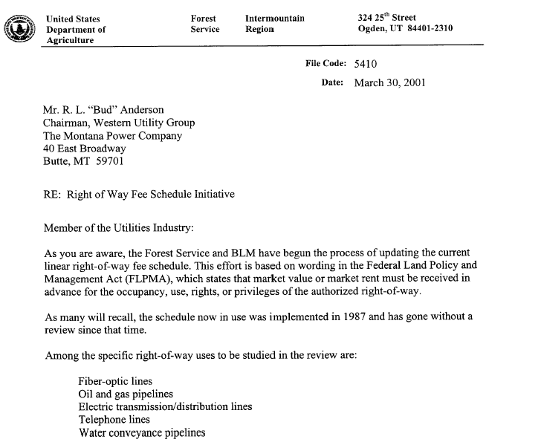
Fiber Optic Public Lands Rights-of-Way

Slide 15
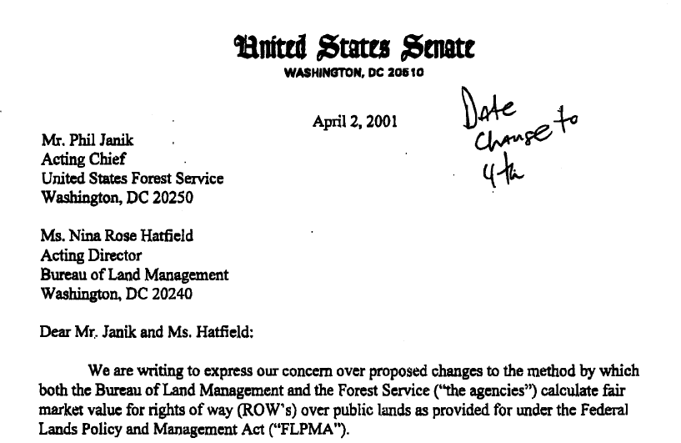
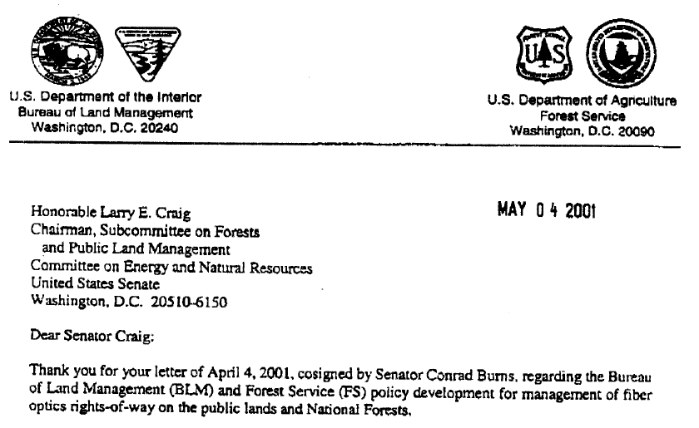
Fiber Optic Public Lands Rights-of-Way

Slide 16
Fiber Optic Public Lands Rights-of-Way

Slide 17
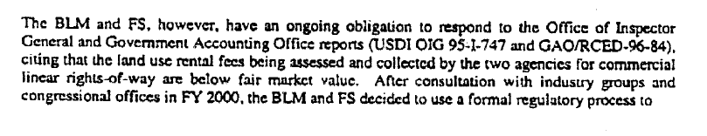
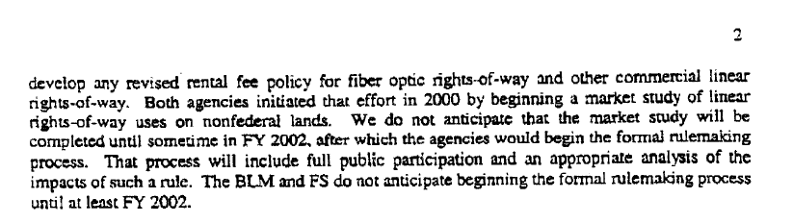
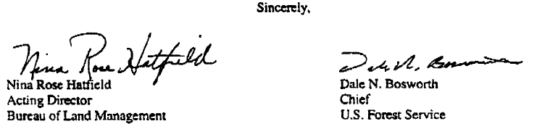
Fiber Optic Public Lands Rights-of-Way

Slide 18
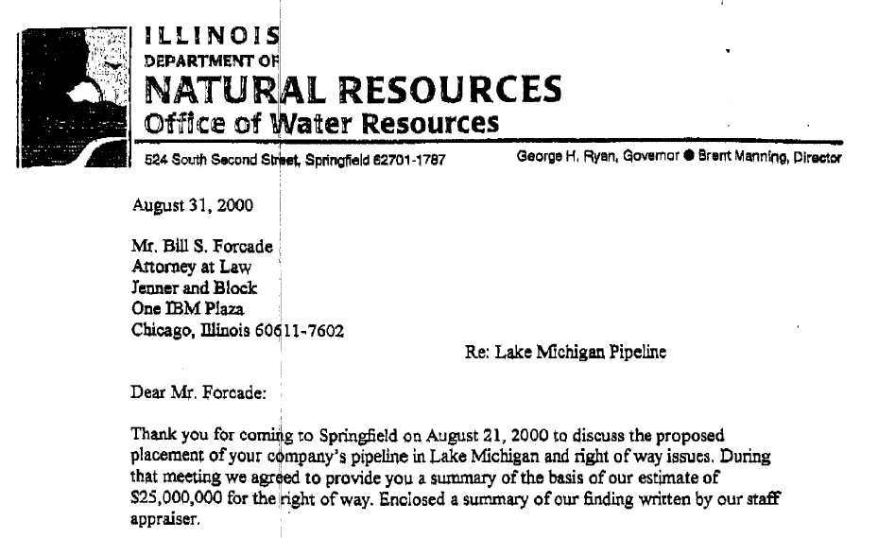
Fiber Optic Public Lands Rights-of-Way

Slide 19
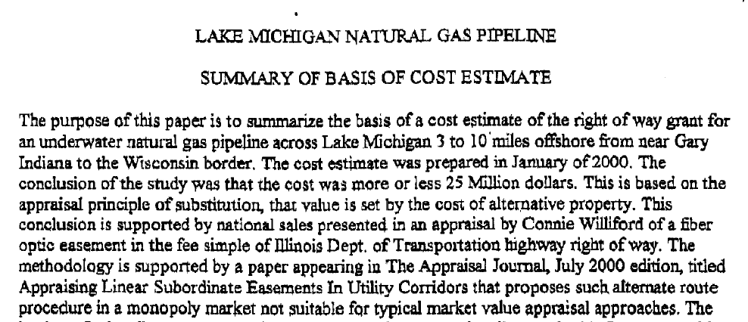
Fiber Optic Public Lands Rights-of-Way

Slide 20
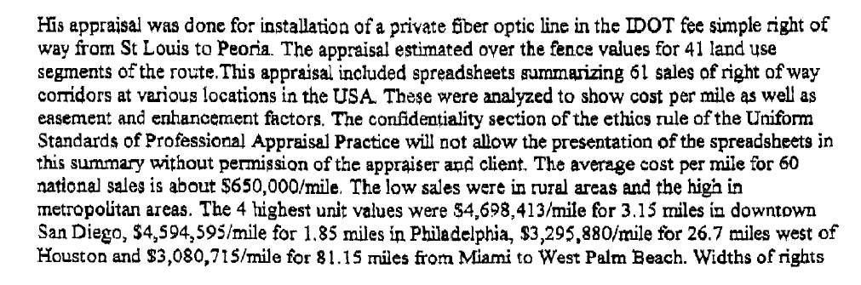
Fiber Optic Public Lands Rights-of-Way

Slide 21
Fiber Optic Public Lands Rights-of-Way
Going Forward
Likely 2-3 years before a new rule is implemented
Agencies proposed surveys and data collection beginning January 1, 2001. Industry is opposed to this, since the type of data to be collected and how it is used remains an important issue of disagreement. BLM has said it will stop – Forest Service?
Industry will host a meeting (Appraisal Institute?) and invite BLM and USFS. Topic will be appraisal theories and applications
Regulatory Fix. Legislative Fix. Both

Slide 22
Fiber Optic Public Lands Rights-of-Way
Telecommunications Right-of-Way (TelROW) Coalition
Enron (Chair)
AT&T
Bell South
Comptel
Edison Electric Institute
FPL Fibernet
Global Crossing
Public Service of New Mexico
Qwest
SBC
Sierra Pacific Resources
Touch America
United States Telecommunications Association
Verizon
Williams Communications Co.

Slide 23
Fiber Optic Public Lands Rights-of-Way
Stephen Burns
Chairman, Telecommunications Right-of-Way Coalition (TelROW)
Tel: 202-466-9166
sburns@enron.com

