Slide 1
Trade Credit in the New Economy
EnronCredit.com

Slide 2
Contents
Credit Risks in the New Economy
Traditional Economy Credit Process
New Economy Credit Process
Enron Bankruptcy Swap & Risk Transfer
Credit Portfolio Approach

Slide 3
Company-Level Credit Exposure
Firms exposed to few industries
Exposure is to small number of firms
Highly Concentrated Credit Risk
Need to diversify exposure
Opportunity to sell unused credit capacity

Slide 4
Reasons for Concern
Decreased credit quality of new entrant customers:
  Often sub-investment grade;
  Often weakly capitalized and/or with large capital commitments;
  Operating in fiercely competitive markets;
  Operating in rapidly evolving markets with high technological risk;
  Facing formidable incumbent competition with strong customer bases & cash flows.
Incumbents facing unparalleled levels of competitive and technological risk.

Slide 5
The Risks
Stock Markets = conflict between credit policy and sales imperatives
Increased exposure to lower quality credits;
Increasing potential for major single exposures:
  Major contracts with individual customers
  Credit concentration via customer consolidation - both vertical and geographical
Weak capitalisation and variable market sentiment towards ‘New Economy’ customers increases customer reliance on vendor finance.
Technological risk of collateral obsolescence.

Slide 6
Dynamics in the New Economy Risks
Accessibility to services and goods increases dramatically
Number of potential counterparties increases and
pressure to transact quickly
Pressure to price deals quickly on-line increases, otherwise customers will switch to competitors
The speed of business accelerates and challenges business infrastructure

Slide 7
New Economy Risks
Volatility of market and speed of transactions increase credit risk
Bankruptcy/default causes a domino effect in losses exacerbated by:
  excessive credit exposures
  lack of credit hedging
Traditional credit risk management processes are not always sufficient or keep up with the pace of the new economy

Slide 8
The Traditional Economy Credit
Management Process

Slide 9
Classical Credit Risk Management
TRANSACTION
CLIENT
Deal Maker
CREDIT REQUEST
APPROVAL+ LIMIT
Binary Credit Decisions
CREDIT
No risk-reward trade-off for deal makers
Market risk not priced into credit decision
Portfolio diversification effects ignored
Credit risk is static - credit migration will be ignored
Deal-makers are not charged for the credit risk they assume -- which encourages risky behavior

Slide 10
Old Economy Steps for
Managing Trade Credit
Letter of Credit Example
No transaction!
Step 1
Buyer requests trade
credit from Seller
Step 2
Salesforce request
approval from Credit
Dept.
Step 3
Credit Dept. gathers info:
From buyer
Info. Providers
References
Step 4
Credit Dept. analyzes data
No
Step 5
Credit Dept. requests letter of credit from Buyer
Credit Dept.
Response
Yes
1 to 3 days
1 to 2 days
0 to 1 day
Step 6
Buyer requests letter of credit from Bank
Step 7
Bank draws up letter of credit
Step 8
Seller’s lawyer reviews & comments on letter of credit
Step 9
Bank revises letter of credit
Step 10
Seller’s lawyer reviews changes
Step 11
Seller’s Credit Dept. approves deal
0 to 1 day
1 to 3 days
1 to 2 days
0 to 2 days
0 to 1 day
Total Time: 3 to 15 business days
Number of Parties Involved: 4

Slide 11
The New Economy
Credit Risk Management Process

Slide 12
New Credit Risk Management
CLIENT
DEAL MAKER
NEW CREDIT FUNCTION
Credit Evaluation & Price Discovery
CREDIT PORTFOLIO
Capital Allocation
Portfolio Management
CREDIT
MARKET

Slide 13
Typical Steps for Managing Trade Credit
New Economy Method
Step 1
Buyers request trade credit from Seller
Step 2
Seller checks Buyer’s Enron Cost of Credit and reviews limits to see if transaction is within limits
Step 3
If not within limits, Seller checks Buyer’s Bankruptcy Swap price on-line
Step 4
Seller purchases Bankruptcy Swap either on- or off-line
Total Time: 1 to 4 hours

Slide 14
The Bankruptcy Swap

Slide 15
Possible Credit Hedging Products
Trade Credit Risks - Bankruptcy Swap
  Bankruptcy
The only credit event required to hedge non-payment risk in trade obligations is bankruptcy/ insolvency.
Securities & Loan Risks - Credit Default Swaps
  Bankruptcy
  Failure to Pay
  Obligation Acceleration
  Restructuring
  Repudiation / Moratorium
ISDA’s definition is solely designed to hedge non-payment risk in financial obligations (Bonds, loans, other debt) and mirrors default language in lending covenants.
}
“Technical Defaults”

Slide 16
Why Is Bankruptcy the Relevant Credit Event?
Viable businesses honor trade obligations
Lenders will restructure debt if business is viable but under financial strain
Well written contracts cover extraneous credit events
Financial loss will only occur if counterpart is insolvent/bankrupt
Publicly observable event

Slide 17
Defaults vs. Bankruptcy
Defaults and Bankruptcies
Quarterly, 1973 - 1999
90
80
Defaults
Bankruptcies
70
60
50
40
30
20
10
0
1973
1974
1975
1976
1977
1978
1979
1980
1981
1982
1983
1984
1985
1986
1987
1988
1989
1990
1991
1992
1993
1994
1995
1996
1997
1998
1999

Slide 18
Bankruptcy vs. Credit Default Swaps
Pricing is based on similar methodology as that used for Credit Default Swaps (CDS) -- structures used by banks.
The credit events have been standardized by the International Swaps and Derivatives Association
CDS covers more default events and therefore, are not wholly representative of corporate contract risk and may be too costly.
CDS premium is based on total exposure, not just unrecoverable amount (based on deliverable obligation)

Slide 19
Bankruptcy Swaps
Purpose:
  Provide a tradable product with which a firm can hedge it’s counterparty credit risk
Features:
  Credit Event: Bankruptcy
  Reference Entity: Counterparty
  Notional: Mark-to-Market of Transaction
  Term (Years)
  Premium (basis points): Cost of swap

Slide 20
Bankruptcy Swaps: Structure
Premium
HEDGER
ENRONCREDIT
100 % Notional
2 year Contract
If the reference entity goes bankrupt, the Swap Seller pays the Hedger the entire notional specified in the Swap contract.
Reference Entity

Slide 21
Credit Rating Information and Credit Prices

Slide 22
Price of Credit
1000
AAA
AA+
AA
800
AA-
A+
A
600
A-
BBB+
Spread over Treasury (bps)
BBB
BBB-
400
BB+
BB
BB-
200
B+
B
B-
CCC
0
1
2
3
5
7
10
30
Years
Prices for A to BBB+ increase significantly;
Then, increase dramatically from investment grade to non-investment grade
Source: CreditMetrics 6 June 2000

Slide 23
Large Variation in Credit Prices within the Same Rating Band
5 Year Mid Credit Prices for BBB+ Entities (bps)
300
250
200
150
100
50
0
Enron Corporation
Teleglobe
International Paper
Praxair Inc
Norfolk Southern
Anadarko
Viacom
Talisman Energy
Cox Communications
Finova Capital Corp
Texas Utilities
Berkley (WR) Corp

Slide 24
Exposures: Some Indicative Sample Pricing
(in Basis Points: 100bps = 1%)

Slide 25
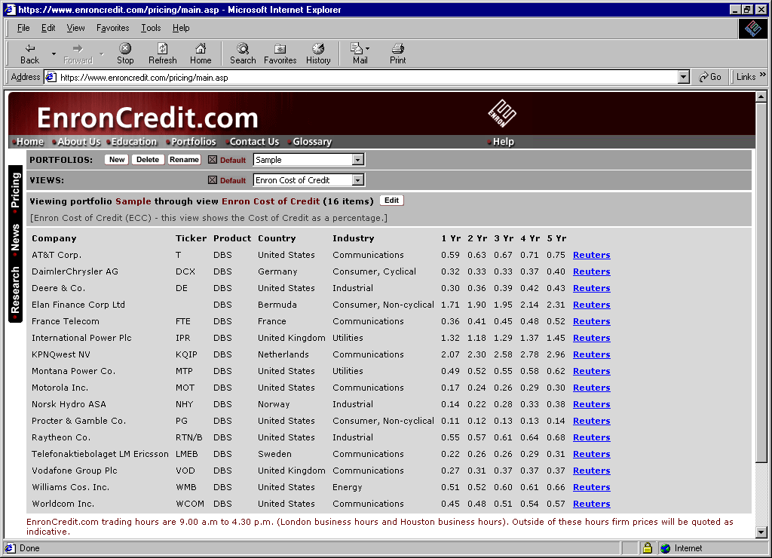
Online Portfolio Tracking

Slide 26
The Value of the Enron Cost of Credit
Traditional Credit
Risk Management
New Economy Credit
Risk Management
22 rating levels (AAA to D)
Updated infrequently
No time dimension (current period only)
Qualitative
“Opinion” oriented
Coarse granularity - inconsistencies with levels
Rating based
looking backwards
Example Exchange
Participants
“Rating” “Price”
S&P ECC
AAA General Electric 0.06%
BBB+ International Paper 0.56% BBB+ Enron 0.52%
BBB+ Marconi Corp. 0.31%
B Amazon.com 11.65%
B- Dictaphone Corp. 6.03%
Enron Cost of Credit (ECC) 10,000 ratings levels
Updated daily
5 year time horizon
Quantitative
“Price” oriented
Fine granularity - no inconsistencies
Market based pricing
looking forward

Slide 27
Credit Product Comparisons
EnronCredit.com
Bankruptcy Swaps
Letter of
Credit
Credit
Insurance
Features
Time to payout 60 days after filing days months
Certainty of payout definite high moderate
Time to implement hours 1 to 13 days days
Linked to specific transactions no yes yes
Liquidity yes no no
Repeated legal intervention no yes yes

Slide 28
Credit Risk -
Portfolio Management Approach

Slide 29
Firms can Optimize Credit Profiles
Aerospace
$10
Utilities
$8
Auto
$6
Telecoms
$4
Entertainment
$2
$0
Oil & Gas
Chemicals
Machinery
Electronics
Retail
Actual Exposure
Ideal Exposure

Slide 30
Debt Portfolio Risk Diversification
Risk Reduction
0
1000
2000
3000
4000
5000
6000
Number of Obligors
Copyright @ 2000 by KMV, LLC.

Slide 31
Equity Portfolio Risk Diversification
Risk Reduction
0
100
200
300
400
500
600
Number of Stocks
Copyright @ 2000 by KMV, LLC.

Slide 32
Optimization
An optimal portfolio is one which has the highest expected spread for a given level of portfolio risk
There is an optimal portfolio for each level of portfolio risk
The set of these optimal portfolios is called the “efficient frontier”
A measure of optimality is the Sharpe ratio
Copyright @ 2000 by KMV, LLC.

Slide 33
Optimization Output
Copyright @ 2000 by KMV, LLC.

Slide 34
Diversified Sample Portfolio Structure
Simple Industry Diversification can lead to a reduction of $18 MM in the First Loss requirement of a portfolio enhancement and risk transfer
(ratings, notional exposure spread remain constant, leading close to a zero cost enhancement)
AAA
Tranche
$182.5MM
AAA
Tranche
$200.5MM
First Loss
Tranche
$42.5MM
First Loss
Tranche
$24.5MM

Slide 35
Energy Co. Sample Portfolio Exposure

Slide 36
Diversified Sample Portfolio Structure

Slide 37
Diversified Sample Portfolio Structure
Simple Industry Diversification can lead to a reduction of $18 MM in the First Loss requirement of a portfolio enhancement and risk transfer
(ratings, notional exposure spread remain constant, leading close to a zero cost enhancement)
AAA
Tranche
$182.5MM
AAA
Tranche
$200.5MM
First Loss
Tranche
$42.5MM
First Loss
Tranche
$24.5MM

Slide 38
Portfolio Diversification Solution
Portfolio Structure:
  created by pooling or swapping diverse set of credit exposures with various corporate entities via the new On-line Bankruptcy Swap (Credit) Market platform
  corporate entities have an opportunity maintain an self-determined expected loss position (e.g. 10%) of this diversified credit risk portfolio while allowing the remaining 90% of the portfolio the receive a industry rating of “A” or better
Critical Considerations:
  level of expected loss (risk) to maintain?
  correct balance of industry diversity and subordination?
  E.g. subordination amounts on a single asset may reach 40% to reach a Single A rating for the remaining 60% -- where a properly diversified portfolio may only require a 10% subordination (underlying assets are rated BBB)
  what is the proper balance of exposures to counterparties?

Slide 39
Key Lessons
Credit can be disaggregated and priced similar to any other risk
Credit exposure can be modelled
There is a market for credit risk
Active portfolio management is possible

Slide 40
Benefits of EnronCredit.com
Product suite of bankruptcy & other credit swaps:
Eliminate the administrative burden of perfecting security on your customers’ assets
Eliminate the risk of security obsolescence in this hi-tech environment
Enable you to price your lending more competitively
Free up your customers’ assets who is often under capitalized
Lower your internal reserve requirements
Allow you to maintain customer concentration without credit concentration
Protect your credit rating

Slide 41
Contacts
EnronCredit.com
Jeff Kinneman, VP Houston - (713) 853-5398
Sales & Origination B2B Alliances
John Haggerty - (713) 853-6615 Craig Chaney - (713) 345-7773
Bruce Harris - (713) 853-0950 Gillian Johnson - (713) 853-9939
George Zivic - (713) 853-7489
Bryan Seyfried, VP London - +44 207 783-7907
Sales & Origination B2B Alliances
David Weekes - +44 207 783-7105 Adam Tyrell - +44 207 783-6638
John Metzler - +44 207 783-4322
Andrew Feachem - +44 207 783-2263

