Slide 1
Presentation to Fitch IBCA
Overview of Key Credit Considerations
October 2001

Slide 2
Business Performance Update
Greg Whalley, President

Slide 3

®
Transportation
& Distribution
Wholesale Services
Retail
Services
Natural Gas Transportation, Electric Distribution and Global Assets
Commodity Marketing and Delivery
Energy Services for Commercial and Industrial Customers

Slide 4
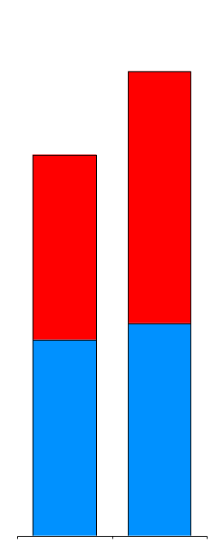
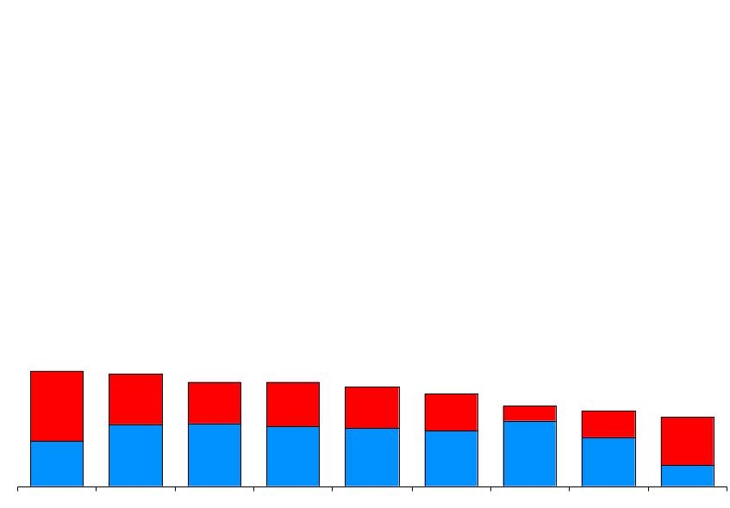
Enron’s Leading Market Position (Physical Settlements in Bcfe/d)
78.8
64.7
Power
Gas
21.6
21.1
19.5
19.4
18.6
17.3
15.0
14.2
12.9
Enron
AEP Reliant Mirant Duke Dynegy Aquila BP El Paso PG&E
2Q01
3Q01
Second Quarter 2001
Source: Gas Daily, Power Markets Week, Company Reports

Slide 5
Performance Highlights
Physical Settlements
(Bcfe/d)
Income Before Interest and Taxes
(Millions)
88.2
$754
$589
53.5
65%
28%
3Q00
3Q01
3Q00
3Q01
Diversified Businesses Drive Consistent Volume and Profit Growth

Slide 6

Financial Settlements
Financial Settlements
(Bcfe/d)
Contracts Settled with Net Cash Payments Without Physical Deliveries
Comprises Significant Portion of Enron’s Longer Term Products
Enron’s Lead Role Provides Distinct Competitive Advantages
Valuable Market Insight
Important Tool to Manage Enron’s Broad-Based Portfolio
319.4
212.2
51%
3Q00
3Q01

Slide 7
New Contract Execution
Transacted Volumes
(New Contracts in Bcfe/d)
Volumes Originated During Current Period for Future Settlement
Record Level Transacted in 3Q01; Driven by Both Gas and Power
Power Comprises Almost 45% of Physical Activity - Up from 20% in 3Q00
Financial Product Expansion Driven by Enron’s Distinct Ability to Make Term Commitments
Average Term Lengthening; Delivery Commitments through 2003
887.7
Financial
Physical
669.8
33%
3Q00
3Q01

Slide 8

EnronOnline Average Daily Transactions
Since Inception
1,550,000 Transactions
$860 Billion Gross Value
>1,800 Products Offered
Nov 1999
Mar 2000
Jul 2000
Oct 2000
Jan 2001
May 2001
Oct 2001

Slide 9

Transaction Mix
Total Enron Transactions
550,000
Traditional
38%
Longer-Term Structured Transactions
Additional Opportunities for Transition to EnronOnline
349,000
EnronOnline
57%
High Penetration in North America Gas & Power; Growing Acceptance in Europe
Rapid Acceptance in Non-Energy Products
Integrated with Logistics and Back Office for Scale Efficiencies
62%
43%
3Q00 3Q01

Slide 10
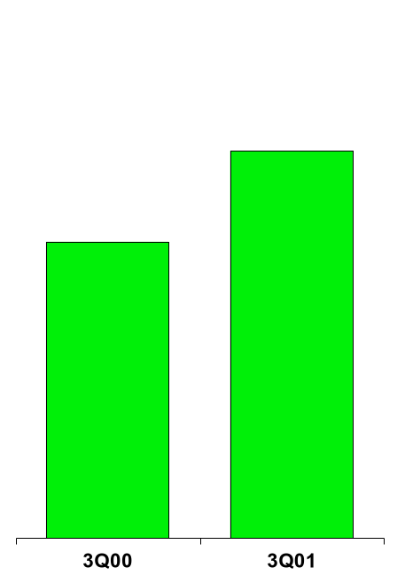
Enron Americas The Most Flexible, Reliable and Valuable Energy Network
Income Before Interest and Taxes
($ in Millions)
701
536
31%

Slide 11
Americas Business Expansion
718.9
540.8
35%
51%
33%
Physical
Financial

Slide 12
Business Highlights East Power
Physical Volumes
(Million MWh)
Number of Transactions
(Per Day)
Making Markets Across the Entire Price Curve
Key Provider of Liquidity
Conducts Majority of Industry’s Long-Term Business
Significant Increase in Long-Term Contracting (Over 40% > One Year)
Growth Driven by Enron’s Core Competitive Advantages
Compares Favorably with Most Merchant’s Entire U.S. Power Operations
Settled
Transacted
196
816
631
73
249
224
168%
264%
153%
OTC
EOL

Slide 13
Regional Transmission Organizations
Current
Proposed
5
# Regions/ISO’s
15+
Not all Users on the System Take Service in a Nondiscriminatory Manner
Non-Discriminatory Access for All Market Participants
Access to Transmission
Very Little Coordination of Service and Planning for Transmission Between Regions
System-wide Planning, Outage Coordination and Congestion Management
Operations
Inefficiency and Lack of Price Transparency Increases Costs Unnecessarily
Cheapest and Most Effective Products for More Customers
Customers
Generation
Lack of Grid Information Hinders Best Siting Decisions
Optimal Siting & Development Decisions Facilitated
Total Portion of Wholesale Market Open
20%-25%
100%
Significant Increase in Available Market with Improved RTO’s

Slide 14
North America Recent Structured Transactions
Canadian Power
Canadian Gas
700 MW Alberta PPA
Operations Outsourcing
West Gas
Long-Term Capacity
East Power
West Power
Load Following
Transaction
Prebuild Package Sale
Midwest Power
Rockies Power
Power Plant Site Sale
West Power
Prebuild Package Sale
QF Expansion & Sale
Southeast Power
Utility Asset Management
Mexico Gas
Price Risk Management
Texas Power
Long-Term Wind PPA

Slide 15
Cash Flow and Earnings Review (Millions)

Slide 16
What has happened?
Jeff Skilling Resigns
3Q Earnings
September 11 Tragedy
WSJ Articles
Bond Spreads Gap
SEC Inquiry
CP Market Disappears
Complete Loss of
Investor Confidence

Slide 17

Road to Recovery
Stage 1:
Change in management
Draw down on bank revolver
Arrange $1.2 BN additional liquidity support from banks
COMPLETED
Stage 2:
Design mid and long-term recapitalization plan
Ratings agencies affirm investment grade rating
Investor/lender meetings
Raise equity

Slide 18
Top Trading Counterparties Based on EOL Volumes
Counterparty
Status
AEP
Reliant
Aquila
Duke
Mirant
Dynegy
Sempra
El Paso
Cook Inlet
Williams
Entergy Koch
Trading
Trading
Trading
Trading
Trading
Trading
Interrupted
Trading
Trading
Trading
Trading

Slide 19
Financial Update
Jeff McMahon, CFO

Slide 20
Key Financial Ratios
51.4
49.2
47.1
46.5
50.2
46.0
43.4
46.0
44.6
41.4
41.9
40.9
39.8
38.6
Total Obligations/Total Capital
Debt/ B/S Capital

Slide 21
Reported Capital Changes Since 1997

Slide 22
What Caused the Capital Erosion?

Slide 23
Cash Projection

Slide 24
Conclusion
Continued Strong Operating Performance
Increased Transparency of Financial and Operating Results
Active Management of Non-Core Businesses
Enron’s Diversified Franchise Provides Solid Platform for Sustainable Growth

Slide 25
®

