Slide 1

®
Natural Gas Pricing Outlook:
Winter 2000-2001& Beyond
Stan Horton, Chairman & CEO,
Enron Transportation Services Company
FGT Customer Meeting
October 13, 2000

Slide 2
U.S. Natural Gas Spot Price Outlook
(in $/MMBtu Henry Hub, LA.)
2001
5.14
$5.24
2000
5.01
4.30
4.25
2001
4.20
4.05
3.47
2.99
2.66
2.75
2000
$2.37
1999
1999
projected
historical
Source: NYMEX (9-11-00 close)

Slide 3
U.S. Residential Natural Gas Prices Since 1984
(1999$/MMBtu)
2000/2001
Winter Estimate
1984
1986
1988
1990
1992
1994
1996
1998
2000
1985
1987
1989
1991
1993
1995
1997
1999
Residentials will purchase gas this winter
at real prices last paid in 1986/87
Source: U.S. DOE (EIA)

Slide 4
Factors Influencing Natural Gas Prices
Strong Economy - Demand for Power Generation and Manufacturing
Declining Natural Gas Production
Warmer Than Normal Winters the Past 3 Years
U.S. Gas Storage Levels Lowest in Past 6 Years
Other Heating Fuels Showing Significantly Higher Prices & Lower Stock Levels
Notes:
<number>
<footer>
<header>
<date/time>

Slide 5
Proved and Potential U.S. Natural Gas Resources
Current estimates:
1,470 average
Shortage
Era
Trillion Cubic Feet

Slide 6
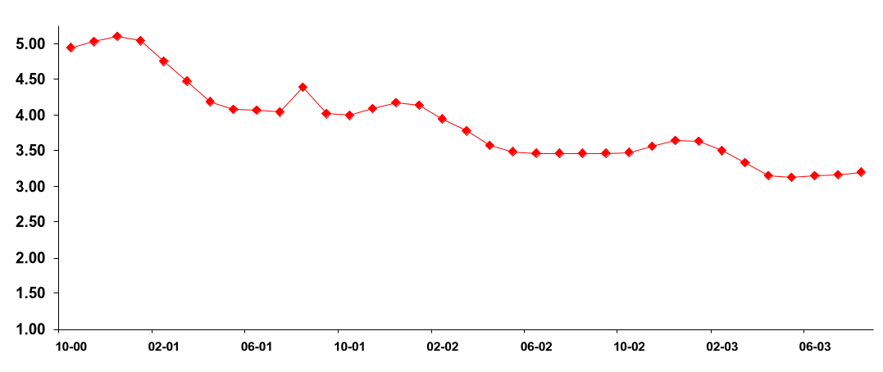
Backwardation Price Curve for Wellhead Gas
($/MMBtu)
$5.15
This Winter
$4.25
Next Winter
$3.75
Winter 02/03
Source: NYMEX (September 11, 2000)

Slide 7
Estimated Storage Inventory
2000 Est.
10% Lower
Than 5 Year
Average
2000 Est.
12% Lower
Than 1999

Slide 8
Historical Winter Weather
November-March Heating Degree Days
5500
5000
4500
4000
97-98
98-99
3500
99-00
10-Yr Avg
3000
2500
2000
DC
New York
Boston
Chicago

Slide 9
Comparative Annualized Daily Volatility
Spot Price Electricity ERCOT
NYMEX Natural Gas
NYMEX Sweet Crude
30-year Treasury Bond Yield
Power
Oil
Gas
Bonds
Notes:
<number>
<footer>
<header>
<date/time>

Slide 10
2000/01 Winter Price Hedging ($/MMBtu)
8/31/00 Lock-in Price for Dec. ‘00/Jan ‘01 - $4.80/MMBtu
Historic 2000 prices through August
Jan/Feb 2000 Hedge for Dec. ‘00/Jan ‘01 - $2.79/MMBtu
Jan
Feb
Mar
Apr
May
Jun
Jul
Aug
2000

Slide 11
®

