Slide 1
Putting the Energy into e-commerce™

Slide 2
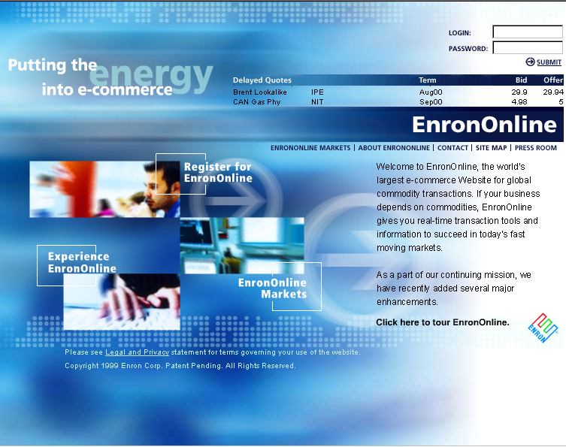
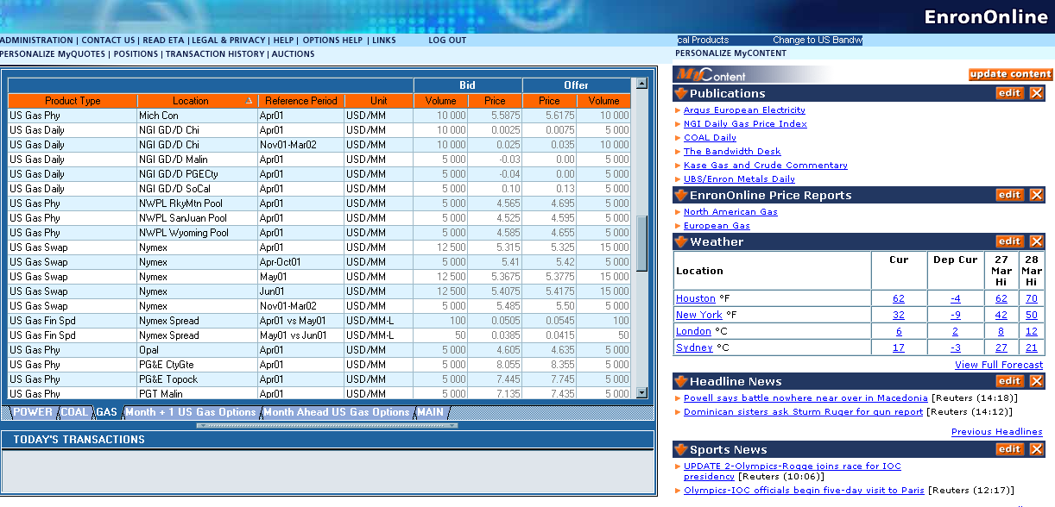
What is EnronOnline?
The Free, Internet-based, Global Transaction System Which Allows Counterparties to View Real Time Prices From Enron’s Traders and Transact Instantly Online

Slide 3


An Additional way to do Business
Previously
Telephone
Enron
Now
Telephone
Enron

Slide 4
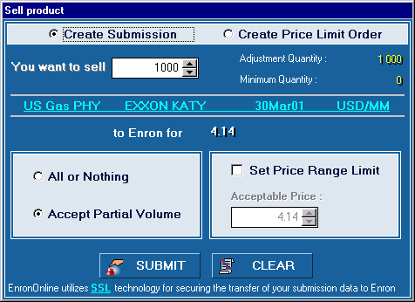




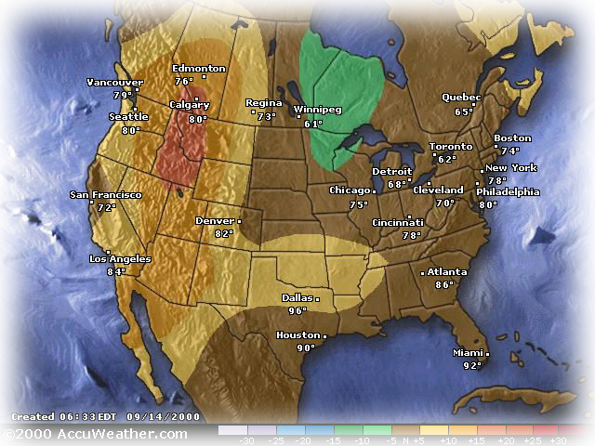




EnronOnline Features
Valuable Transaction Functionality
1800 Products Available (bids and offers)
Instantaneous Pricing
Options
Limit Orders
Spreads
24 x 7, 365 days a year
Attractive Features
Specialized Access and Content
Customers Choose From 40 Different Entry Methods (eg. www. Weather-Risk.com, www.EnronSteel.com)
Dynamically Updated Information Direct from Enron’s Marketers

Slide 5
Benefits of EnronOnline
Free of Charge
Enron’s Best Prices
Real-Time Pricing Information
Faster than Traditional Channels
Access to Complementary Markets and Product Information
Simple Access via the Internet
Easy to Use

Slide 6
Markets Available on EnronOnline
Commodity Types
Argentine Natural Gas
Asian Crude & Products
Asian Metals
Australian & Japanese Weather
Australian Power
Austrian Power
Bandwidth
Belgian Natural Gas
Canadian Natural Gas
Canadian Power
Credit Derivatives
Dutch Power
Dutch Aluminium
Emissions
European Coal
European Weather
German Power
International Coal
Japanese Aluminum
LME Metals Contracts
LPG
Nordic Power
Oil & Refined Products
Petrochemicals
Plastics
Pulp & Paper
Sea Freight
Spanish Power
Swiss Power
UK Metals
UK Metal Spreads
UK Natural Gas
UK Power
US Gas Pipeline Capacity
US Gas Spreads
US Lumber
US Metals
US Natural Gas
US Power
US Steel
US Weather

Slide 7
Markets Available on EnronOnline
Auctions
Emissions Auctions (US)
EnBank Virtual Storage Auction (UK)
Pipeline Capacity Auction
Options
Continental Power Options
Nuclear Outage Knock-In Call Options
Nordic Power Options
UK & US Gas Options
NYMEX Natural Gas
NYMEX WTI (24 x 7)

Slide 8
Utilization of EnronOnline
EnronOnline Transactions as a % of Total Transactions
Traditional Channels
* The percentage of transactions on EnronOnline declined in 3Q00 due to the purchase of MG Metals.
EnronOnline

Slide 9
EnronOnline Statistics
Total Life to Date Transactions >1,020,000
Average Daily Transactions > 4,700
Life to Date Notional Value of Transactions > $610 billion
Daily Notional Value Approximately $2.8 billion
Number of Products Offered: Approximately 1,800
Number of Currencies Traded in = 13
EnronOnline Version 1.0 Launch Date: November 29, 1999
EnronOnline Version 2.0 Launch Date: September 18, 2000

Slide 10
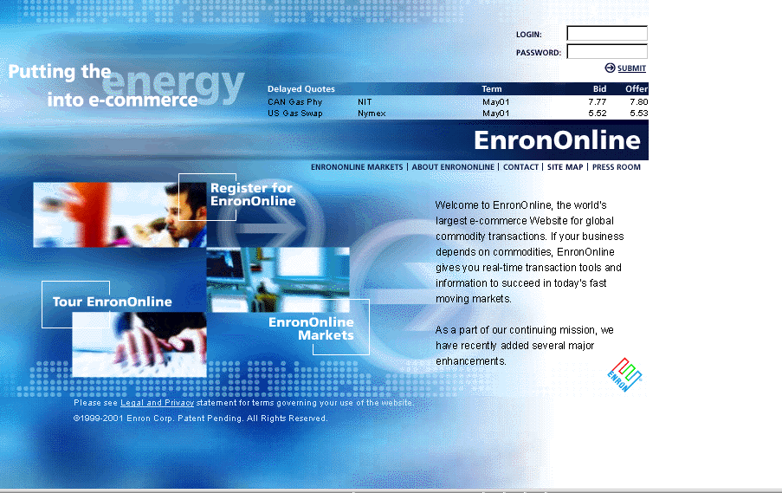
www.EnronOnline.com

Slide 11
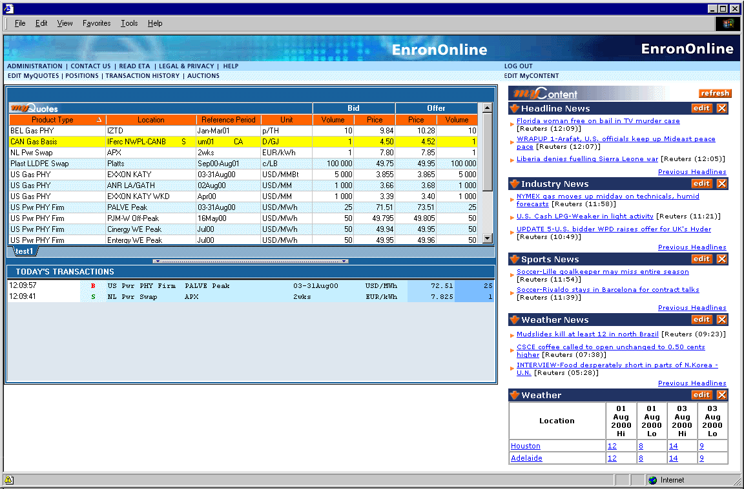
EnronOnline Main Screen
Notes:
We are not Internet experts. Instead, EnronOnline is an extension of our vision of where we believe the future of buying and selling energy and various other commodities to be headed. The direction is toward global markets and global customers.
This global community has emerged and expanded with the help of the Internet. EnronOnline has tapped into that expansion and offers an information system that is… “free”…(next slide)

Slide 12
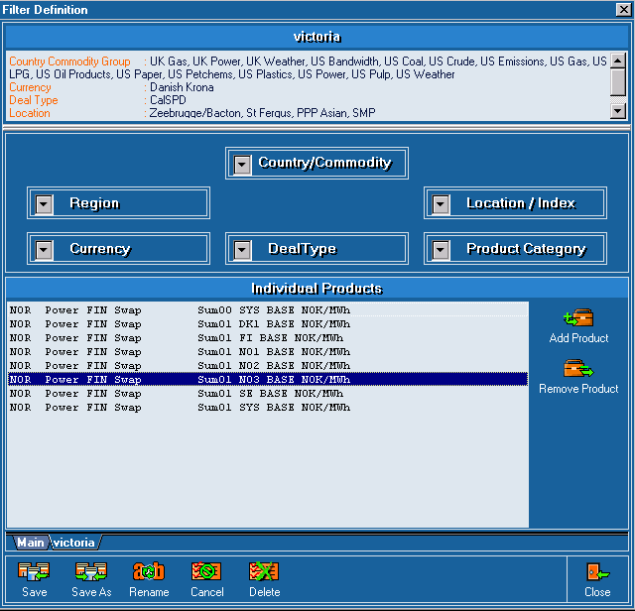
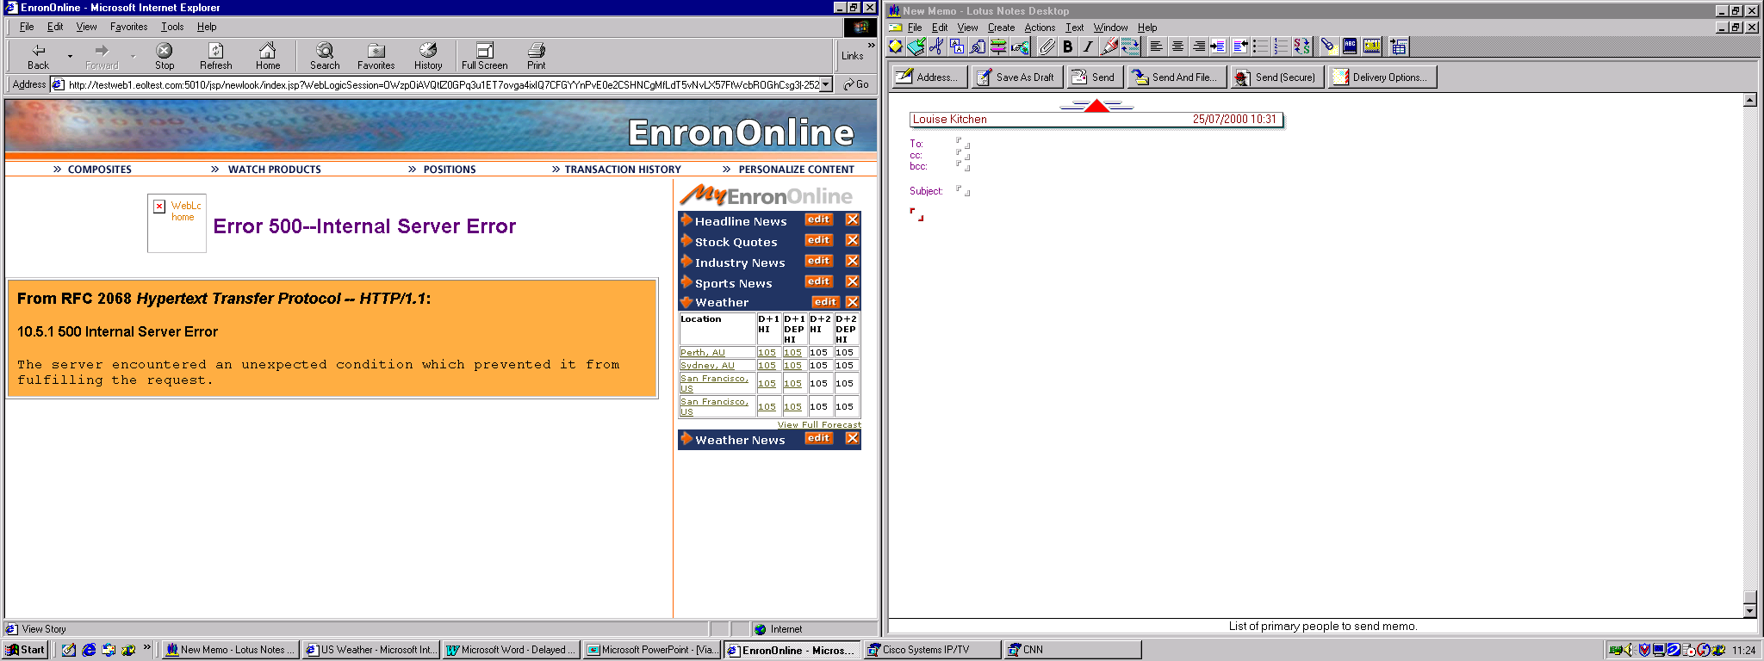
Customized Information
Customize your products and information according to your interests.
Commodity
Content

Slide 13
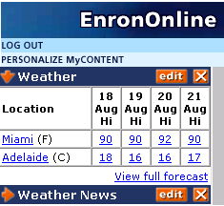
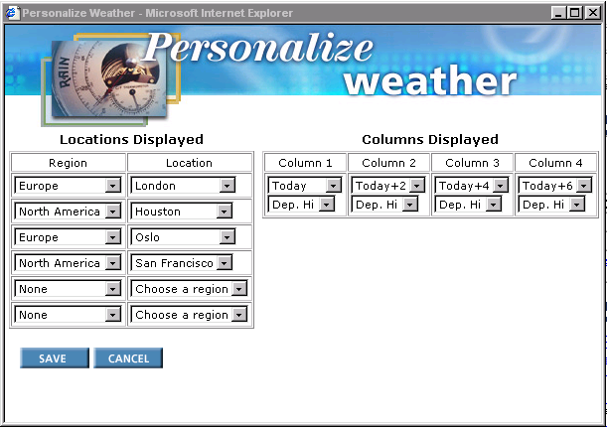
Customize your Weather

Slide 14
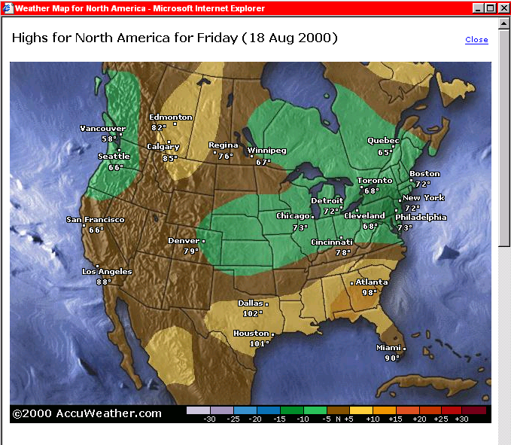
Weather Maps

Slide 15
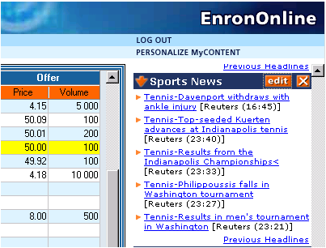
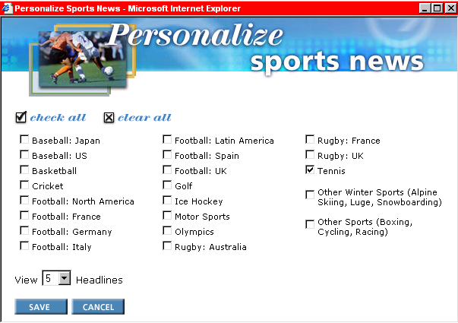
Customize your Sports Content

Slide 16
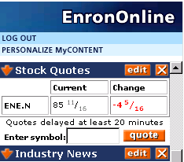
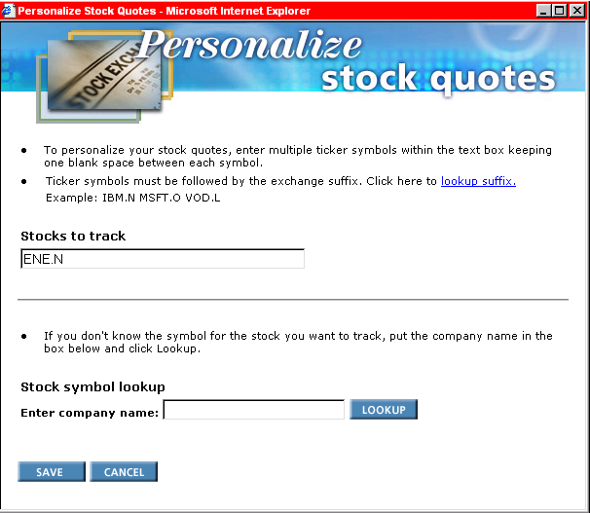
Customize your Stock Quotes

Slide 17
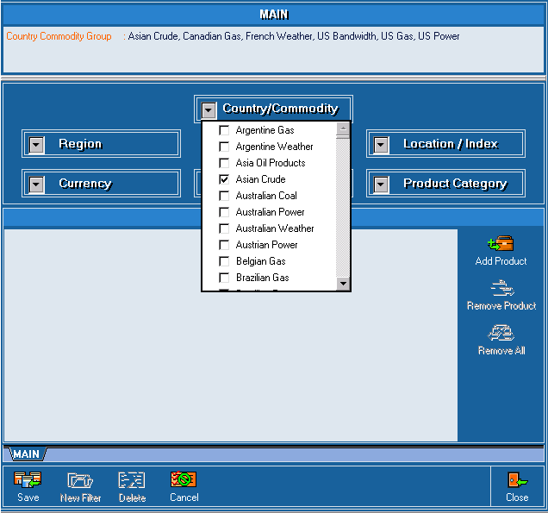
Customize your EnronOnline Quotes
Customize by:
Country
Commodity
Region
Currency
Location/Index
Product category
Deal Type

Slide 18
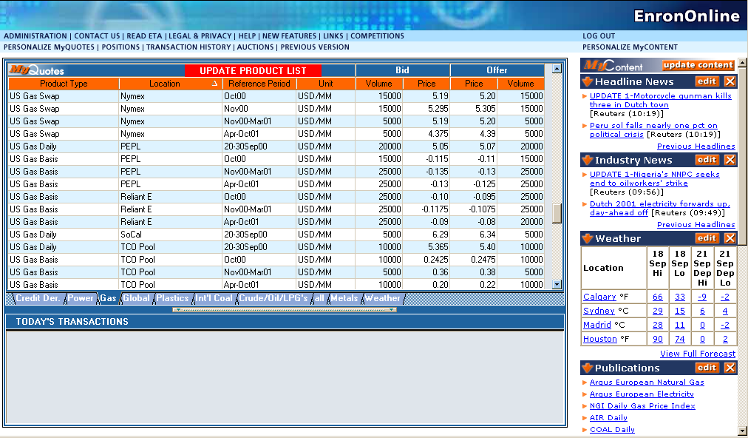
Quotes Page

Slide 19
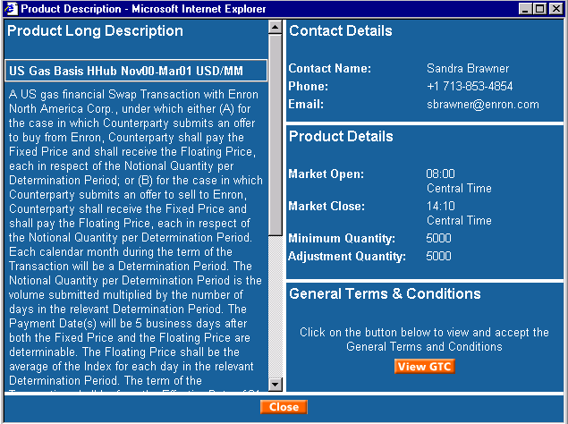
Product Description

Slide 20
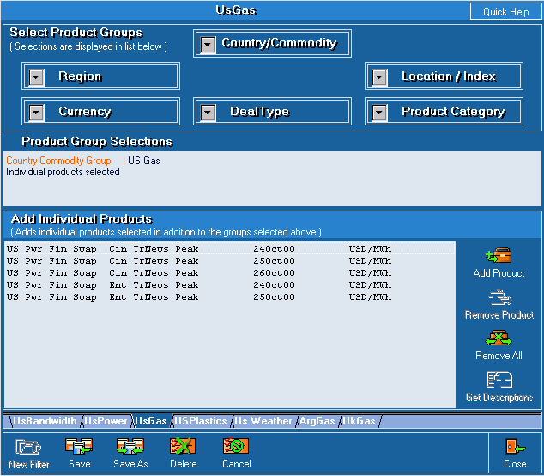
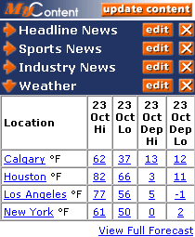
Customized Information
Customize your products and information according to your interests.
Commodity
Content

Slide 21
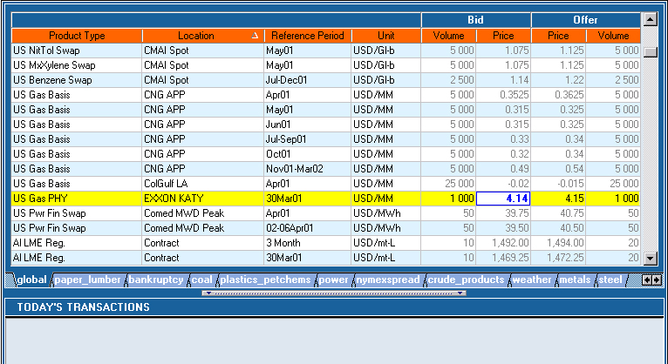
Transacting

Slide 22
Submission Screen

Slide 23
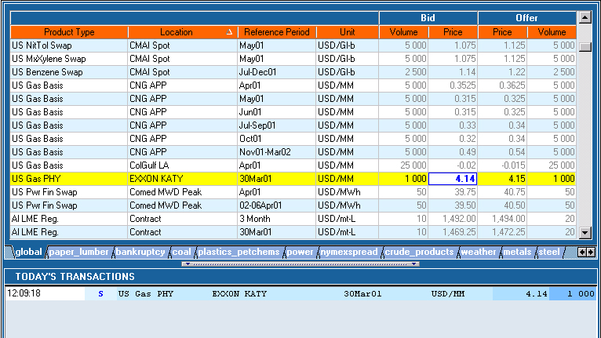
Successful Transaction

Slide 24
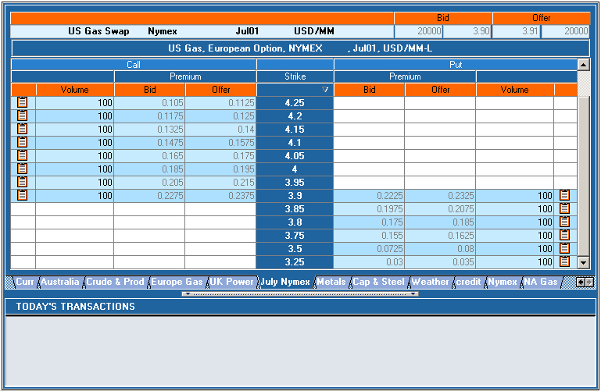
Options

Slide 25


How EnronOnline Works
Customer
EnronOnline Server
3
3
1
2
5a
4
EnronOnline
Enron Trader
5b
1. Enron Trader activates products on server
2. Server sends message to EnronOnline Website
3. Customer clicks on price and submits offer
4. Message goes to server
5a. Deal confirmation sent to Enron Trader
5b. Deal Confirmation sent to Customer via website

Slide 26
Market Price Determination
Customer
Other System
EnronOnline
Customers select attractive prices from EnronOnline
If Price is too high, customers buy elsewhere and sell to Enron
If Price is too low, customers buy from Enron and sell elsewhere
Net Result = EnronOnline reflects the market

Slide 27
Market Price Determination
EnronOnline
Combined effect of thousands of customers drive EnronOnline pricing
Enron is a provider of liquidity through EnronOnline

Slide 28
Other e-Commerce Initiatives
EnronCredit.com
Credit Products
DealBench.com
Auctions/RFQs
M&As
Syndications
CommodityLogic.com
Settlements and Back Office

Slide 29
Contact Us
If you have questions or problems regarding registration or using EnronOnline:
Call us:
The Americas: Asia and Australia All Other Regions:
+1 (713) 853-4357 (HELP) +61 2 9229 2300 +44 (0)20 7783 7783
Write us:
EnronOnline EnronOnline EnronOnline
P.O. Box 4656 Level 21 Enron House
1400 Smith Street 9 Castlereagh Street P.O.Box 29173
Houston, TX 77002 Sydney NSW 2000 London SW1X 7WB
USA Australia UK
E-Mail us at help@enrononline.com

Slide 30
Putting the Energy into e-commerce™

Slide 31
Transactions via EnronOnline
Quarterly

Slide 32
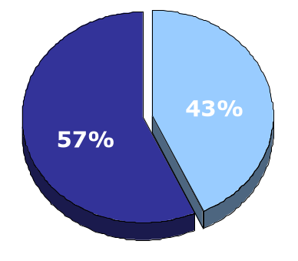
EnronOnline vs. Traditional Channels
Transactions
Daily % (30-day trailing average)
Traditional Channels
EnronOnline

