Slide 1
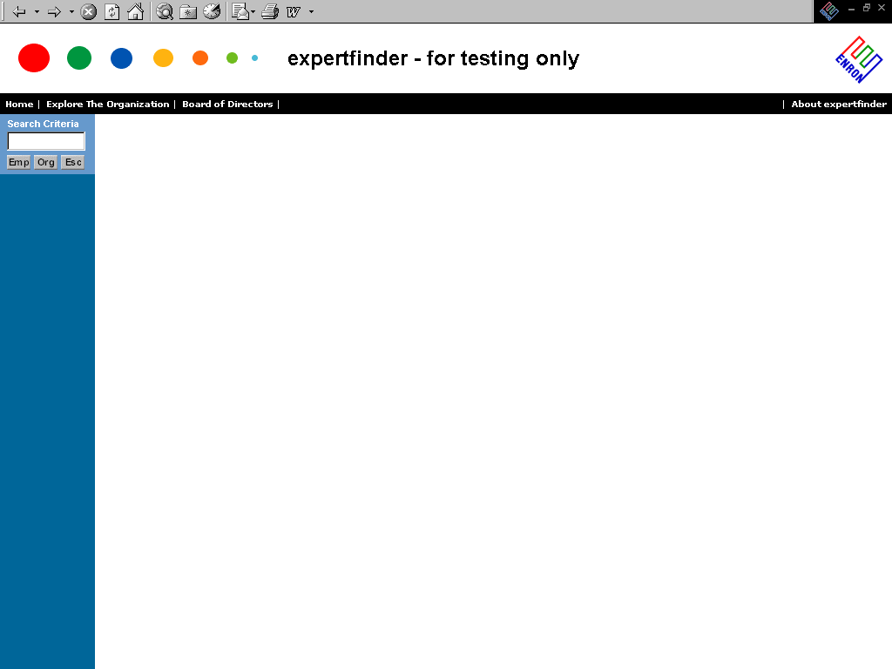
https://gcs.enron.com/expertfinder/tcid.asp
The expertfinder is a tool that will enable you to find people
in the organization by several different methods:
Organization Structure - By Department, Cost Center, Supervisor,
Job Group, Peer Group, HR Rep Responsibility, Job Title
Skills - Search by a skill set
Language - Search to see who speaks a certain language
Schools - Find out who went to your school
Prior Experience - Who may have experience you are needing
Under Development

Slide 2
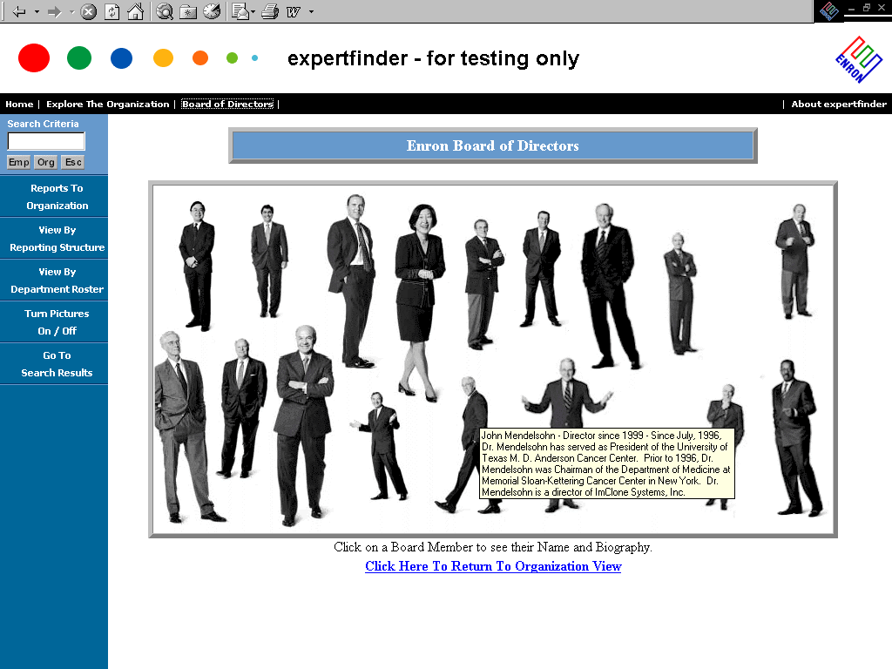
View the Board of Directors and their Bio ...

Slide 3
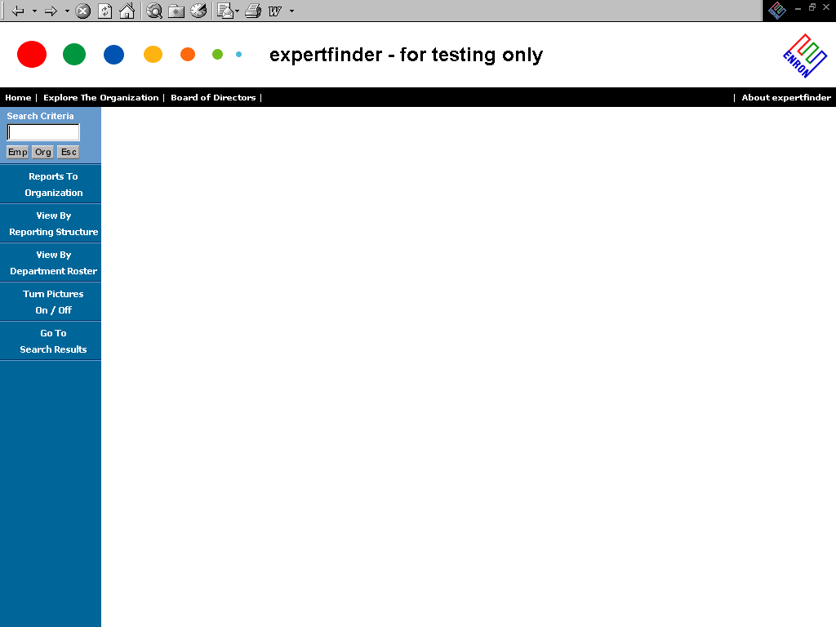
Views can also be looked at by additional structures ...
View by Reports to Organization
View by Reporting Structure
View by Department Roster
Turn Pictures On or Off to Save Load Time
Return to Original Search Query

Slide 4
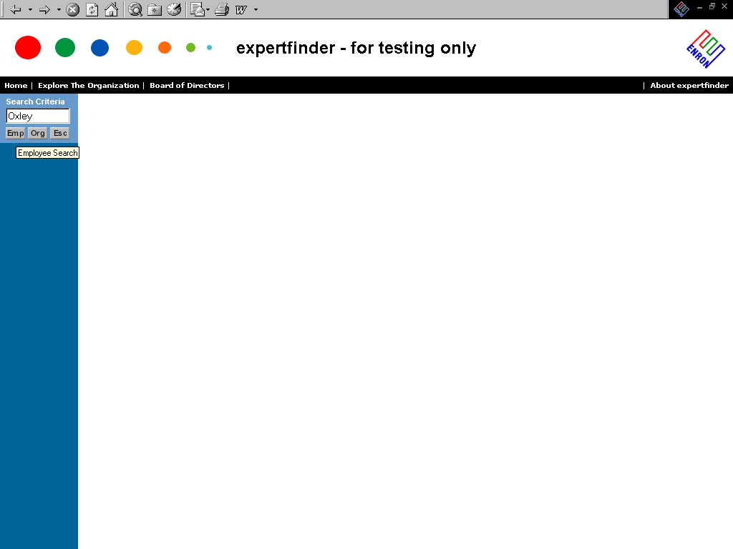
Current search capabilities ...
Search for a Person
or an Organization
Unit (Department)

Slide 5
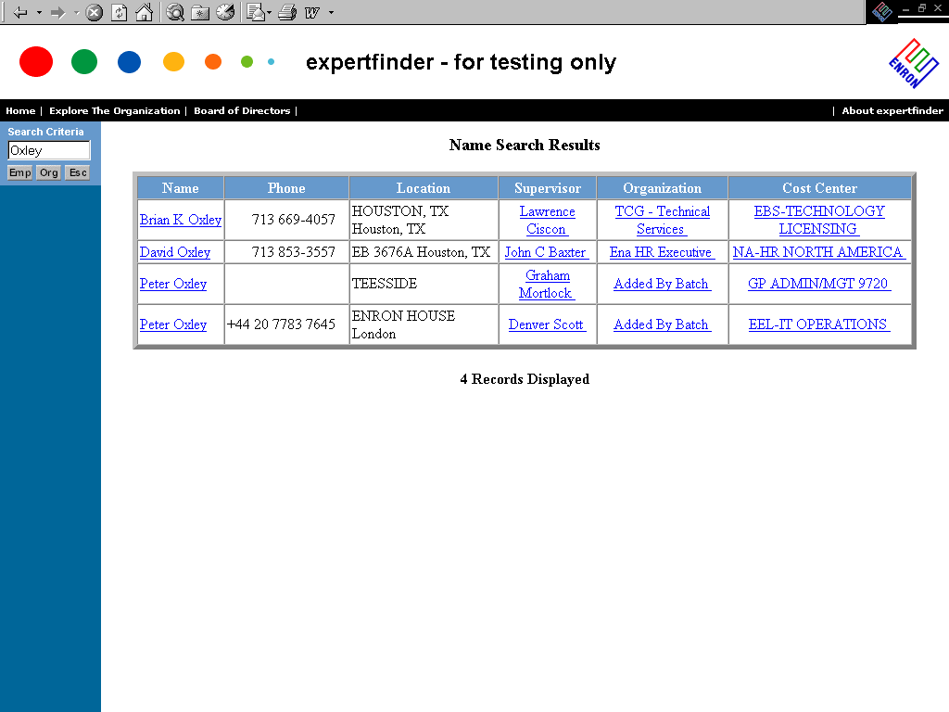
You can search by a partial name and a list to chose from will come up ...

Slide 6
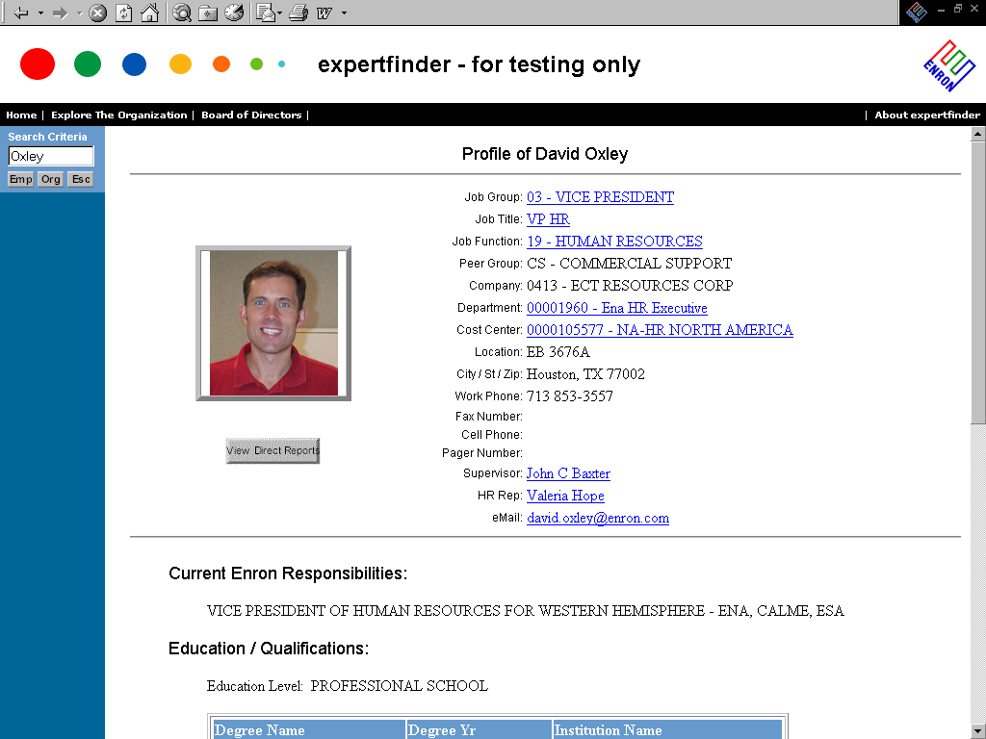
You have the ability to look at lists of people by the areas below ...
Job Group
Job Title
Job Function
Department (Org Unit)
Cost Center
Supervisor
HR Rep
Ability to email coming soon!

Slide 7
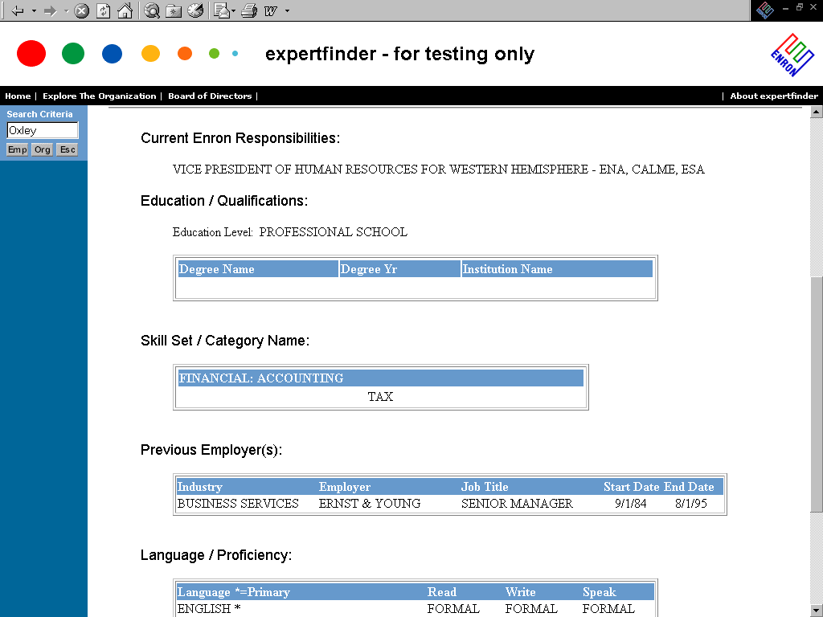
Currently, you can view profile information ...

Slide 8
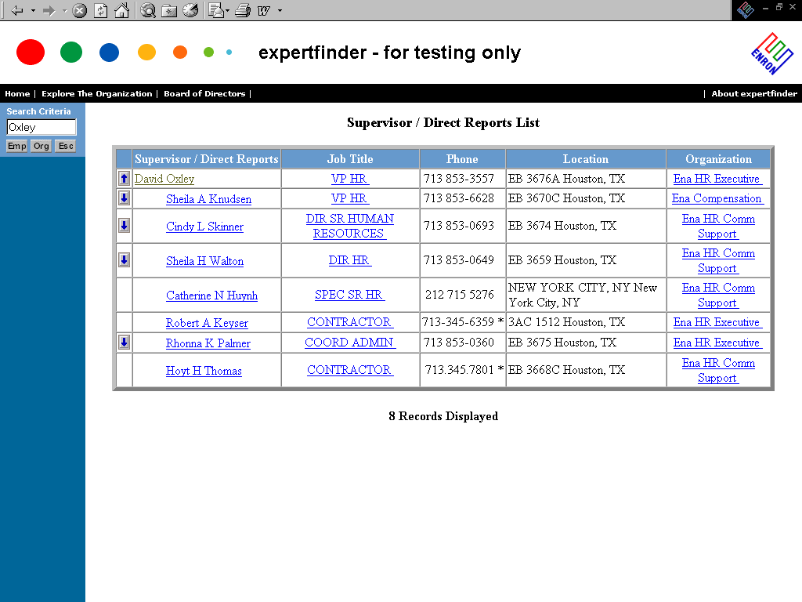
From a list view, you can view the traversing of the organization ...
You can go up the tree ...
or
You can go down the tree

Slide 9
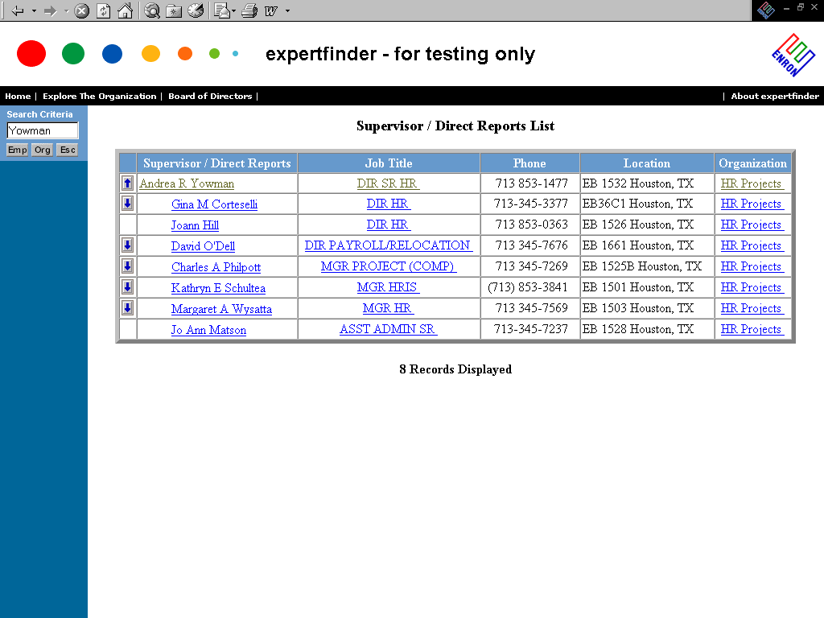
Going down the tree in HR Projects ...

Slide 10
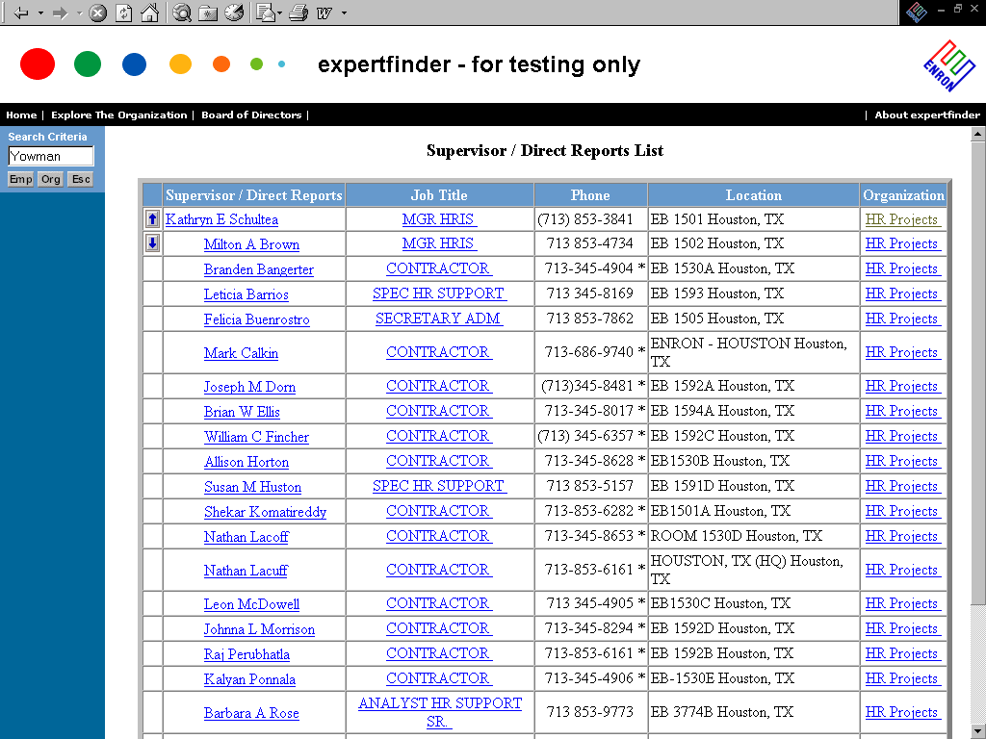
Going down the tree in HR Projects ...

Slide 11
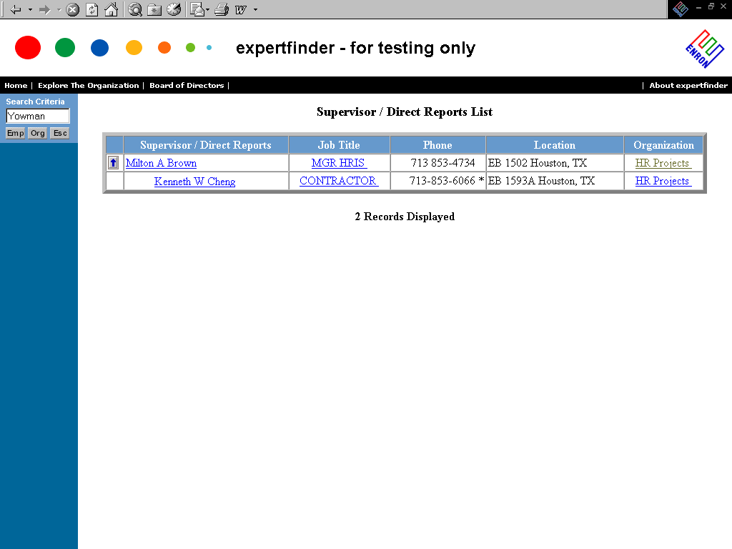
Going down the tree in HR Projects ... until the levels run out
This is the lowest level for the “reports to” view.

Slide 12
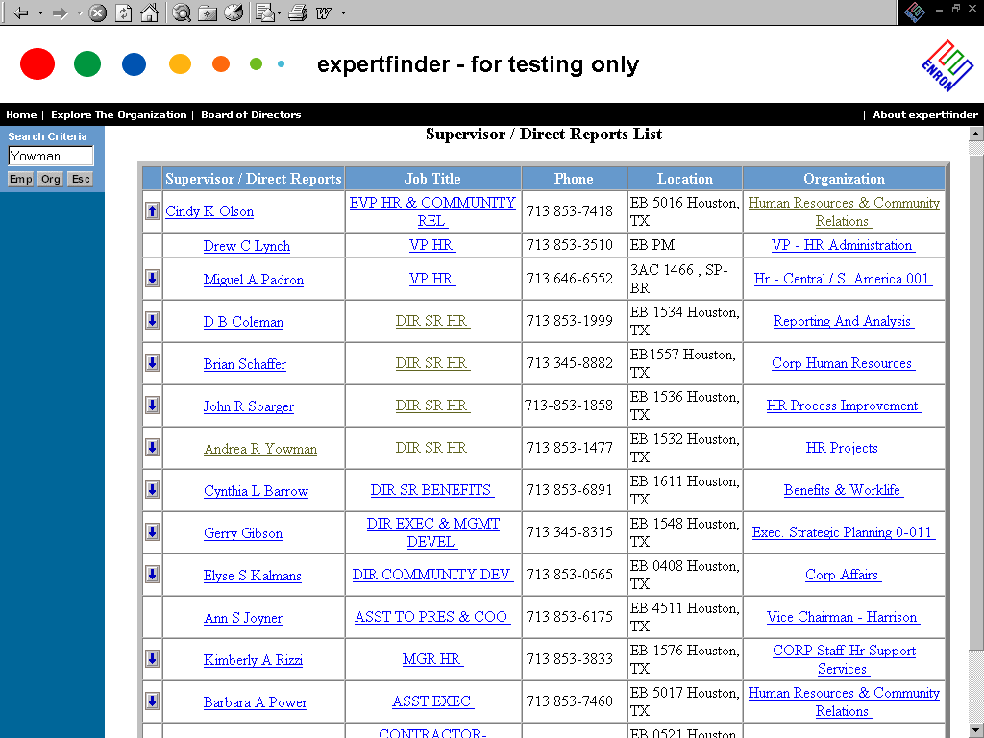
Going back up the tree in HR Projects to HR EVP ...

Slide 13
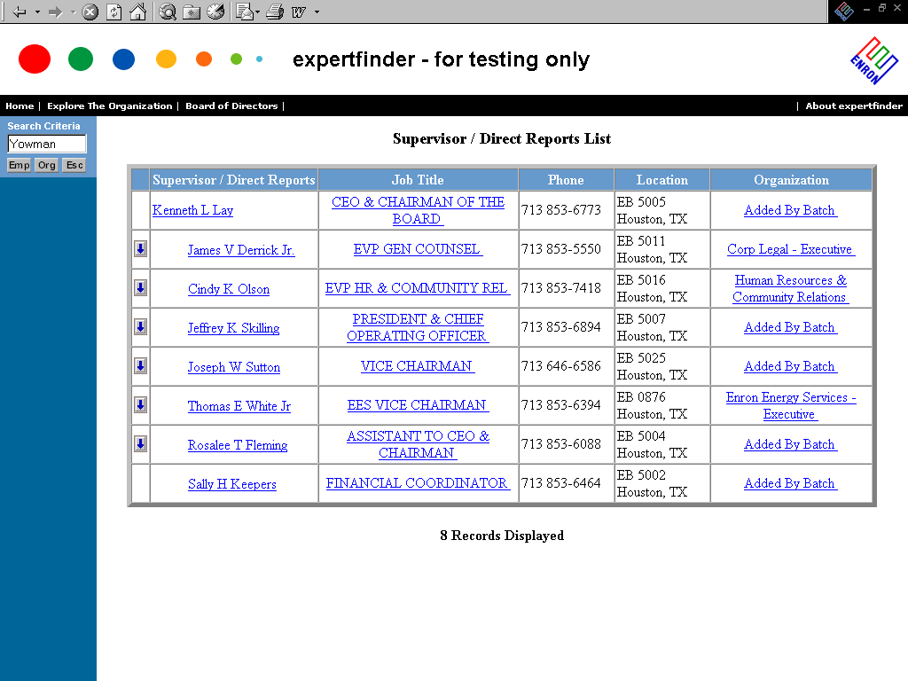
Going back up the tree from HR Head to OTC ...

Slide 14
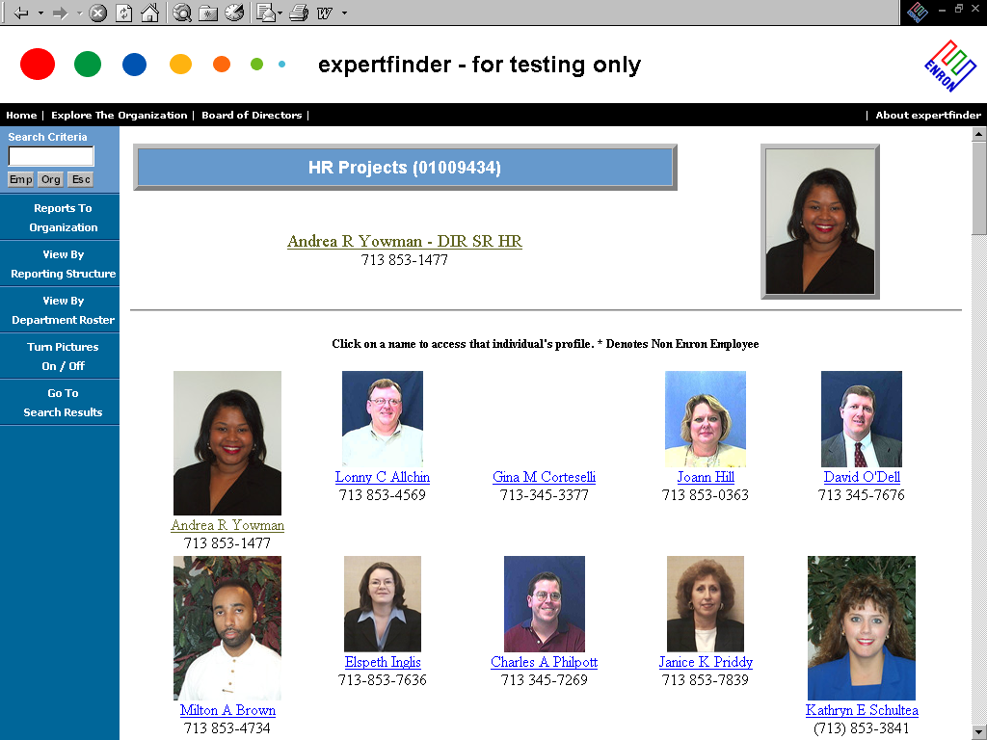
Pictures can be viewed from the Department Roster or by Selecting the Department of who you’re currently viewing ...

