Slide 1

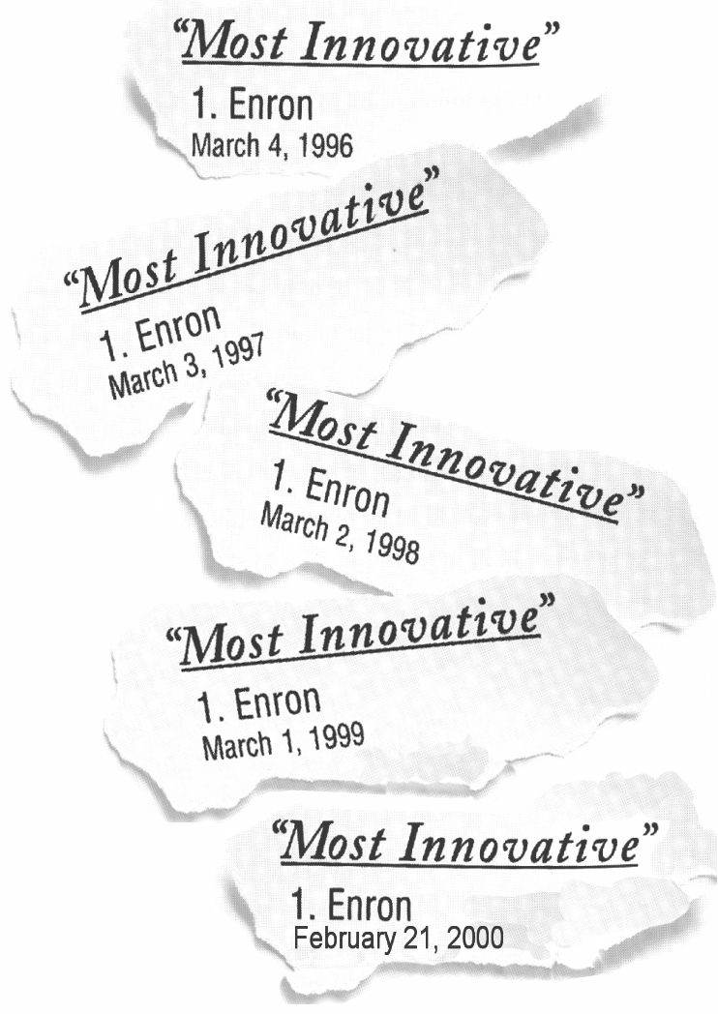


Attracting and Retaining Talent at Enron
HR Analysis and Reporting
November 2000
Confidential and Proprietary

Slide 2
Executive Summary
Attracting Talent
An enhanced company brand will likely have a positive impact for recruiting. Enron is still an unknown to some college and experienced candidates.
Enron’s new hire count increased by 68% in 2000 due to both the company’s business growth and a rising turnover rate. The increasing labor market deficiency and Enron’s rising turnover rates are competing factors that may suppress the company’s rapid growth rate.
Enron’s offer acceptance ratio is decreasing (91% to 86%), and compensation is the major reason candidates decline offers. Enron needs to increase marketing efforts related to non-compensation benefits such as entrepreneurial culture, free talent market, etc. as well as perform ongoing compensation market analysis. “Personal Reasons” is reported to be the second reason for declines, again another reason for WorkLife initiatives.
Retaining Talent
Enron’s total turnover rate has almost doubled, increasing from 6.0% to 10.0% over the past year. “Personal Reasons” is reported to be the main driver. Of those who have left the company for both voluntary and involuntary reasons, these employees have on average been satisfactory or below performers, indicating that Enron is high-grading its workforce.
By organizational levels, turnover is highest for the staff to senior specialists. However on average, the company is losing poorer performers rather than high performers.
The Enron population is slightly younger and more diverse. Average tenure plunged 37% from over 7 years to less than 5 years over the past year.
The most frequent tenure of voluntary separators is less than 1 year, indicating a revolving door. The average employee who voluntarily terminates is age 35, typically an experienced hire.
Confidential and Proprietary
NOTE: Presentation reflects domestic Enron employees, as well as international employees paid from headquarters. EOTT, PGE, EFS, Nepco and Wind employees were excluded, as well as contractors and temporary employees. 1999 data includes October 1998 to October 1999; 2000 data includes October 1999 to October 2000.
<number>

Slide 3
Attracting Top Talent
External Market Conditions
Company’s Staffing Growth
Recruiting Statistics

Slide 4
Staffing Challenges
Enron’s staffing needs are increasing
Rapid Growth
New jobs created is estimated to be 10% or over 2,000 new hires.
Rising Turnover
Turnover rates have almost doubled accelerating replacements
Future labor market projections indicate a growing labor deficiency for knowledge workers.
Increasing turnover and a competitive labor market are competing factors that may impact Enron’s rapid growth rate.
Confidential and Proprietary
NOTE: US Census is source for domestic labor demand graph.
Turnover excludes Analysts and Associates who terminated to return to school.
<number>

Slide 5
MBA.com Phenomenon
Fortune’s Top 50 Companies among MBAs (4/17/00):
  Amazon.com jumped to 2nd place in 2000 from 130th in 1999
  Yahoo.com leaped to 6th from 146th last year
  Meanwhile, companies like Microsoft and Enron fell
Enron’s Offer Acceptance Ratio from 1999 College Recruiting is 50%.
Rank
2000
2
6
7
10
11
12
15
17
22
28
30
60
1999
130
146
25
5
14
22
31
24
13
77
51
44
Company
Amazon.com
Yahoo
Cisco Systems
Microsoft
Dell
Intel
IBM
Lucent Technologies
Hewlett-Packard
3Com
Sun Microsystems
Enron
Source: Fortune, “So where do you want to work”, April 17,2000

Slide 6
Recruiting Efforts-Experienced Hires
        1999 2000 Benchmark*
Offer Acceptance Ratio 91.4% 86.4% 90.5%
Days to Fill N/A 44 50
Cost per Hire $6,557 N/A $5,249
1st Reason for Decline Personal Reasons Compensation
2nd Reason for Decline Accepted Other Offer Personal Reasons
Enron’s offer acceptance ratio is decreasing. Compensation is the major reason candidates decline offers. Increased marketing for other employment benefits and ongoing compensation market studies may assist in this area. Personal reasons are reported to be the second driver related to Enron’s reputation for long hours.
Confidential and Proprietary
<number>
* Saratoga Institute, 1999 (non-bank financial companies)

Slide 7
Retaining Talent
Who is Enron?
Turnover
Contribution Loss

Slide 8

Who is Enron?
1999 2000 2000
(including GPG) (excluding GPG)
Age 40 38 36
Tenure 7.6 yrs 4.8 yrs 2.7 yrs
Most Frequent Tenure 0-1 yr 0-1 yr 0-1 yr
Male/Female 65%/35% 66%/34% 62%/38%
Ethnicity - Caucasian 78% 60% 53%
Education - Advanced 20% 15% 17%
Degrees
The Enron population is slightly younger and more diverse. Average tenure plunged 37% from 7.6 years to 4.8 years over the past two years.
Confidential and Proprietary
<number>

Slide 9

Overall Turnover
1999 2000 Benchmark*
Turnover Rate 6.0% 10.3% 17.6%
- Voluntary Rate 3.5% 5.6% 14.4%
- Involuntary Rate 2.5% 4.7% 3.3%
Turnover Costs* $37M $74M
- Direct Costs $10M $20M
- Indirect Costs $27M $54M
1st Major Reason Reorganization/Surplus Personal Reasons
2nd Major Reason New Job (non- New Job (non-
competitor/unknown) competitor/unknown)
Q3 2000 Turnover
Turnover Rate 21.7%
- Voluntary Rate 15.3%
- Involuntary Rate 6.5%
Major Reason Personal Reasons
Turnover rate and costs has almost doubled from 1999 to 2000.
Q3 2000 annualized turnover rate (21.7%) is indicating that turnover is on the rise.
Turnover rate and costs have almost doubled from 6% to 10% over the past year. Employees state “Personal Reasons” is the driver.
(“Personal Reasons” is one of 26 potential termination reasons).
Confidential and Proprietary
NOTE: Turnover excludes Analysts and Associates who terminated to return to school.
* Turnover costs estimated at $66,640 per termination ($18,202 direct costs; $48,438 indirect costs).
* Saratoga Institute, 1999 (non-bank financial companies)
<number>

Slide 10
Voluntary Turnover
        1999 2000
Age 36 35
Tenure 3.8 yrs 3.9 yrs
Most Frequent
Tenure 1-2 yrs 0-1 yr
Male/Female 59%/41% 60%/40%
Business Unit
Most Affected ENA EEL
1st Major Reason New Job (non- Personal Reasons
competitor/unknown)
2nd Major Reason Personal Reasons New Job (non-
competitor/unknown)
Voluntary Turnover is increasing, notably after All-Employee stock options vested in July.
The most frequent tenure of voluntary separators is less than one year, indicating a revolving door. The average employee who voluntarily terminates is age 35 (an experienced hire).
Confidential and Proprietary
<number>
NOTE: Turnover excludes Analysts and Associates who terminated to return to school.

Slide 11
Contribution Loss
Contribution Loss is a metric introduced this year that indicates the type of performers leaving ie. High performers or low performers.
  Enron is currently high-grading in all business units ie replacing poor performers with new hires.
Voluntary Terminations
Involuntary Terminations
Annualized Contribution Loss = 6.7%
Annualized Turnover = 8.9%
Annualized Contribution Loss = 1.8%
Annualized Turnover = 4.0%

Slide 12
Turnover and Contribution Loss by Organizational Levels
        Voluntary
        Turnover* Contribution Loss
Upper Mgt 0.3% 0.1%
Middle Mgt 0.8% 0.5%
Lower Mgt 1.5% 0.8%
Analysts/Associate 0.5% 0.5%
Staff to Sr. Specialist 4.3% 3.5%
Administrative 1.8% 1.6%
Voluntary Turnover is highest in the staff to senior specialist areas.
For all organizational levels, the company is losing on average poorer performers.
Confidential and Proprietary
<number>
* NOTE: Turnover period includes July 2000 to September 2000 and excludes analysts who planned to return to school. These rates have been annualized.

Slide 13

Overtime Factor
Extensive overtime and burnout can cause high turnover, increased medical costs and poor morale.
Current Situation
Overtime hours are currently not tracked for exempt employees.
Proposed Action
We propose a poll survey to assess overtime conditions. Survey must be anonymous or results may be skewed.
Confidential and Proprietary
<number>

Slide 14
Flexible Work Options
        1999 2000
Part-time and Reduced Hours 1.3% 0.7%
Employees / Full-time Employees
Number of Part-time and 101 92
Reduced Hours Employees
The percentage of employees who work part-time or reduced hours decreased 46%. Management should consider flexible work options as a retention tool for top performers when the need arises.
Confidential and Proprietary
<number>

