Slide 1
Enron and the New Architecture Model
Richard J. Black (with apologies to Jeffery Skilling)
July 2001
Notes:
Admission: I stole most of these slides from Jeffery Skilling in June 2001.
The more I hear Jeff talk about his ideas for the future of Enron,
the more I realised that our current technology platform wasn’t going to help much
Introduction:
Jeff uses these slides to talk about his “new” business structure for Enron.
Today, I’m going to show you how you can structure the architecture of your systems to closely match the way the business will be structured at Enron.
It’s about closely aligning your systems with your businesses.
It’s about building structures that will outlast changes to business, outlast changes to underlying technologies.

Slide 2
Evolution of the Economic Trade-Off
1300’s
Interaction Costs
Creation of
Money
1800’s
Barter
Economy
2000’s
Transportation &
Communication
Specialization
& Firms
Internet &
InfoTech
Integrated,
Hierarchical
Firm
“Virtually
Integrated”
Firm
Time
Notes:
Key Points:
The cost of integrating businesses is constantly falling (even without Technology)
With the advent of technologies like XML, WSDL, UDDI & SOAP, soon the cost of integrating technology and business will be almost ZERO.

Slide 3
Types of Interaction Costs
Credit
Legal &
Regulatory
Logistics
Price of
Successful
Economic
Transactions
Information
Seeking &
Gathering
Payments
Inventory
Notes:
Key Points:
Constructing a business is expensive, often because of these interaction costs. The total all-in cost of transaction can be expensive.

Slide 4

Cost of Interaction
Mining
Financial
Institutions
U.S.
30-40%
60-70%
55%
India
40-50%
Source: McKinsey
Notes:
Key Points: - A large percentage of the cost of doing business, is the interaction cost.

Slide 5
Early Structures
Not Cost Competitive
Business c.1920
Technology c.2001
Henry Ford Forrest
My Own Deal Capture
Henry Ford Saw Mill
My Own Valuation
Henry Ford Floorboards
My Own Reporting
Henry Ford Model-T Cars
My Own Back office
<number>
Notes:
Key Points:
Henry Ford created a very sucessful structure in the 1920s, the “vertical business”.
Designed to avoid the pain of interaction
Vertical Businesses
Buy/build all your facilities,
make all your own products,
Lower integration costs
Sell good products at lower price
May not be using the best components
Vertical Technology
Build Deal Capture
Build Valuation
Build Reporting
Build BackOffice
Perceived as “efficient”
Very little re-use
Usually tightly-coupled

Slide 6
The New Structures
Business c.1960
Technology c.2005?
Best Car Radio
Best Deal Capture - market feed
Best Tyres
Best Valuation
Best Seats
Best Reporting
Best Engines
Best Back office - web service?
<number>
Notes:
Integrated Businesses (like Toyota in the 1960s)
Toyota created a better busienss strcuture in the 1960’s. By focusing on managmeent techniques (like Just-In-Time production), they were able to dramatically lower the cost of interaction.
They created the ability to rapidly integrate best-in-breed businesses into a world beating service/product

Slide 7
Where’s the Opportunity?
.90
Providing packaged turnkey solutions for customers:
- Complex structures
- Differentiation
- Customization
.10
.20
.85
“Virtual” Integration
.20
.10
.80
.20
.10
.90
<number>
Notes:
Key Point:
Vertical businesses
asset-intensive,
low margin operations.
The horizontal sectors
Commoditized
Overcapitalized
Globalized
“Virtual Integration” is about
* lowering the cost of integration almost zero
dramatically increasing the speed of integration.
Technology:
* Use smart systems architectures to make it happen:
* Call it what you want: X2X (B2Consumer, B2Business, B2Market), STP Straight-through-processing etc etc
Fully-Integrated, automated business processing, processing-by-exception
The flexbilty and agilty to create new services on the fly

Slide 8
Enron Opportunity
Traditional Model
Asset intensive
Vertically integrated
Slow moving and rigid
Hierarchical
New Model
Brain power intensive
Networked
“Real options” oriented
Fast moving & entrepreneurial
Notes:
Key Points:
It’s the same opportunity: business and technology
Enron’s businesses demand:
Increased speed
Increased flexibility
Increased agility
Decreased cost
This is hard to do:
Increasing the speed == taking more shortcuts/ decreasing the flexibility
Increasing the flexibility == increasing the timescales/decreasing the speed

Slide 9
Enron–Accelerating Market Development
Freight
Credit
Metals
Bandwidth
Commodity
Product
Financial
Australian Power & Gas
Pulp & Paper
Coal
Weather
Scandinavian Power & Gas
Plastics
Emissions
Financials (interest rate, equity)
UK Power & Gas
Electricity
Currencies
Natural
Gas
1985
1986
1987
1988
1989
1990
1991
1992
1993
1994
1995
1996
1997
1998
1999
2000
2001
* Lighter shading indicates a developing market
Darker shading indicates a mature market
Notes:
Key Points:
Enron isn’t slowing down, there’ll be
more products,
more trade structures,
more transactions, and
more firms to integrate than ever before.
More services to deliver than ever before

Slide 10
Pulp and Paper
Transactions
1,131
Acquired Garden State Paper Company
210,000 Tons/Yr. Newsprint Facility
4 Recycling Centers
Location in Key Market Areas
Gained Logistics Personnel and Industry Experience
Launched Clickpaper.com
Offers Over 100 Financial and Physical Products
Tailored to Paper Industry Participants
436
14
73
1997
1998
1999
2000
Volumes
(Thousand Tonnes)
12,051
6,311
4,480
314
1997
1998
1999
2000
Financial and Physical Settled Volumes

Slide 11
Bandwidth
Transactions
(2000)
236
Commoditizing and creating liquid markets in circuits, IP capacity and managed storage capacity
Major ramp-up in transaction activity with broad range of counterparties
Significant growth in both transactions and volumes of data delivered expected in 2001
59
3
23
Q1
Q2
Q3
Q4
DS 3 Month Equivalents
(2000)
2,393
1,399
985
432
Q1
Q2
Q3
Q4

Slide 12
Product Development
Technology can not afford to be an inhibitor
LAG
New Businesses
New businesses, new products, new acquisitions being created in ever shorter timescales
New Systems
Need to dramatically reduce timescales, in a sustainable way
Time

Slide 13
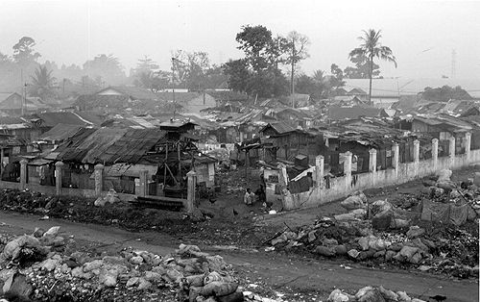
No Architecture - the tell-tale signs
Shanty Town
Systems that can’t keep up with the business scalability, flexibility
Systems require extensive rework poor-architecture
Cost of transactions remains high no workflow automation
Business process not supported Lack of integration
New Business==New Systems lack of components
Systems takes weeks to deploy, after they completed configuration management
Systems breakdown lack of best-practices
Notes:
I’m sure these things never happen on your own systems, but…
Architects get called in every day to help fix problems
And here’s what we see…

Slide 14
Technology Vision
Enron Net Works creates the agile, efficient operation of business products and services.
Create
Efficient
Operation
flexible, agile service creation using system building blocks
low-cost, scalable transactions using business process automation through workflow
fault-tolerant, active monitoring , pro-active resolution
Notes:
A now, a little alignment of business and technology
NOTE: Maybe the tag line isn’t perfect, but you get the idea.

Slide 15
What difference will it make?
The Old Way
The New Way
Analyst/Programmers
Tightly-coupled
Performance Issues
Deployment Issues
Duplicated Projects
Loose governance
Poor visibility
Specialists
Loosely-coupled
Best practice design
Holistic approach
Global services
Defined Process
High visibility
Europe
24%

Slide 16
Flexibility
The New Way
Flexibility
Loosely-coupled systems become more flexible over time
The Old Way
Tightly-coupled application families become so inflexible over time that they need to be replaced.
Time

Slide 17
Ten Seven High-Level Principles
Enron Information Bus Consistent global application Integration
Business Process Automation Reducing transaction costs using workflow
Global One Enron
Enforced Development Process process reengineering, high-level use cases, interface definition, etc
Best Practices industry-wide & Enron-wide
Total Lifecycle Management software + networks + hardware
Visibility Issue Tracking, Requirements Mgmt, Financial Controls, Development Metrics
Commercialisation making money with $USD500M and 1,000 people
Europe
24%
Notes:
*OK, I know there are only seven
* We’ve left three blank positions for future expansion

Slide 18
Making it happen. Enforcement & Governance
Team Leaders to enforce Design Reviews with Architects
Training programme for developers
Embrace and extend vendor relationships
Actively plan vendor technology
Global Issue Tracking
Business sponsorship to make change happen
Raising our game – improving the development process
Team Leaders to build global service relationships and strategies
Portal to communicate best practices
Europe
24%

Slide 19
The Master View - what it will look like
All major business process/finanantial transactions integrated through the bus
Increasing integration with customers and service providers
Consistent, rapid connection to the information bus using a stnandard adapter
Business process configuration and automation using workflow engines
Highly distributed, highly scalable valuation clusters
The ability to “shourt” for authorisation etc using mobile phones, PDAs, etc
Europe
24%
Notes:
The principles in practice…
Your applications will evolve to fit within this framework.
New applications/businesses/services will developed using these ideas.

Slide 20
A few last thoughts…
Think ‘years’ not ‘months’
It is not about new tools
It is about getting organized
It is about creating a new culture of co-operation, collaboration & governance
It is about Technology running more like an external consultancy
It is about transforming Technology into a competitive advantage
It is about getting smarter
It is about success
Europe
24%

Slide 21
What is architecture?
Vision & Strategy Aligned with business goals
Communication system views, presentations, frameworks, newsletters, interviews, meetings
Design Reviews Jump-starting development
Best-practices Industry, vendors, IEEE, SEI, WWISA, Enron-teams, etc
Vendors Relationships, negotiation, support, partnering, roadmaps
Performance Reviews system event tracing & analysis
Technology Planning emerging, production, maintain, retire.
Europe
24%
Notes:
- What have architects ever done for us?

Slide 22
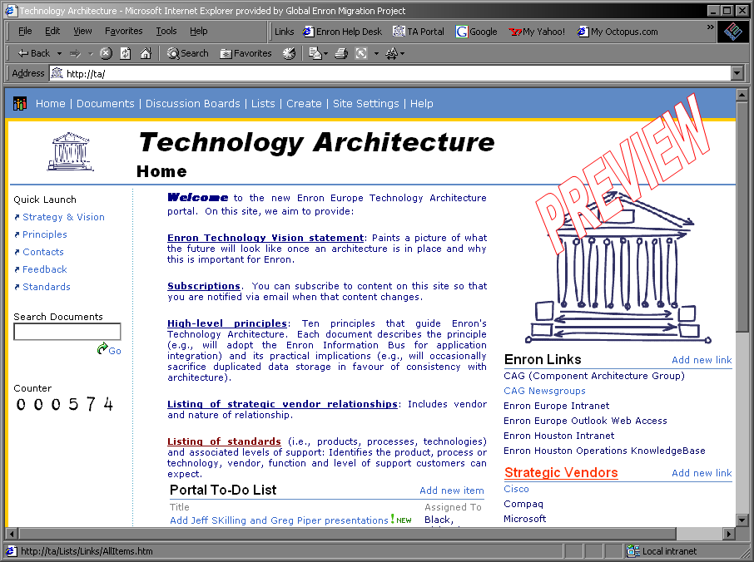
The Architecture Portal
A single point of contact for all architectural matters
Documents
Discussions
Links
Surveys
News
Subscriptions
Feedback
http://ta.corp.enron.com

