Slide 1


Confidential
PDCATM BookRunner Screenshots Excerpts -- Weather
LONGITUDETM, the LONGITUDE logoTM, COMPLETING THE WORLDS CAPITAL MARKETSTM, PARIMUTUEL DIGITAL CALL AUCTIONTM and PDCATM are service marks and/or trademarks of Longitude, Inc. Other product names, company names, brand names and trade names mentioned herein may be the trademarks of their respective holders. All rights in the trademarks, company names, trade names or logos used for Longitude, Inc. or third party products or services belong exclusively to Longitude, Inc. or their respective owners, and are protected from reproduction, imitation, dilution or confusing or misleading uses under national and international trademark and copyright laws.
Notes:
ss

Slide 2
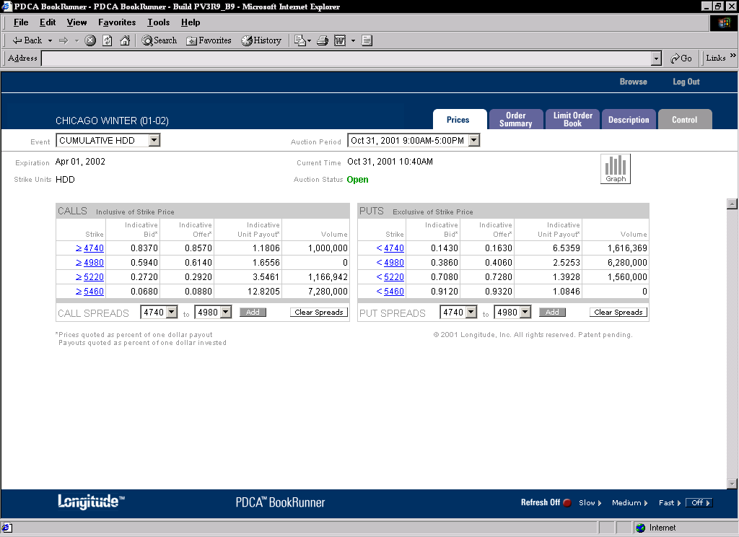

Slide 3
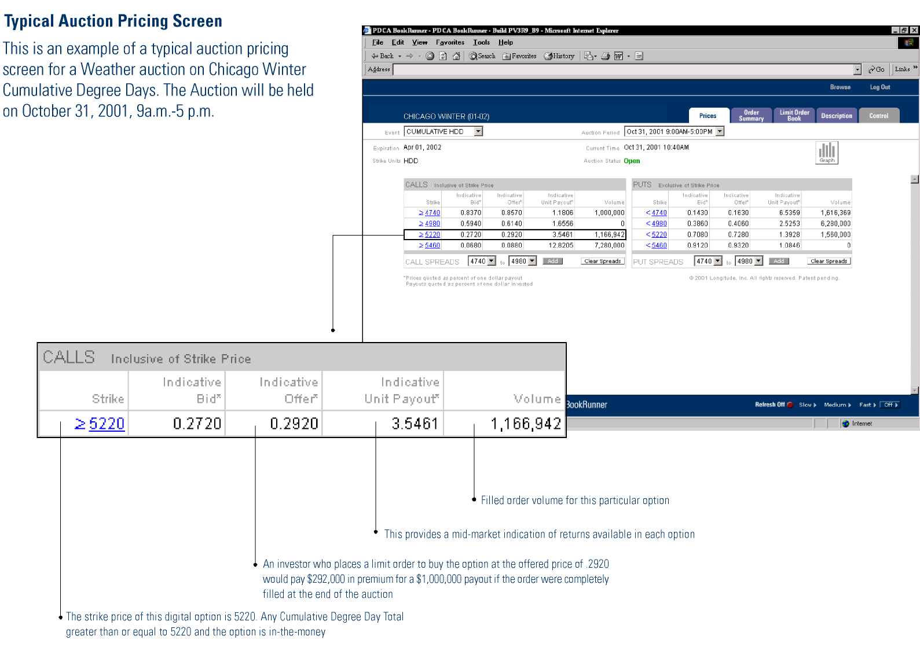

Slide 4
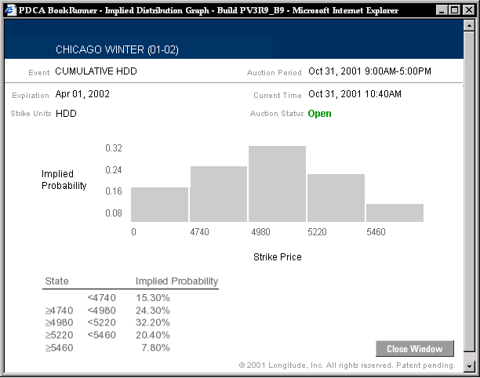
Notes:
ss

Slide 5
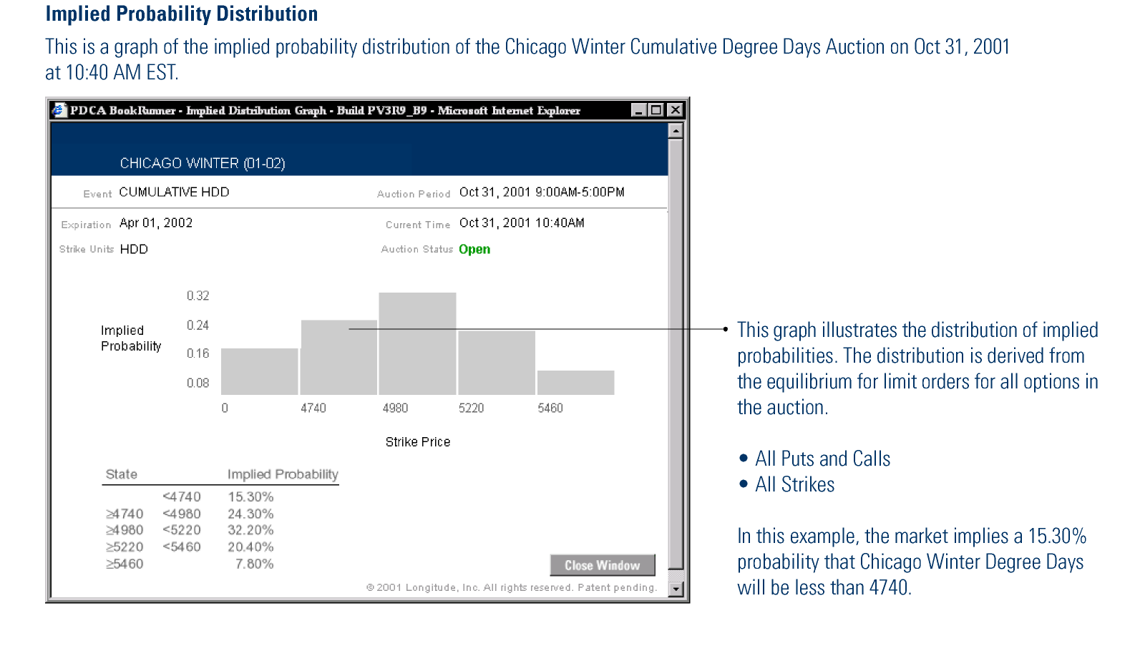

Slide 6
Confidential
Longitude, Inc
650 Fifth Avenue
New York, NY 10019
212.468.8500
www.longitude.com
Notes:
ss

