Slide 1
Introduction
Two principal operating divisions
  Merchanting
    number 1 independent copper merchant
    one of the top 3 independent nickel, aluminium and copper concentrates merchants
    one of the leading European merchants of recycled non-ferrous metals
  Financial Services
    one of the leading LME members
    - number 1* in aluminium forwards
    - number 1* in copper forwards to three months
    - number 1* in options in other base metals and exotics
    one of the leading LME metals warehousing businesses
Notes:
<number>
<footer>
<header>
<date/time>

Slide 2
Metals Industry Overview
Cyclical industry
- consumption tied to industrial production
- history of excess supply followed by shortage of supply
Fragmented industry
Long-term growth markets
Producers and consumers must continue to manage price risk
Large energy consumer

Slide 3
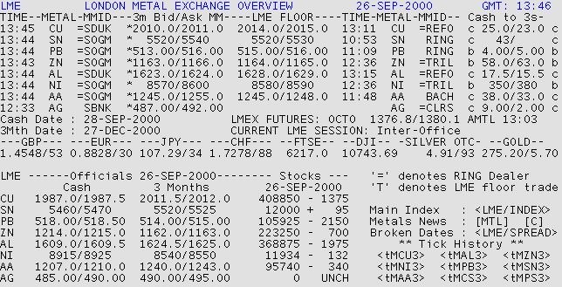

Slide 5
Backwardation
The market is in “backwardation”, when the cash price is higher than the future price; this occurs mainly when the present demand is higher than supply
Insurance
Rent
Cash Price
Like the contango, the backwardation is the difference between the cash and the future price.
Backwardation
Cash to 3 Months
Interest
Future Price

Slide 6
“Contango”
“Contango” is the
difference between
the “cash” and the
“future” price!
3 months: the
future price
Insurance
The “market is in
a contango”, when
the “cash” price is
lower than the
“future” price!
Rent
Cash of 3 month
Contango
Interest
Contango =Interest + Rent + Insurance
“Cash”: today’s
prompt price

Slide 7
Merchanting Activities
Non-ferrous metals, recycled metals and non-ferrous concentrates merchant
  trading as principal with the world’s major producers and consumers
Activities encompass
  purchase, storage, shipment and sale of refined and recycled metals and concentrates
  global stockholding
  LME and COMEX hedging/arbitrage/position management via Financial Services division
  Structured projects
Notes:
<number>
<footer>
<header>
<date/time>

Slide 8



Chinese State Registered Bureau Buyer
Elektrokoppar
Consumer
Codelco
Producer

Slide 9
Strategy
Strengthen presence in copper, copper concentrates and nickel
Increase volumes in aluminium, zinc and tin
Establish positions in lead and zinc concentrates
Expand recycled metals business
Strategic alliances
  Long term structured projects
Go Online!
Notes:
<number>
<footer>
<header>
<date/time>

