Slide 1
Enron Overview
Jeff Skilling
President & CEO, Enron Corp.
April 2001

Slide 2
Earnings Performance
(Recurring Per Diluted Share)
$1.47
$1.18
$1.00
$0.87
+ 15%
+ 18%
+ 25%

Slide 3
Enron Annual Revenues
100.8B
40.1B
31.3B
20.3B
+ 54%
+ 28%
+ 151%

Slide 4
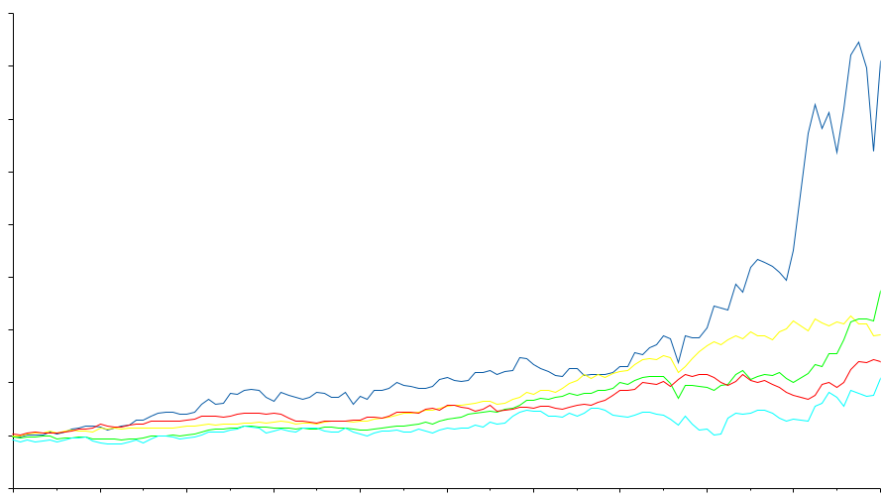
Total Return to Shareholders
January 1, 1990 to February 28, 2001
1600
1400
Enron Corp.
S&P 500
Pipeline Avg.
Utility Avg.
E&P Avg.
1,151%
354%
571%
246%
183%
1200
1000
800
600
400
200
0
-200
Dec 90
Dec 91
Dec 92
Dec 93
Dec 94
Dec 95
Dec 96
Dec 97
Dec 98
Dec 99
Dec 00
Jan 01
Feb 01
Note: Calculated to February 28, 2001

Slide 5
Enron Business Units
Enron Corp
Enron Transportation Services
Enron Wholesale Services
Enron Energy Services
Enron Broadband Services
Xcelerator

Slide 6
Enron Transportation Services
Northern Natural Gas
4.3 Bcf/d Peak Capacity
16,463 Miles
$1.2 Billion Rate Base
100% Owned
Enron’s Gas Pipelines
Transport 15% of U.S. Natural Gas Demand
840 MMcf/d Capacity Added Over Past Two Years
9.8 Bcf/d Peak Capacity
24,959 Miles
$2.5 Billion Rate Base (Net to Enron)
Northern Border
2.4 Bcf/d Peak Capacity
1,214 Miles
$1.4 Billion Rate Base
8% Owned
Transwestern
1.7 Bcf/d Peak Capacity
2,487 Miles
$500 Million Rate Base
100% Owned
Florida Gas
1.5 Bcf/d Peak Capacity
4,795 Miles
$1.3 Billion Rate Base
50% Owned

Slide 7
Enron Transportation Services
Consistent Earnings & Cash Flow
(Millions)
Income Before Interest and Taxes
Cash Flow from Operations
$415
$391
$380
$370
$346
$351

Slide 8
Enron Wholesale Services
Regional Energy Networks
North America
Europe
Offices
Power
Marketing Activity
Gas
Power
South America
Japan
Australia
Global Markets
Crude & Products, Coal & Emissions, Weather, LNG
Industrial Markets
Pulp, Paper & Lumber, Metals, Steel
Global Assets
Asset Operations Worldwide
Enron Net Works

Slide 9
Enron North America
The Most Flexible, Reliable & Valuable Energy Network
Marketing Offices
CALGARY
Gas Pipeline Access
Electric Grid Access
PORTLAND
NYMEX
TORONTO
NEW YORK
Leased Gas Storage
COB
PJM
Hub
OMAHA
Hub
Power
SAN FRANCISCO
CHICAGO
Gas
DENVER
WASHINGTON
Power Plants
In Operation
Palo
Verde
Hub
In Operation; Sale Pending
Entergy
Hub
Under Development
Henry
Hub
HOUSTON
Expansive Market-Making
Least-Cost Packaging
Reliable Delivery
Broad Customer Reach
Cross-Commodity Expertise
Innovative Products
MONTERREY

Slide 10
Enron North America
Volumes-Natural Gas
(Bcf/d)
Volumes-Power
(Millions/MWH)
Total Transactions
(Physical & financial)
24.7
579
775,071
381
13.9
220,247
+77%
+52%
+252%
1999
2000
1999
2000

Slide 11
Enron’s European Wholesale Network
Helsinki
24 Offices
14 Countries
51 Languages
56 Nationalities
Nord
Pool
Offices
Energy Exchange
Energy Partnerships
Leased Capacity
Utility Services
Power Plants
In Operation
Under Development
Marketing Activity
Gas
Power
Coal
Metals
Oslo
Stockholm
Teesside
1,875 MW
Wilton
154 MW
Amsterdam
Oxford
Hamburg
Moscow
APX
Warsaw
IPE
London
EEX
Nowa Sarzyna
116 MW
Brussels
Frankfurt
Enron/Petrom JV
Zurich
Budapest
Milan
Bucharest
Sarlux
551 MW
Madrid
Mora la Nova
1,600 MW
Marmara
478 MW
Arcos
1,200 MW
Building a Valuable Energy Franchise

Slide 12
Enron Europe
Volumes
(BBtue/d)
Daily Transactions
(Average)
10,335
319
Power
Gas
Continent
Nordic
U.K.
4,058
91
2,270
155%
251%
34
1998
1999
2000
1998
1999
2000
Physical and Financial Settled Volumes

Slide 13
Enron in Japan
Merchant Plant Opportunities
Enron’s Marketing Activities
Developing New Power Plants as Part of Enron’s Joint Venture with E-Power
Offering Power Contracts Today:
  Up to 5 Year Term
  10% Price Reduction in First Year
  Option to Supply in Later Years
Office
Power Plant
in Development
Third Party
Transmission Lines
Gas Pipelines
Industrial Power Prices -1999
(¢/KWh)
9.04
6.27
5.06
4.21
TOKYO
Japan
U.K.
Germany
U.S.
Source: WGI and OECD Energy Prices and Taxes
Notes:
Enron has selected a site in Aomori Prefecture as a priority candidate for constructing and operating a large gas-fired combined cycle power plan in six to seven years. Project proposals include:
LNG receiving and storage facilities and/or natural gas receiving pipeline facility
Natural gas fired power plant with a capacity of approximately 2,000MW
Availability of competitive, electricity, heat and gas to contribute to local infrastructure
Local government views the project as an important step towards establishing the region as an energy supply center
Further analysis and a feasibility project are the next steps to estimate total cost

Slide 14
Enron South America
Asset & Trading Position
PBGás
0.1 MMcm/d
18 Customers
PARAÍBA
Porto Velho
Copergás
0.5 MMcm/d
37 Customers
PERNAMBUCO
B R A Z I L
ALAGOAS
RONDÔNIA
TOCANTINS
SERGIPE
Cuiabá 480 MW
and 390 mi Pipeline
Algás
0.3 MMcm/d
5 Customers
P E R U
Bahiagás
1.6 MMcm/d
21 Customers
BAHIA
B O L I V I A
Cuiabá
Emsergás
0.1 MMcm/d
18 Customers
La Paz
MATO GROSSO
GOIÁS
Brasília
MINAS GERAIS
Santa Cruz
de La Sierra
Transredes
Pipeline
3,093 Miles
SANTA CRUZ
MATO GROSSO
DO SUL
Belo
Horizonte
ESPÍRITO
SANTO
Campo Grande
Vitória
Eletrobolt
379 MW
SÃO PAULO
RIO DE
JANEIRO
P A C I F I C
O C E A N
Bolivia-Brazil Pipeline
1,864 Miles
CEG/Riogás LDCs
3.3 MMcm/d
551,000 Customers
C H I L E
P A R A G U A Y
São Paulo
Rio de
Janeiro
Asunción
PARANÁ
Curitiba
Elektro
1.5 Million customers
10,200 GWh
Compagás
SANTA CATARINA
Florianópolis
A R G E N T I N A
A T L A N T I C
O C E A N
RIO GRANDE DO SUL
SCGás
Porto Alegre
0
350
700
Kilometers
Santiago
TGS
4,104 Miles
U R U G U A Y
Offices
Buenos Aires
Montevideo
Power Trading
Gas Trading
Existing Assets and Operations
Projects/Businesses Under Construction

Slide 15
Enron South America
The Eletrobolt Opportunity
Brazil will face an energy shortage with significant price increases during the next three to five years
ESA will build, own, operate and syndicate a 379MW skid-mounted merchant power plant near Rio de Janeiro, Brazil
Transaction Strengths
  Significant merchant position in a tight market
  Improved future trading capability
Notes:
Hydro comprises 96% of electricity output.
Rationing is level below 49% in April.
Reasons for shortages:
- Significant increases in demand (projected to be 5% to 6% per year).
- Public investment in new generation has been cancelled or postponed.
- Private investment in generation delayed due to uncertainty surrounding pass-through pricing rules.
- Very little rain.
Furthermore, the ONS has dispatched hydro power plants well above the global Guaranteed Energy Level in order to meet growing demand and to mitigate other types of generator’s failure.
This has depleted reservoirs to historically low levels.
It may have jeopardized the ability of existing hydro plants to produce up to Guaranteed Energy levels in the next 2 years, increasing the likelihood and magnitude of power shortages over this period.

Slide 16
Enron Wholesale Services
Extending to Other Markets
Replicating Proven Business Model
to New, High Potential Markets
Applying Technology to Accelerate Penetration and Growth
Demonstrated Success In Rapid
Development of Lead Market Positions

Slide 17


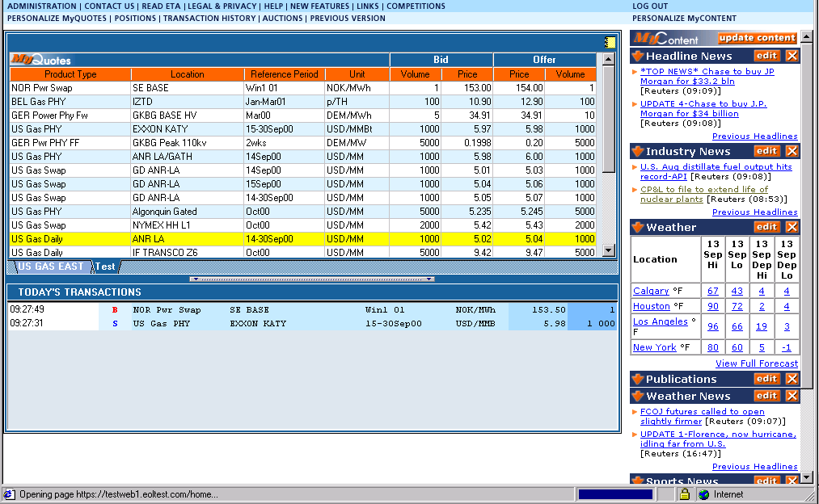
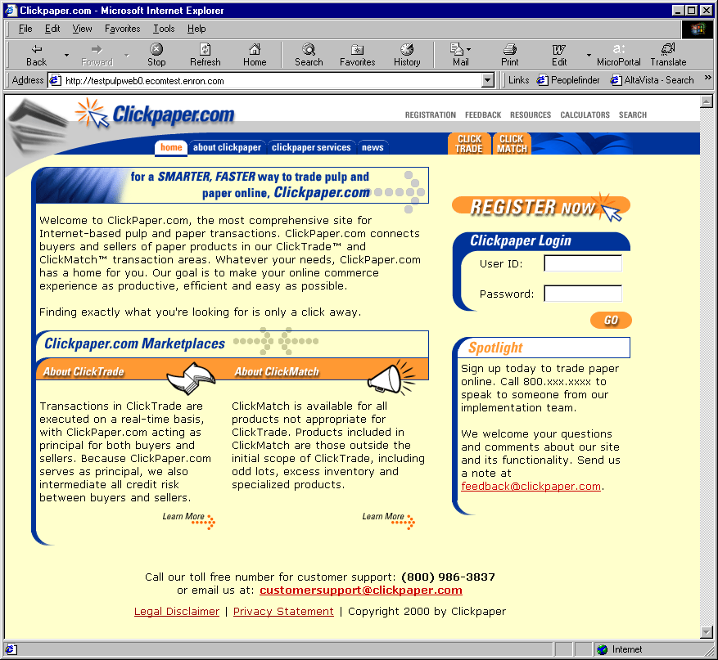
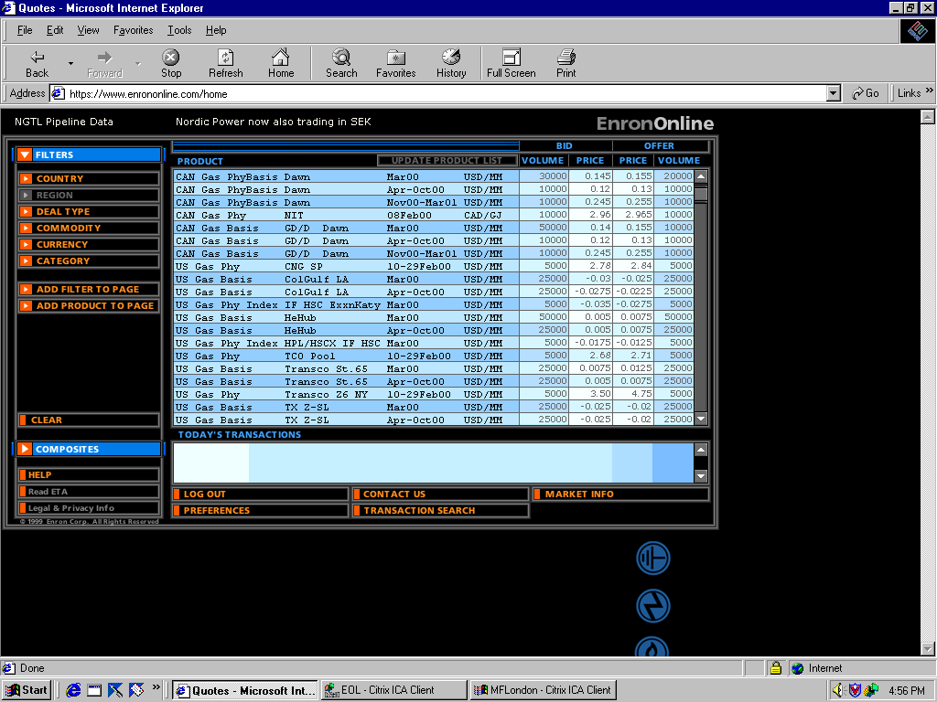
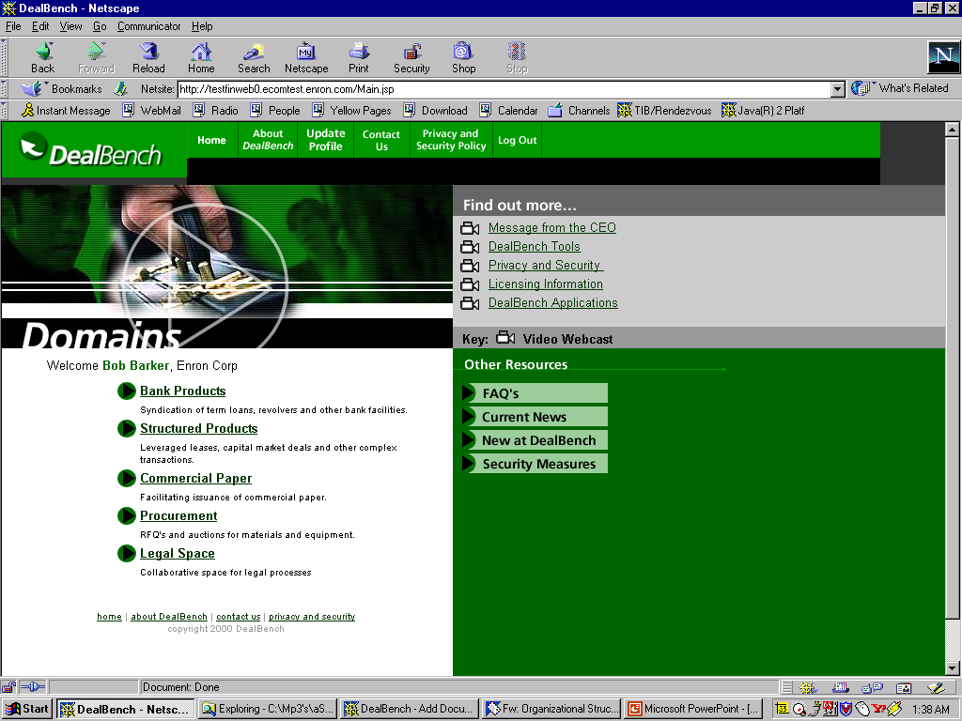
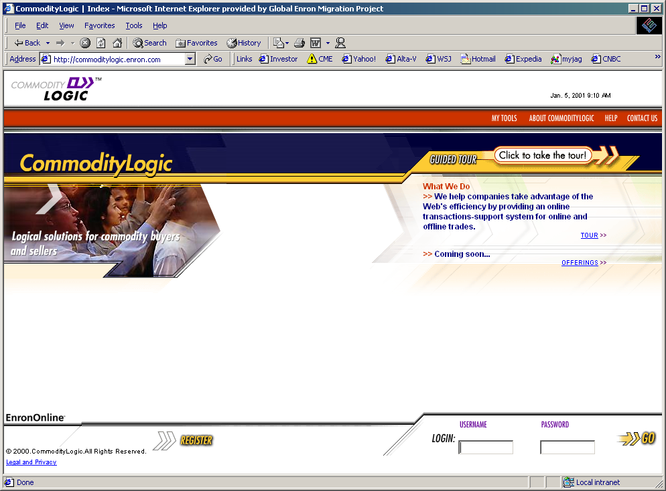
EnronOnline v2.0
®
Enron Net Works
Clickpaper.com
EnronOnline
DealBench
CommodityLogic
November 1999
Enron Credit
Today

Slide 18
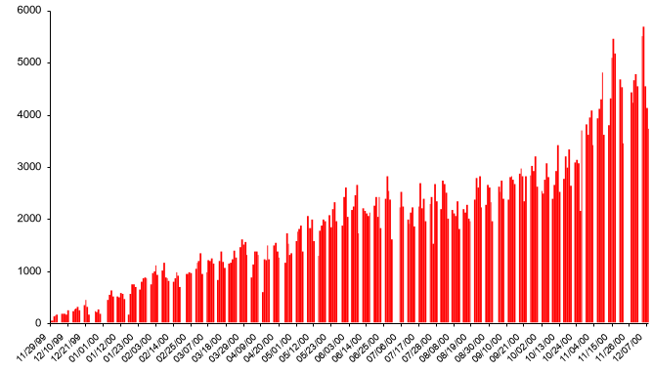
EnronOnline
Changing the Way Energy Is Traded
Free, Reliable Transaction System with Enron as Principal
Free, Reliable Transaction
System with Enron as Principal
02/28/01
01/31/01
11/29/99
12/21/99
06/14/00
12/07/00
12/10/99
01/01/00
06/25/00
10/13/00
11/26/00
01/12/00
03/07/00
07/17/00
08/08/00
01/23/00
08/19/00
09/10/00
02/03/00
02/14/00
02/25/00
03/18/00
03/29/00
04/09/00
04/20/00
05/01/00
05/12/00
05/23/00
06/03/00
07/06/00
07/28/00
08/30/00
09/21/00
10/02/00
10/24/00
11/04/00
11/15/00
Transactions per day

Slide 19
EnronOnline Efficiency Gains
Transactions
Per Market Maker
Marginal
Cost Per Transaction
(Indexed)
100
3,084
25
672
1999
2000
1999
2000

Slide 20
EnronOnline vs. Major Competitors
North American Natural Gas & Power (TBtue)
31,151
22,594
23,149
10,625
3,680
1,021
1,689
1,452
1Q00
2Q00
3Q00
4Q00
All Major Platforms Reporting Combined (Includes Altrade, DynegyDirect, Intercontinental Exchange and NGX)
EnronOnline

Slide 21
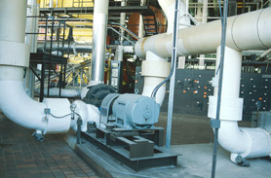
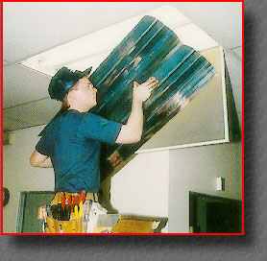
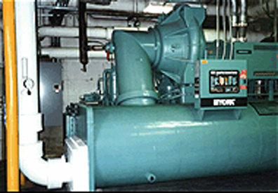

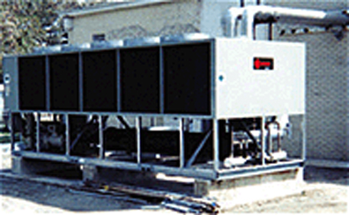
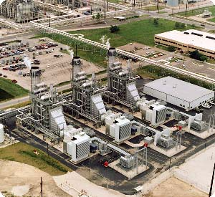
Enron Energy Services
Energy Management Market
Public Utility
“Private Utility”
End Products
Energy Conversion Assets
Boilers
Lighting
Distribution
Chillers
Conditioned
Air
Transmission
Controls
Lighting
Generation
Power
Substations
Market Opportunities - United States
$465 Billion
Market Opportunities - Europe
$300 Billion

Slide 22
Enron Energy Services
Executed Contracts
$16.0B
$8.5B
$3.8B
$1.2B

Slide 23





















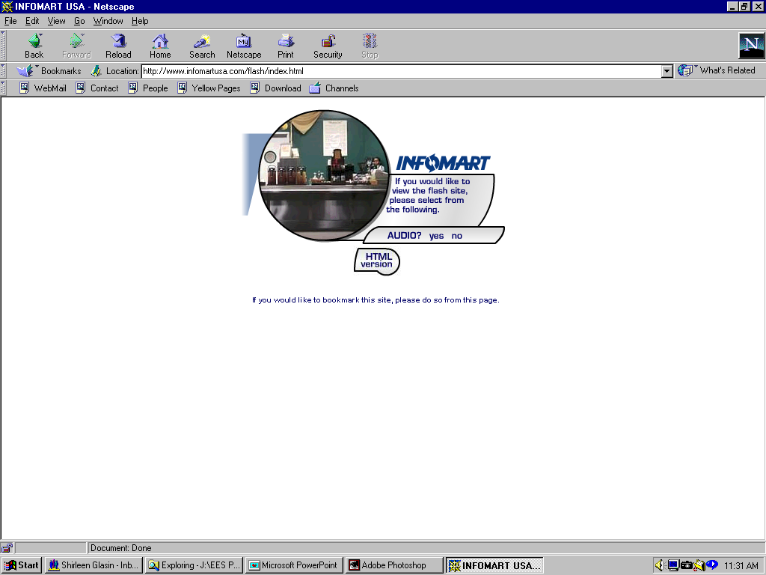



































Enron Energy Services
Executed Contracts
1997
Today
Structure

Slide 24
Enron Broadband Services – 2001
Enron
Intelligent
Network
Intermediation
Services
Deploy the Most Open, Efficient Global Broadband Network
Content
Services
Be the World’s
Largest Buyer and
Seller of Bandwidth
and Network Services
Be the World’s Largest Provider of Premium Broadband Delivery Services
First to Attain Broad Connectivity
First to Create Multi-Layer Network Control
First Integrated Scalable Transaction Processing Platform
First to Create Risk Management Building Blocks for Networks
First Successful Commercial
and Technical Platform for Digital Delivery of Content

Slide 25

Enron Intelligent Network
Controlled Capacity
Seattle
Tokyo
Portland
Boston
Salt Lake City
New York
Denver
Chicago
Philadelphia
San Francisco
Washington
San Jose
Las Vegas
London
Amsterdam
Los Angeles
Brussels
Atlanta
Paris
Dusseldorf
Dallas
Frankfurt
Houston
New Orleans
Miami
Controlled Capacity
Enron Owned Fiber
3rd Party Capacity
Pooling Points Complete
Operations Center

Slide 26
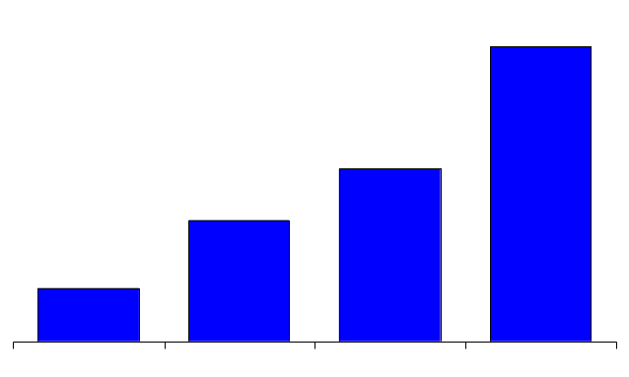
EBS – Intermediation Services
2000 Transactions
Transactions
Network Services Delivered
(DS3 Month Equivalents Delivered)
236
2,393
321 Total Transactions
5,209 Total Deliveries
1,399
985
59
432
23
3
4Q00
1Q00
2Q00
3Q00
1Q00
2Q00
3Q00
4Q00

Slide 27
EBS – Content Services
Enron has the Only Commercially Viable
and Scalable Broadband Delivery Platform
Because of the EIN and Enron Bandwidth Intermediation Services, Enron is Uniquely Capable of Providing Customized, End-to-End Global Content Solutions
First Mover Advantage: Demonstrated Ability to Deliver Leading-Edge Commercial and Technical Solutions

Slide 28
Enron Xcelerator
Enron’s New Business Building Company
Leverage Enron’s Capabilities
Market insight
Access to ideas & deal flow
Financial discipline
Innovation skills & entrepreneurial culture
Reputation
Deep talent pool
Capital raising & portfolio management expertise

Slide 29
Enron Xcelerator
Focus on execution
Entrepreneurial feel
Disciplined approach
Startup attitude & look

Slide 30
®

