Slide 1


Enron Overview
Jeff Skilling
Chief Operating Officer

Slide 2
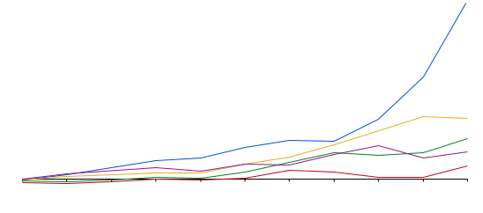
Total Return to Shareholder*
January 1, 1990 to May 31, 2000
1,200
1,000
Enron Corp 1,224%
S&P 500 417%
Pipeline Avg 279%
Utility Avg 195%
E&P Avg 93%
800
294%
600
400
200
0
-200
Dec-90
Dec-91
Dec-92
Dec-93
Dec-94
Dec-95
Dec-96
Dec-97
Dec-98
Dec-99
May-00
*Dividends Reinvested in Security

Slide 3
Fourth Vision
?
(2000- )
Enron’s Visions
to Date
Third Vision
To Become the World’s Leading Energy Company
(1995-1999)
Second Vision
Become the World’s
First Natural Gas Major
(1990-1995)
First Vision
Become the Premier Integrated Natural Gas Company in North America
(1986-1989)

Slide 4
The Energy Network Model
Applications
Utility Facility
Operations
& Management
Energy
Outsourcing
Fuel
Management
Services
eCommerce
Applications
Physical Delivery
Contracts
Price Risk
Management
Contracts
Settlement
Services
Peaking &
Storage Services
Finance
Market Making
Contract Access
Physical Assets

Slide 5
Energy
Communications
Transportation
&
Distribution
Wholesale
Energy
Retail
Energy
Broadband
Services
Enron
Net Works
Natural Gas
Transportation
Electric Distribution
Marketing and
Delivery of Energy
Products Worldwide
Energy Outsourcing
to Commercial and
Industrial Customers
Bandwidth Management
and Broadband Delivery
Services
Seeks IT Commercial synergies
Traditional
New

Slide 6
Energy
Communications
Transportation
&
Distribution
Wholesale
Energy
Retail
Energy
Broadband
Services
Enron
Net Works
Natural Gas
Transportation
Electric Distribution
Traditional
New

Slide 7
Transportation and Distribution
Operating Highlights
Northern Border
1,214 Miles
Began construction for Florida Gas Transmission’s Phase IV expansion. Conducted Open Season for Mainline expansion.
Transwestern installed
new compressor station
in Gallup, NM increasing available capacity by
15 percent.
99% Utilization of Northern Border’s Pipeline.
Currently conducting
open season for C & D line extensions on Northern Natural Gas’ Pipeline.
Northern Natural Gas
16,463 Miles
Transwestern Pipeline
2,487 Miles
Interstate Throughput
(Bbtu/d)
Florida Gas Transmission
4,795 Miles
9,785
9,151
Throughput for 1999 was 9.2 Bbtu/d
Operates 32,000 Miles of Natural Gas Pipelines
Serves Customers in 21 states
Transports 15% of U.S. Natural Gas Demand

Slide 8
Energy
Communications
Transportation
&
Distribution
Wholesale
Energy
Retail
Energy
Broadband
Services
Enron
Net Works
Natural Gas
Transportation
Electric Distribution
Marketing and
Delivery of Energy
Products Worldwide
Energy Outsourcing
to Commercial and
Industrial Customers
Bandwidth Management
and Broadband Delivery
Services
Seeks IT Commercial synergies
Traditional
New

Slide 9
Wholesale Energy Operations and Services
Physical Volumes
(BBtue/d)
Income Before Interest and Taxes
(Millions)
32,429
$1,317
27,308
$968
17,970
$654
12,392
$466
8,966
$401
1995
1996
1997
1998
1999
1995
1996
1997
1998
1999
38% Compound Annual Growth Rate
35% Compound Annual Growth Rate

Slide 10
COB
COB
Hub
Hub
Cinergy
Cinergy
Hub
Hub
Palo
Palo
Verde
Verde
Hub
Hub
Entergy
Entergy
Hub
Hub
Henry
Henry
Hub
Hub

Slide 11
Enron’s European Wholesale Network
Nordic Region
Market Maker and Largest
Power Marketer
U.K.
Established Market Leader in Power and Gas
Nord
Pool
Helsinki
Total Volumes (BBtue/d)
Oslo
Offices
Energy Exchange
LNG Project Under Development
Energy Services
Energy Partnerships
Leased Capacity
Utility Services
Teesside
1,875 MW
Stockholm
3,243
Power and Other
Wilton
154 MW
Gas
Amsterdam
Oxford
APX
Warsaw
Moscow
EEX
Nowa Sarzyna
116 MW
1,825
London
Brussels
Power Plants
Frankfurt
In Operation
In Construction
Under Development
Energovill
Zurich
Enron/Petrom JV
Budapest
+78%
Milan
Jertovec
Energy Marketing
Activity
240 MW
Bucharest
Gas
Power
Coal
Sarlux
551 MW
Madrid
Marmara
478 MW
1Q99
1Q00
Arcos
1,200 MW
Continental Europe
Only Significant New Entrant in Power and Gas

Slide 12
Enron Today: International Portfolio
In Operation
Power Plant
Pipeline
Other
E&P
LPG Facility
LNG Facility
Water
Gas Distribution
Electricity
Distribution
In Construction
Power Plant
Pipeline
Other
LPG Facility
LNG Facility
In Development
Power Plant
Pipeline
Other
E&P
LPG Facility
LNG Facility
LNG Vessel
Barge
Offices
Office
Locations
Teesside
1,875 MW
United Kingdom
London
Sutton Bridge
790 MW
Poland Elektrocieplownia
Nowa Sarzyna
116 MW
Wessex
Germany
Bitterfeld
125 MW
Jertovec
240 MW
Italy
Milan
Croatia
Zagreb
China
Beijing
Turkey
Trakya
478 MW
Western-Eastern China
Natural Gas Pipeline
South Korea
Seoul
Dominican Republic
Santo Domingo
Italy
Sarlux
551 MW
Palestine
Gaza
Power Project
EOG
Sichuan
E&P
Wuhan
Loop
Sichuan-Wuhan
Natural Gas Pipeline
SK-Enron
Gas Distribution
LPG Import
Puerto Rico
San Juan
United Arab Emirates
Dubai
LNG Vessel
135 Mc³m
Dabhol-
Talasari
Pipeline
EOG - India
3,200 Bbls/d
38 MMcf/d
Wuhan Qingshan
443 MW
Guatemala
Guatemala City
Puerto Plata
185 MW
EcoEléctrica
507 MW
LNG Facility
Chengdu
Logun
284 MW
Wuhan Wuchang
189 MW
Guam
Anigua
Puerto Quetzal
110 MW
124 MW
Jamaica
Kingston
San Juan Gas
LDC
Abu Dhabi
500,000 Tons
LNG Export
Oman
1.6 MM Tons
LNG Export
India
Delhi,
Mumbai
Philippines
Manila
Piti
80 MW
IGL
ProCaribe
Trinidad and
Tobago
EOG
115 MMcfd;
3,500 Bbls/d
Dabhol
LNG
Import
Thailand
Bangkok
Hainan Island
160 MW
Subic Bay
116 MW
Nicaragua
Corinto
70MW
Progasco
Nigeria
Lagos State
Power Project
90 MW Barge
560 MW CCGT
Vietnam
Hanoi
Batangas
110 MW
Venezuela
Caracas
India
Dabhol
2,184 MW
Phase I: 740 MW
Phase II: 1,444 MW
Malaysia
2.6 MM Tons
LNG Export
First Gas Power Co
Fuel Supply
30-35,000 Bbls/d
Panama
Bahía Las Minas
355 MW
Phase I: 245 MW
Phase II: 110 MW
Colombia
Bogotá
Ventane
Citadel Venezolana
Benin
Integrated Gas
& Power Project
80 MW
20 Miles
Singapore
Promigas
1,062 Miles
Bachaquero III
Centragas
357 Miles
CALIFE
LDC
Accro III & IV
Gaspart Northeast
5 LDC
Pantanal Energía
480 MW
Phase I: 150 MW
Phase II & III: 330 MW
Indonesia
Jakarta
Bolivia
Santa Cruz
Brazil
Salvador, Sáo Paulo, Rio de Janeiro
Maputo Iron &
Steel Project
Integrated Steel Slab
Manufacturing Facility 3.5 MTPY
TRANSREDES
3,093 Miles
Cuiabá Pipeline
385 Miles
Riogás/CEG
LDC
Bolivia to Brazil
Pipeline
1,864 Miles
Gaspart South
2 LDC
Pande Gas Project
378 Miles
Elektro Eletricidade e Serviços
South Africa
Johannesburg
Mozambique
Maputo
Obras Sanitarias
de Mendoza
Australia
Sydney
Argentina
Buenos Aires
TGS
4,104 Miles
Enron projects completed or underway
in over 30 countries

Slide 13

EnronOnline
TM
Putting the Energy into e-commerce
TM

Slide 14
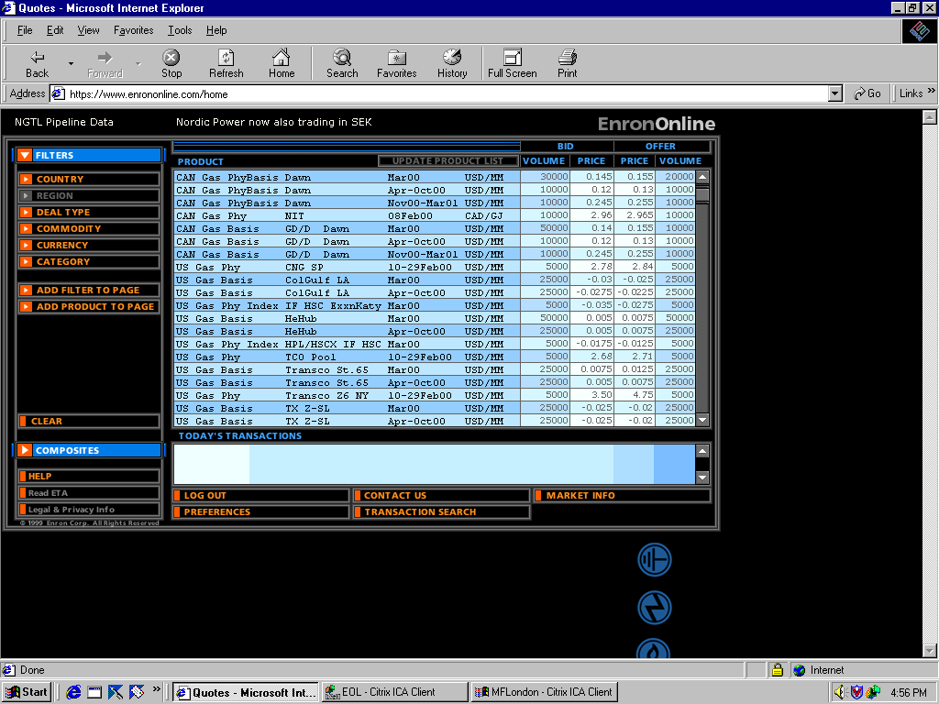
EnronOnline
Extending Enron’s Products to the Internet
Free, Reliable Transaction System with Enron as Principal
Fully Integrated into Enron’s
Established Risk Management
and Logistic Processes
Utilizing Site to Offer Energy-Related Auction Capabilities
Expands Enron’s Information Base and Market Knowledge
“Tried and Tested” Platform for Expanding Enron’s
eCommerce Activity

Slide 15
Mass Customization
Enron Risk Products
EnronOnline: 840 products
Gas
Electricity
Liquids
Other

Slide 16
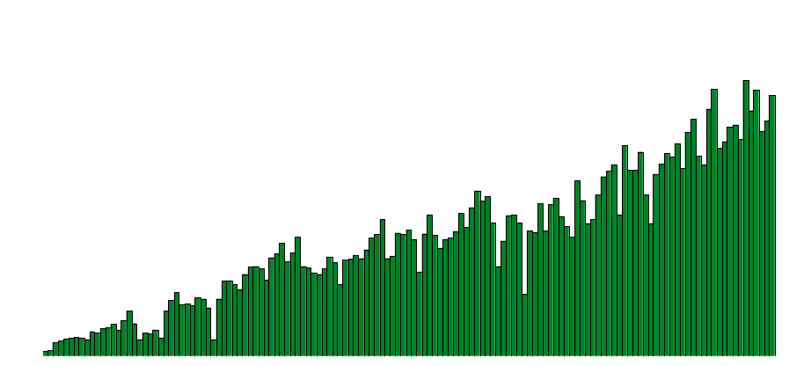
EnronOnline
Daily Transactions
Nov & Dec 1999
Jan
Feb
Mar
Apr
May
June

Slide 17
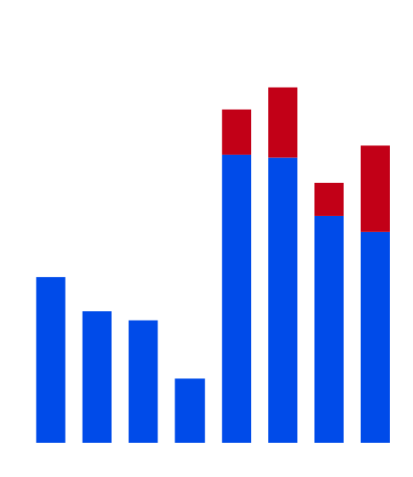

Impact of EnronOnline
Power
Gas
EnronOnline
EnronOnline
544
116
480
109
452
EnronOnline start date
97
EnronOnline start date
410
85
Deals per week
260
54
225
43
40
158
132
21
December
January
December
January

Slide 18
Energy
Communications
Transportation
&
Distribution
Wholesale
Energy
Retail
Energy
Broadband
Services
Enron
Net Works
Natural Gas
Transportation
Electric Distribution
Marketing and
Delivery of Energy
Products Worldwide
Energy Outsourcing
to Commercial and
Industrial Customers
Bandwidth Management
and Broadband Delivery
Services
Seeks IT Commercial synergies
Traditional
New

Slide 19
Enron Energy Services
Annual Contract Value
(Billions)
Profitability
(Millions)
$16.0
$75
($107)
($119)
($68)
$8.5
$3.8
$1.2
1997
1998
1999
2000E
1997
1998
1999
2000E

Slide 20
Total Energy Outsourcing
Traditional Suppliers
Customer Needs
Enron
Utilities
Commodity
Management
Software Vendors
Light
Control Manufacturers
Architects
Energy Information Management
Engineers
Equipment Manufacturers
Conditioned Air
Mechanical Contractors
Energy Asset
Management
Electrical Contractors
HVAC Svc Companies
Consultants
Facilities
Management
Specialty Contractors
Managed Facilities
Lenders
Capital
Management
Internal Treasury

Slide 21
Enron’s Retail Energy Customers
Manufacturing
High Technology
Hotels / REITs
BICCGeneral
Lockheed Martin
MFG
The Orange County Register
Owens Corning
Polaroid
Ridgid
Solo
Tyco Healthcare
World Color™
Applied Materials
Cisco Systems
GTE
IBM
InfoMart
Lucent Technologies
Bell Labs Industries
Pacific Bell
Excelsior Hotel
Hilton
Hyatt
Simon
Food Processing
Sports Venues
Financial Institutions
Public Sector/Institutions
OceanSpray
Packaged Ice Inc.
Suiza
Tricon
Cleveland Browns
Enron Field
San Francisco Giants
Bank of America
Chase
First Interstate
Archdiocese of Chicago
California State University
Department of
Veterans Affairs
DESC
Fort Hamilton
General Services
Administration
Los Angeles County

Slide 22
Enron Retail in Europe
Marketing Offices in London, Frankfurt, Stockholm and Amsterdam
670 Employees
Successfully Expanding U.S. Relationships to Europe
Rolling Out Energy Outsourcing to Large European
Customers
Significantly Growing Mid-Market Commodity Business
  Customer Segments Include:
    Retail Establishments
    Transportation
    Government

Slide 23
Energy
Communications
Transportation
&
Distribution
Wholesale
Energy
Retail
Energy
Broadband
Services
Enron
Net Works
Natural Gas
Transportation
Electric Distribution
Marketing and
Delivery of Energy
Products Worldwide
Energy Outsourcing
to Commercial and
Industrial Customers
Bandwidth Management
and Broadband Delivery
Services
Seeks IT Commercial synergies
Traditional
New

Slide 24
Enron Broadband Services
Enron
Intelligent
Network
Bandwidth
Intermediation
Deploy the Most Open, Efficient Network with Broad Connectivity
Content
Services
Be the World’s Largest Provider of Premium Broadband Delivery Services
Be the World’s
Largest Buyer and
Seller of Bandwidth
Fiber
Servers
Pooling Points
Software
Bandwidth Marketing
Comprehensive
Bandwidth
Management
Delivery of Streaming
Content
Data Management
Services
Replicating Enron’s Wholesale Energy Experience and Skill Base in a Highly Scalable, Efficient Broadband Strategy

Slide 25


Network Connectivity
_{Europe}
_{Asia}
Fiber
Servers
Markets
Pooling Points
Unlimited, Real-Time Bandwidth Access with
End-to-End Control

