Slide 1
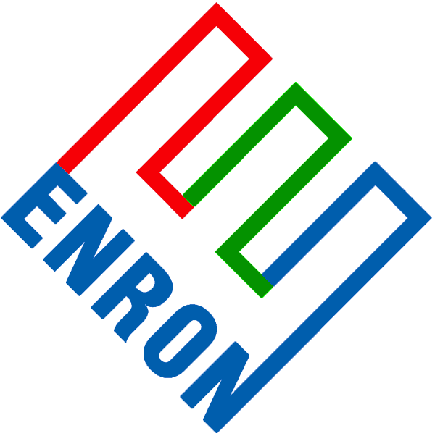
Enron
Wholesale
Services
Retail
Energy
Services
Communications
Independent
Enron Americas
Enron Energy
Services
Enron
Broadband
Services
Azurix
-Natural Gas and Power marketing
-Risk Management
Investment and Finance
Trading
New Asset Development Activities
-Manages electric and natural
gas commodities
-End-to-end broadband content delivery (EIN)
-Content and applications services
-Rich media and streaming video transport
-Bandwidth intermediation – bandwidth on demand
-Water Commodity
Enron Europe
Enron Facility Services
Enron Transportation
Services
-Natural Gas and Power marketing
-Risk Management
-Investment and Finance
-Integrated Facility Management including facility O&M and support services, consulting services, subcontract management and administrative services
- Gas Transportation and Storage
Enron Global Assets
Enron Engineering and Construction Services
Portland General Electric
Energy infrastructure projects
Developer, manager and operator
-Retail Electric & Wholesale Power Trading
Turnkey EPC
Product management, engineering, financing, licensing, commissioning, O&M, safety,
Enron NetWorks
-Expansion Vehicle for New Commodity Industry Penetration (EnronOnline offers: gas, power, oil and refined products, plastics, petrochemicals, liquid petroleum gases, natural gas liquids, coal, emission allowances, bandwidth, pulp and paper, metals, weather derivatives, credit derivatives and more.
Enron Global Markets
Enron Industrial Markets
-Energy and agriculture commodities including coal, crude & derived products, agribusiness, LNG, weather, insurance, equities, interest rates and foreign exchange.
-Physical and financial commodity products for specific industries, including pulp and paper, steel and lumber

Slide 2
Enron
Wholesale
Services
Retail
Energy
Services
Communications
Independent
Enron Americas
Enron Energy
Services
Enron
Broadband
Services
Azurix
-EnronCredit.com,
-Power
-Natural Gas
-Enron Capital Resources
-Energy Infrastructure
Development
-Commodity Management
-Energy Asset Management
-Energy Information Management
-Capital Management
-Account & Delivery Management
-ePowerOnline.com,
-MediaCast, Streaming Media Solution
-IP Net Connect,
-Enron Intelligent Network
-Trading
-Enron Capital Resources, Financing
-WaterDesk.com,
-Water2Water.com
Enron Europe
Enron Facility Services
Enron Transportation Services
-Energy Infrastructure
Development
-Power
-Natural Gas
-EnronDirect.com,
-EnergyDesk.com,
-EnronStrommarkt.de
-Enron Capital
Resources
-MAP, Maintenance Analysis Program
-FAsT-Facility Assessment Toolkit
-ABSolute - Computerized Maintenance
Management System (CMMS)
-HotTap.com
Enron Global Assets
Enron Engineering and Construction Services
Portland General Electric
-Power
-Power
-Natural Gas
Enron NetWorks
-EnronOnline.com, DealBench.com
Enron Global Markets
Enron Industrial Markets
-EcoElectrica
-Global RM
-Enron Weather RM
-Coal and emissions RM
-Plastics and Petrochemical RM
-Crude oil & Products RM
-Industrial Commodity Derivatives
-Clickpaper.com

