Slide 1
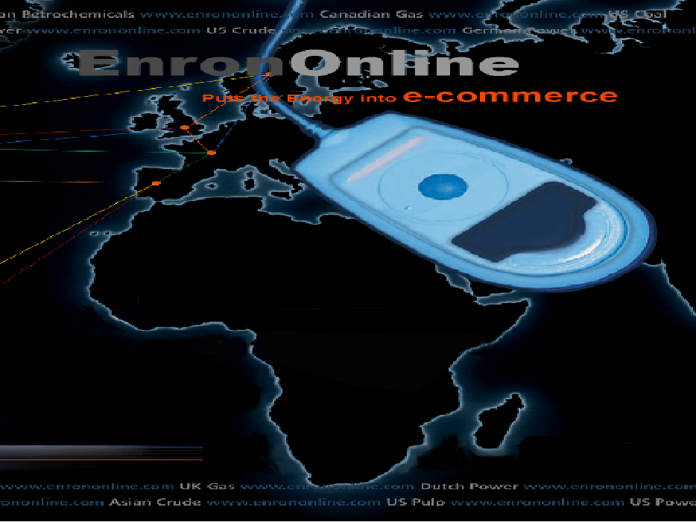

Slide 2
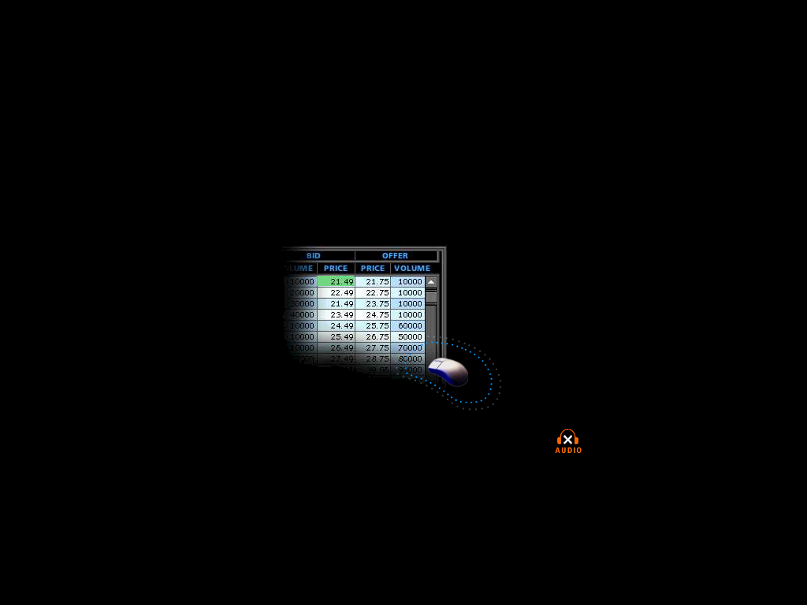
EnronOnline
A Free, Internet-Based, Global Transaction System Which Allows Counterparties to View Real Time Prices From Enron’s Traders and Transact Instantly Online
Click ’n’ Transact

Slide 3
EnronOnline Features
Multi-commodity
Multi-currency
Multi-lingual
Real-Time Transparent Prices
Customized Profiles
Customer Friendly Environment
Best Prices

Slide 4
Product Roll-Out
    November 1999 US Natural Gas
    Canadian Natural Gas
    December 1999 Coal
    Nordic Power
    Plastics
    Pulp & Paper
    US Power
    January 2000 Continental European Power
    Continental European Gas
    Emissions
    LPG
    Oil & Refined Products
    Petrochemicals
    UK Gas
    UK Power
    Weather
    March 2000 Australian Power

Slide 5
Customer Comparison*
(Number of Transactions)
EnronOnline
Traditional
1998
1999
1998
1999
1998
1999
1998
1999
1998
1999
1998
1999
A
B
C
D
E
F
Major Energy Marketers
*November 30 – January 13

Slide 6
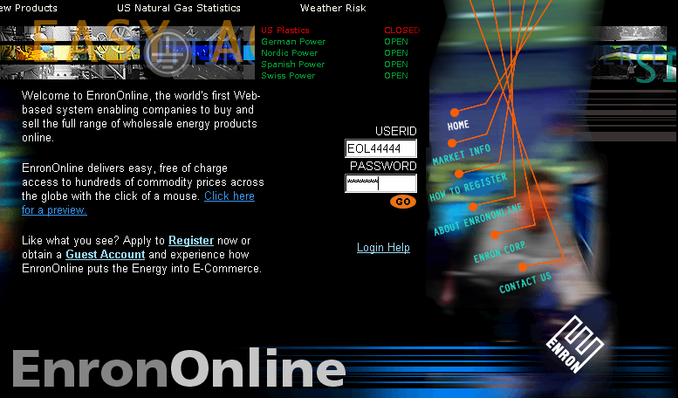
The Home Page

Slide 7
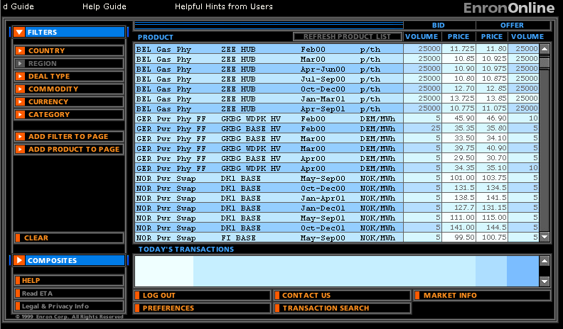
Live Quotes Screen

Slide 8
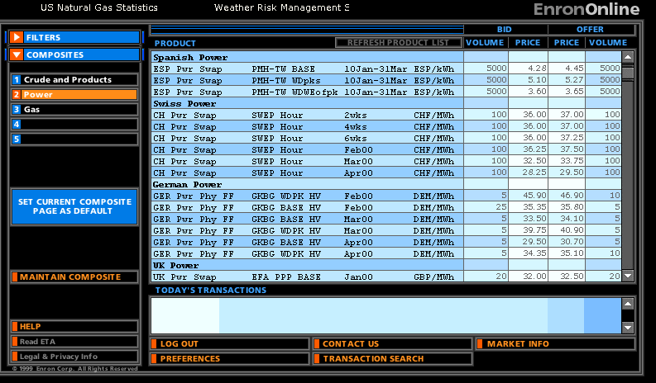
Customized Views

Slide 9
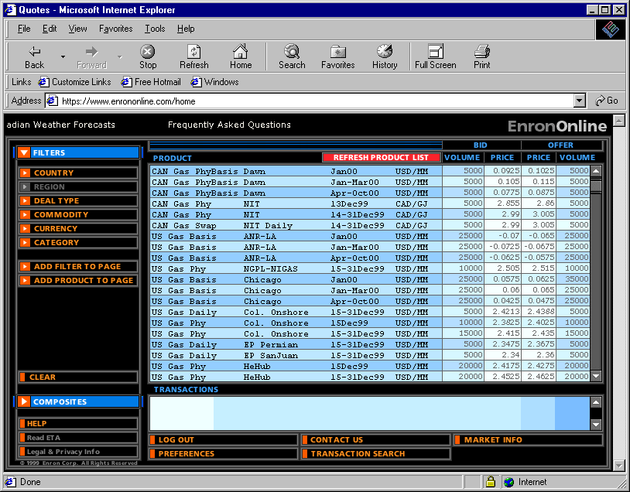
Legal Definition and Product Information

Slide 10
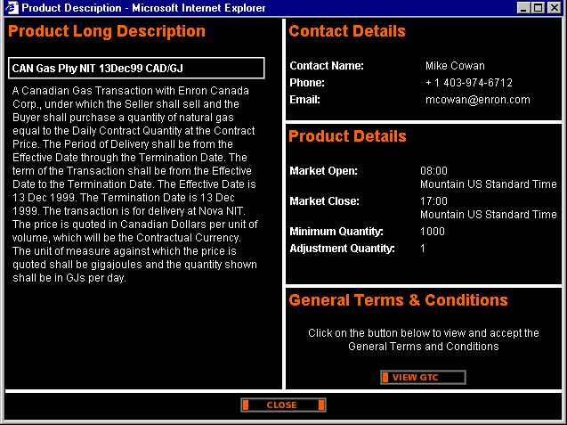
Legal Definition and Product Information

Slide 11
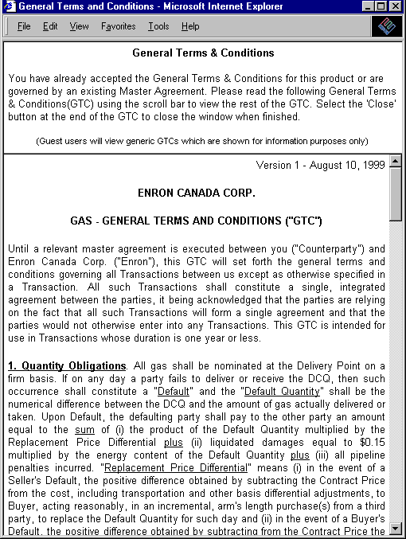
Legal Definition and Product Information

Slide 12
Click on Bid or Offer Price

Slide 13
Submission Screen
USUS Gas Swap Nymex Jan00 USD/MM
2. 26
2.24

Slide 14
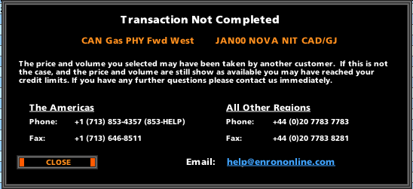
Failed Transaction
USUS Gas Swap Nymex Jan00 USD/MM

Slide 15
Successful Transaction

Slide 16
Automated Process
Transaction
Submitted
Validation
Credit
Price
Volume
Risk
Management
Portfolio
Accounting
&
Settlement
Secure
Secure
Secure
    Automated System Facilitates Fast, Efficient Transactions
    Multiple Controls Ensure Users Operate Within Customized Profiles

Slide 17
eCommerce Business Comparison
Value of Goods
(Million)
Business To Consumer* (B2C)
eBay
Amazon.com
Dell.com
$ 2,650
1,600
10,190
Business To Business* (B2B)
FreeMarkets
Cisco Online
Altrade
$ 1,400
9,480
12,000
EnronOnline**
$ 19,300
*
**
Est. 1999 Annual Results
Annualized Results to Date

Slide 18
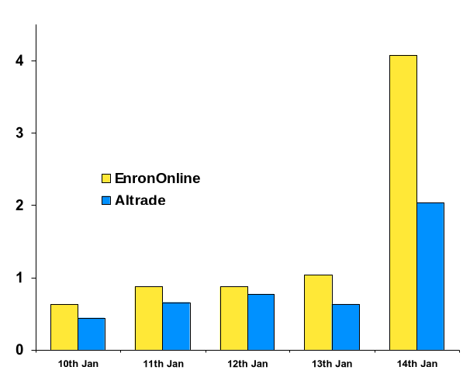
eCommerce Energy Providers
Volume Comparison
(Bcf)
Source: Altrade

Slide 19
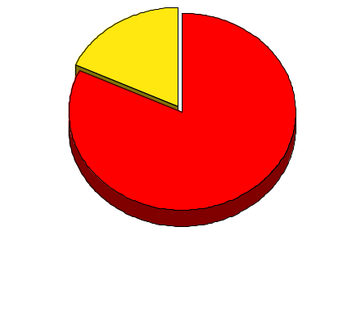
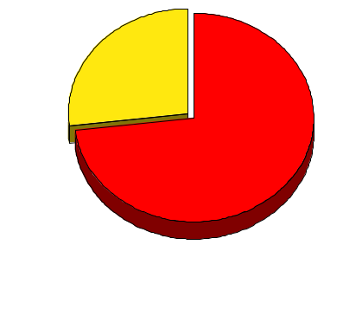
EnronOnline Versus Traditional Channels*
Volume
Transactions
18%
27%
82%
73%
EnronOnline
Traditional
1.6 Tcfe Transacted Online
*Est. Activity Nov 99 – Jan 00

Slide 20
EnronOnline
  Free, Internet-Based, Global, Click and Transact Commodity Service
  Successful Implementation with Excellent Customer Response
  Extends Existing Business
  Demonstrates Enron's Leadership in e-Commerce Development

