Slide 1
EnronOnline 8 July 1999

Slide 2
Rationale for Click Trading
Fully automated click trading will allow us to:
Increase Liquidity
Stimulate trading activity in the developing commodity markets
Gain Incremental Volume (incremental share of transactions in market)
Streamline the trading process
Gain economies of scale benefits through a fully scalable application
Capitalise on Market Valuation of “Online Factor”

Slide 3
What are we aiming for with Online Trading?
EnronOnline represents true “click trading” and will be the “one stop shop” for wholesale energy trading worldwide.
Global
Web-based
Multi-commodity
Multi-currency
Multi-lingual (future phases)
Fast
Easy to Use
Tailored to Customer Needs
Best Markets (also critical success factor)

Slide 4
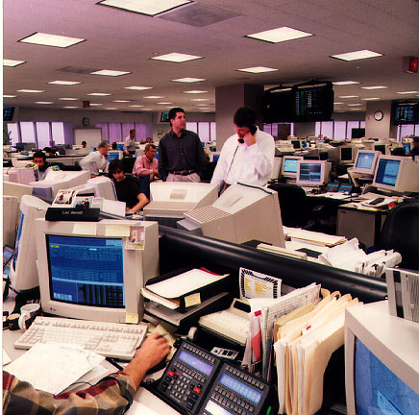
Products
The system will allow to trade standardized products and initially will be geared toward “breadth vs. depth” in:
Gas
Power
Coal
Oil Products
Liquids
Pulp & Paper
Weather Derivatives
SO2
Bandwidth (end of the year)
Both physical and financial
Variety of Instruments:
Swaps
Options & Swaptions
Capacity
Numbers of products
342 in Europe
344 in US

Slide 5
Global Coverage
Regions covered in Phase I include:
North America: US, Canada
Europe: UK, Germany, Switzerland, Norway, Finland, Sweden, Portugal, Spain, France, Italy, Belgium,
Netherlands, Austria, Denmark, Poland, Slovenia,
Croatia, Romania ...……..
Asia: Singapore
Australia ?
Future Phases will cover other countries in Asia, South America, and Africa

Slide 6
Participants
External:
Enron’s current trading counterparties
Future trading counterparties
Banks
Regulators
Media
Others...
Internal:
Traders
Credit
Back Office
RAC
Documentation Group
Legal
Senior Management

Slide 7

Market Developments & Competition
Everywhere you turn:
Launching today: HoustonStreet.com
US Power Trading over the net
created by BayCorp.
US power only (for now)
also provides some “portal” features (yet to see these)
Who is our competition? Who can offer a global trading platform?
Only a JV between some counterparties would compete on a global basis with Enron
Many combinations are possible - Bloomberg and Dynegy
Others
online energy exchanges (Bloomberg, Altra, SwapNet)
traditional & new exchanges (NYMEX, IPE)
online stock brokers (Morgan Stanley, Merrill Lynch, Charles Schwab, Datek, E*TRADE)
other energy companies (Coral Energy, energy.com)

Slide 8
EnronOnline: Short Term (Phase I)
The Basic Portal + Application Concept
Home/Login Page
Trading Application
Audience: Any Internet User
Concepts/Content:
Selling the Vision
Provide “teasers”
- basic news ticker
- energy risk management
glossary
Demo of trading application
Audience: Registered Users ONLY (post-login)
Concepts/Content:
- Online Trading Application
- maximize volume
- Stickiness factors

Slide 9
Process
Customers will receive Password Applications (one page) with marketing details
Customers return PA and are issued with a login/password
Login and trade
Master agreements govern trade if in place between Enron and the counterparty otherwise counterparty has to accept GTC (General Terms and Conditions On-Line)
Click on a bid or an offer
Click Submit (2 clicks and you’re done)
Transaction details appear in your summary list
Transaction will be processed in back office systems
Confirmations dispatched

Slide 10
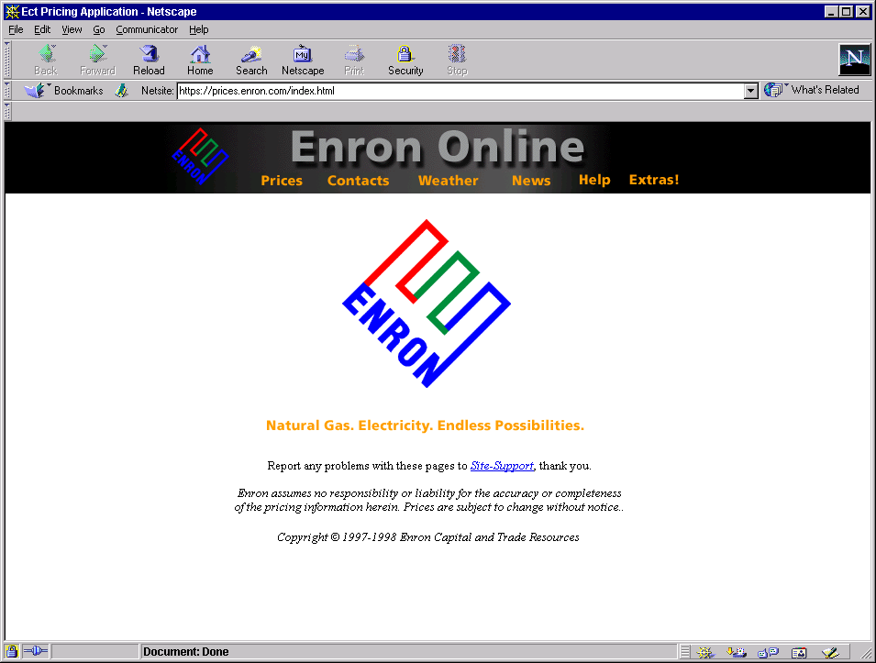

Home
Contacts
News
Quotes
Transactions
Administration
Quotes
Composite
Northeastern US Physical Forwards
Description
Bid
Offer
Name
Default
TRCO/Z6 IT, Next Day Dlvy, in USD/MMBtu
20000
2.05
2.065
50000
TRCO/Z6 IT, Next Month Daily Dlvy, in USD/MMBtu
20000
2.02
2.05
50000
TRCO/Z6 Firm, Next 3 months Daily Dlvy, in USD/MMBtu
50000
2.18
2.25
50000
Central US Physical Forwards
Description
Bid
Offer
NNG/Matt, Next Day Dlvy, in USD/MMBtu
30000
2.13
2.15
30000
Clicking on the Product Description will go to another page which provides:
- Long description
- Minimum quantity, Tick size, Trading hrs
- Access to GTC
- Ability to add product to custom list
Filter
Composites
Transactions this Session
DateTime
Buy/Sell
Description
Quantity
Price
6/1/99 7:15 AM CST
Buy
TRCO/Z6 IT, Next Day Dlvy, in USD/MMBtu
8000/day
2.045
6/1/99 7:15 AM CST
Sell
TRCO/Z6 IT, Next Day Dlvy, in USD/MMBtu
5000/day
2.035

Slide 11
Please Confirm
Home
Contacts
News
Quotes
You are selling
Transactions
Administration
20000
Quotes
Northeastern US Physical Forwards
TRCO/Z6 IT, Next Day Dlvy, in USD/MMBtu
Composite
Description
for 2.05
Bid
Offer
Name
Default
TRCO/Z6 IT, Next Day Dlvy, in USD/MMBtu
20000
2.05
2.065
50000
All or Nothing
TRCO/Z6 IT, Next Month Daily Dlvy, in USD/MMBtu
20000
2.02
2.05
50000
TRCO/Z6 Firm, Next 3 months Daily Dlvy, in USD/MMBtu
50000
2.18
2.25
50000
Accept Partial Volume
Central US Physical Forwards
Description
I accept
I decline
Bid
Offer
NNG/Matt, Next Day Dlvy, in USD/MMBtu
30000
2.13
2.15
30000
Filter
Composites
Transactions this Session
DateTime
Buy/Sell
Description
Quantity
Price
6/1/99 7:15 AM CST
Buy
TRCO/Z6 IT, Next Day Dlvy, in USD/MMBtu
8000/day
2.045
6/1/99 7:15 AM CST
Sell
TRCO/Z6 IT, Next Day Dlvy, in USD/MMBtu
5000/day
2.035

Slide 12
Please Confirm
Home
Contacts
News
Quotes
You are selling
Transactions
Administration
20000
Quotes
Northeastern US Physical Forwards
TRCO/Z6 IT, Next Day Dlvy, in USD/MMBtu
Composite
Description
for 2.05
Bid
Offer
Name
Default
TRCO/Z6 IT, Next Day Dlvy, in USD/MMBtu
20000
2.05
2.065
50000
All or Nothing
TRCO/Z6 IT, Next Month Daily Dlvy, in USD/MMBtu
20000
2.02
2.05
50000
TRCO/Z6 Firm, Next 3 months Daily Dlvy, in USD/MMBtu
50000
2.18
2.25
50000
Accept Partial Volume
Transaction Failed
Central US Physical Forwards
Description
I accept
I decline
Bid
Offer
Reason Transaction Failed will show here.
The reason could be that our database has not yet registered that this client has seen the GTC governing this transaction. If this is the case, this box will include a link to the page containing the GTC. If the user clicks this link, we will then register that it has been read by this client.
2.13
NNG/Matt, Next Day Dlvy, in USD/MMBtu
30000
2.15
30000
Filter
Composites
Transactions this Session
DateTime
Buy/Sell
Description
Quantity
Price
6/1/99 7:15 AM CST
Buy
TRCO/Z6 IT, Next Day Dlvy, in USD/MMBtu
8000/day
2.045
6/1/99 7:15 AM CST
Sell
TRCO/Z6 IT, Next Day Dlvy, in USD/MMBtu
5000/day
2.035
6/1/99 8:15 AM CST
Sell
TRCO/Z6 IT, Next Day Dlvy, in USD/MMBtu
20000/day
2.05

Slide 13
Vision
Make Enron “Your One Stop Shop” for all energy related commodities and wholesale services worldwide
You need to keep it sticky

Slide 15

Make Enron “Your One Stop Shop” for all energy related commodities and wholesale services worldwide Create the Portal on the EIN
Wholesale Service Bureau
Global Multi-Commodity e-Trading
Full integration with
Web-based EnergyDesk.com
trading systems suite
(e.g. GasDesk, ElectricityDesk)
Sports
Weather
Trader/user chat
facilities.
News - Initial
proposal
from Reutars received
My Enron - customised filters
Community - Trader/user chat facilities,photos,phones etc
Video streaming (from Enron Communications - Media Cast, Media Transport)
Value added information
Market Trends eg LIM
Time Series data
Regulatory Information
Glossaries (Energy Risk Management Glossary)
Enron Price Indices
Risk Management
Real time Mark to Market
differential pricing capability for credit spreads

Slide 16
Current Status
Currently in Project Week #7 of 18
Technical
External: Design phase underway - Agency.com based in Dallas
Internal: Internal application and database development in progress
Web Design
Basic “look-and-feel” determined
Second creative review with multiple screens scheduled for next week
Website business content to be edited by copywriters
Online demo to be developed
Legal review required on all site content
Stickiness factors being embedded
Marketing
draft marketing plan developed and launch strategy underway
external copywriters hired
collateral materials including brochures to be developed

Slide 17
Current Status
Legal Issues
Legal framework for site established (Short and Long product descriptions)
Enabling Agreements completed for 18 different countries (Password Applications to be completed offline and Electronic Trading Agreements to be completed online)
European GTCs for online trading under final legal
US GTCs underway
Translation of ETAs, PAs and GTCs commenced this week
Legal advice on other parts of the site has been obatined (Electronic links advice, Generic disclaimers, Privacy statement (data protection issues)
Regulatory
Ongoing review across 18 jurisdications of site
Commodities (Financial/Physical)
Website Issues
UN e-commerce directive lobbying (Article 11.1)
Monitoring progress of CFTC on ecommerce

Slide 18
Current Status
Trading
Product Descriptions prepared and legal review complete
Staffing underway
Trader Application in fourth design stage
Business Processes
Processes near completion
Tax
Cost Sharing Agreement drafted, to be finalised
Collecting front and back office cost data
Assessing foreign tax exposure
redrafting of all financial GTCs
Credit
RAC/Limits
Research
Risk Management
Back Offices processes
Staffing commenced

Slide 19
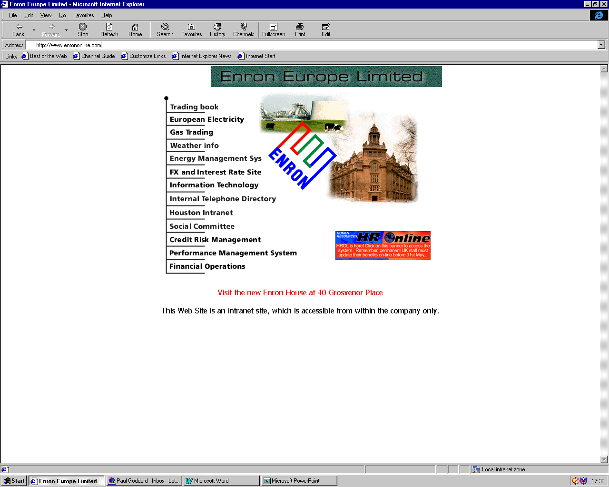
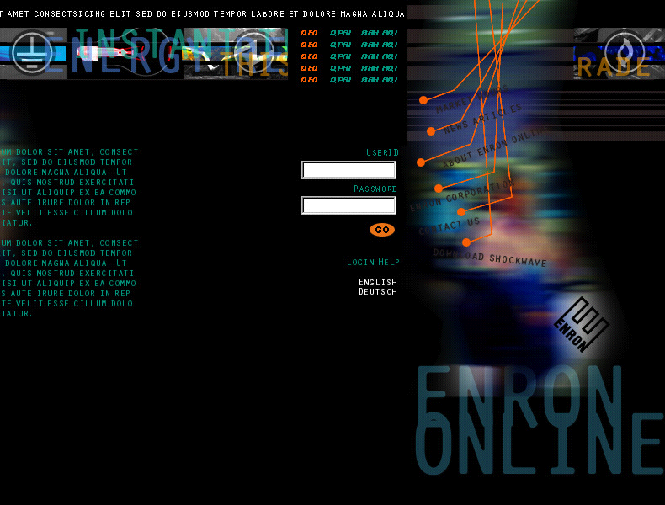
EnronOnline: Home Page & Login

Slide 20
THE END

Slide 22
EnronOnline Background Slides (IF REQUIRED)

Slide 23



EnronOnline Sample Qualitative Competitor Metrics
+++++
++++
+++
++
+
First Mover
Trading Expertise
+++++
++++
+++
++
+
Ability to Achieve Global Scale
Multi-Commodity Capabilities

Slide 24
EnronOnline Project Scope
Phase I: “Click and Trade”, multi-commodity,
multi-language enabled (GTCs initially) ,multi- currency, global coverage, system news, customizable, after-hours trading
Phase II: Multi-lingual, more products,
broader news offering (e.g. energy related news),
cross-marketing, banner advertisement
Phase III: Trading Portal / Energy Portal ?

Slide 25
EnronOnline Current Status
Project Week #7 (Project kicked-off 24 May)
Technical
External: Design Phase underway
Internal: Internal Application and Database development in progress
Legal
Online Enabling Agreements prepared (18 jurisdictions in Europe)
European GTCs for Online Trading completed, US GTCs underway
Regulatory - review completed for US & Europe
Trading
Product Descriptions prepared and legal review complete
Staffing underway
Trader Applications (Research)
Business Processes
Processes near completion
Tax, Credit, RAC/Limits, Research, Risk Management.
Similar meetings held in US and UK
Marketing ( to customers/to analysts/press) - marketing plan drafted
Testing Plan - developed
Website design - underway, 2nd creative review July 12

Slide 26
EnronOnline External Clients
Access to quotes will be granted by:
Country
Commodity
product type
Physical/financial/capacity
Deal Type
Firmness Level - optional
and term limits.
Examples:
Bid
Offer
US Firm Physical Gas Forwards
6 months
Trade
Read
UK Financial Swaps
3 months
Read
None
Customers will have the ability to further restrict the access of specific traders

Slide 27
EnronOnline Concept
Quotes
This is a nice quote with a nice price! This is a nice quote with a nice price! This is a nice quote with a
Enron Traders
Transaction
Transactions
Server
Apply Security Filter
Quotes
External Clients
This is a nice quote with a nice price! This is a nice quote with a nice price! This is a nice quote with a
Manage Transaction
Transactions
Quotes
This is a nice quote with a nice price! This is a nice quote with a nice price! This is a nice quote with a
This is a nice quote with a nice price! This is a nice quote with a nice price! This is a nice quote with a
Database
Transactions

Slide 28
Home
Contacts
News
Quotes
Transactions
Administration
Quotes
Filter
Central US Gas Physical Forwards
Description
Bid
Offer
Country
All
TRCO/Z6 IT, Next Day Dlvy, in USD/MMBtu
20000
2.05
2.065
50000
Region
All
TRCO/Z6 IT, Next Month Daily Dlvy, in USD/MMBtu
20000
2.02
2.05
50000
Commodity
All
TRCO/Z6 Firm, Next 3 months Daily Dlvy, in USD/MMBtu
50000
2.18
2.25
50000
Phys/Fin/Capacity
All
UK Gas Physical Forwards
Deal Type
All
Bid
Offer
Currency
All
NBP Firm, Day Ahead Dlvy, in pence/therm
10000
9.45
9.65
25000
Bacton Firm, Prompt Month Dlvy, in pence/therm
20000
9.38
9.43
10000
Add to Composite
Filter
25000
9.82
9.86
25000
Euro Gas Physical Forwards
Bid
10.23
Offer
Zeebrugge Firm, Q4/99 Dlvy, in pence/therm
20000
10.44
25000
Composites
Transactions this Session
DateTime
Buy/Sell
Description
Quantity
Price
6/1/99 7:15 AM CST
Buy
TRCO/Z6 IT, Next Day Dlvy, in USD/MMBtu
8000/day
2.045
6/1/99 7:15 AM CST
Sell
TRCO/Z6 IT, Next Day Dlvy, in USD/MMBtu
5000/day
2.035

Slide 29
EnronOnline Enron Traders
Security:
Access to manage products will be granted by
product type
{Country, Commodity, Phys/Fin/Capacity, Deal Type, Firmness}
and region.
Status Definitions:
active
Product is visible on the web with active prices
suspended
Product is visible on the web with no prices
inactive
Product is not visible on the web

Slide 30

EnronOnline Enron Traders - Toolset
Product Management Application
Stack
Add new products
Activate/Suspend/De-activate products
Become product manager for products
Change trading hours
Automated suspension of product at conclusion of trading hours
Manage active products
Plus suggested ideas…………………………...

Slide 31
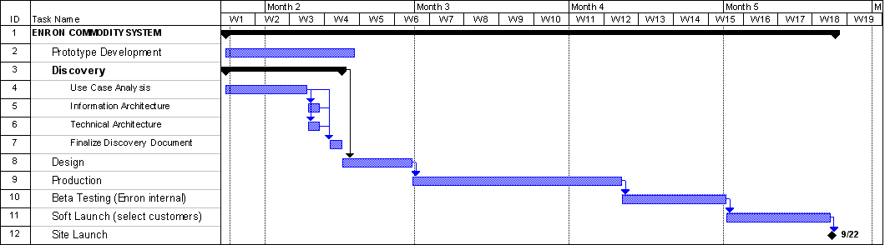
EnronOnline Project Schedule
Phase I: Driven by external supplier
18 weeks, Deadline: September 24, 1999
Cash incentive to deliver before week 14, i.e. August 29, 1999
Delivery on 1st August means $100,000 for software supplier
Penalties incurred for delivery after week 16
Other clients of external supplier:
British Airways www.british-airways.com (ongoing relationship)
The Economist www.economist.com
Reuters www.reuters.com
Excite www.excite.com (localization sites across Europe)
COMPAQ www.compaq.com
Hewlett-Packard www.hp.com/go/comms
Texaco www.texaco.com

Slide 32
UK Gas Products Input

Slide 33
UK Gas Products Short Descriptions

Slide 34
EnronOnline Products Examples

Slide 35
EnronOnline Enron Traders - Toolset
Static Data Maintenance
counterparties, locations, countries, commodities, product types, etc.
Suspend Trading Application
Suspend Trading
Product
Counterparty
All By Trader
All By Commodity
All By Country
All
Greg ???
Background processing
Automated after trading-hours product suspension
Limits Checking
Automated conversion to transaction systems

Slide 36
Home
Contacts
News
Quotes
Transactions
Administration
Quotes
Filter
Central US Gas Physical Forwards
Description
Bid
Offer
Country
All
TRCO/Z6 IT, Next Day Dlvy, in USD/MMBtu
20000
2.05
2.065
50000
Region
All
TRCO/Z6 IT, Next Month Daily Dlvy, in USD/MMBtu
20000
2.02
2.05
50000
Commodity
All
TRCO/Z6 Firm, Next 3 months Daily Dlvy, in USD/MMBtu
50000
2.18
2.25
50000
Phys/Fin/Capacity
All
UK Gas Physical Forwards
Deal Type
All
Bid
Offer
Currency
All
NBP Firm, Day Ahead Dlvy, in pence/therm
10000
9.45
9.65
25000
Bacton Firm, Prompt Month Dlvy, in pence/therm
20000
9.38
9.43
10000
Add to Composite
Filter
25000
9.82
9.86
25000
Euro Gas Physical Forwards
Bid
10.23
Offer
Zeebrugge Firm, Q4/99 Dlvy, in pence/therm
20000
10.44
25000
Composites
Transactions this Session
DateTime
Buy/Sell
Description
Quantity
Price
6/1/99 7:15 AM CST
Buy
TRCO/Z6 IT, Next Day Dlvy, in USD/MMBtu
8000/day
2.045
6/1/99 7:15 AM CST
Sell
TRCO/Z6 IT, Next Day Dlvy, in USD/MMBtu
5000/day
2.035

