Slide 1
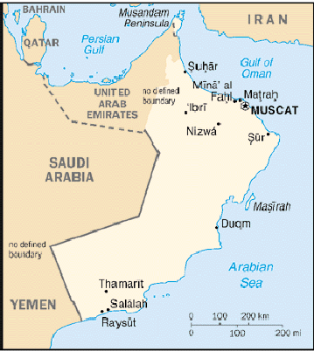
Enron’s Vision for Oman
Prepared by Enron Middle East
January 19, 2001

Slide 2
Contents
Country Highlights
Government Focus Areas
Value of Oman to Enron (i.e., why Oman)
Enron activities to date in Oman
Current development activities:
  Al-Assema Gas Marketing
  Gas pipeline operations bid
    $1 million bid bond due 29 January
  Oman to UAE pipeline
Appendix

Slide 3
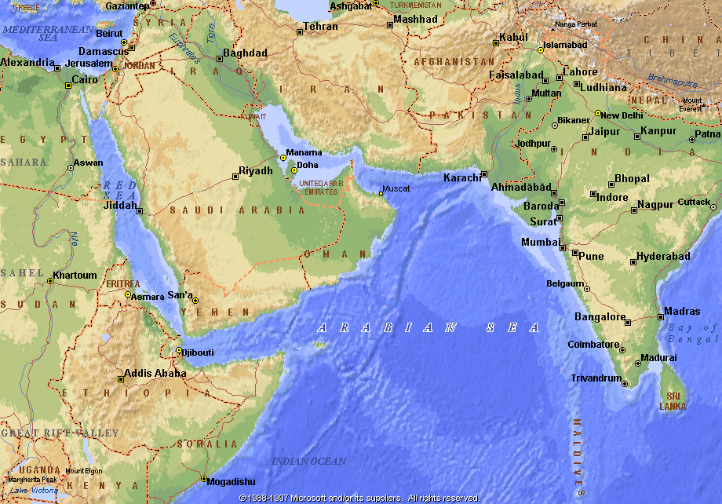
Country Highlights
Strategic location outside the Arabian Gulf with direct access to the Indian Ocean
Culturally different from other Gulf Cooperation Council countries
  Traditionally a sea-faring nation founded on trade with India and Africa
  Physically closer to India than to Kuwait
E-Rating: 4
Energy policy and operations strongly influenced by Royal Dutch/Shell
OMAN

Slide 4
Oman Government’s Commercial Focus
Expand trading/investment activities with multiple international companies
Expansion of LNG market; third baseload train and spot/short-term merchant trade
Strengthen economic ties with GCC neighbors (e.g., UAE/Qatar via Dolphin)
Reduce influence of Shell on oil and gas policy
  Shell owns 34% of the national oil company Petroleum Development Oman (PDO) and 30% of Oman LNG
  Closer Enron relationships viewed favorably by Government

Slide 5
Value of Oman to Enron
Most attractive Middle East source of LNG
  Desire to expand capacity and sales aggressively
  More flexible thinking, better marketing vision and more risk tolerance than other suppliers in region
Potential for trade in other EGM products
  Looking for marketing partner to counterbalance traditional oil company domination
  Open to consider and employ risk management products
Interest in developing market-based gas distribution systems
Future growth market for Dolphin

Slide 6
Enron’s Activities To Date in Oman
Dabhol LNG contract (1.6 mmtpa FOB, commencing 2002)
LNG merchant deals
  Master spot agreement signed in May 2000
  First spot cargo (3 bcf) to Lake Charles, June 2000
  Diversion charter agreement for Oman/Korea Gas ship, June 2000
  Purchase/diversion to Lake Charles of Osaka Gas Omani cargo, February 2001
  Six cargos (12 bcf) for the Hoegh Galleon, 3/2001 to 1/2002
Development of Al-Assema Gas Marketing Company
Short-listed for gas pipeline O&M/training contract
  Bid due January 29
Evaluating the Oman to Dubai gas pipeline for importing Omani gas to UAE (reversed later as part of Dolphin)

Slide 7
Al-Assema Gas Marketing Company
Background/Update
A 60/40 venture between Enron/local Omani company
In final negotiations with government on a 25-year Concession and 300 BCF Gas Supply Agreement
Negotiating a sell-down of 20% to Oman Oil Company
  Recover development costs
  Gain strong marketing and energy services support
Additional sell-down candidates have been identified
Advanced negotiations with 5 initial/anchor customers; four more good prospects in the wings
Pre Sell-down Economics
Nine initial customers - $9.2MM NPV₁₄, 34% IRR
  Capital cost of $27MM ($19MM debt/$8MM equity); could be reduced to under $18MM if equipment cost is paid by buyers directly
NPV₁₄ per development man/year: $4.5 million
NPV of entire gas allocation potentially 4-5 times higher

Slide 8
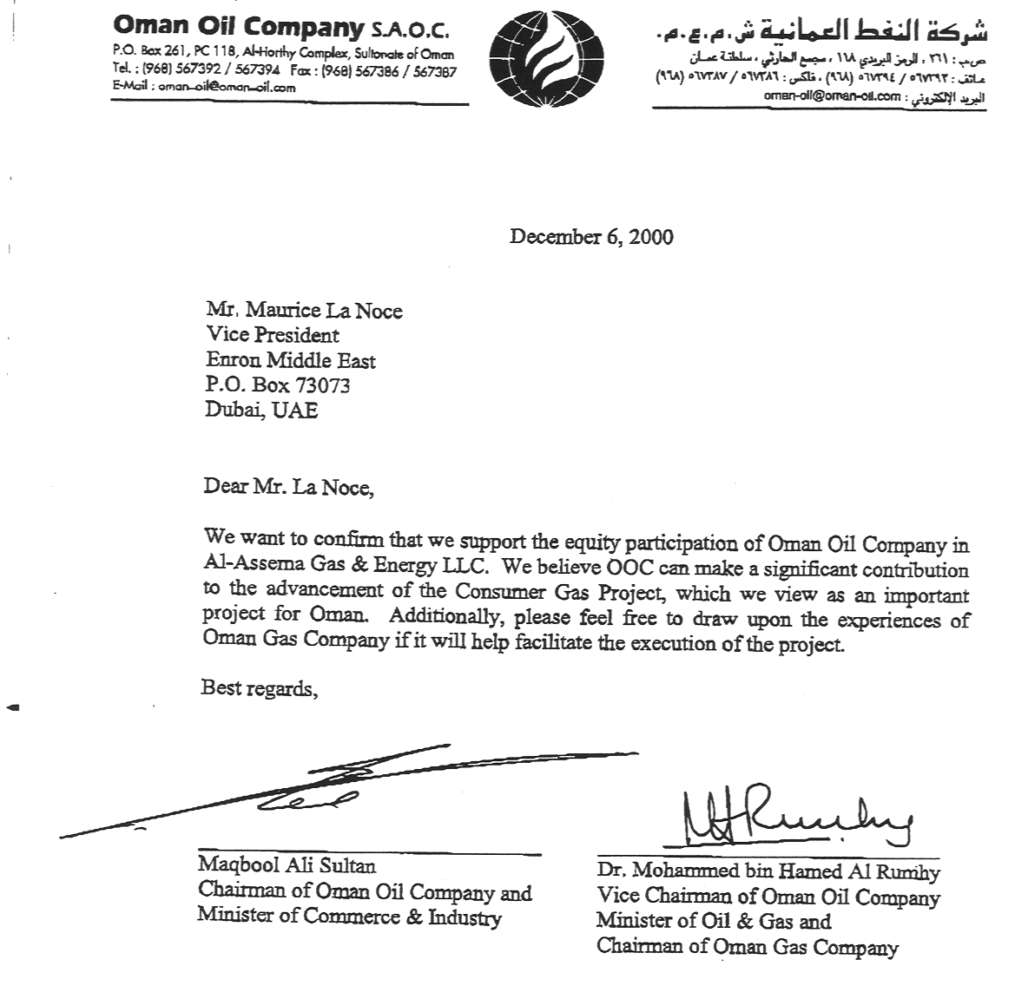

Slide 9
Al-Assema: Implementation Plan
Milestones/Timeline
  Execute Concession and GSA Feb 01
  Sell-down to Oman Oil Company Jun 01
  Sign 5 anchor customers Oct 01
  Financial close (local banks) Nov 01
  Sign next 4 key customers Mar 02
  Additional sell-down Mar 02
Other Issues
Equipment suppliers (e.g., Sumitomo) to lease/sell equipment directly to end-users
Financing through local banks with draw-down in phases as customers are signed up
Pipeline EPC and O&M to be sourced locally

Slide 10
Pipeline Operations Bid: Background
In August 2000, the government transferred ownership of its gas pipelines (5,000 km - operated by Shell) to the Oman Gas Company (OGC), a new 100% government-owned company to:
  Reduce operations costs
  Train Omanis to operate gas systems
  Privatize OGC in 3 to 5 years
OGC issued a tender for gas pipeline operations and training in November 2000
  3 to 5 year term (bridge to privatization)
  Bids due January 29, 2001
Enron is one of four short-listed groups - others:
  BG/Transco (UK)
  Enbridge/BC Gas (Canada)
  Dodsal (India)

Slide 11
Rationale for Bidding
Create an Enron presence in the heart of Oman’s gas operations
  Participate with high-level Omani management in all major gas decisions
  Gain inside knowledge about gas development plans, especially those affecting LNG availability and Dolphin
Cover the cost to put Enron (ETS) management and technical representatives on the ground in the region
Leverage ETS personnel to support other Enron pipeline activities (Dolphin, Al-Assema, Saudi)
Bring home approximately $5 million of pre-tax net income (~$1 million/year)

Slide 12
Bidding Strategy
Bid lump-sum, fixed price of $9 to $10 million/year for pipeline operations and personnel training
  Includes ~$1MM/year pre-tax margin to Enron
  Roughly $2MM/year below current charges from Shell
ETS currently performing due diligence in Oman to define final numbers
65% Enron / 35% local partner
  Special Technical Services Ltd. (STS), the incumbent, low cost subcontractor for pipeline O&M in Oman
  Will share bid/performance bond cost and risk
  Will provide local manpower and office space at cost
Need approval to issue bid bond of approximately $1MM
  RAC advises that McConnell can sign DASH to authorize bid bond

Slide 13
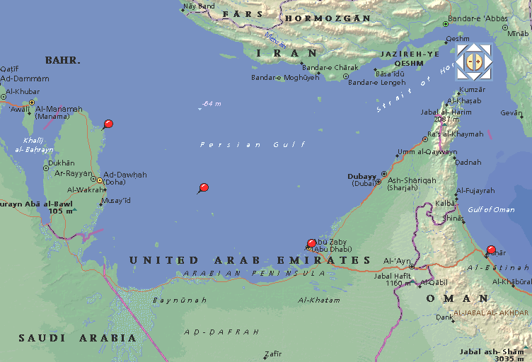
Oman to UAE Gas Pipeline Proposal
Chevron and Oxy are developing gas offshore Sohar and have strong interest in developing a pipeline to Dubai
Line could be reversed later to bring Dolphin gas to Oman
Possible alternative is to build line to Fujayrah for UOG-sponsored power and water plant
Key question: Should Dolphin preempt Chevron/Oxy and build/control the line?
Ras
Laffan
Arabian Gulf
Dubai
Taweelah
BVS-7
Sohar
From
Fahud

Slide 14
Appendix

Slide 15
Background
Sultanate of Oman: a monarchy that has existed as an independent state since ousting the Portuguese in 1650
Ruler: Sultan Qaboos bin Sa’id has reigned since 1970 and is progressive and pro-development
  Used oil revenues for infrastructure, education, healthcare, etc.
  Pushing for diversification from oil and privatization of power, water and gas systems
  Established an elected parliament to advise the government
Royal Dutch/Shell: dominates the oil and gas sectors
  Recognized need to reduce dependence on Shell
Currency: Omani Riyal (fixed at 2.60 US$/Riyal since 1986)
Enron Country Ranking: 4

Slide 16
Relative Country Statistics
Oman is about the size of Kansas with a low GDP per capita compared to its richer neighbors, resulting in a focus on maximizing value of natural resources, privatization and open markets, i.e., don’t let Shell run the show

Slide 17
Note:
Currently exploring possibility of having customers purchase equipment directly from sellers such as Sumitomo.

