Slide 1
Overview of Enron Freight Markets
June 2, 2001

Slide 2
History and Objectives
Dan Reck

Slide 3
Organizational Chart
Enron Freight Markets Dan Reck
Administrative Assistants
Shirley Isbell
Shimira Jackson
Jacqui Darrah
Jennifer Morris
Scott Wilson
TIB
Chris Kravas
Forward Trading
Matt Arnold
Origination
Shawn Cumberland
Technology Liaison
Ken Crane
Mid Marketing
Marty Gleason
Mike Arendes
Owen Zidar
Greg Sharp
Trading
Structuring
Colin Jackson
Deirdre McCaffrey
Brad Romine
Edmund Gaither
Commercial Coordination
Kim Frumkin
Tana Cashion
Beth Cowan
Fundamentals
Jeff Andrews
Gabe Gonzalez
Business Development
Kellie Metcalf
Ricardo Charvel
Charles Wickman
Sam Enochian
Neithard Foley
Operations
Dan Burke
Nels Franzen
Dave Werner
8 Contractors
Pricing &
Scheduling
Brad Carey
Sandy Olitsky
Spot Trading
Jason Beckstead
Mike Keyser
Bryan Robins
John Ashman
Ken Newman
Mike Reen
Jennifer Nguyen
Meredith Campbell

Slide 4
Organizational Chart
Mid-Office Systems Integration
Nanette Kettler
Enron Networks
Mid-Office Michelle Bruce Shelly Stubbs Todd Hall Mike Perun
Kevin Sweeney
Chris Hanz
Connie Truong
Shannon Powers
Nadine Costanzo
Helen He
Lisa (Yiwei) Hu
Dee Ware
Chriss Hall Jeff Johnson
Wayne Jiang
Nancy Johnson
Fan Li
Vivian Liu
Baron Rozwell
Jerry Song
Eric Wetterstroem
Mark Gonzales
Xiagoe Zhou
Legal
Alan Aronowitz
Coralina Rivera
Sarah Bruck
Accounting - Financial Operations EGM
John Best
Hang Bui
Human Resources
Shanna Funkhouser
Enron Freight Markets
Tax - State & Local
Chris Bystriansky
HR - Recruiting
Amy Gambill
Paul Weinberger
Operational Accounting
Mark Leskowitz
Brandi Wachtendorf
Documentation
Jeff Sorenson
Linda Loukanis
Valerie Landry
Credit
Tom Moran
Nidia Mendoza
Brant Reves
* Denotes people dedicated full-time to EFM
EFM Coordination & Setttlements
Lisa Walker
Coordination - Payables
Vicki Malloy
Chrishelle Berrel
Coordination - Receivables
Reginald Thompson
Vicki Bone
Glenda Ulmer
Helen Martin
Settlements - Receivables
Shelia Archie
Settlements - Payables
Linda Preston

Slide 5
General Items
Space plan
New Administrative staff responsibilities
Phone processes

Slide 6
Forward Trading
Matt Arnold

Slide 7
Forward Trading Team Members
Forward
Trading
Pricing/
Scheduling
Fundamentals
Colin
Jackson
Andres
Balmaceda
Jeff
Andrews
Deirdre
McCaffrey
Brad
Carey
Gabe
Gonzales
Brad
Romine
Sandy
Olitsky

Slide 8
Role of Forward Trading Group
Current
Future
Forward Pricing and Scheduling
Truck/Intermodal
Maintain and update WebModal Configurator
Systems Development
Accurate, reliable pricing tools for forward swaps and options
Integration of Truck and Intermodal models into a single interface
Market Development
Educate traditional shippers/carriers
Foster standard OTC transactions with new counterparties
Standard terms and conditions
Product Development
Firm pricing, service levels, diesel hedging, structured forward products
Maintain and calibrate pricing engines/curves
Manage forward freight capacity and diesel positions
Price term deals for mid market and structured trades
Trade standard products in the forward OTC market

Slide 9
Interaction with EFM Commercial Groups
Forward Traders
Develop and maintain price and volatility curves
Manage all commodity price risk:
All deals done by originators and mid marketers valued against forward curves
Trading desk owns price risk after the deal is completed
Price
Price
Positions
Originators
Longer term deals
Complex and/or highly structured transactions
Mid Marketers
Medium to long term deals
Straightforward transaction structures
Develop and maintain customer relationships

Slide 10
Introduction to Basic Risk Management Concepts
Forward Curves
Mark to Market Accounting

Slide 11
Risk Management Concepts: Forward Curves
A Forward Curve is a representation of actual prices at which counterparties are willing to transact today for delivery at some specified point in the future
Price
Actual Market
Price Indication
Interpolation/Projection
Time

Slide 12
Mark to Market vs Accrual Accounting
Accrual Accounting
Company recognizes net revenues as they come in the door
Mark-to-Market Accounting
Company recognizes the net present value of future revenue streams on day one
Advantages of MTM accounting
Allows future profit streams to be recognized upon contract execution
Physical assets can be valued and traded like financial products
Facilitates active management of open positions

Slide 13
MTM Accounting Requirements
MTM treatment requires a that a transaction be governed by a firm contract that guarantees a payment stream under ordinary market conditions.
Contractual requirements include:
Liquidated damages / take or pay provisions
Narrowly defined force majeure
Fixed volume
Fixed term
Fixed price

Slide 14
MTM Example of Forward Freight Transaction
EFM sells one year of firm truck capacity:
Origin: Los Angeles
Destination: Chicago
Term: January 02 – December 02
Volume: 5 loads/week
Price: $1.08/mile fixed
At deal closure, transaction is valued against forward curve and EFM recognizes the present value of the cumulative projected gain/loss over the entire term.
As market prices change, the forward curve shifts and EFM’s P&L is adjusted according to a daily revaluation of the remaining open position.

Slide 15
MTM Example: Fixed Price Short vs. Forward Curve
Fixed Price
EFM Forward Curve
$1.15
$1.08/mile sales price
$1.10
EFM Loss
$1.05
EFM Gain
$1.00
$0.95
$0.90
Jan
Feb
Mar
Apr
May
Jun
Jul
Aug
Sep
Oct
Nov
Dec

Slide 16
MTM Example: Projected Term P&L
Fixed Price
EFM Forward Curve
Avg Curve Price
$1.15
$1.08/mile sales price
$1.10
$1.05
$1.00
$0.04/mile projected
profit over term
MTM value is the PV of
this income stream ($19K)
$1.04/mile average
curve price over term
$0.95
$0.90
Jan
Feb
Mar
Apr
May
Jun
Jul
Aug
Sep
Oct
Nov
Dec

Slide 17
MTM Example: Positive Curve Shift
Forward Curve
Prior Curve Avg
New Avg Curve Price
$1.15
P&L effect of curve shift is a positive $0.04 per mile, or $19K.
$1.10
$1.05
$1.00
$0.95
$0.90
Jan
Feb
Mar
Apr
May
Jun
Jul
Aug
Sep
Oct
Nov
Dec

Slide 18
MTM Example: Negative Curve Shift
Fixed Price
EFM Forward Curve
Avg Curve Price
$1.15
P&L effect of curve shift is a negative $0.05 per mile.
$1.10
$1.05
$1.00
Although original transaction is still in the money, EFM suffers $22K MTM loss on previously recognized earnings.
$0.95
$0.90
Jan
Feb
Mar
Apr
May
Jun
Jul
Aug
Sep
Oct
Nov
Dec

Slide 19
Review of Risk Management Concepts
Firm commodity transactions receive MTM accounting treatment, allowing projected future income streams to be recognized up front.
Once a deal is booked as a MTM position, the original transaction price becomes immaterial. As positions are liquidated, they settle against the current curve price.
Traders maintain curves by monitoring changes in spot and forward markets
All EFM forward positions are revalued daily against forward curves

Slide 20
Risk Management Methodology
Risk Identification and Disaggregation
Truck Capacity Risk Components

Slide 21
Overview of Enron Risk Management Process
Identify risks in any transaction
Break overall risk into component parts
Assign risks to parties best qualified to manage them
Internal “books” managed by traders
Unwanted risks transferred to external counterparties
Gas Trading Example:
$
Enron sells fixed price natural gas at Chicago City Gate.
Components of short position are managed by four risk books.
Customer
ENA
NG
Credit
Interest
Rate
NYMEX
Nat Gas
Chicago
Basis

Slide 22
Derivation of Truck Capacity Risk Components
Pricing theory: Assume that the underlying cost of operating a truck is independent of the lane in which it travels.
It follows that all market trucking rates (for a specific class of service) can be described by the following equation:
P = UCF + IB + OB + F
where: P = Price
UCF = Universal Cost Function
IB = Inbound Basis
OB = Outbound Basis
F = Fuel Cost

Slide 23
Definition of Truck Capacity Risk Components
P = UCF + IB + OB + F
Universal Cost Function includes a Loading Charge and Variable Operating Costs
Loading Charge refers to the cost (in utilization terms) of picking up and dropping off a load
Variable Operating Costs include driver wages, equipment costs, insurance, O&M, and profit component
Inbound Basis is the premium/discount associated with the demand for freight capacity (availability of next load) in the destination city
Outbound Basis is the premium/discount associated with the supply of freight capacity (driver/equipment availability) in the origin city
Fuel component captures any diesel exposure not covered under pass-through schedules

Slide 24
Basis Components Will Be Managed Within Regional Trading Books
Northwest
Midwest
Northeast
Ohio
Valley
West
Mountain
Southeast
South Central

Slide 25
Trading Books Will Be Comprised of Inbound and Outbound Basis Curves for Each Hub City
Seattle
Minneapolis
Boston
Detroit
Newark
Chicago
Pittsburgh
Oakland
Columbus
Baltimore
Denver
Cincinatti
Kansas City
Los Angeles
Charlotte
Memphis
Phoenix
Atlanta
Dallas
Jacksonville
Houston
Tampa
Laredo
Miami

Slide 26
Example: Isolation of Trucking Risk Components
EFM sells 1 year of firm truck capacity from Seattle to Atlanta at a fixed price (fuel included).
Risks are disaggregated and managed as follows:
Operating Costs: Underlying Cost Function Book
Outbound Basis: Northwest Book, Seattle OB curve
Inbound Basis: Southeast Book, Atlanta IB Curve
Fuel Price: Diesel Book
Counterparty Default: Enron Credit Desk/Enron Credit.Com
Interest Rate: IR Desk

Slide 27
EFM Risk Management Process: Review
Forward Traders will manage regional basis books consisting of Inbound and Outbound Basis curves for each hub city.
Basis may be a positive or negative component of final rate depending on supply and demand characteristics of origin and destination cities.
Basis is capped by the cost of deadheading to (from) the nearest location with available freight (equipment).
Universal Cost Function and Diesel curves will be managed independently.

Slide 28
Product Development
Firm Pricing
Variable Service Levels
Options
Day of Week Pricing

Slide 29
Firm Truck Capacity
Description: Buyer and seller contractually bound to delivery of truck capacity for specified term and lane
Benefits to Customers
Shippers: Predictable freight costs; decreased likelihood of being “cut” in capacity constrained periods
Carriers: Reliable source of surge capacity for peak periods; provides means of selling capacity forward (revenue predictability)

Slide 30
Variable Service Levels
Description: Counterparties specify level of service/ acceptable level of non–performance for trucking capacity
Benefits to Customer
Shippers: Ability to tailor service levels to needs of business (manage price/flexibility trade offs); buy down shipping costs
Carriers: Ability to specify and manage operational risk of non-performance

Slide 31
Capacity Options
Description: Right, but not obligation, to buy or sell firm truck capacity at a specified price
Calls: Right to acquire capacity at a specified price
Puts: Right to sell capacity at a specified price
Customer Benefits: Calls/Puts
Shippers: Shippers able to specify baseload (swaps) and variable needs (call options); manage cost volatility of transportation
Carriers: Flexibility to acquire or sell off capacity depending upon operational needs

Slide 32
Collars
Description: Setting of combined cap and floor on price. Offers counterparties to bound the revenues/costs associated with freight. Sale of one side may fund purchase of the other (“Zero Premium Collar”).
Customer benefits
Shipper: Ability to buy protection from price increases by selling benefits of price decreases (self-funding, generally no up front fee)
Carrier: Ability to buy protection from price decreases by selling upside of price increases

Slide 33
Diesel Book and Products
Deirdre McCaffrey

Slide 34
Topics of Discussion
What is Diesel?
Curve Methodology/Derivation
EFM Products
Shippers’ Market
Carriers’ Market
Other Counterparties

Slide 35
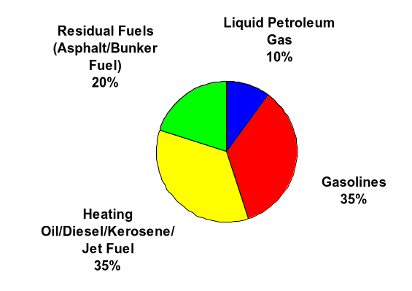
Crude Oil Refining Process
Outputs will vary by type of crude and refinery

Slide 36
What is Diesel?
Diesel is low sulfur heating oil
A hydrotreater is used in the refining process to desulfurize heating oil
Diesel output is dependent on the hydrotreater capacity at each refinery

Slide 37
Diesel v. Heating Oil
DOE diesel price
NYMEX Heating Oil
180.0
160.0
140.0
120.0
100.0
80.0
60.0
40.0
20.0
-
Mar-94
Jul-94
Nov-94
Mar-95
Jul-95
Nov-95
Mar-96
Jul-96
Nov-96
Mar-97
Jul-97
Nov-97
Mar-98
Jul-98
Nov-98
Mar-99
Jul-99
Nov-99
Mar-00
Jul-00
Nov-00
Mar-01

Slide 38
Diesel Hedging Methodology
Dirty Hedging
Nymex No. 2 Fuel Oil
Platts High Sulfur No. 2 Fuel Oil (NY or Gulf Coast)
Platts Low Sulfur No. 2 Fuel Oil (NY or Gulf Coast)
These hedges do not take into consideration location differential or retail fluctuations
One Variable Diesel Curve
strong relationship but wide range of error
Multi-variable Diesel Curve
Multiple predictors in deriving a diesel curve
Lower R2
Tighter error band

Slide 39
Curves and Products
Curves
DOE
National Average
PADD Averages
Opis RAC prices
35 cities (freight hubs)
Products Traded
Swaps
Puts/Calls
Collars/Straddles

Slide 40
Sample Transaction
The freight model values a lane assuming a $1.05/gallon diesel price with a specific fuel surcharge schedule
If a counter-party wants a fixed price contract, you have to adjust the $1.05 price to current diesel market price
If current diesel price is $1.65/gallon, $0.60/gallon (or $0.10/mile assuming 6mpg) must be added to the Shippers charge
Diesel risk has been shifted from the shipper through the freight book to the diesel book
The diesel book hedges the position with the appropriate number of heating oil contracts

Slide 41
Off Set of Risk
Shipper
Diesel Risk
Freight
Book
Diesel Risk
Diesel
Book
Heating Oil Risk
Crude
Desk

Slide 42
Typical Fuel Surcharge Schedule
For a $0.10 increase in the DOE, rates rise $0.013/mile

Slide 43
Surcharge v. Actual Increase
Actual increase
Surchare

Slide 44
Diesel Price Risk
Current Market

Slide 45
Shippers’ Risks
Standard Contracts allow carriers’ to pass-through incremental diesel costs
The large percentage of these are based on the DOE National Average
Large companies (i.e. Walmart) may transport for themselves, therefore bear all diesel fuel risk
This group is farthest removed from the diesel market and therefore, least prepared to anticipate and handle the fluctuations

Slide 46
Shippers’ Products
Purchase digital calls – to back those sold to carriers under transport agreements
Swaps
DOE – for contracts with carriers
RAC – for those transporting for themselves

Slide 47
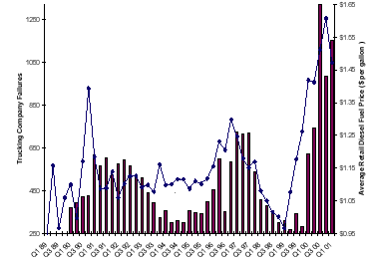
Carriers’ Risks
Negotiated surcharge schedules do not allow for full recovery of increased costs
Inability to enforce surcharge schedules
Fear of losing large contracts
Did not lower rates in lower diesel market

Slide 48
Carriers’ Products
Sell digital calls (under recover) and purchase call to better reflect actual cost increases
Short term swaps for contracts non pass-through contracts
National Average v. PADD of purchase swaps

Slide 49
Alternative Markets
Refineries – could sell RAC swaps – this is a cleaner hedge than the heating oil crack spread because it takes into account the differentials created by diesel (to heating oil) and location (v. New York where the Nymex contract trades)
Fuel Card Companies – potential customer outlet, currently, interested in very retail oriented products (i.e. load following fixed prices)

Slide 50
Fundamental Market Analysis
Jeff Andrews

Slide 51
Market Analysis
Two approaches to forecast markets:
Fundamental Analysis
Focused on Supply and Demand drivers
Forecasts magnitude and direction of changes in these drivers
Identifies Supply/Demand imbalances to formulate market forecast
Technical Analysis
Focused on graphically displayed price data
Attempts to identify relative strength in buying and selling forces
Ignores Supply/Demand balance underlying commodity or market

Slide 52
EGM Approach
Commercial group
Cross-commodity interaction
Share information
Develop synergies
Global EGM/Fundamentals offices keep pace with the markets
Houston
London
Tokyo (coming soon)

Slide 53

Organization
Current staff:
3 Managers
6 Associates
12 Analysts
3 Specialists
12 Summer Interns
. . . and this is just Houston

Slide 54
Products & Services
Analyses
Forecasting models
Supply/demand based on market drivers
Databases
Specialized per trading group
Publications
External news and analysis
In-house products
Week-Ahead
Critical Mass
Special Reports
EGM/Fundamentals Intranet

Slide 55
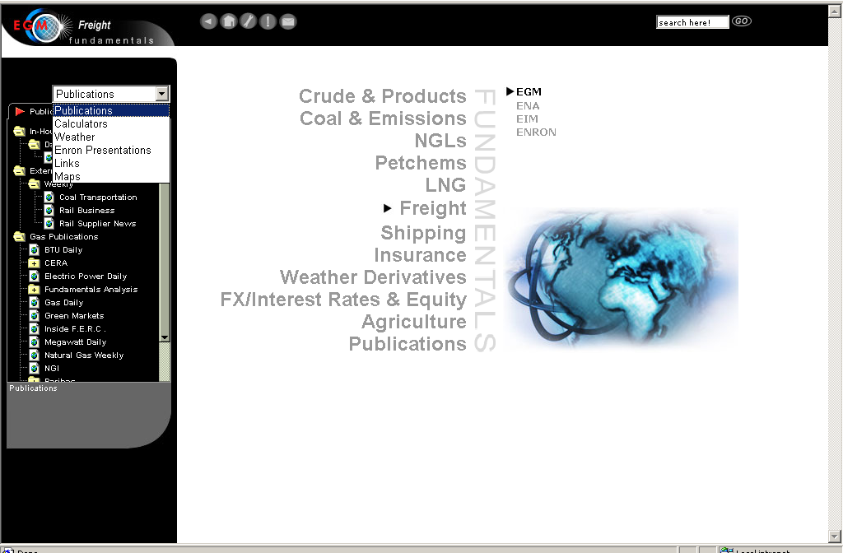
EGM/Fundamentals Intranet

Slide 56
Freight Fundamentals Phase 1
Preliminary market descriptions, for example:
Analyze truckload and intermodal freight flow & seasonality
Describe major shipping lanes
Support immediate forward trading group needs
Refine universal trucking cost model
Develop diesel hedging strategy
Develop intranet site
Publications
Models
Market alerts
Centralize data resources
Government resources
Consultant services

Slide 57
Freight Fundamentals Development
Phase 2:
Phase 3:
Detail freight flows by specific commodity
Correlation between macroeconomic indicators and freight markets
Develop freight indices for trucking and intermodal supply/demand
Completion of source/sink models
Identify and forecast major shifts in freight market
Develop dynamic seasonality models
Most importantly:
Develop synergies among trading groups related to freight

Slide 58
Origination
Shawn Cumberland

Slide 59
EFM – Origination
Origination’s function is to execute longer term, structured transactions that involve the purchase or sale of “freight”, financings, monetizations, special purpose vehicles, etc.
Origination typically will work with the CFO/COO level to provide structured solutions to EFM counterparties
Origination will also work on transactions that further EFM’s strategic goals – provide greater liquidity through commodity purchase/sale agreements, enhance capabilities through acquisitions, generate MTM income through contract restructuring

Slide 60
Enron Terminology
Origination – execution of long-term deals that provide Mark to Market Income. These deals typically involve commodity, structured finance and derivative products
Marked to Market(MTM) – entire value of a contract (less prudency reserve) is taken at time of execution. The contract is an “asset” which involves the purchase or sale of a commodity. The contract price for the commodity is valued against the trading book’s curves. Each day profit or loss is calculated based on the value of the position versus the value of market

Slide 61
Enron Terminology continued
Long – when you own or have rights to the commodity (e.g., EFM enters into a firm,long-term contract to purchase services – EFM is long)
Short – when you have the obligation to provide the commodity (e.g., EFM enters into a firm contract to sell to a shipper and does not immediately match the position with a purchase – EFM is short)
Firm Contract – when a buyer or seller has the obligation to take or provide a commodity. Damages will be provided for non-performance. Firm contracts are necessary for MTM treatment

Slide 62
Origination Objectives
$10 – 20 MM in MTM income for 2001
Enter into long-term firm contracts with Carriers to create a long position
Create the standardized template from which all deals will be done – firm purchase or sale contract
Work with Mid-Markets to enter into firm, long-term sales contracts to create a short position
Execute large structured deal with Shipper that will create “buzz” and additional customer interest/deals

Slide 63
Initial Truckload Capacity Contract
EFM to purchase two trucks going each way on six lanes for a one-year term
Six Lanes: LA-CHI, LA-Newark, CHI-Newark, CHI-ATL, Newark-ATL, LA-ATL
MTM Income on the deal ~ $1.0MM
Educational process for Carriers – explaining and demonstrating the need for a firm product with specific damages for non-performance
EFM will contract with multiple Carriers – allowing EFM to establish relationships with more Carriers and minimize risk by diversifying supply

Slide 64
Truckload Capacity Contract – Key Provisions
Nomination Procedures – very specific operational procedures for tendering a shipment – six hour notification, specified transit time, and 18 hour delivery window
Liquidated Damages – calls for market-based damages for non-performance by either buyer or seller
Late Delivery Penalties -- calls for a 5 - 10% reduction in the $/mile rate paid by buyer for each hour that the carrier is late in delivering the shipment
Fuel Surcharge – EFM is using its own fuel surcharge schedule, which calls for a change in the surcharge for each penny move in the DOE national weekly index. This removes the digital option embedded in commonly accepted fuel surcharge schedules

Slide 65
Truckload Capacity Contract – Uses
Initially, the contract will be used to purchase long-term, firm capacity
The contract will be modified to sell long-term, firm capacity
Finally, the contract will be standardized for use both to purchase and sell
The standardized contract will facilitate transactions and allow for additional deals without lengthy contract negotiations

Slide 66
Truckload Capacity Contract – Options
EFM’s firm purchase contract provides the buyer the right to extend the term and to increase the capacity
Carriers do not value these rights as economic options and therefore do not charge for them or charge very little
EFM values both the right to extend and the right to increase capacity as call options
EFM will MTM the value of the options upon contract execution

Slide 67
Other Efforts in Securing Long Position
Rail – current discussions
CSX Intermodal
BNSF Intermodal
Amtrak
Truck – NewCo concept
Partnership with operator/carrier to provide dedicated non-lane specific capacity
NewCo owns, operates, and maintains capacity
EFM markets capacity

Slide 68
2nd Half 2001 – Outlook for Origination
Begin strong push to build/secure short positions
Working closely with mid-marketers
Compelling optionality potential with shippers
Continue building long portfolio of capacity
Truck
Rail

Slide 69
Lunch

Slide 70
TIB Overview
Chris Kravas

Slide 71
Overview of Spot Trading
Jason Beckstead

Slide 72
Spot Trading Team
Jason Beckstead
John Ashman
Mike Keyser
Ken Newman
Bryan Robins
Mike Reen
Jennifer Nguyen
Meredith Campbell
Staffing Targets | Q2 | Q3 | Q4
 | 9/7 | 18 | 27

Slide 73
Volume of Total Loads by Month for Spot Marketing

Slide 74
Spot Trading Strategy & Goals
Meet aggressive hiring targets
50% Industry + 50% Enron
Build out spot trading systems
Meet spot trading volume targets
(generated independently of mid-market & origination loads)
Cover Mid-market & origination loads
Volume Targets
Q2
Q3
Q4
2000
Spot Generated Loads
1,440
7,200
14,400
23,040
Covered Loads
1,200
10,200
47,700
59,100
Total Volume
2,640
17,400
62,100
82,140

Slide 75
Overview of Mid-Marketing
Chris Kravas

Slide 76
Mid-Marketing Team
Marty Gleason
Greg Sharp
Owen Zidar
Mike Arendes
Staffing Targets
Q2
Q3
Q4
4/3
9
15

Slide 77
Mid-Market Strategy and Goals
Market traditional freight transportation intermediary services
Introduce freight transportation risk management solutions
Industry assignments
Retail – Food & beverage
Industrial – Consumer goods
Expand existing relationships
Leverage Enron relationships and referrals
Volume Targets
Q2
Q3
Q4
2000
Loads Sold
4,800
36,000
150,000
190,800

Slide 78
Commercial Coordination
Chris Kravas

Slide 79
Commercial Coordination
Kim Frumkin
Prospecting
Marketing and communications
Website design and content
Beth Cowan and Tana Cashion
Spot trading and mid-marketing volume and opportunity reporting
Carrier relations
Projects

Slide 80
Collateral
Annual Report
Press Releases
Tear Sheet
Brochure (in process)
Exchange Article
Enron Collateral
EFM Power Point Presentation

Slide 81
Chicago Operations
Dan Burke

Slide 82
EFM Chicago Operations Chicago, IL - May, 2001

Slide 83
Intermodal Process
TRADER
Trader and shipper create a transaction
Confirm original dray capacity
Enter trade data into the deal capture system
Legal confirmation is sent to dray confirming price and time. Load has now been dispatched
OPS
Reserve intermodal equipment
OPS
Verbally verifies legal confirmation one day prior to dispatch
Carrier confirms
Carrier confirms
Send pre-note with operational information
send legal confirmation verifying price and time.
set customer delivery
Monitor last street events
Street turn or terminate equipment
Send railroad rail bill information
Monitor load to destination
Select destination dray carrier
Carrier fails to confirm
Carrier fails to confirm
Select alternative carrier
notify trader if pricing is greater than $25 from original quote
Select alternative carrier
notify trader if pricing is greater than $25 from original quote

Slide 84
Truck Process
TRADER
Enter trade data into the deal capture system
Trader sends legal confirmation to carrier confirming price and time.
Trader sends legal confirmation to shipper.
Load has now been dispatched
OPS
Trader creates a transaction
Confirm original capacity
OPS
Verbally confirms legal confirm one day prior
If confirmed
Retrieve status updates daily from trucker
Terminate load and market for invoicing
Trucker sets delivery appointment and sends us detail to input into system
If not confirmed
Find alternative

Slide 85
Daily Operational Activities
Confirm pick-up schedules
Confirm accuracy and on time rail billing
Secure delivery appointments
Confirm scheduled deliveries
Monitor shipments in route for schedule variances
Document unplanned accessorials
Notify customers of unplanned accessorials
Confirm destination dray capacity, rates and schedule
Monitor destination rail units to ensure notifications sent
Terminate equipment to owner
Monitor equipment reservation sites for proper termination events
Document pick-up and delivery changes and reasons
Document margin impacts
Resolve customer operational inquiries

Slide 86
Developmental Activities and Challenges
Chicago move
Finalize mid-market process
Complete over-the-road system training

Slide 87
Keys To Success
Accurate and complete data from traders
Document unique customer requirements in the system
Exception monitoring tools
Carrier integration (EDI rail billing)
CRM tool to include carrier performance

Slide 88
Technology Overview
Ken Crane

Slide 89
Technology Overview
System Roadmap
Trade Capture/Scheduling
Keypoint Integration
Webmodal PointClickShip Enhancements
Web Reporting Data Analysis
Q/A

Slide 90
System Roadmap
Deal Capture
Aug 2001
Scheduling
June 2001
PointClickShip
Keypoint
Liquid Acct
July 2001
SAP

Slide 91
System Roadmap
Deal Capture
Aug 2001
Scheduling
June 2001
Poin
tClickShip
Keypo
int
Liquid Acct
July 2001
SAP

Slide 92
System Roadmap
Poin
int
Deal Capture
Aug 2001
Scheduling
June 2001
tClickShip
Keypo
Liquid Acct
July 2001
SAP

Slide 93
System Roadmap
Indicative
Price
Deal Capture
CRM
Sept 2001
Scheduling
Aug 2001
PointClickShip
Keypoint
June 2001
Liquid Acct
July 2001
SAP

Slide 94
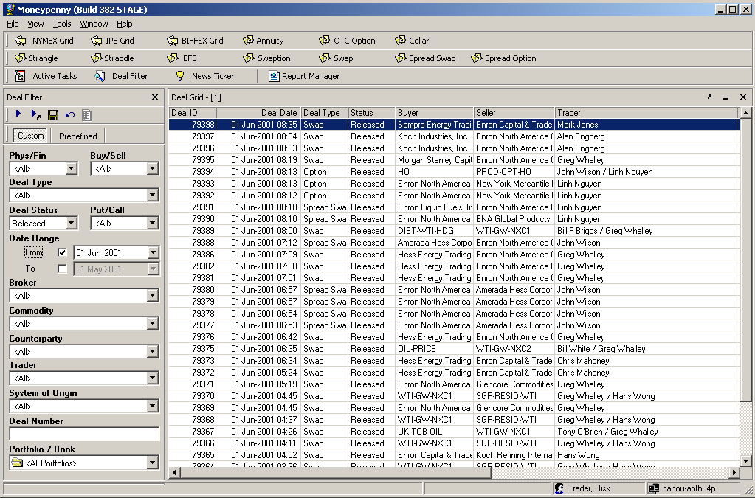
MoneyPenny Trade Capture

Slide 95
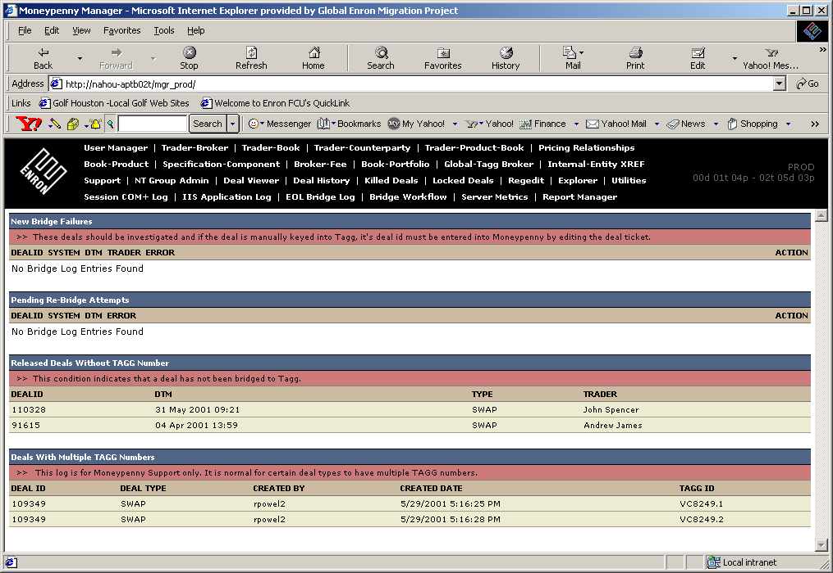
MoneyPenny Manager

Slide 96
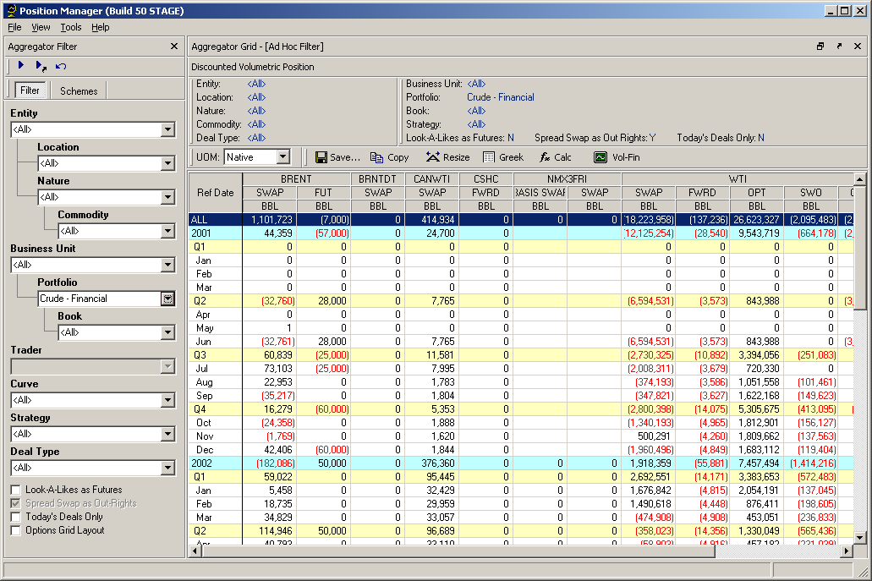
Position Manager

Slide 97
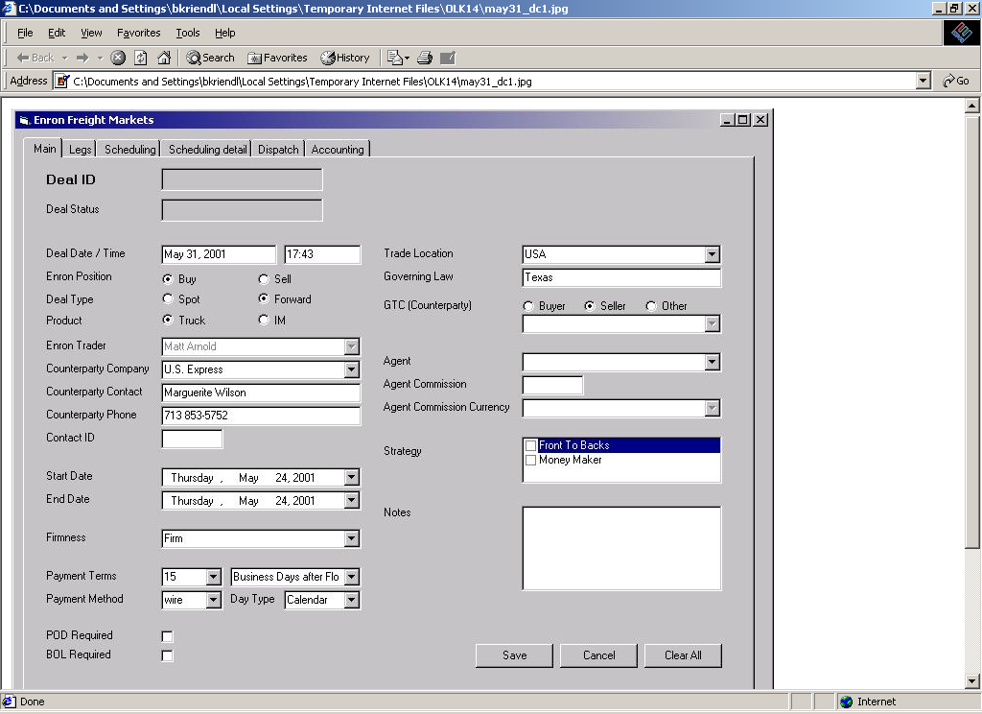
Deal Capture Main Menu

Slide 98
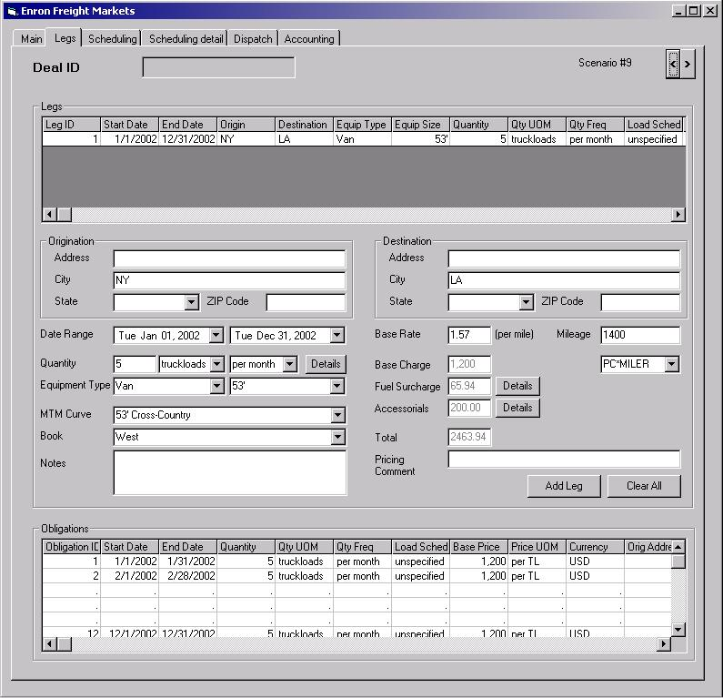
Deal Capture Legs

Slide 99
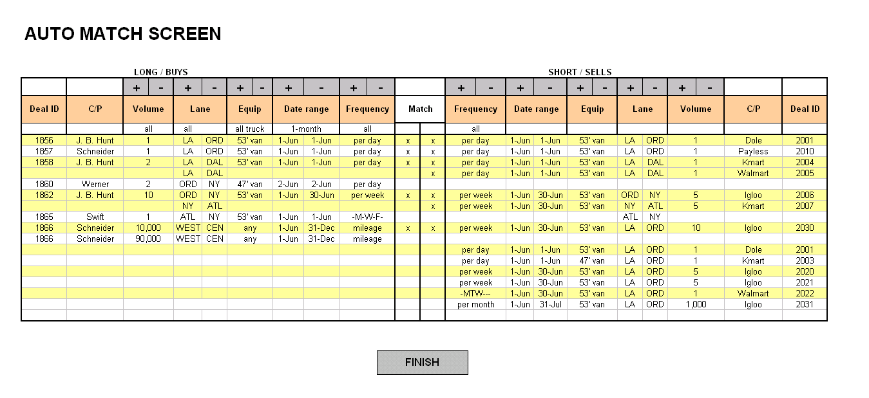
Scheduling

Slide 100
Webmodal PCS Enhancements
Release 2 Functionality
Simplified Price
Quoted Price
Dray Assignment
Beneficial Owner
Web Reports

Slide 101
Simplified Price
Create a synthetic dray rate for each customer city / ramp pair
Origin
Average + (.68 * Standard Deviation)
Destination
Average

Slide 102
Simplified Price – Process Flow
Origin Drays for Chicago
C&K
Great Point Intermodal
Galaxy Transport
Rasmussen Transportation
Cushing
Triton Transport Services
Destination Drays for Los Angeles
Golden Eagle Express
Rail Delivery Services
Devins & Peters
Quality Motor Carriers
Pacific Rim
Enron Provided Origin Dray
BNSF
UP
Enron Provided Destination Dray

Slide 103
Beneficial Owner
For both dray and rail
Price for a specific intermediary
Price for a specific intermediary plus beneficial owner
Internal users
Can see all prices
Can filter for intermediary/beneficial owner
External intermediary
Can see “their” rates and public rates

Slide 104
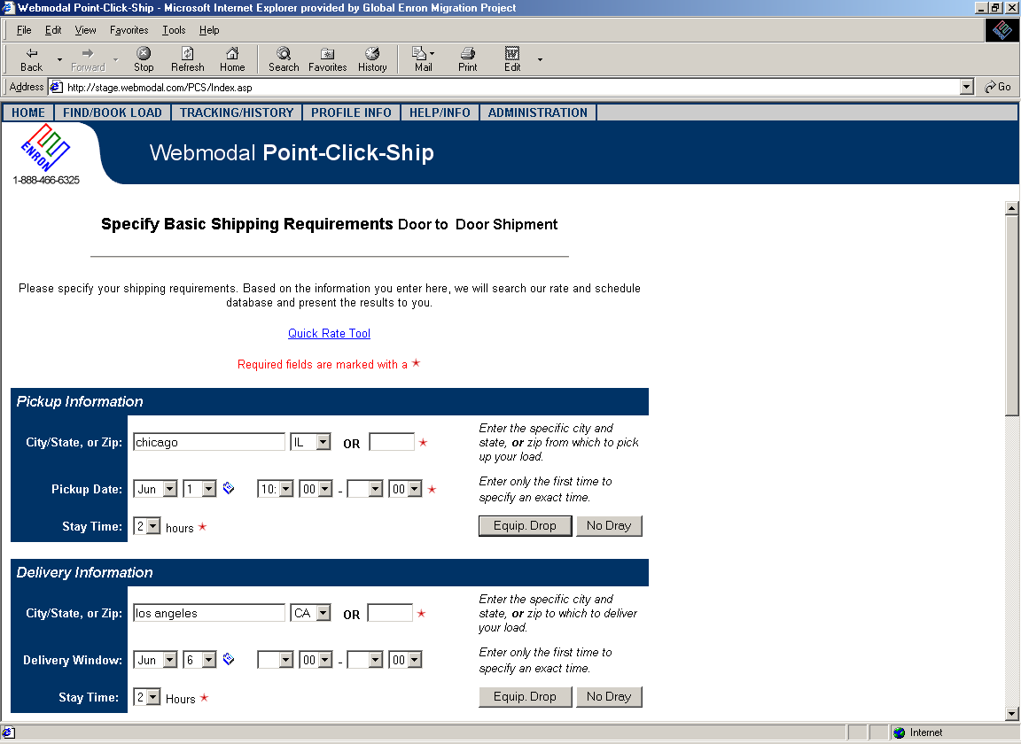
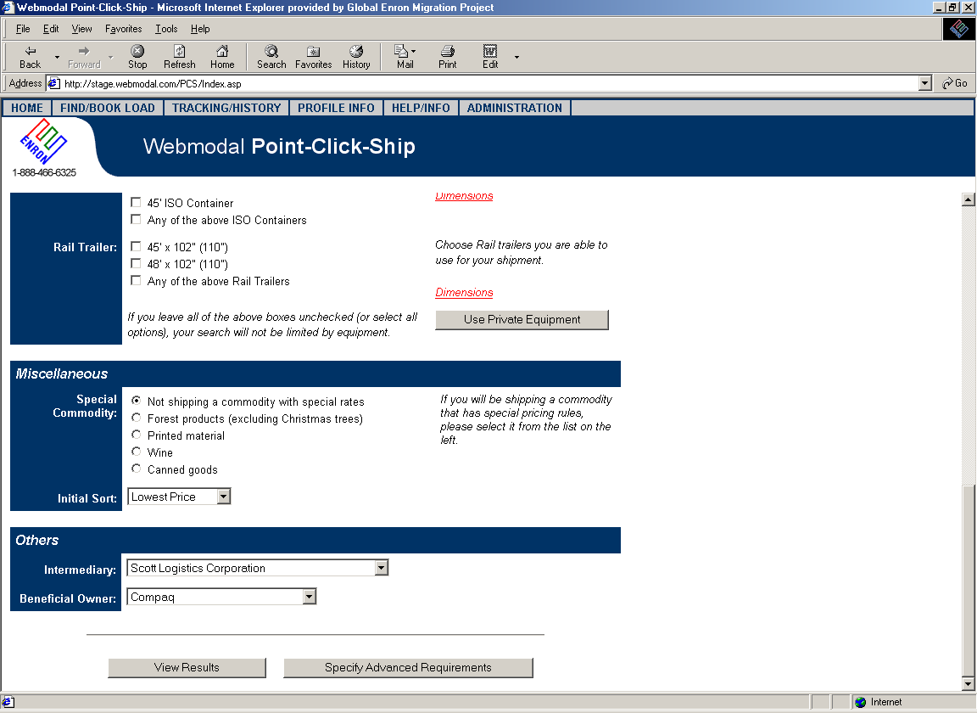
Book A Load
Internal only

Slide 105
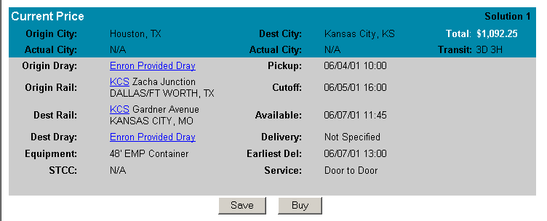
External View of Public Price
$1,129.50

Slide 106
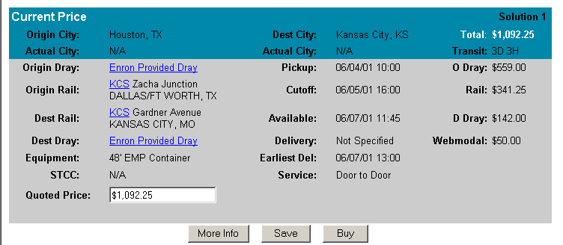
Internal View of Public Price
$1,129.50
$558.00
$75.00
$1,200.00
By default, Quoted Price = Simplified Price

Slide 107
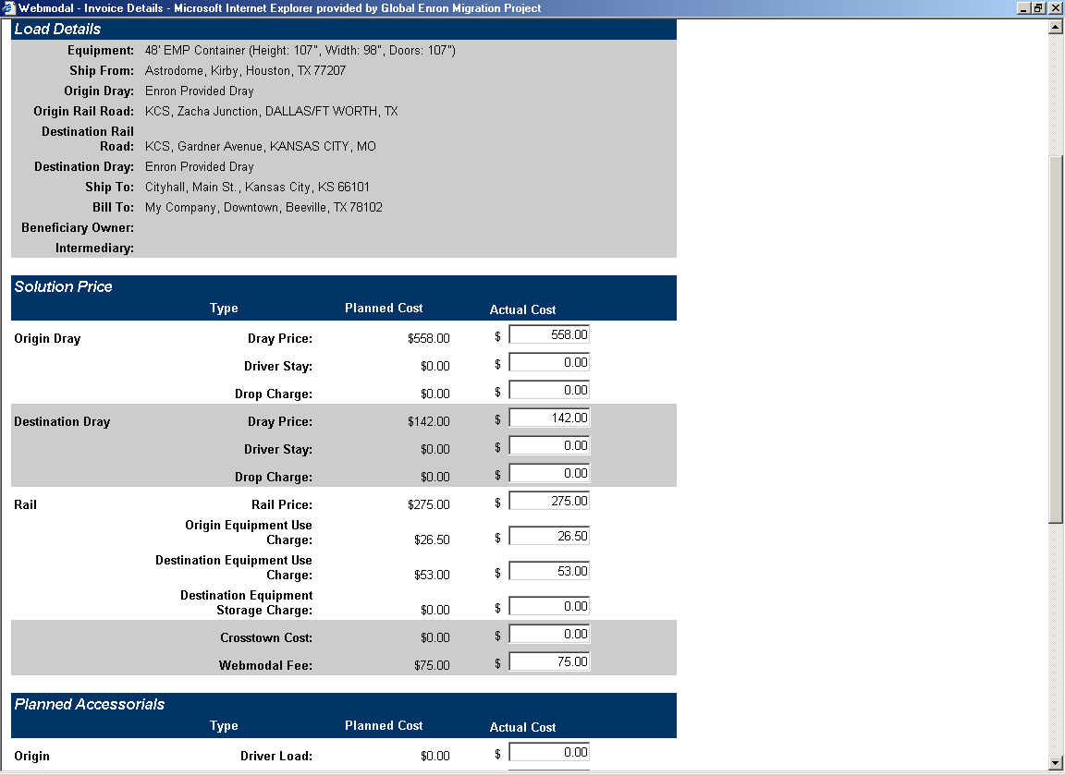
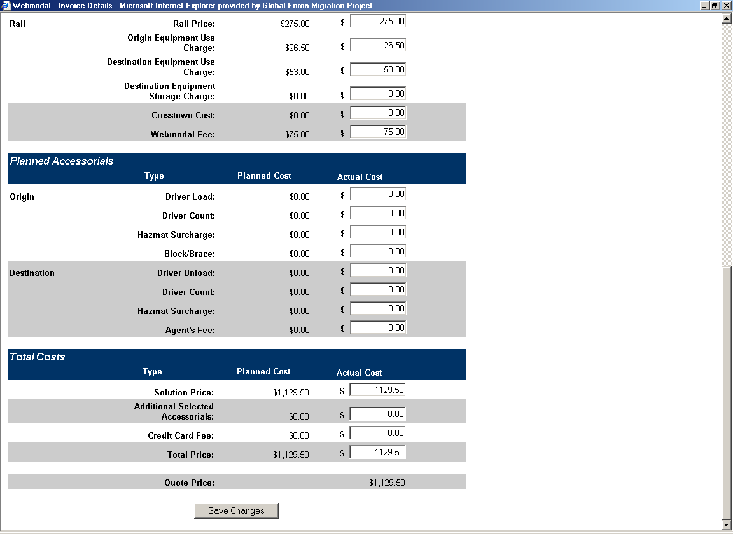
Invoice Details
Simplified
Price
Quoted
Price
$1,200.00

Slide 108
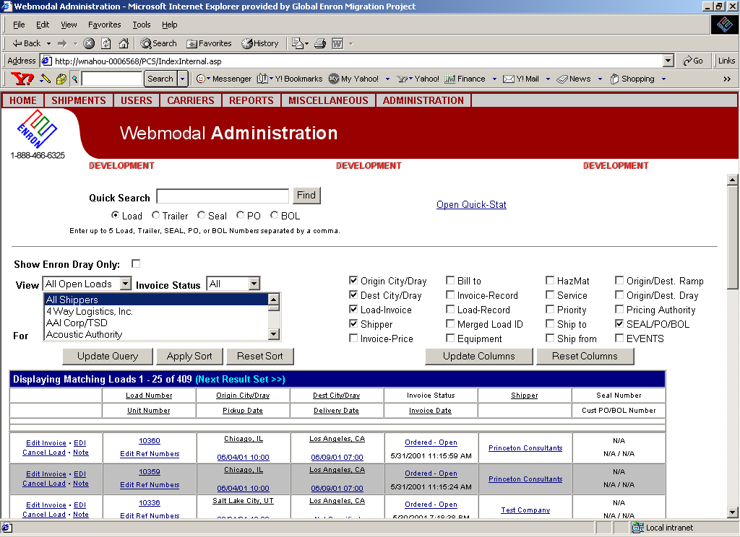
Load Manager
Enron Provided Dray
Enron Provided Dray

Slide 109
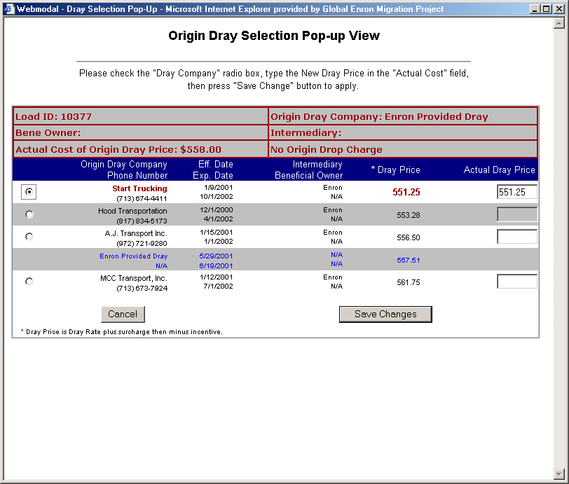
Select a Dray
558.00
Target Price
Select a different dray
Negotiated rate possible

Slide 110
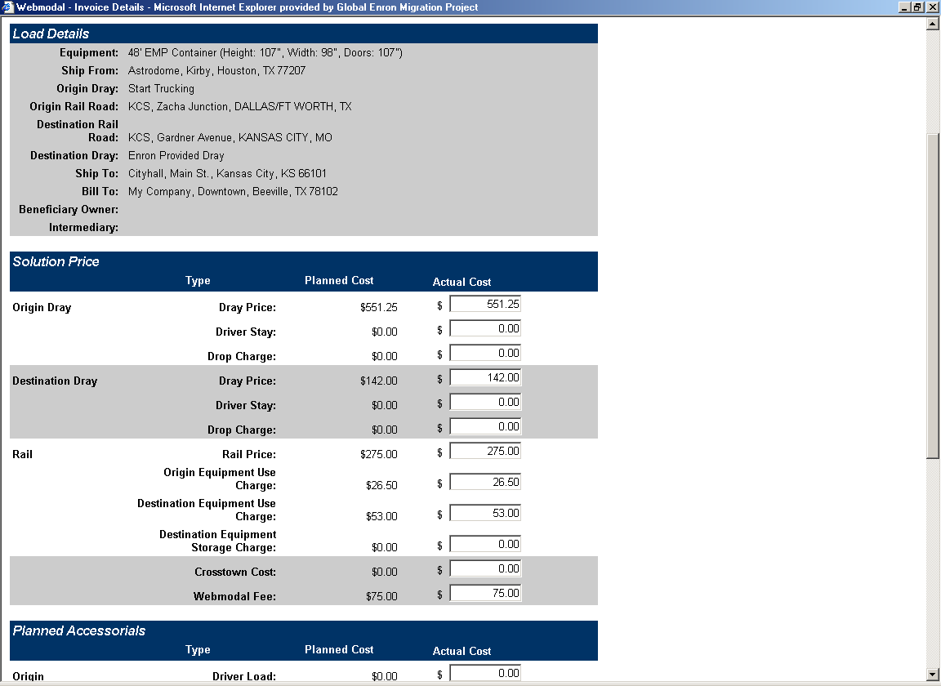

Update Invoice Details
Updated
Prices
Quoted
Price
$1,200.00

Slide 111
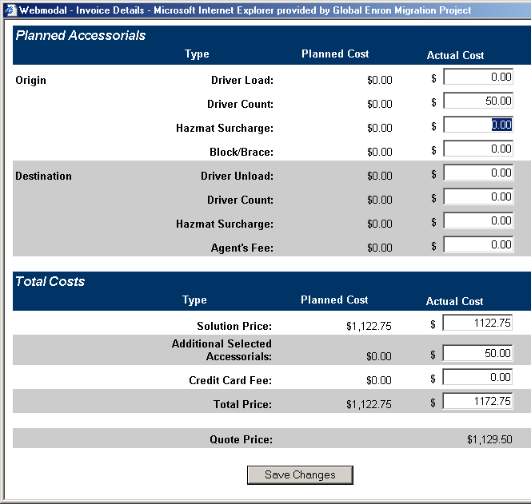
Update Invoice Details
Accounting updates
Invoice Details with
information from
Notes screen
Total Price is
automatically
updated
$1,200.00

Slide 112
Truck Brokerage
Keypoint
Phase 1
Stand alone application
Functionality
Order management
Dispatch
Track and trace
Confirmation
Phase 2
Feed from deal capture
Feed to Liquids Accounting

Slide 113
Web Reporting
Replaces need for expert user
Mitigate risk associated with users having direct access to production data
Provides real time access to live data
Supports “Adhoc” analysis without IT support
Replaces approximately 40 reports generated by users today

Slide 114
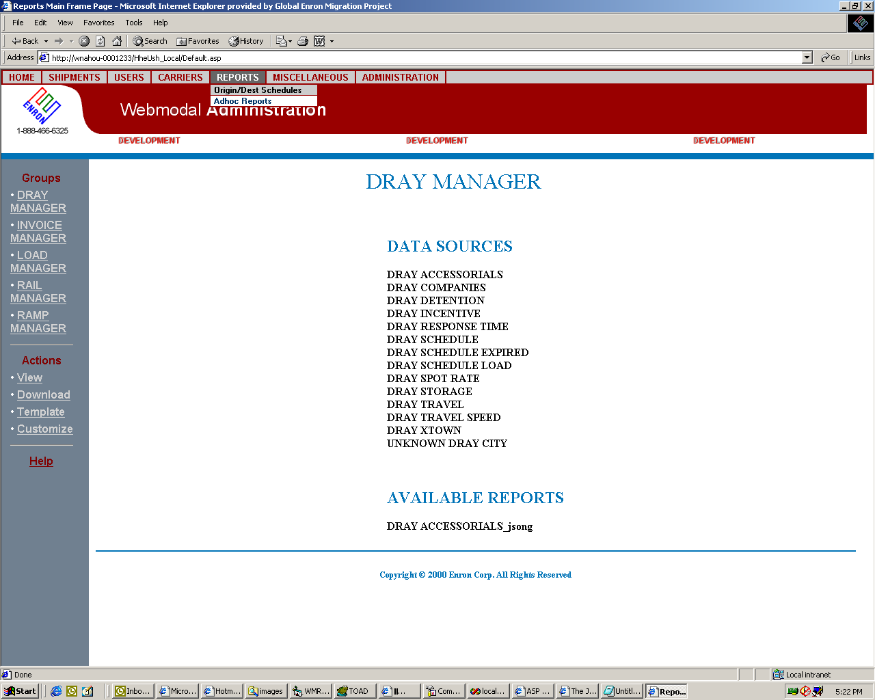
Select from Templates and Reports

Slide 115
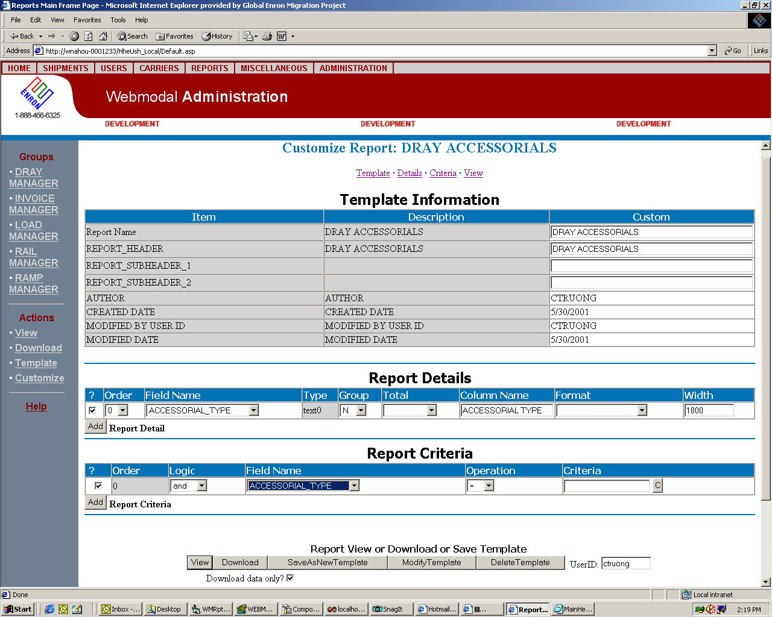
Customize a Template

Slide 116
Recap and Closing Remarks
Dan Reck

