Slide 1

Enron North America

Slide 2
Enron North America
Leading Provider of Energy in North America
Unparalleled Energy Network and Product Offerings
Significantly Benefiting from Changes in Energy Markets
Further Expanding Market Presence through e-Commerce

Slide 3
Key Markets
Natural Gas
Power
Coal
Crude Products
Emissions
Weather
Pulp and Paper
Merchant
Investments
Profit Opportunities Exist Within and Between Markets
Scale and Information Identify Highest Value Opportunities
Low Incremental Cost to Enter New Markets
Diversification Contributes to Strong Business Growth

Slide 4
Key Markets
Natural Gas
Power
Coal
Crude Products
Emissions
Weather
Pulp and Paper
Merchant
Investments

Slide 5
North America
Wholesale Gas Market
Structural Changes in Wholesale Power Demand Patterns Providing Exceptional Gas-Related Opportunities
High Premiums Earned for Flexibility and Services
Opportunities in Outsourcing Energy Assets and Supply
e-Commerce Applications Differentiating Competitors

Slide 6
Enron’s Wholesale Gas Network
Storage Capacity
(Bcf)
52
28
Leased
Owned
Counterparties
Manufacturing
Marketers
Producers
Utilities
Others
Henry
Henry
Henry
Henry
Hub
Hub
Hub
Hub
Contract Term
Marketing Offices
Owned and Leased Capacity
NYMEX
Owned Gas Storage
Leased Storage
<1Yr
1-10 Yr
>10Yr
Gas Marketing Activity

Slide 7
Natural Gas
Physical Volumes
(BBtu/d)
United States
Canada
13,955
11,463
10,377
8,948
22%
1996
1997
1998
1999

Slide 9
Key Markets
Natural Gas
Power
Coal
Crude Products
Emissions
Weather
Pulp and Paper
Merchant
Investments

Slide 10
North America
Wholesale Power Market
Deregulation Provides Enormous Opportunities
  Divesting of Generation Assets
  Access to Industrial Energy Load
Further Changes in Regulatory Environment will Facilitate Access to Utility Territories
Customers Need Price Risk Management Services to Compete More Effectively

Slide 11
Enron’s Wholesale Power Network
Peaking Generation
(MW)
2,800
1,300
MAPP
MAIN
0
ECAR
NPCC
1998
1999
2000E
ComEd
Hub
COB
PJM
Hub
Hub
MAAC
Cinergy
Cinergy
Cinergy
Hub
Hub
Hub
Counterparties
Cinergy
WSCC
Hub
SPP
Manufacturing
Marketers
SERC
Utilities
Palo
Palo
Palo
Municipal
Palo
Verde
Verde
Verde
Verde
Hub
Hub
Hub
Others
Hub
TVA
Hub
Entergy
Entergy
Entergy
Hub
Hub
ERCOT
Hub
Contract Term
Marketing Offices
NYMEX
Marketing Hub
FRCC
<1Yr
1-5Yr
>5Yr
Power Plants
In Operation
Under Development
Power Marketing Activity
Transmission Grid

Slide 12
Power
Physical Volumes
(Million MWh)
402
381
192
60
1996
1997
1998
1999

Slide 13
North America Non-Regulated Power Market
(Million MWh)
18,000
14,500
11,000
8,000
5,000
3,450
3,359
1,556
2,306
819
863
908
1993
1994
1995
1996
1997
1998
1999E
2000E
2001E
2002E
2003E
2004E
39% Projected Growth Rate

Slide 14
North America
Power Market Offers Significant Growth Prospects
Gas
(Bcf/d)
Power
(Million MWh)
400
18,000
Futures
300
14,000
10,000
200
Wholesale
6,000
100
Delivered
Wholesale
Delivered
2,000
0
0
Futures
1990
1991
1992
1993
1994
1995
1996
1997
1998
1990
1991
1992
1993
1994
1995
1996
1997
1998
Source: EIA Electric Power Annual; EIA Natural Gas Monthly; McGraw-Hill

Slide 15
Enron’s Lead Power Market Position
First Nine Months 1999
(Million MWh)
292
240
179
168
167
162
78
77
68
57
Enron
AEP
Aquila
Avista
PG&E
Southern
Duke
Reliant
Citizens
Williams
Source: Natural Gas Week

Slide 16
Natural Gas and Power Volumes
Enron’s Lead Market Position
First Nine Months 1999
(TBtue/d)
23.4
17.0
16.1
13.5
11.1
10.9
10.6
10.0
9.9
6.6
Enron
Aquila
PG&E
Duke
Southern
AEP
Dynegy
Coral
Reliant
TransCanada
Gas
Power

Slide 17
Key Markets
Natural Gas
Power
Coal
Crude Products
Emissions
Weather
Pulp and Paper
Merchant
Investments

Slide 18
Enron’s Merchant Investments
Portfolio by Industry
Extension of Products Provided to Customers
Comprises Equity and Debt Investments in Energy-Related Businesses
Capital and Finance Expertise Leverages Enron’s Position in Energy-Related Markets
Investments can Include Board Representation
Pulp & Paper, Steel and Other
Energy
$1.5 Billion Value as of 12/31/99

Slide 19
Key Markets
Natural Gas
Power
Coal
Crude Products
Emissions
Weather
Pulp and Paper
Merchant
Investments

Slide 20
Coal
Market Developments
Enron’s Transactions
Coal Fuels 57% of U.S. Generation
Changing Regulations Create Market Uncertainty and Opportunities for Enron
Increased Competition Demands Price Certainty and Supply Flexibility
Forward Market Developing
715
250
0
46
Enron’s Coal Business
1996
1997
1998
1999
Customers Include Coal Producers, Generators and Utilities
Providing Comprehensive Management Services
  Physical Delivery
  Price and Volume Risk Management
  Investment Capital
Market Maker for Emissions Credits
Largest Wholesale Marketer of Coal in U.S.
Enron’s Volumes
(Thousand Tonnes)
26,732
5,589
0
21
1996
1997
1998
1999

Slide 21
Pulp and Paper
Market Developments
Enron’s Transactions
432
Industry Experiences Extreme Price Volatility
Price Uncertainty Results in Inefficient Capital Structures
Financial
Physical
Enron’s Pulp & Paper Business
73
17
Lead Provider in U.S. of Risk Management Services
Providing Structured Customized Solutions
  Energy Commodities
  Risk Management Products
1997
1998
1999
Enron’s Notional Volumes (Thousand Tonnes)
6,868
4,507
Serving Large, Energy-Intensive Industrial Customers
314
1997
1998
1999

Slide 22
Enron North America
Leading Provider of Energy in North America
Unparalleled Energy Network and Product Offerings
Significantly Benefiting from Changes in Energy Markets
Further Expanding Market Presence through e-Commerce

Slide 23
Enron Europe

Slide 24
Enron’s European Network Strategy
Natural Gas
Power
Coal
Crude Products
Emissions
Weather
Pulp and Paper
Merchant
Investments
Establish Europe’s Leading Energy Network
  Capture Sustainable First Mover Advantage
Extend the Network
  Strong, Competitive Position in High Growth Markets
Exploit the Network
  Create Significant Value to Enron and its Customers

Slide 25
Enron: The Leading Energy Network in Europe
Nordic Region
Market Maker and Largest
Power Marketer
U.K.
Established Market Leader in Power and Gas
Nord
Pool
Helsinki
Oslo
Excellent Physical Access to Key Markets
  Large Scale and Scope
  Diverse Portfolio of Assets and Contracts
  Extensive Market-Making Capabilities
Fully Integrated Approach
  Geographically
  Across the Energy Chain
  Across Enron
Rapid and Complete Transfer of Enron’s Wholesale Business Model
Offices
Energy Exchange
LNG Project Under Development
Energy Services
Energy Partnerships
Leased Capacity
Utility Services
Teesside
1,875 MW
Stockholm
Wilton
154 MW
Sutton Bridge
790 MW
Amsterdam
Oxford
APX
Warsaw
Moscow
GEX
Nowa Sarzyna
116 MW
London
Brussels
Power Plants
Frankfurt
In Operation
In Construction
Under Development
Energovill
Zurich
Enron/Petrom JV
Budapest
Milan
Jertovec
Energy Marketing
Activity
240 MW
Bucharest
Gas
Power
Coal
Sarlux
551 MW
Madrid
Marmara
478 MW
Arcos
1,200 MW
Continental Europe
Only Significant New Entrant in Power and Gas

Slide 26
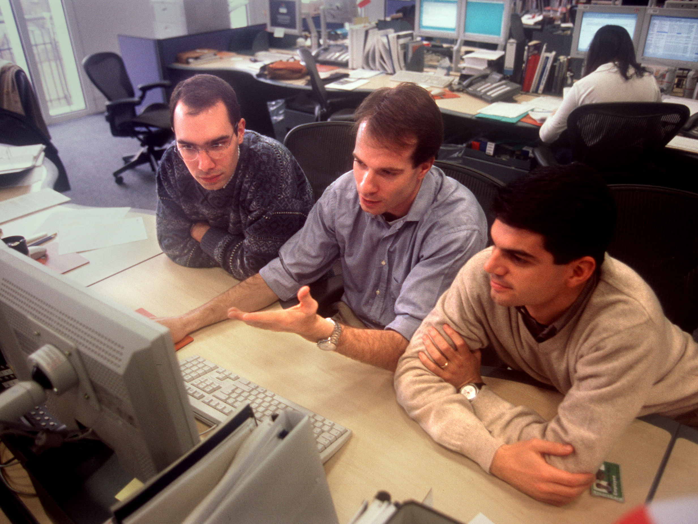
Skilled Personnel Deployed in Local Markets
1,750 Employees
18 Offices
16 Countries
36 Languages
42 Nationalities
Key Competitive Advantage – Strong Barrier to Entry

Slide 27
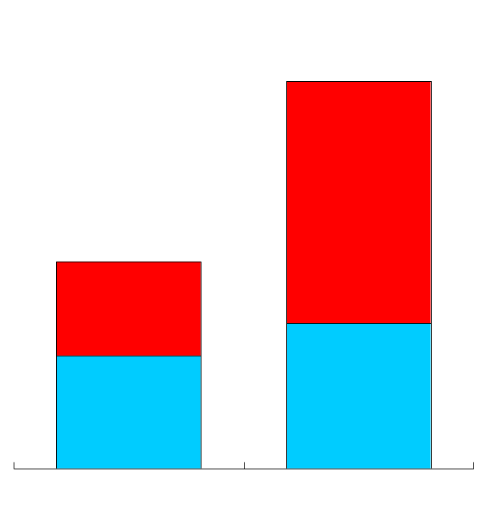
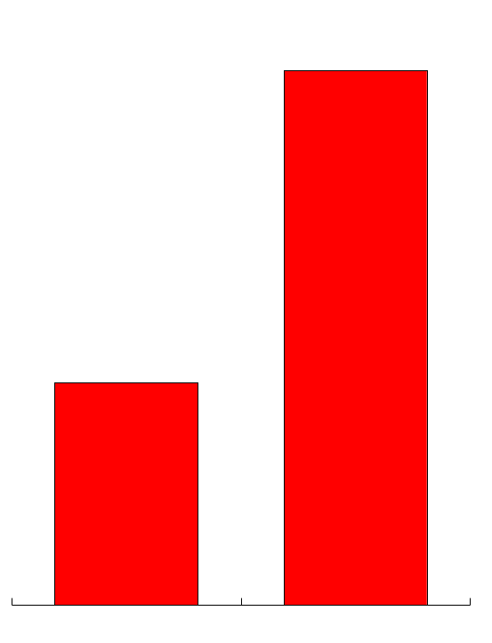
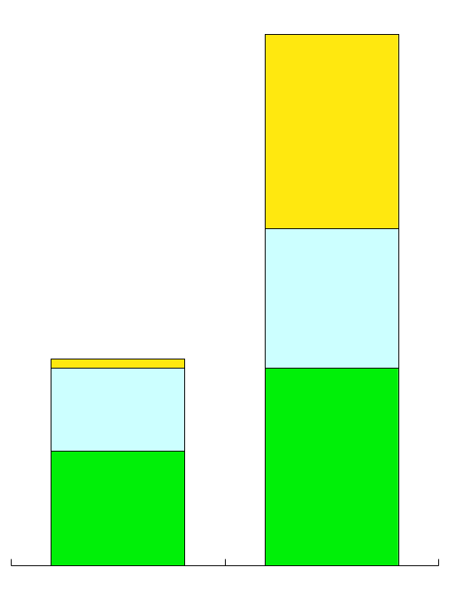
Enron Europe
Volume and Transaction Growth
Total Volumes*
(BBtue/d)
Power Volumes*
(Million MWh)
Number of Transactions
Power
Gas
4,255
91
Continent
Nordic Region
U.K.
24,241
2,270
38
9,451
1998
1999
1998
1999
1998
1999
*Physical and Financial
Note: In the U.K and parts of Europe, volumes are physically transported by the national grid operators and financially settled by energy service providers.

Slide 28
U.K. Wholesale Energy Market
Market Size
Major Participants
$17 Billion Annual Revenues
Gas Enron
Enron
Accord
BP
Dynegy
Centrica
TXU
Coal
Enron
TXU
National Power
Mission
PowerGen
AES
Power
Enron
TXU
National Power
PowerGen
Mission
EDF
Gas
3 Tcf
Power
293 TWh
Enron Counterparties
31 Power
59 Gas
3 Coal
100% Open to Competition

Slide 29
Enron’s U.K. Energy Network
Optimizing Strong Asset
Base – 2,900 MW
  Teesside Power
  Teesside Gas Processing
  Teesside Utility Services
  Sutton Bridge Power
Leveraging Strong Gas and Power Market Positions
  Innovative “Virtual” Gas Storage
  Opportunities Related to New Electricity Trading Arrangements
  Coal and Weather Products
Benefiting from Increased Competition
  Industry Divestment Creates New Transaction Opportunities
  Enron’s Volumes Increasing
Teesside
Wilton
Offices
Energy Services
Leased Capacity
Utility Services
Gas Processing
Sutton
Bridge
Power Plants
Oxford
Interconnector
In Operation
Under Development
London
Energy Marketing
Activity
Gas
Power
Kent
Coal

Slide 30
U.K. Market Environment
Government Agenda
    Positive Reform of the Electric Trading Arrangements
    Continued Moratorium on New Gas-Fired Plants
    Divestment of Generation
Market Developments
    Well-Developed, Liquid Power and Gas Markets
    Increased Energy Convergence
      Gas/Power
      U.K./Continental Europe
    Established Continental Energy Companies Entering U.K. Gas Market
    New Product Opportunities (i.e., Storage and Linepack Services)

Slide 31
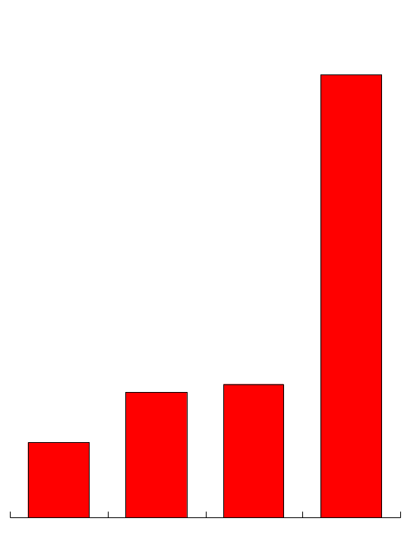
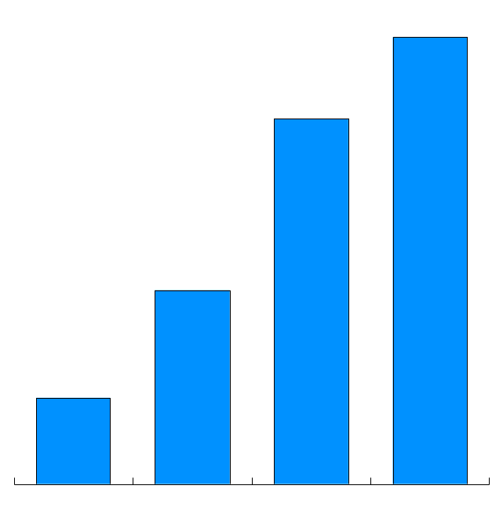
Enron’s U.K. Volume Growth
Gas*
(BBtue/d)
Power*
(Million MWh)
1,520
53
1,243
660
15
16
293
9
1996
1997
1998
1999
1996
1997
1998
1999
*Physical and Financial

Slide 32
Enron’s Nordic Energy Network
World’s Most Deregulated Power Market
Leading Player and Market Maker
Increased Liquidity, Price Transparency and Cross-Border Influence
eCommerce Facilitates Long-Term Energy Partnerships
240 Enron Counterparties
Sweden
Volume Growth*
(Million MWh)
31
Norway
Finland
Nord
Pool
21
Oslo
Stockholm
Helsinki
Offices
Energy Partnerships
Power
8
GEX
3
Denmark
1996
1997
1998
1999
*Physical and Financial

Slide 33
Continental Wholesale Energy Market
Market Size
Enron’s Customer Mix
$156 Billion Annual Revenues
210 Wholesale Counterparties in 16 Countries
Power – 3,157 TWh
1,695
Czech
Republic
Other
1,027
435
Belgium
German
Western
Central
Eastern
Incl. Russia
Italy
Gas
29.6 Tcf
Swiss
18.2
Dutch
9.0
2.4
Western
Central
Eastern
Incl. Russia
(Inception to Date Volumes Traded Per Country)

Slide 34
Enron’s Continental Energy Network
Building Liquidity Across Europe
  Transacting in Every Major Market
  Contracts Range Up to 2.5 Years
Strong Catalyst for Liberalization
  Negotiating Access and Providing
  Mutual Benefits to Customers
  Favorably Impacting Regulatory
  Processes
Benefiting from Lead Market
Making Role
  Early Identification of Bottlenecks
  Innovative Products to Manage Price and Term Risk
Exploiting Arbitrage Opportunities
  Geographically and Across Commodities
Extending Market Reach Through
eCommerce Applications
Offices
Energy Exchange
Leased Capacity
Energy Partnership
Copenhagen
Moscow
Power Plants
In Operation
In Construction
Under Development
Interconnector
APX
Warsaw
GEX
Nowa Sarzyna
Energy Marketing
Activity
Brussels
116 MW
Frankfurt
Gas
Power
Zurich
Energovill
Budapest
Coal
Milan
Enron/Petrom JV
Jertovec
240 MW
Bucharest
Sarlux
551 MW
Arcos
1,200 MW
Marmara
478 MW

Slide 35
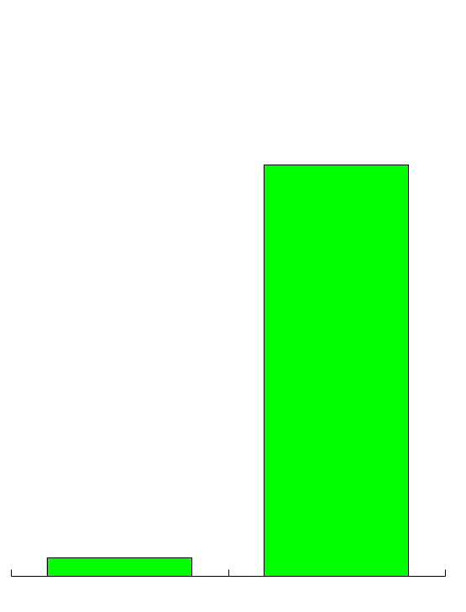
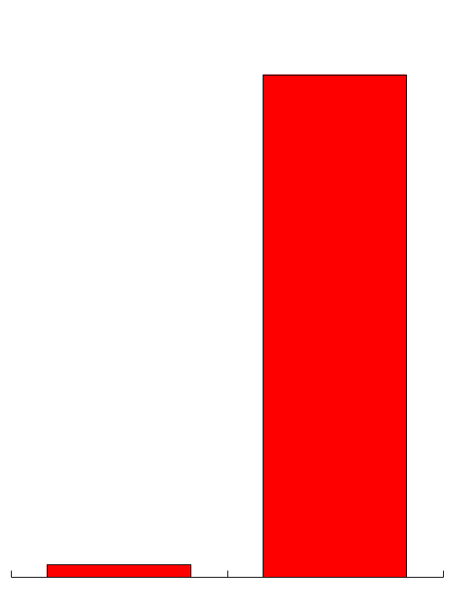
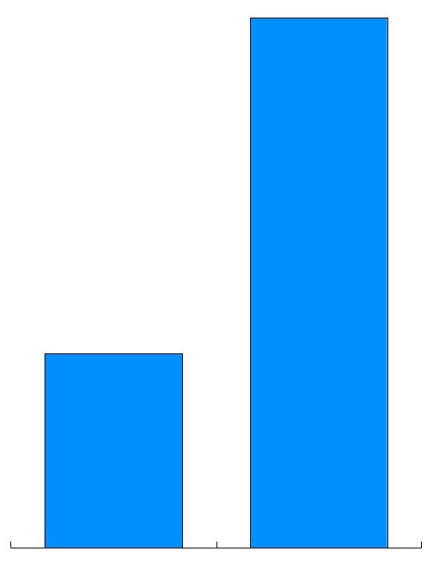
Enron’s Continental Volume Growth
Transactions
Volumes*
(Thousand MWh)
Counterparties
8,859
7,201
210
44
414
186
1998
1999
1998
1999
1998
1999
*Physical and Financial

Slide 36
Enron Europe
Established Europe’s Leading Energy Network
- Sustainable First Mover Advantage
Extending Network Aggressively
- Strong, Competitive Position in High Growth Markets
Exploiting Network to Create Significant Value
- Continued Strong Earnings in the U.K.
- Accelerating Earnings From Continental Europe
Redefining European Energy

Slide 37
Enron North America
Natural Gas
Power
Coal
Crude Products
Emissions
Weather
Pulp and Paper
Merchant
Investments

Slide 38
Peoples Energy
Natural Gas
Power
Coal
Crude Products
Emissions
Weather
Pulp and Paper
Merchant
Investments
Long Term Gas
Supply
Hub
Services
Wholesale
Electric Supply
Supply Peoples’ Natural Gas
Requirements
  - 5 Year Term
  - 270 MMcf/d
  - 10% of Natural Gas
  Consumed in Chicago
Enron
Marketing
Risk Management
National Reach
Peoples
Storage Assets
Transportation
Regional Expertise
Provide Key Services
to Peoples’ Retail Power
Markets
- Wholesale Power Supply
- Risk Management
Target Market Area
Representing 5% of U.S.
Natural Gas Consumed
Increase Liquidity & Flexibility
at Chicago City Gate
- Access Multiple Supply
Basins
- Interconnect With 6 Major
Pipelines
  Acquire and Optimize
  Transport Capacity Within Enron’s Broader Portfolio
  Provide Weather Risk Management Services

Slide 39
The United Illuminating
Company (U.I.)
Natural Gas
Power
Coal
Crude Products
Emissions
Weather
Pulp and Paper
Merchant
Investments
Long-Term Power Outsourcing for Major Northeastern Utility Serving 314,000 Customers
Assumes and Optimizes U.I.’s Power Purchase Agreements
Significantly Increases Enron’s Power Portfolio
Facilitated by Unparalleled Capabilities
  Load Forecasting, Volume Management and Superior Systems
Significant Opportunities in Managing Full Requirements Power Contracts

Slide 40
Power Generation –
Peaking Plants
Natural Gas
Power
Coal
Crude Products
Emissions
Weather
Bismark
Pulp and Paper
Merchant
Investments
1,300 MW Peaking Capacity Developed and Constructed in Less than 12 Months
  Utilized Resources Across Enron’s Networks
  Commissioned June 1999
1,500 MW Peaking Capacity in Construction
  Strategic Locations
  Commercial Operation Due Mid-Year 2000
Sites for Additional 1,500 MW Peaking Capacity under Development
Lincoln, IL
ComEd
Hub
Cinergy Hub
Denver
West Fork, IN
Gleason, TN
Brownsville, TN
New Albany, MS
TVA
Entergy Hub
Caledonia, MS
Caledonia
, MS
In Operation
Nymex
In Development and Construction
Marketing Hubs
Provides Reliability of Supply at Known Cost and Increases Power Portfolio Flexibility
1999 Peaker Timeline
July 98
Sept 98
Feb 99
May 99
June 99
Identified
Market
Opportunity
Sites Permitted
& Began Construction
Gas Turbines
Delivered
Testing
Commercial Operations

Slide 41
Powder River Basin
Natural Gas
Power
Coal
Crude Products
Emissions
Weather
Basin Dominated by Small to Mid-Sized Independent Producers
Enron is Providing Capital to Develop Gas Reserves and Build Gathering and Compression Systems
Creates New Volumes for Fort Union Pipeline in Which Enron has an Equity Interest
Strategically Positions Enron to Expand Services to Producers in Most Active Basin in U.S.
Pulp and Paper
Merchant
Investments
Ft. Union Gathering System
Interconnecting Pipelines

Slide 42
Enron’s Lead Market Position
Natural Gas Volumes
Enron
Aquila
PG&E
Duke
Coral
Dynegy
1
1997
5
NA
3
6
2
1998
1
2
3
4
6
5
3Q99 YTD
1
3
4
2
4
5
Power Volumes
Enron
AEP
Aquila
Southern
PG&E
Avista
1
6
4
8
NA
1997
NA
1998
1
NA
3
2
8
13
3Q99 YTD
1
2
3
6
5
4
Source: Natural Gas Week, Megawatt Daily, Gas Daily, Natural Gas Intelligence, Power Marketers Week
NA=Not Available

Slide 43
Enron North America
Premier Energy Merchant in North America
Network
Relationships
Assets
  Continental Scope
  Multi-Commodity
  Information
  Customers
  Suppliers/Developers
  Market Makers
  People
  Systems
  Physical

Slide 44
Extending Enron’s European Energy Network
Nordic Region
Teesside Utility Services
Continental Europe Power Market
Nordic Region
Power Plant Development
Teesside
Utility Services
Continental
Europe
Power Market
Power Plant Development
In Operation
Under Construction or Development
Future Development
Power Plants
Coal
Utility Services
Coal Marketing
Energy Partnerships

Slide 45
Wilton Teesside Utility Services
Substantial Merchant Position in Large, Growing Industrial Complex
  155 MW of Coal, Oil and Gas-Fired Power Plants
  Contract and Distribution Network for Gas, Power, Steam and Services
  Approximately 500 Acres of Certificated, Undeveloped Land
Wilton
Teesside Utility Services
Utility Services
Coal Marketing
Power Plant in Operation
Power Plant Under Development
United Kingdom

Slide 46
Continental Europe
Major Transmission Lines
Denmark
Netherlands
Poland
Interconnector to UK
Belgium
Germany
Luxembourg
Czech Republic
Slovakia
France
Austria
Hungary
Switzerland
Slovenia
Romania
Croatia
Croatia
Italy
Spain
Portugal

Slide 47
Continental Europe
Continental Europe
Netherlands - Power
Netherlands
–
Power
Denmark
Denmark
Denmark
Denmark
Denmark
Denmark
Denmark
Denmark
Netherlands
Netherlands
Netherlands
Netherlands
Poland
Poland
Poland
Poland
Poland
Poland
Poland
Poland
Germany
Germany
Germany
Germany
Germany
Germany
Germany
Germany
Belgium
Belgium
Belgium
Belgium
Belgium
Belgium
Belgium
Belgium
Czech Republic
Czech Republic
Czech Republic
Czech Republic
Czech Republic
Czech Republic
Czech Republic
Luxembourg
Czech Republic
Luxembourg
Luxembourg
Luxembourg
Luxembourg
Luxembourg
Luxembourg
Luxembourg
France
France
France
France
France
France
France
France
France
France
France
France
Hungary
Hungary
Hungary
Hungary
Hungary
Hungary
Hungary
Hungary
Hungary
Hungary
Hungary
Hungary

Slide 48
Continental Europe
Germany
-
Power
Switzerland

Slide 49
Continental Europe
Italy – Power
Austria
Austria
Hungary
Switzerland
Hungary
Switzerland
Slovenia
Slovenia
Croatia
Croatia
Italy
Italy
France

Slide 50
Nordic Region
Sweden
Norway
Finland
GEX
Denmark
  Energy Partnerships

Slide 51
Enron Europe: Creating Powerful Energy Partnerships
Integrating Enron’s Comprehensive Energy Management Products
into Customers’ Operations
Physical Delivery
Portfolio Management
Multi-Commodity
Any Load Profile
Invoicing
Risk Policy
Hedging
Reporting and Control
e-Commerce
Marketing
Energy Pricing Systems
Hedging Analysis
OnLine Trading and Execution
Strategy Development
New Product Development
End-User Sales Support
Leverages Customers’ Organization, Local Market Presence and
Operating Knowledge
Enhances Customers’ Competitiveness with Enron’s Unique
Skills and Capabilities

Slide 52
Expansion of Enron’s Energy Network-
Power Plant Development
France
Switzerland
Slovenia
Italy
Spain
Portugal
Turkey
Arcos

Slide 53
Power Plant Development
Arcos Power Plant – Spain
Portugal
_{CÓRDOBA}
_{JAEN}
Spain
_{SEVILLA}
_{HUELVA}
Arcos
_{GRANADA}
_{Regasification}
_{Terminal}
_{MÁLAGA}
_{CÁDIZ}
_{Gas}
_{400 kV}
_{220 kV}
_{TANGER}
Maghreb-Europe Pipeline
_{ALGERIA}
_{MOROCCO}
1,200 MW Combined Cycle Gas-Fired Plant
150 MMcf/d Gas Requirement
Power Deliveries Targeted Third Quarter 2002

Slide 54
Enron Europe
The Only Pan-Continental Gas and Power
Merchant
Rapidly Changing Markets Provide Significant Opportunities
Enron’s Scale, Scope and Network Provide Tremendous Competitive Advantages

Slide 55
Continental Europe
Netherlands – Power
Denmark
Denmark
Denmark
Denmark
Denmark
Denmark
Netherlands
Netherlands
Netherlands
Poland
Poland
Poland
Poland
Poland
Poland
Germany
Germany
Germany
Germany
Germany
Germany
Belgium
Belgium
Belgium
Belgium
Belgium
Belgium
Czech Republic
Czech Republic
Czech Republic
Czech Republic
Czech Republic
Luxembourg
Czech Republic
Luxembourg
Luxembourg
Luxembourg
Luxembourg
Luxembourg
France
France
France
France
France
France
Hungary
Hungary
Hungary
Hungary
Hungary
Hungary

Slide 56
Continental Europe
Germany - Power
Continental Europe
Germany – Power
Denmark
Denmark
Denmark
Denmark
Netherlands
Netherlands
Poland
Poland
Poland
Poland
Germany
Germany
Germany
Germany
Belgium
Belgium
Belgium
Belgium
Luxembourg
Luxembourg
Luxembourg
Luxembourg
Czech Republic
Czech Republic
Czech Republic
Czech Republic
Austria
Austria
Austria
France
Austria
France
France
France
Switzerland
Switzerland
Switzerland
Switzerland
Italy
Italy
Italy
Italy

