Slide 1
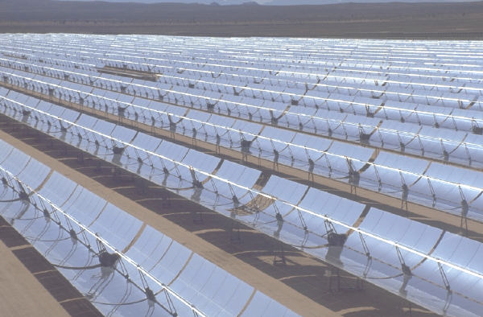

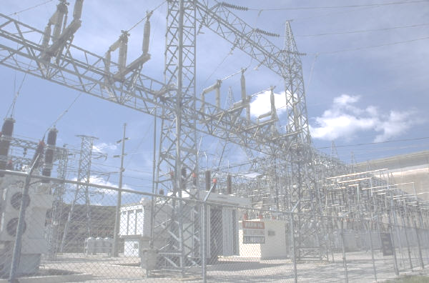
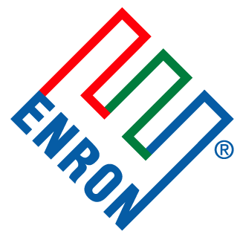
EnronOnline
Open Exchange and Enron Funds
Created and Managed by the Financial Managers of Enron

Slide 2

Enron: Making New and Needed Markets
What can an individual consumer trade today?
  Stocks
  Bonds
However, higher financial barriers required for further diversification in:
  Power, Oil, Natural Gas, or Weather

Slide 3
Enron: Making New and Needed Markets
Minimum Purchase Requirements:
    Power
      432 MWh’s in COB
      732 MWh’s in Cinergy
    Oil
      1,000 barrels
    Natural Gas
      10,000 MMbtu’s
    NY Harbor Gasoline
      42,000 gallons

Slide 4

The Greater Possibilities
1 Enron can allow individual traders to trade individual products at individual levels
2 Enron can enter the retail mutual fund industry and create funds for the market made up purely of commodities

Slide 5
The Greater Possibility
EnronOnline Open Exchange
Enron allows individual traders to trade individual products at individual levels

Slide 6
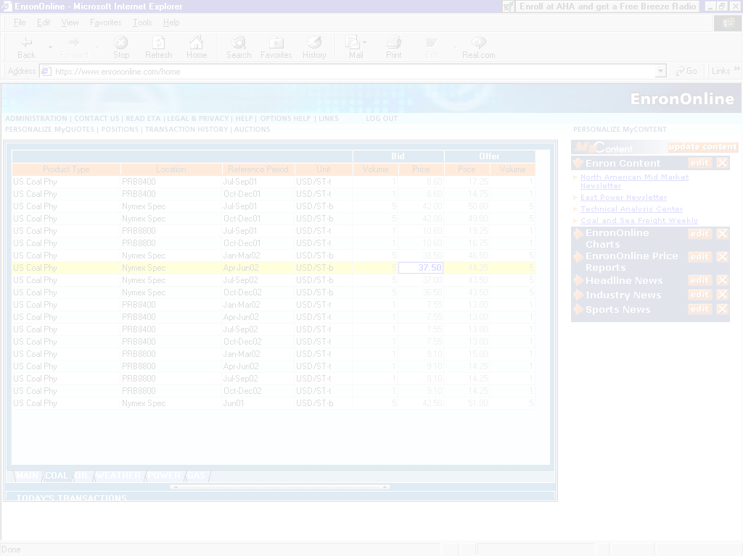
Financials

Slide 7
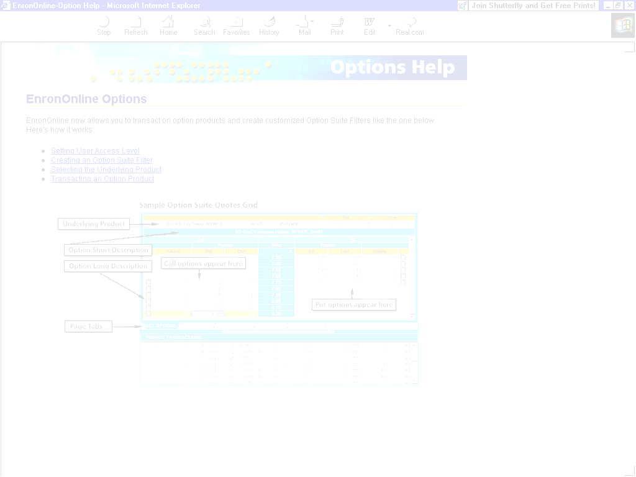
EnronOnline Open Exchange: Timeline

Slide 8
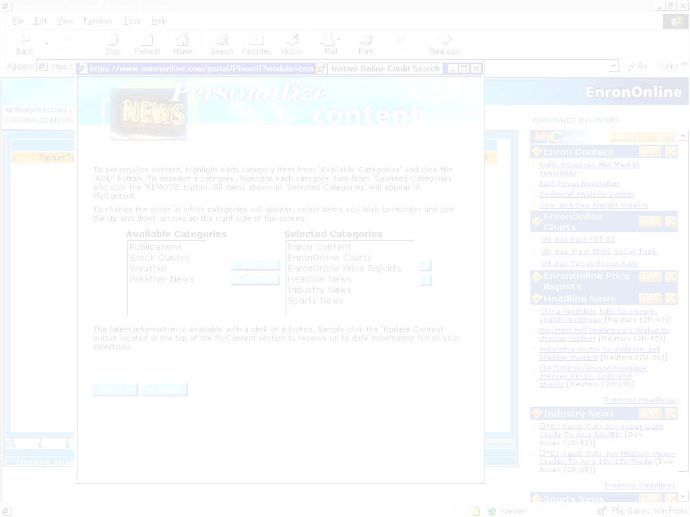
Open Exchange: Process
Customer deposits $2,000
Customer invests any amount of balance in a ‘phantom’ future / commodity
  Utilize EOL as platform
  Cash is kept in-house until necessary to reduce a pre-set VAR

Slide 9

The Greater Possibility
The Enron Funds
Enron creates funds for the market made up purely of commodities
  Offers the conservative investor further diversification (or risk averse commodity end-user an easy to use tool for hedging commodity price exposure)
  Examples: The Enron Natural Gas Fund The Enron Oil Fund The Enron Paper/Pulp Fund The Enron Commodity Index

Slide 10
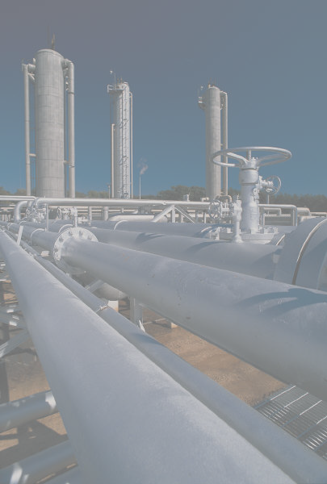

Example:
A speculative composite of natural gas swaps, options and forwards designed to show profits with time

Slide 11
EnronOnline
Open Exchange and Enron Funds
Created and Managed by the Financial Managers of Enron
Thank you for your consideration

