Slide 1


Jeffrey A. Shankman
Chief Operating Officer
Enron Global Markets

Slide 2
Ask Why?
To bring management focus to complimentary market segments
To take geography out of the equation
To exploit more cross commodity optionality
To expand Enron’s network to new businesses

Slide 3
Ask What?
Coal
(60 Billion)
Crude Products
LNG
Other
(15 Trillion)
Weather
(Trillion +)
Insurance
(Non Life 900 Billion)
(Life 1. 2 Trillion)
EGM
Transportation
(850 Billion)
Agribusiness
(Meats 300 Billion)
(Grains 200 Billion)
New
( ? )
FX / Rates
(Trillion +)

Slide 4
Where Do We Want To Be Along
The Value Chain?
LDC
Ship
Producer
End
User
Pipeline
Distributor
Refiner
Ship

Slide 5
EBusiness & New Economy vs.
Physical Business & Old Economy
Value of Information
Customer  Market  Asset  EOL

Slide 6

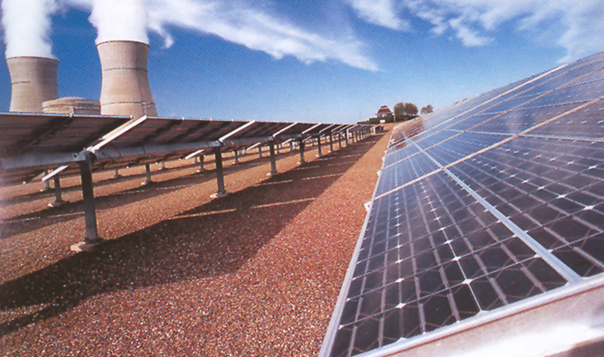
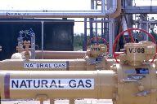
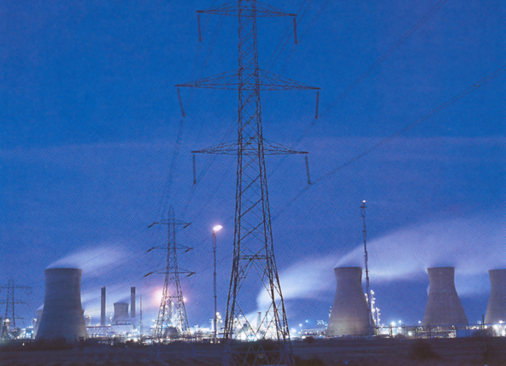

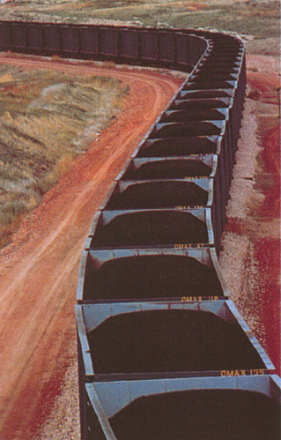

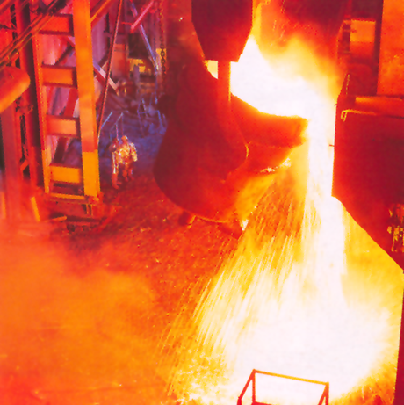
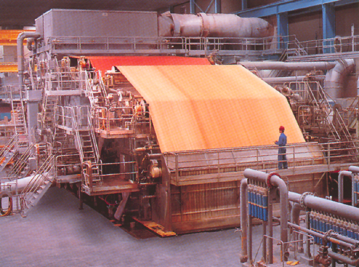
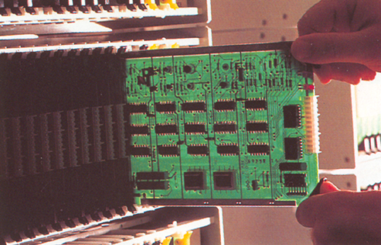

Enron Today vs. Enron Tomorrow
Natural Gas
Petrochemicals
Broadband
Energy
?
Telecommunications
Metals
Coal
Electricity
Paper
Data Storage
Weather

